Slide 1
Objectives
In this session, you will learn to:
  Use wait and notify to communicate between threads
  Use synchronized to protect data from corruption
  Develop code to set up the network connection
  Describe the TCP/IP Protocol
  Use ServerSocket and Socket classes for implementation of TCP/IP clients and servers

Slide 2
The wait and notify Methods
The java.lang.Object class provides the following two methods for thread communication:
  wait
  notify
The wait() and notify() methods are called only from within a synchronized block on the instance on which they are being called.
When a thread executes a synchronized code that contains a wait call on a particular object, that thread is placed in the wait pool for that object.
The thread that calls wait releases that object’s lock flag automatically.

Slide 3
The wait and notify Methods (Contd.)
When a notify call is executed on a particular object, an arbitrary thread is moved from that object’s wait pool to a lock pool, where threads stay until the object’s lock flag becomes available.
The notifyAll() method moves all threads waiting on that object out of the wait pool and into the lock pool.

Slide 4
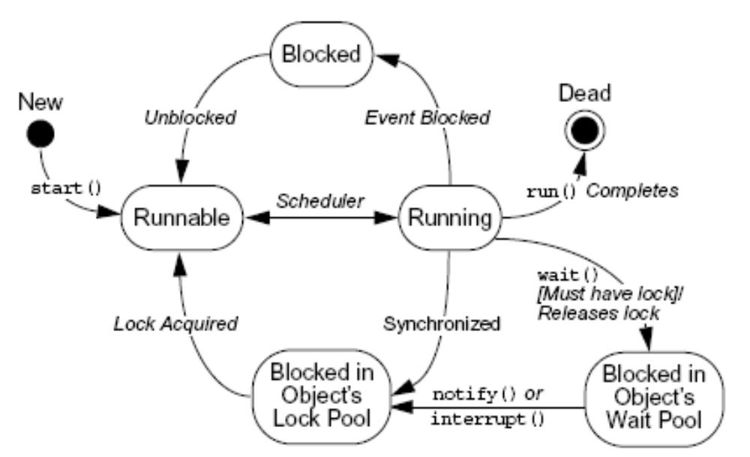
Thread States
The following figure displays a state transition diagram for a thread.

Slide 5
Monitor Model for Synchronization
Coordination between two threads needing access to common data can get complex.
The programmer must ensure that:
  No thread leaves shared data in an inconsistent state when there is the possibility that any other thread can access that data.
  The program does not deadlock because threads cannot release the appropriate lock when other threads are waiting for that lock.

Slide 6
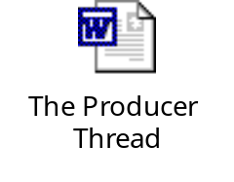
The Producer Thread
Let us understand the concept of a producer thread that generates new characters to be placed on the stack by using the embedded document.

Slide 7

The Consumer Thread
Let us understand the concept of a consumer thread that removes characters from the stack by using the embedded document.

Slide 8
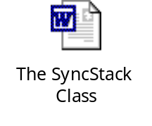
The SyncStack Class
Let us understand the concept of push and pop methods of a stack by using the embedded document.

Slide 9
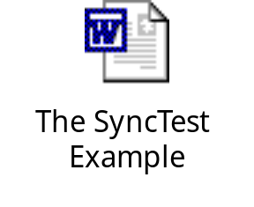
The SyncTest Example
Let us understand the concept of stack object that is shared by all threads by using the embedded document.

Slide 10
Sockets
Socket is the name given to the endpoints of a communication link between processes.
When processes communicate over a network, Java uses the streams model.
A socket can hold two streams:
  Input stream
  Output stream
A process:
  Sends data to another process through the network by writing to the output stream associated with the socket.
  Reads data written by another process by reading from the input stream associated with the socket.

Slide 11
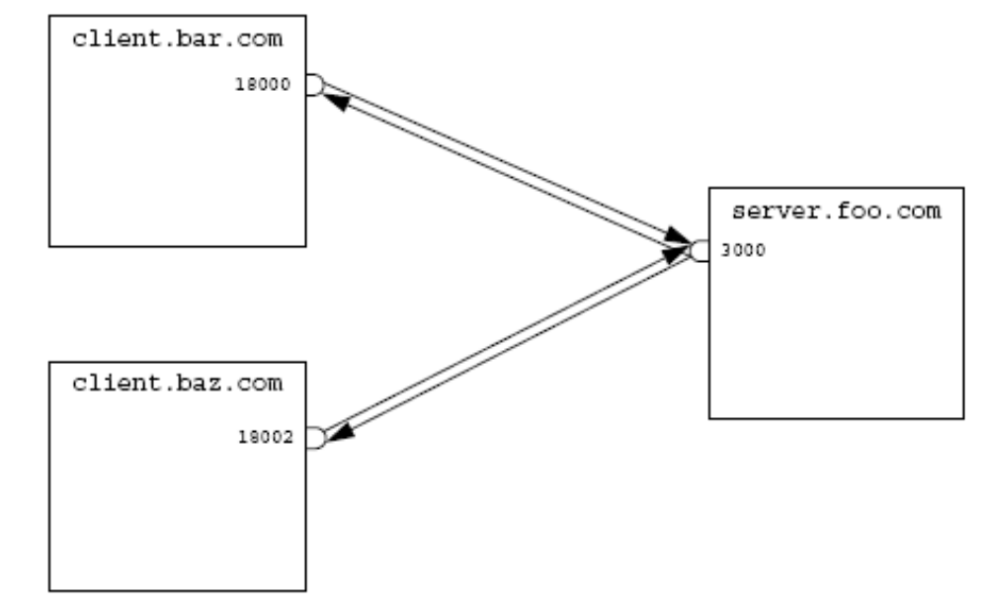
Setting Up the Connection
To set up the connection, one machine must run a program that is waiting for a connection, and a second machine must try to reach the first.
The following figure displays a sample TCP/IP network connection.

Slide 12
Addressing the Connection
The following points need to be ensured in order to establish a network connection:
  The address or the name of the remote machine
  The connection that requires a port number
  The particular purpose for the connection

Slide 13
Port Numbers
Port numbers in TCP/IP systems are 16-bit numbers and the values range from 0–65535.
Port numbers below 1024 are reserved for predefined services.
Both client and server must agree in advance on which port to use.
If the port numbers used by the two parts of the system do not agree, communication does not occur.

Slide 14
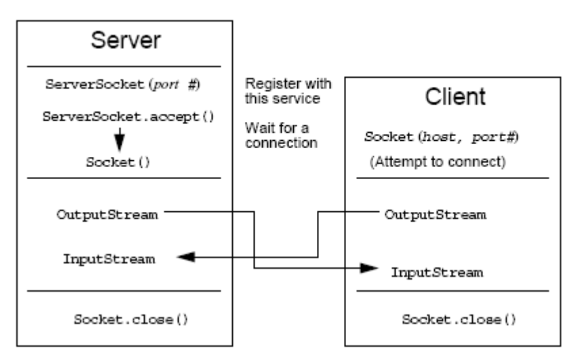
Java Networking Model
TCP/IP socket connections are implemented with classes in the java.net package.
The following figure displays a TCP/IP socket connection.

Slide 15

Minimal TCP/IP Server
TCP/IP server applications rely on the ServerSocket and Socket networking classes provided by the Java language.
Let us understand how to use the ServerSocket class by using the embedded document.

Slide 16

Minimal TCP/IP Client
The client side of a TCP/IP application relies on the Socket class.
Let us understand how to use the Socket class by using the embedded document.

Slide 17
Demo: Networking
Let us see the demonstration of creating a chat room network application.

Slide 18
Summary
In this session, you learned that:
  The java.lang.Object class provides the following two methods for thread communication:
    wait()
    notify()
  When a thread executes synchronized code that contains a wait call on a particular object, that thread is placed in the wait pool for that object.
  When a notify call is executed on a particular object, an arbitrary thread is moved from that object’s wait pool to a lock pool, where threads stay until the object’s lock flag becomes available.
  The notifyAll() method moves all threads waiting on that object out of the wait pool and into the lock pool.

Slide 19
Summary (Contd.)
  The programmer must ensure that:
    No thread leaves shared data in an inconsistent state when there is the possibility that any other thread can access that data.
    The program does not deadlock because threads cannot release the appropriate lock when other threads are waiting for that lock.
  Socket is the name given to the endpoints of a communication link between processes.
  A socket can hold two streams:
    Input stream
    Output stream
  The following points need to be ensured in order to establish a network connection:
    The address or the name of the remote machine
    The connection that requires a port number
    The particular purpose for the connection

Slide 20
Summary (Contd.)
  Port numbers in TCP/IP systems are 16-bit numbers and the values range from 0–65535.
  TCP/IP socket connections are implemented with classes in the java.net package.
  TCP/IP server applications rely on the ServerSocket and Socket networking classes provided by the Java language.
  The client side of a TCP/IP application relies on the Socket class.

