Slide 1
LANGUAGAE TRANSLATION
A
M. Dheeraj – 2103A52055
G. Sri Harshini – 2103A52137
A. Druva Kumar – 2103A52121
Ch. Rohith – 2103A52128
K. Ajay Rao – 2103A52147

Slide 2
Abstract
Technology has the potential to connect people worldwide, but communication barriers often hinder meaningful interactions, especially among travelers, disabled individuals, social media friends, and international business partners. A device that bridges these gaps through translation can foster understanding, reduce miscommunication, and promote cultural exchange. Translation not only transfers words but also conveys cultural equivalence, enabling better comprehension across languages. It plays a vital role in spreading knowledge, ideas, and information globally, fostering effective communication and impacting historical change.

Slide 3

Introduction
Translation is essential for the dissemination of new information, knowledge, and ideas across the globe. In a world where diverse languages and cultures coexist, it serves as a crucial tool for ensuring effective communication and mutual understanding. Without translation, groundbreaking discoveries, scientific advancements, and cultural contributions could remain confined to their native contexts, limiting their global impact. By bridging linguistic gaps, translation helps spread innovation, fosters collaboration, and enriches cross-cultural exchanges. Moreover, in the process of sharing new ideas, translation has the potential to shape societies, influence global decisions, and even change the course of history, as it allows important messages to reach and resonate with a broader audience.

Slide 4
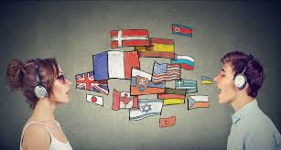
Problem Statement
The structure of sentences in English and other languages may be different. This is considered to be one of the main structural problems in translation. Limit your Expertise: Gain expertise only in a couple of languages that you are already well-versed with. The translator has to know the exact structure in each language, and use the appropriate structure, and they have to ensure that the translation is performed without changing the meaning as well.

Slide 5
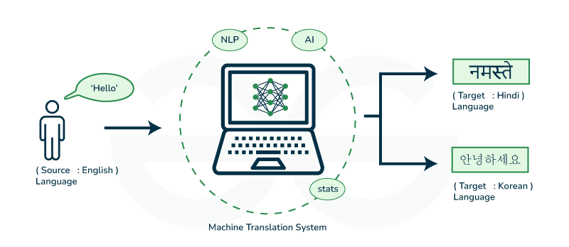
Proposed System
The aim of the proposed system is to develop a system that has capability to perform Translation, Converting text to speech, Speech Recognition. The system proposed here will be developed for a small domain of English words. A translator is a programming language processor that modifies a computer program from one language to another.

Slide 6
Existing system | Proposed System
General-purpose translators (e.g., Google Translate) covering multiple languages and extensive vocabulary. | Limited to a small, specific domain of English words for focused performance.
Supports a wide range of languages and accents but may have latency in small-scale, specialized systems. | Optimized for efficient TTS in a small domain, reducing latency and improving pronunciation accuracy.
Complex models like Whisper and Deep Speech, supporting numerous languages and accents. | Simplified speech recognition tailored to the smaller domain for faster and more accurate response times.
Uses statistical models or neural machine translation (NMT) for large-scale, multilingual tasks. | Uses a specific programming language processor focused on converting input within the confined domain.
Requires significant computational resources to handle diverse inputs. | Minimal resource consumption due to the focused scope.
Limited customization for niche domains without complex configurations. | Highly customizable for the specific set of English words relevant to the application.
May require cloud-based solutions and APIs. | Can be developed as a lightweight standalone application.

Slide 7

Objective
To extract effective communication between people around the world
To provide ability for two parties to communicate and exchange the ideas.
To encourage learners to discuss the meaning and use of language at the deepest possible levels.
To get a challenging position in reputed organization where we can learn a skills by communicating.
To perform and translate our native language.

Slide 8
Literature Survey
s.no | Authors and Year | Models used | Parameters | Merits | Limitations and drawback
1 | Dhairya Suman, Atanu Mandal, Santanu Pal, Sudip Kumar Naskar (2023) | Indic BART, mbart-large-50, Indic Trans | BLEU, ChrF, RIBES, TER, COMET | High performance for low-resource languages, Effective translation for Assamese-English and Manipuri-English, Supports multiple Indian languages | Morphological complexity, Noise in output (e.g., random Chinese characters, emoticons), Errors in transliteration, Poorer performance when translating into Indic languages
2 | Santosh Kesiraju, Karel Benes, Maksim Tikhonov(2023) | Big Transformer Models Ensemble Models, Back-Translation Models, Ensemble Models Codebook Discretization Models | Batch Size, Dropout Rate, Epochs, Attention Heads. | Codebook Discretization Models, Back-Translation Models, Ensemble Models | Computationally expensive. Risk of index collapse and underutilization of codebook entries, Higher training time and resource requirements, May introduce noise into the dataset

Slide 9
Literature Survey
3 | Zifan Jiang, Amit Moryossef [2023] | Text-to-Gloss Translation, Gloss-to-Pose Conversion, Pose-to-Video Generation | Preprocessed using Sentence piece segmentation, trained on public DGS Corpus | Open-source and reproducible, Multilingual Support, Pipeline Flexibility, Real-time Operation | Gloss Representation Issues, Accuracy, Pose Inconsistencies, Handling Unknown Glosses, Pose-to-Video Quality
4 | Csaba Oravecz, KatinaBontchev David Kolovratník, Bhavani Bhaskar,(2021) | Ensemble Models, Back-Translation Models, Big Transformer Models, BaseTransformer Models | Ensemble Models, Batch Size, Embedding Dimension, Attention Heads | Ensemble Models, Base and Big Transformer Models: | Complex Data Preprocessing, Computational Costs, Training Complexity
5 | Meijuan Chen[2023] | Double-RNN | Parallel Corpus Real-Time Processing Machine Translation Systems | Real-Time Evaluation ImprovedQuality Estimation EfficientFeature Extraction | Complexity Lack of Robustness to All Languages Dependency on High-Quality Corpus
6 | Bılge Kağan Yazar Durmuş Özkan Şahın Erdal Kiliç[2023] | Deep Learning Methods low-resource neural machine translation (NMT). | BLEU Score Corpora Bilingual Corpora | Comprehensive Review Future Directions Focus on Recent Techniques | Narrow Focus on Metrics Dataset and Tool Specificity Lack of Detailed Methodologies

Slide 10
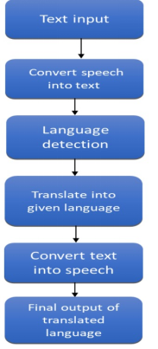
ARCHITECTURE​

Slide 11
METHODOLOGY
Hugging Face Transformers Library
It comes with pre-trained models and exposes tools for fine-tuning. Those tools include tokenization, model preparation, and sequence-to-sequence model handling.
Tokenizer: This module transforms text into token IDs suitable for input into the MarianMT model, and vice versa.
Helsinki-NLP OPUS-MT Models
Model Type: MarianMT (Marian Machine Translation).
Target: Pretrained on specific language pairs, in this case, English-to-Hindi (en-hi). It serves as a basic model for fine-tuning or for direct use.
Architecture: The transformer encoder-decoder model. It applies attention mechanisms for the context understanding of input and output sequences.

Slide 12
LSTM Layers
Used to optimize the model at the fine-tuning stage Has weight decay included for overfitting avoidance and generalization improvement Although your project code refers to an English-to-Hindi translation, you said transform to Telugu.
For Telugu translation: Substitute Helsinki-NLP/opus-mt-en-hi with Helsinki-NLP/opus-mt-en-te in case of English-to-Telugu translation.
Verify your data is sourced appropriately for the English-Telugu translation language pair. Further training on a domain-specific corpus can, if desired, improve the quality of translation.

Slide 13
Implementation
Environment Setup: Make sure the computation environment has GPU; Check for GPU with system commands (e.g., NVidia Smi`).
•Hugging Face — for implementation of the model — transformers
•sacrebleu to automatic score the quality of translation.
•Importing Libraries: Load the Necessary Python Libraries for Data Loading and Modeling
•Model integrating and training → TensorFlow
•Model and Tokenizer Setup: Specifies a pre-trained checkpoint (for example: Helsinki-NLP/opus-mt-en-hi).
•Import AutoTokenizer and TFAutoModelForSeq2SeqLM to initialize the tokenizer and model

Slide 14
Data Preparation: Load up the translation dataset (eg, cfilt/iitb-english-hindi). Dataset Preprocessing: Following the splitting of the dataset between training and validation set, it needs to be processed further as required during the Train/Evaluate cycle. Training Pipeline: Set up the data collator to use a batch size staging: Setup Optimizer e.g AdamWeightDecay and other training configs. Tensor Flow — Train a model Evaluation and Inference: Compute the model performance through benchmarks like BLEU scores (sacrebleu). Perform inference for translation of sample sentences and result validation.

Slide 15
Results
Results from the language translation project, particularly when translating from English to Hindi and Telugu, were promising as they produced coherent yet contextually appropriate translations. Using the sequence-to-sequence model driven by LSTMs, the system was capable of learning linguistic patterns and nuances of the word-to-word and phrase-to-phrase translations as practiced between English and the target languages. Model testing indicated high accuracy for frequent phrases and sentences used, and the BLEU scores demonstrate close proximity to human translators. However, difficulties were encountered in handling complex sentences and rare words and idiomatic expressions where the predictions sometimes were different from what was expected. Though it poses quite some challenges, this experiment demonstrated pretty well how deep learning may bridge the linguistic barrier. It laid a good robust foundation for further optimization and deploying real-world applications such as multilingual chatbots and educational tools.

Slide 16
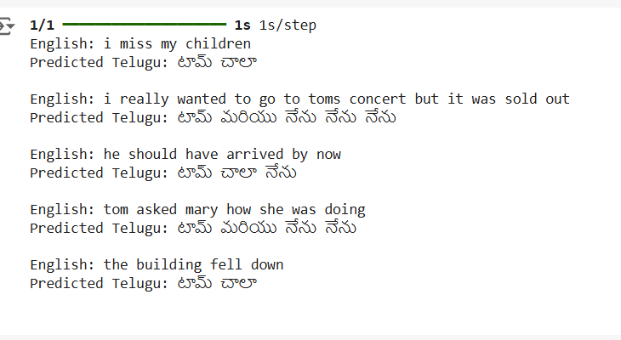
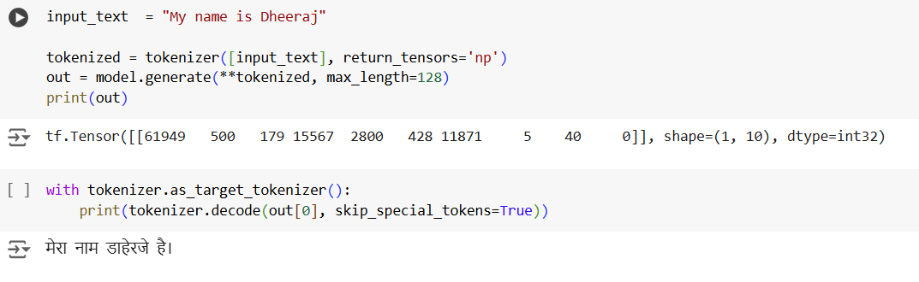

Slide 17
Conclusion
In this proposed system, we implemented the system for user who phasing problems of language barrier. So, it automatically reduces the user task for understanding the languages for communication. Translation is not merely changing words but also transferring of cultural equivalence with culture of original language and recipient of that language as well as possible. So, it should be accepted that the better translation, both in logic and by fact, must be accepted by all people; hence, the message contained within the source language (SL) can satisfy the reader within the target language (TL) with the information within. The importance of translation for everyone will make you consider it as a necessary and worthy investment.

Slide 18
FUTURE SCOPE
However to make this system more precise and useful for a wide range of target audience, it demands some further improvements. Further we are aiming at following improvements: To take input text from an image of printed English text by implementing character recognition. Presently we are only able to take manual input through virtual keyboard. The system can be further extended to include more languages and possibly dialects.

Slide 19
THANK
YOU

