Slide 1
DIGITAL DESIGN & COMPUTER ARCHITECTURE — PROJECT
Design and Simulation of a
Smart Water Tank Overflow
Protection and Pump Control System
TEAM
2620030640 Yanamadala Ujwal Amogh
2620030642 Nannapaneni Suhas
2620030644 Dheeraj Jasti
2620030696 Alluri Nithish Varma
Guide: KARTHEEK V
Department of Computer Science & Engineering
KLH University
Academic Year 2026–2027

Slide 2
Introduction
Water storage tanks are used in homes, hostels, and industries to store and supply water on demand. Traditionally, tank filling is monitored manually — someone switches the pump ON and OFF by estimating the water level, which is inefficient, error-prone, and often leads to either overflow (wastage) or dry-run of the pump (motor damage).
HIGH (H)
This project applies core Digital Logic Design concepts — combinational logic, latches, and sequential control — to build a Smart Water Tank system that senses discrete water levels and automatically drives the pump and an overflow alarm, simulated and verified in Logisim.
MID (M)
LOW (L)
Conceptual tank with
three-level sensing
Smart Water Tank Overflow Protection & Pump Control System
2

Slide 3
Problem Statement
Manually operated pump systems cannot reliably guarantee that a tank is filled to the correct level at the correct time. There is a clear need for an automatic, sensor-driven controller that switches the pump ON/OFF at defined levels and independently guards against overflow — without relying on human attention.
Water Wastage
Motor Damage
Overflow from forgetting to switch OFF the pump wastes a valuable resource and damages surroundings.
Running the pump on a near-empty tank causes dry-running, overheating, and premature motor failure.
No Early Warning
Manual Dependency
Conventional float-switch setups give no audible alert before an overflow actually occurs.
Filling schedules depend on someone being available to observe and operate the pump switch.
Smart Water Tank Overflow Protection & Pump Control System
3

Slide 4
Objectives
1
Design a digital logic circuit that senses three discrete water levels — Low, Mid, and High.
2
Implement automatic pump ON/OFF control using a latch (memory element) so the pump switches on at Low and off at High.
3
Build an independent overflow-protection path that raises an alarm and force-cuts the pump if the High sensor stays active.
4
Simulate the complete circuit in Logisim and verify correctness using truth tables and timing behaviour.
5
Demonstrate a low-cost, reliable alternative to manual or purely mechanical float-switch systems.
Smart Water Tank Overflow Protection & Pump Control System
4

Slide 5
Literature Survey / Existing System
Existing Approach | How It Works | Key Limitation
Manual switching | Person visually checks tank and toggles the pump switch. | Fully dependent on human availability and attention.
Mechanical float valve | A floating ball mechanically shuts off water inflow at a fixed level. | Only one fixed cut-off; no low-level pump start, no alarm.
Simple float switch + relay | A single float switch directly drives a relay to run the pump. | No hysteresis — rapid ON/OFF chatter near the switching level.
Microcontroller-based (IoT) | Ultrasonic/pressure sensor + microcontroller with app notifications. | Higher cost, needs firmware/software; overkill for a fixed-level tank.
Gap identified: existing low-cost setups lack both automatic hysteresis-based control and a dedicated, independent overflow alarm — this project addresses both using pure digital logic.
Smart Water Tank Overflow Protection & Pump Control System
5

Slide 6
Proposed System
1
Three-level sensing
2
Latch-based hysteresis
Discrete Low (L), Mid (M) and High (H) conductive probes give clean digital inputs — no analog processing needed.
An SR latch remembers pump state, starting the pump at Low and stopping it only at High — eliminating relay chatter.
3
Independent overflow cut-off
4
Fully simulated in Logisim
A separate combinational path forces the pump OFF and sounds a buzzer the instant the High sensor is active, regardless of latch state.
Every gate, latch and connection is built and verified in Logisim before being mapped to real components.
Smart Water Tank Overflow Protection & Pump Control System
6

Slide 7
System Architecture / Block Diagram
Pump Driver
(Relay Circuit)
Level Sensors
(L, M, H probes)
Signal Conditioning
(Comparator / Buffer)
Digital Control Logic
(SR Latch + Gates)
Overflow Alarm
(Buzzer + Indicator)
Independent overflow feedback bypasses the latch for fail-safe cut-off
Data flow: the three level probes are conditioned into clean digital 0/1 signals, which feed a combinational + latch-based control block. This block drives the pump relay for normal fill/stop operation, while a separate fail-safe path monitors the High-level line directly to trigger the buzzer and override the pump — ensuring overflow protection even if the latch state is stuck.
Smart Water Tank Overflow Protection & Pump Control System
7

Slide 8
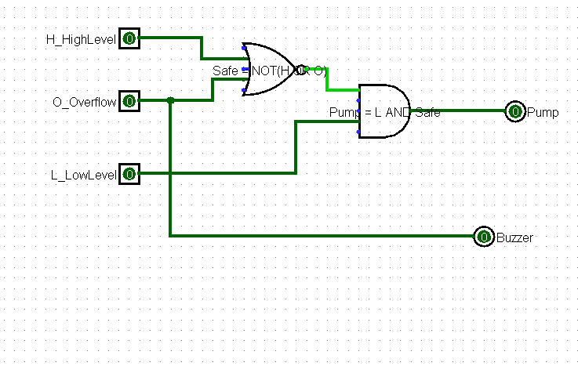
Circuit Diagram (Logisim)
Smart Water Tank Overflow Protection & Pump Control System
8

Slide 9
Results and Discussion
Simulated Operating Sequence (Logisim)
Step | L | M | H | Pump | Buzzer | Observation
1 | 0 | 0 | 0 | ON | OFF | Tank empty — pump starts filling
2 | 1 | 0 | 0 | ON | OFF | Passed Low mark — latch holds pump ON
3 | 1 | 1 | 0 | ON | OFF | Passed Mid mark — no change, still filling
4 | 1 | 1 | 1 | OFF | ON | Reached High — latch resets, alarm sounds
5 (fault) | 1 | 1 | 1 | OFF | ON | Latch forced stuck-set — safety path still cuts pump
3
0
100%
discrete input levels sensed
false pump-ON events during simulation
overflow cut-off success across fault-injected tests
Smart Water Tank Overflow Protection & Pump Control System
9

Slide 10
Conclusion
A fully digital, latch-based controller was designed and simulated that automates pump ON/OFF switching between defined Low and High water levels.
An independent, fail-safe overflow path guarantees the pump is cut off and an alarm sounds even under a fault in the main control latch.
Logisim simulation confirmed correct behaviour across all input combinations, matching the derived truth table with zero false triggers.
The design meets all stated objectives using only basic gates and a latch — a low-cost, reliable alternative to manual or purely mechanical systems.
Thank You
Smart Water Tank Overflow Protection & Pump Control System
10

