Slide 1

Design Combination Readout v2
MGA
A-FRAME SIGN STUDY | August 2026
Prepared by: J Brown Fitterman | jbrown@mindgenomicsassociates.com
Mind Genomics Associates, Inc
United States

Slide 2
HOW TO READ THIS REPORT: UNDERSTANDING ELEMENT LIFTS
Top builds are created by selecting the strongest option in each element category
How the model works
Example from the saved builds
Respondents rated a large number of sign combinations — each showing different design elements. The model then separates those ratings into an individual lift score.
Each lift score shows how much that layer raises or lowers appeal relative to the model baseline.
A saved combination keeps one option from each layer. Swapping one element only changes that slot. Everything else stays, because each score was measured on its own.
In Female · 18-24 · 25-34 · Atlanta, ITP · $75000 or more, one build uses Lemon (-1.0) in Backgrounds.
Swapping to Good for People and the Planet (-2.0) only changes that slot. The other layers stay as they are.
The result: Good for People and the Planet totals +18.0 against +19.0 for Lemon — a difference of 1.0 points.
2

Slide 3
Top 3 Performing
Combinations

Slide 4
Top Down
Female · 18-24 · 25-34 · Atlanta, ITP · $75000 or more

Slide 5



KEY FINDINGS: TOP COMBINATIONS
Female · 18-24 · 25-34 · Atlanta, ITP · $75000 or more
TOP COMBINATION
Cream · Delivery Graphic
Cream · Produce
Melon · Delivery Graphic
+45.0
+45.0
+45.0
Saved segment: Female · 18-24 · 25-34 · Atlanta, ITP · $75000 or more. Scores are from the overall model. Base appeal 50.1. Top-2 Box model: estimated total combination lift above baseline. Values rounded to one decimal.
5

Slide 6
A-FRAME KEY FINDINGS: TOP COMBINATIONS
TOP 3 PACK COMBINATIONS · PACK 1 — HIGHEST LIFT BUILD
Top Down
Base appeal
50.1
starting point (overall)
Cream
+6.0
Backgrounds
Georgia Farms Delivered
+12.0
Headlines
Skip The Grocery Store
+1.0
Sub Headers
Delivery Graphic
+18.0
Images
Good for People and the Planet
+8.0
CTA
TOTAL LIFT OVER BASE
+45.0
Saved segment. Scores are from the overall model.
Top-2 Box model: element lifts show movement above or below the model baseline. Values rounded to one decimal.
6

Slide 7
A-FRAME KEY FINDINGS: TOP COMBINATIONS
TOP 3 PACK COMBINATIONS · PACK 2 — SECOND HIGHEST LIFT BUILD
Top Down
Base appeal
50.1
starting point (overall)
Cream
+6.0
Backgrounds
Georgia Farms Delivered
+12.0
Headlines
Skip The Grocery Store
+1.0
Sub Headers
Produce
+18.0
Images
Good for People and the Planet
+8.0
CTA
TOTAL LIFT OVER BASE
+45.0
Saved segment. Scores are from the overall model.
Top-2 Box model: element lifts show movement above or below the model baseline. Values rounded to one decimal.
7

Slide 8
A-FRAME KEY FINDINGS: TOP COMBINATIONS
TOP 3 PACK COMBINATIONS · PACK 3 — THIRD HIGHEST LIFT BUILD
Top Down
Base appeal
50.1
starting point (overall)
Melon
+6.0
Backgrounds
Georgia Farms Delivered
+12.0
Headlines
Skip The Grocery Store
+1.0
Sub Headers
Delivery Graphic
+18.0
Images
Good for People and the Planet
+8.0
CTA
TOTAL LIFT OVER BASE
+45.0
Saved segment. Scores are from the overall model.
Top-2 Box model: element lifts show movement above or below the model baseline. Values rounded to one decimal.
8

Slide 9
Top Down
5 or more · Metro Atlanta, OTP

Slide 10



KEY FINDINGS: TOP COMBINATIONS
5 or more · Metro Atlanta, OTP
TOP COMBINATION
Win a Free Month of Groceries · 80 Sourced Within 70 Miles
Win a Free Month of Groceries · Visit Our Booth for 50 Off
Visit Our Booth for 50 Off · 80 Sourced Within 70 Miles
+51.0
+51.0
+51.0
Saved segment: 5 or more · Metro Atlanta, OTP. Scores are from the overall model. Base appeal 50.1. Top-2 Box model: estimated total combination lift above baseline. Values rounded to one decimal.
10

Slide 11
A-FRAME KEY FINDINGS: TOP COMBINATIONS
TOP 3 PACK COMBINATIONS · PACK 1 — HIGHEST LIFT BUILD
Top Down
Base appeal
50.1
starting point (overall)
Cotton
+3.0
Backgrounds
Win a Free Month of Groceries
+17.0
Headlines
80 Sourced Within 70 Miles
+10.0
Sub Headers
Box
+9.0
Images
Guess the Price of Our Box to Win!
+12.0
CTA
TOTAL LIFT OVER BASE
+51.0
Saved segment. Scores are from the overall model.
Top-2 Box model: element lifts show movement above or below the model baseline. Values rounded to one decimal.
11

Slide 12
A-FRAME KEY FINDINGS: TOP COMBINATIONS
TOP 3 PACK COMBINATIONS · PACK 2 — SECOND HIGHEST LIFT BUILD
Top Down
Base appeal
50.1
starting point (overall)
Cotton
+3.0
Backgrounds
Win a Free Month of Groceries
+17.0
Headlines
Visit Our Booth for 50 Off
+10.0
Sub Headers
Box
+9.0
Images
Guess the Price of Our Box to Win!
+12.0
CTA
TOTAL LIFT OVER BASE
+51.0
Saved segment. Scores are from the overall model.
Top-2 Box model: element lifts show movement above or below the model baseline. Values rounded to one decimal.
12

Slide 13
A-FRAME KEY FINDINGS: TOP COMBINATIONS
TOP 3 PACK COMBINATIONS · PACK 3 — THIRD HIGHEST LIFT BUILD
Top Down
Base appeal
50.1
starting point (overall)
Cotton
+3.0
Backgrounds
Visit Our Booth for 50 Off
+17.0
Headlines
80 Sourced Within 70 Miles
+10.0
Sub Headers
Box
+9.0
Images
Guess the Price of Our Box to Win!
+12.0
CTA
TOTAL LIFT OVER BASE
+51.0
Saved segment. Scores are from the overall model.
Top-2 Box model: element lifts show movement above or below the model baseline. Values rounded to one decimal.
13

Slide 14
Bottom 3 Performing
Combinations

Slide 15
Bottom Up
Female · 18-24 · 25-34 · Atlanta, ITP · $75000 or more

Slide 16



KEY FINDINGS: BOTTOM COMBINATIONS
Female · 18-24 · 25-34 · Atlanta, ITP · $75000 or more
BOTTOM COMBINATION
Win a Free Month of Groceries!
Lemon
Good for People and the Planet
+20.0
+19.0
+18.0
Saved segment: Female · 18-24 · 25-34 · Atlanta, ITP · $75000 or more. Scores are from the overall model. Base appeal 25.6. Top-2 Box model: estimated total combination lift above baseline. Values rounded to one decimal.
16

Slide 17
A-FRAME KEY FINDINGS: BOTTOM COMBINATIONS
BOTTOM 3 · BOTTOM PACK 1 — LOWEST LIFT BUILD
Bottom Up
Base appeal
25.6
starting point (bottom up)
Win a Free Month of Groceries!
+8.0
Sub Headers
Box
+2.0
Images
Eat Local Eat Organic Eat Better
+10.0
CTA
TOTAL LIFT OVER BASE
+20.0
Saved segment. Scores are from the overall model.
Top-2 Box model: element lifts show movement above or below the model baseline. Values rounded to one decimal.
17

Slide 18
A-FRAME KEY FINDINGS: BOTTOM COMBINATIONS
BOTTOM 3 · BOTTOM PACK 2
Bottom Up
Base appeal
25.6
starting point (bottom up)
Lemon
-1.0
Backgrounds
Win a Free Month of Groceries!
+8.0
Sub Headers
Box
+2.0
Images
Eat Local Eat Organic Eat Better
+10.0
CTA
TOTAL LIFT OVER BASE
+19.0
Saved segment. Scores are from the overall model.
Top-2 Box model: element lifts show movement above or below the model baseline. Values rounded to one decimal.
18

Slide 19
A-FRAME KEY FINDINGS: BOTTOM COMBINATIONS
BOTTOM 3 · BOTTOM PACK 3
Bottom Up
Base appeal
25.6
starting point (bottom up)
Good for People and the Planet
-2.0
Headlines
Win a Free Month of Groceries!
+8.0
Sub Headers
Box
+2.0
Images
Eat Local Eat Organic Eat Better
+10.0
CTA
TOTAL LIFT OVER BASE
+18.0
Saved segment. Scores are from the overall model.
Top-2 Box model: element lifts show movement above or below the model baseline. Values rounded to one decimal.
19

Slide 20
Bottom Up
5 or more · Metro Atlanta, OTP

Slide 21
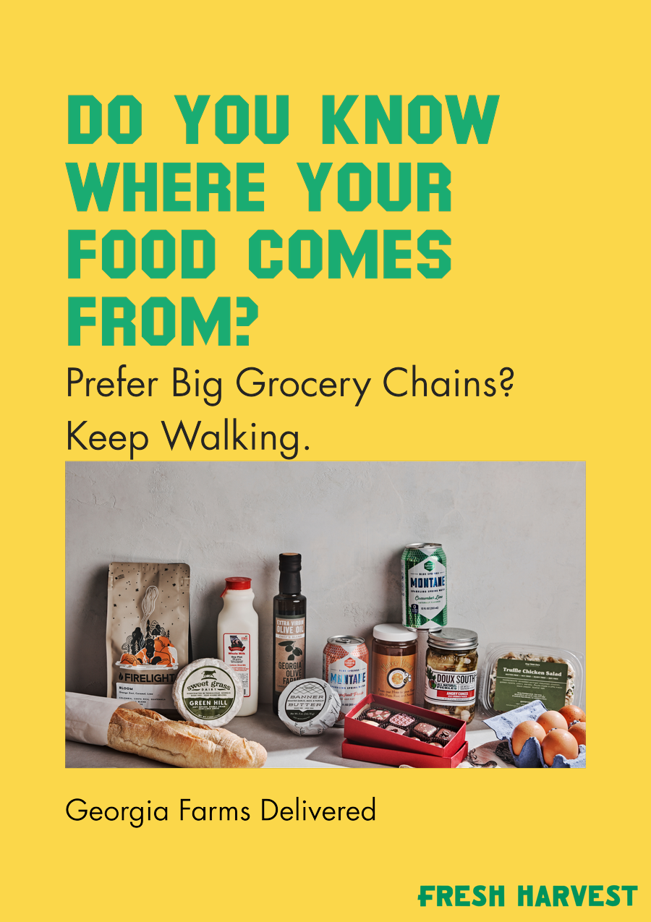
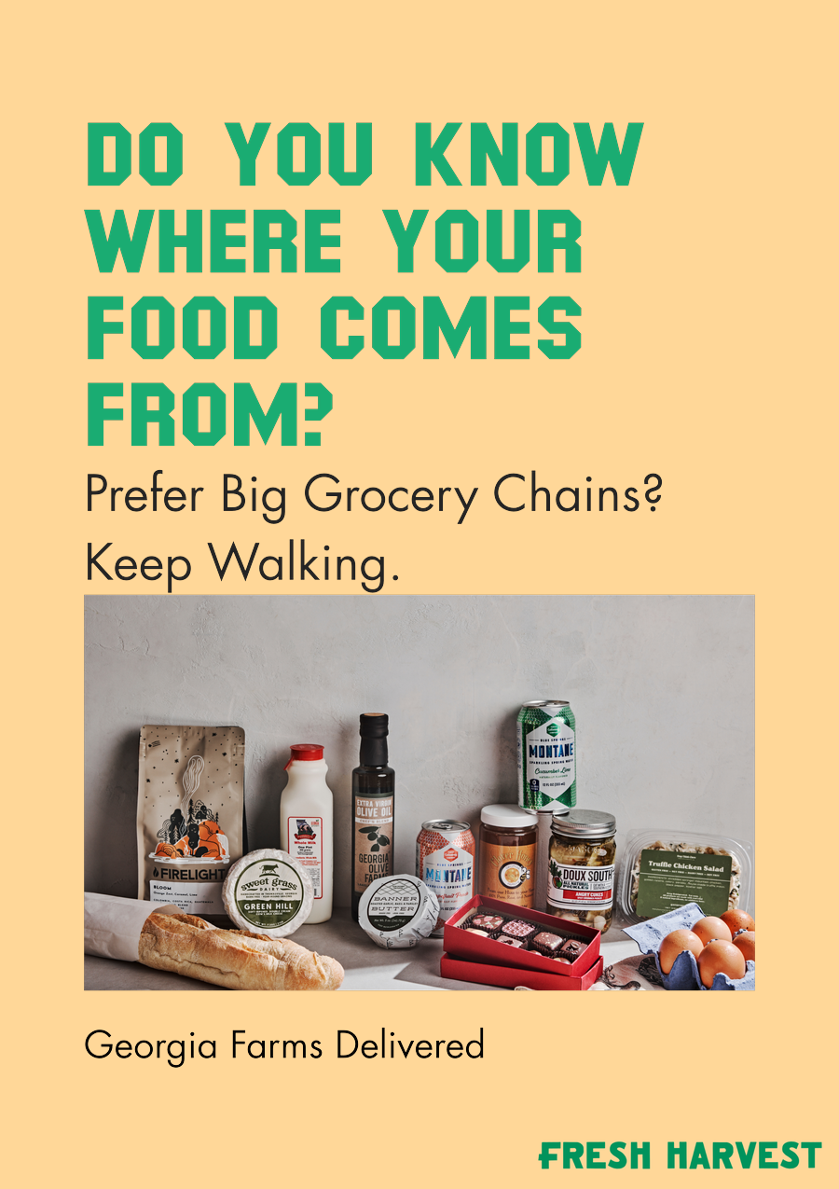

KEY FINDINGS: BOTTOM COMBINATIONS
5 or more · Metro Atlanta, OTP
BOTTOM COMBINATION
Lemon · Georgia Farms Delivered
Melon · Georgia Farms Delivered
Lemon · Good for People and the Planet
+15.0
+15.0
+15.0
Saved segment: 5 or more · Metro Atlanta, OTP. Scores are from the overall model. Base appeal 25.6. Top-2 Box model: estimated total combination lift above baseline. Values rounded to one decimal.
21

Slide 22
A-FRAME KEY FINDINGS: BOTTOM COMBINATIONS
BOTTOM 3 · BOTTOM PACK 1 — LOWEST LIFT BUILD
Bottom Up
Base appeal
25.6
starting point (bottom up)
Lemon
+3.0
Backgrounds
Do you know where your food comes from
+1.0
Headlines
Prefer Big Grocery Chains_ Keep Walking
+6.0
Sub Headers
Grocery
+1.0
Images
Georgia Farms Delivered
+4.0
CTA
TOTAL LIFT OVER BASE
+15.0
Saved segment. Scores are from the overall model.
Top-2 Box model: element lifts show movement above or below the model baseline. Values rounded to one decimal.
22

Slide 23
A-FRAME KEY FINDINGS: BOTTOM COMBINATIONS
BOTTOM 3 · BOTTOM PACK 2
Bottom Up
Base appeal
25.6
starting point (bottom up)
Melon
+3.0
Backgrounds
Do you know where your food comes from
+1.0
Headlines
Prefer Big Grocery Chains_ Keep Walking
+6.0
Sub Headers
Grocery
+1.0
Images
Georgia Farms Delivered
+4.0
CTA
TOTAL LIFT OVER BASE
+15.0
Saved segment. Scores are from the overall model.
Top-2 Box model: element lifts show movement above or below the model baseline. Values rounded to one decimal.
23

Slide 24
A-FRAME KEY FINDINGS: BOTTOM COMBINATIONS
BOTTOM 3 · BOTTOM PACK 3
Bottom Up
Base appeal
25.6
starting point (bottom up)
Lemon
+3.0
Backgrounds
Do you know where your food comes from
+1.0
Headlines
Prefer Big Grocery Chains_ Keep Walking
+6.0
Sub Headers
Grocery
+1.0
Images
Good for People and the Planet
+4.0
CTA
TOTAL LIFT OVER BASE
+15.0
Saved segment. Scores are from the overall model.
Top-2 Box model: element lifts show movement above or below the model baseline. Values rounded to one decimal.
24

Slide 25
Response Time
Combinations

Slide 26
Response Time
Female · 18-24 · 25-34 · Atlanta, ITP · $75000 or more

Slide 27



KEY FINDINGS: RESPONSE TIME
Female · 18-24 · 25-34 · Atlanta, ITP · $75000 or more
RESPONSE TIME
Melon
Good for People and the Planet
Cotton
+1.427
+1.424
+1.420
Saved segment: Female · 18-24 · 25-34 · Atlanta, ITP · $75000 or more. Scores are from the overall model. Base appeal 1.838. Top-2 Box model: estimated total combination lift above baseline. Values rounded to three decimals.
27

Slide 28
A-FRAME KEY FINDINGS: RESPONSE TIME
RESPONSE TIME · PACK 1
Response Time
Base appeal
1.838
starting point (response time)
Melon
+0.004
Backgrounds
Good for People and the Planet
+0.706
Headlines
Georgia Farms Delivered
+0.316
Sub Headers
Produce
+0.085
Images
Skip The Grocery Store
+0.316
CTA
TOTAL LIFT OVER BASE
+1.427
Saved segment. Scores are from the overall model.
Top-2 Box model: element lifts show movement above or below the model baseline. Values rounded to three decimals.
28

Slide 29
A-FRAME KEY FINDINGS: RESPONSE TIME
RESPONSE TIME · PACK 2
Response Time
Base appeal
1.838
starting point (response time)
Good for People and the Planet
+0.706
Headlines
Georgia Farms Delivered
+0.316
Sub Headers
Produce
+0.085
Images
Skip The Grocery Store
+0.316
CTA
TOTAL LIFT OVER BASE
+1.424
Saved segment. Scores are from the overall model.
Top-2 Box model: element lifts show movement above or below the model baseline. Values rounded to three decimals.
29

Slide 30
A-FRAME KEY FINDINGS: RESPONSE TIME
RESPONSE TIME · PACK 3
Response Time
Base appeal
1.838
starting point (response time)
Cotton
-0.004
Backgrounds
Good for People and the Planet
+0.706
Headlines
Georgia Farms Delivered
+0.316
Sub Headers
Produce
+0.085
Images
Skip The Grocery Store
+0.316
CTA
TOTAL LIFT OVER BASE
+1.420
Saved segment. Scores are from the overall model.
Top-2 Box model: element lifts show movement above or below the model baseline. Values rounded to three decimals.
30

Slide 31
Thank you
MGA
We look forward to exploring more combinations
A-FRAME SIGN STUDY | August 2026
Prepared by: J Brown Fitterman | jbrown@mindgenomicsassociates.com
Mind Genomics Associates, Inc
United States

