Slide 1
Inventory Management System
Improving Data Accuracy Using Total Quality Management (Q07)
SRS Review 1 & Review 2 Presentation: Process, Architecture, Poka-Yoke & TQM Analytics
STUDENT NAME
COURSE
ACADEMIC SESSION
ASSIGNED GOAL
Dheeraj Khetwal
Lead Developer & TQM Analyst
BBAT104
Fundamentals of TQM
2026–27
Undergraduate Project
Goal Q07
Improve Data Accuracy

Slide 2
REVIEW 1 — SETUP & SRS
Vision, Mission & Quality Objective
Setting the foundational quality philosophy for the software lifecycle
VISION
MISSION
QUALITY OBJECTIVE (Q07)
A zero-defect warehouse inventory ecosystem where no incorrect, duplicate, or unverified stock entry ever enters the database.
Build a production-grade desktop application that validates inputs at the gate (Poka-Yoke), locks processes, and preserves immutable audit logs.
1. Error prevention at source (Input Masking)
2. Process control (Controlled Categories & Transactions)
3. Monitoring & Traceability (Audit Logs & TQM Charts)
Student: Dheeraj Khetwal | Course: BBAT104 — Fundamentals of TQM | Quality Goal: Q07 — Improve Data Accuracy

Slide 3
REVIEW 1 — SETUP & SRS
Baseline Understanding & Problem Statement
Quantifying the Cost of Poor Quality (COPQ) in traditional inventory systems
BASELINE PROBLEMS IN LEGACY SYSTEMS
TQM QUALITY GOAL Q07 SOLUTION
• Negative & Decimal Quantities: Operators enter '-10' or '12.5', corrupting inventory ledgers.
• Unchecked Monetary Fields: Strings or zero-prices entered during rapid invoice receiving.
• Fragmented Categories: Free text allows 'elec', 'Electronic', 'ELECT' to split reporting.
• Duplicate Identifiers: Accidental duplicate SKUs cause barcode scan failures and orphaned stock.
• Untracked Stock Variances: Manual stock write-offs without supervisor sign-off or recorded reasons.
• Accidental Deletions: One click permanently wipes historical catalog records.
✓ Poka-Yoke Input Gates: ProductValidator rejects malformed entries before reaching SQLite.
✓ Controlled Taxonomies: 6 standard master categories in OptionMenu; manual typing blocked.
✓ Automated Barcode Masking: Uppercase SKU regex enforcement (^[A-Z0-9-]{3,20}$).
✓ Confirmation Modals: Explicit impact summary before any delete or stock adjustment.
✓ Transactional Audit Trail: Immutable audit_logs table storing JSON diffs of old & new values.
✓ Deming PDCA Loop: Measured defect data continuously feeds Pareto, FMEA, and CTQ scorecards.
Student: Dheeraj Khetwal | Course: BBAT104 — Fundamentals of TQM | Quality Goal: Q07 — Improve Data Accuracy

Slide 4
REVIEW 1 — SETUP & SRS
Three Quality Ideas Behind the Software
The TQM engineering pillars powering the entire software design
1. ERROR PREVENTION AT SOURCE
2. PROCESS CONTROL
3. MONITORING & TRACEABILITY
TQM Pillar: POKA-YOKE
• Blank names blocked
• Negative quantity blocked
• Duplicate SKU blocked
• Decimal in quantity blocked
• Non-positive price blocked
TQM Pillar: STANDARDIZATION
• One path for all work
• Controlled category dropdown
• Mandatory adjustment reasons
• Atomic ACID transactions
• UI cannot bypass validation
TQM Pillar: SEE AND TRACE
• Real-time Dashboard alerts
• Immutable JSON audit logs
• Defect checksheets
• Pareto 80/20 root cause chart
• Live CTQ scorecard
Student: Dheeraj Khetwal | Course: BBAT104 — Fundamentals of TQM | Quality Goal: Q07 — Improve Data Accuracy

Slide 5
REVIEW 1 — SETUP & SRS
System Scope & Stakeholder Roles
Clear separation of user responsibilities aligned with quality governance
WAREHOUSE RECEIVING CLERK
STORE SUPERVISOR
QUALITY AUDITOR & TQM LEAD
Primary Task: Register new goods inward
Input: Supplier note, item name, SKU, price
Guards: Poka-Yoke regex & dropdown selection
Cannot do: Delete catalog items, bypass validation
Primary Task: Stock allocations & cycle counts
Action: Audited Stock Level Adjustment
Guards: Mandatory reason selection & confirmation modal
Result: Generates movement transaction & audit log
Primary Task: Verify data integrity & analytics
Tools: CTQ Scorecard, Pareto 80/20, FMEA, PDCA
Access: Read-only inspection of JSON audit logs
Outcome: Drive continuous improvement cycles
Student: Dheeraj Khetwal | Course: BBAT104 — Fundamentals of TQM | Quality Goal: Q07 — Improve Data Accuracy

Slide 6
REVIEW 1 — SETUP & SRS
Measurable Requirements (Viva Metrics)
Translating qualitative stakeholder needs into empirical numbers we can count
Quality Need | Measurable Requirement | Target Metric | How It Is Enforced
No Negative Stock | Negative quantity entry attempts blocked | 100% Rejection | ProductValidator + SQLite CHECK (qty >= 0)
No Duplicate SKUs | Number of duplicate SKU registrations | Exactly 0 duplicates | Pre-save query + SQLite UNIQUE constraint
Clean Taxonomy | Compliance to 6 master category choices | 100% Compliance | Controlled CTkOptionMenu dropdown list
Trace Every Change | Catalog edits & adjustments audited | 100% Audit Coverage | Atomic transaction writes to audit_logs
Fast Product Find | Debounced auto-complete suggestion delay | < 200 milliseconds | 180ms debounce + indexed SQLite query
Prevent Accidental Loss | Unconfirmed deletion & adjustment events | 0 Unconfirmed Events | CustomTkinter ConfirmDialog modal window
Student: Dheeraj Khetwal | Course: BBAT104 — Fundamentals of TQM | Quality Goal: Q07 — Improve Data Accuracy

Slide 7
REVIEW 1 — SETUP & SRS
Measurable Quality Objectives (O1 to O5)
Formal quality objectives mandated for Course BBAT104 project acceptance
O1: ZERO INVALID DATABASE ENTRIES
O2: 100% RELATIONAL INTEGRITY
100% of invalid inputs (empty name, negative stock, decimal qty, non-positive price, bad SKU) are rejected before persistence.
Zero duplicate SKUs or product IDs. Foreign keys enforced across products, stock_movements, and audit_logs.
O3: 100% AUDIT TRAIL COVERAGE
O4: TRANSACTIONAL ATOMICITY
Every product creation, update, deletion, and stock adjustment generates an immutable JSON diff snapshot.
Multi-table modifications save completely or roll back entirely. Zero partial writes or broken audit records.
Student: Dheeraj Khetwal | Course: BBAT104 — Fundamentals of TQM | Quality Goal: Q07 — Improve Data Accuracy

Slide 8
REVIEW 1 — SETUP & SRS
Assigned Quality Goal Q07 — 5 Mandatory Features
Core features mandated by the university for Quality Goal Q07 (Improve Data Accuracy)
FEATURE 1: INPUT MASKING & STRICT VALIDATION
Poka-Yoke regex mask for SKU (^[A-Z0-9-]{3,20}$), integer-only quantities, positive unit price (> 0.00), whitespace normalizer.
FEATURE 2: CONTROLLED DROPDOWN LISTS
Eliminates category spelling fragmentation. Restricts options to 6 standardized master categories in CustomTkinter OptionMenu.
FEATURE 3: SEARCH WITH AUTO-COMPLETE
180ms debounced search suggestion popover querying real database records by name or SKU to prevent duplicate catalog entries.
FEATURE 4: CONFIRMATION MODALS
CustomTkinter modal dialog displaying before/after impact summary before destructive deletions or sensitive stock adjustments.
FEATURE 5: TRANSACTIONAL AUDIT LOGGING
Dedicated audit_logs table storing JSON diffs of previous vs new values. Dedicated history screen with side-by-side JSON diff inspector.
Student: Dheeraj Khetwal | Course: BBAT104 — Fundamentals of TQM | Quality Goal: Q07 — Improve Data Accuracy

Slide 9
REVIEW 1 — SETUP & SRS
Crucial Viva Mapping (The Golden Formula)
How every software feature directly maps to a TQM principle and customer need
1. CUSTOMER NEED
2. MEASURABLE REQUIREMENT
3. PROCESS CONTROL
4. AUDIT & MONITORING
5. CONTINUOUS IMPROVEMENT
Accurate, trustworthy inventory records that reflect physical warehouse reality.
Negative quantity attempts = 0, Duplicate SKUs = 0, Category compliance = 100%.
Validation gatekeeper blocks invalid forms; UI cannot bypass service rules.
JSON audit logs, real-time dashboard alerts, defect checksheets & Pareto 80/20.
FMEA risk scoring (RPN = S*O*D) and Deming PDCA cycles eliminate recurring issues.
Student: Dheeraj Khetwal | Course: BBAT104 — Fundamentals of TQM | Quality Goal: Q07 — Improve Data Accuracy

Slide 10
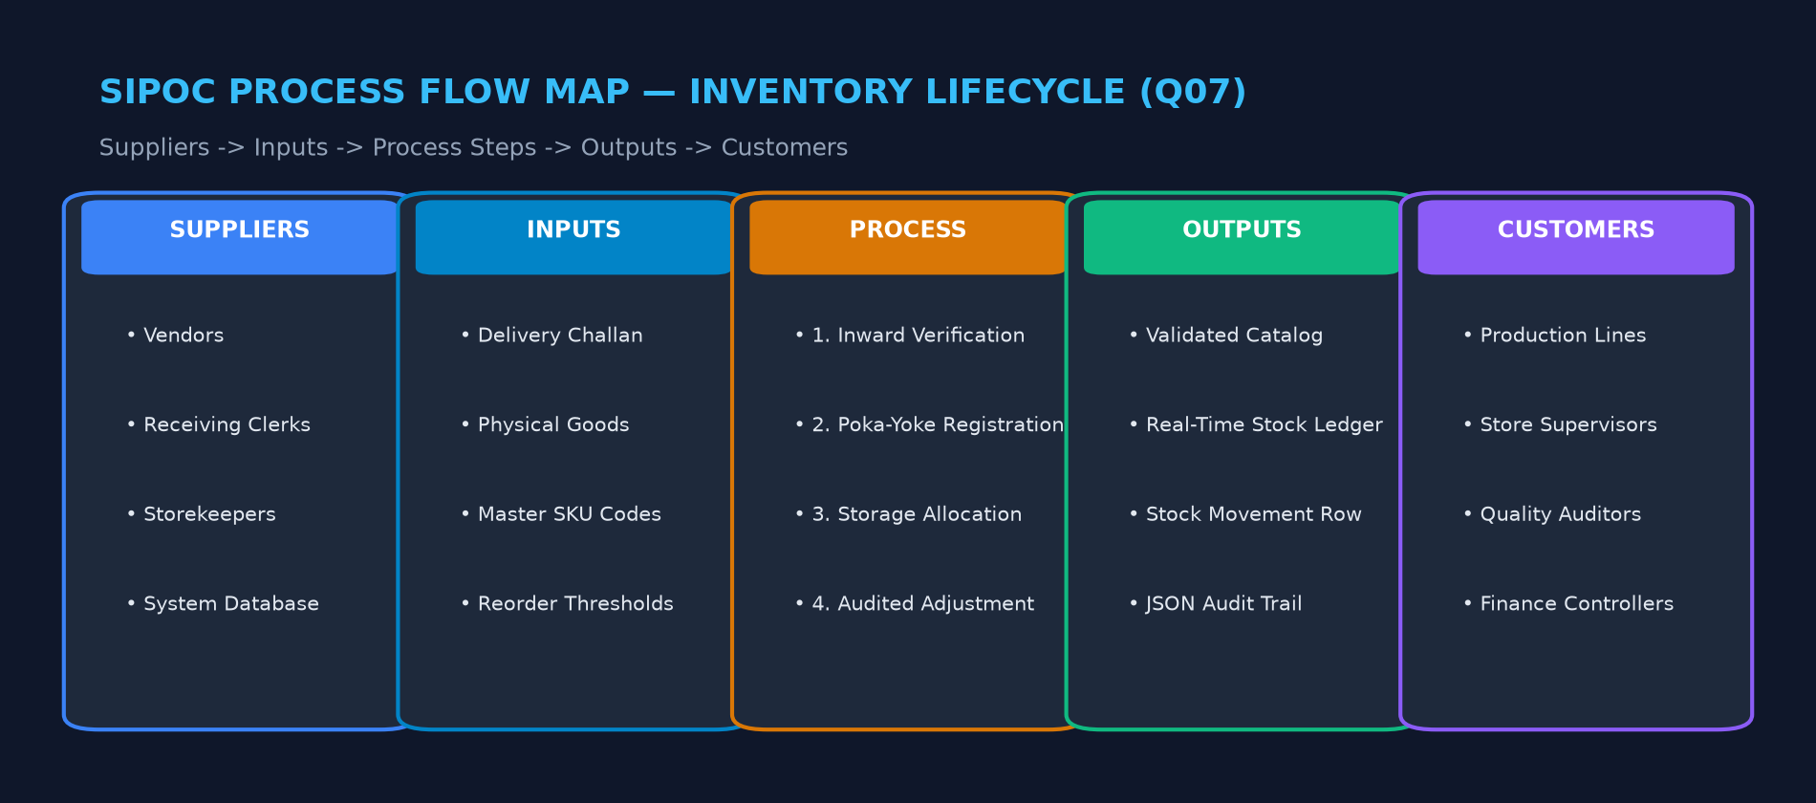
REVIEW 1 — SETUP & SRS
SIPOC Process Map: Inventory Lifecycle
Defining process boundaries: Suppliers -> Inputs -> Process -> Outputs -> Customers
Student: Dheeraj Khetwal | Course: BBAT104 — Fundamentals of TQM | Quality Goal: Q07 — Improve Data Accuracy

Slide 11
REVIEW 1 — SETUP & SRS
Modular Folder Architecture & SoC Design
Strict Separation of Concerns: Presentation, Business Logic, and SQLite Storage
DIRECTORY STRUCTURE
THE GOLDEN ARCHITECTURE RULE
Inventory_TQM_Project/
├── main.py # Application entry point
├── app/
│ ├── config.py # System paths & master categories
│ ├── database/ # connection.py (WAL, FK) & schema.py
│ ├── models/ # product, audit_log, movement, tqm
│ ├── services/ # product, inventory, audit, tqm
│ ├── ui/ # app_window, theme, components, views
│ └── utils/ # validators (Poka-Yoke) & logger
├── tests/ # 42 automated pytest test cases
└── docs/ # 11 comprehensive TQM documents
THE SCREEN MUST NEVER TALK TO THE DATABASE:
UI Layer (CTk) -> Service Layer -> Model / Database
• No SQL queries inside view files (UI only presents and asks).
• Services hold business rules (stock math, SKU uniqueness, diffs).
• Validators stop bad data at the front door before DB is touched.
• Database layer manages connections, transactions, and foreign keys.
• Benefits for Viva: Easy to explain, easy to debug, high marks for modularity.
Student: Dheeraj Khetwal | Course: BBAT104 — Fundamentals of TQM | Quality Goal: Q07 — Improve Data Accuracy

Slide 12
REVIEW 1 — SETUP & SRS
Database Design: Relational Schema & Integrity
SQLite3 with WAL mode, foreign key enforcement, and check constraints
TABLE: products
TABLE: stock_movements
product_id (UK), name, category, sku (UK), quantity CHECK(>=0), unit_price CHECK(>0), reorder_level, supplier_name, timestamps
id, product_id (FK), movement_type (IN/OUT/ADJUSTMENT/INITIAL), quantity_change, previous_quantity, new_quantity CHECK(>=0), reason, timestamp
TABLE: audit_logs (Q07)
TABLE: defects (Checksheet)
id, entity_type, entity_id, action (CREATE/UPDATE/DELETE/STOCK_ADJUSTMENT), old_values (JSON), new_values (JSON), reason, timestamp
id, defect_code (UK), category, description, severity (Low/Med/High/Critical), occurrence_count, status, corrective_action, dates
TABLE: fmea_items
TABLE: pdca_records
id, process_step, failure_mode, failure_effect, potential_cause, controls, severity (1-10), occurrence (1-10), detection (1-10), rpn (S*O*D), action, owner
id, title, stage (PLAN/DO/CHECK/ACT), problem_statement, plan_description, do_action, expected_result, actual_result, verification, standardization, owner
Student: Dheeraj Khetwal | Course: BBAT104 — Fundamentals of TQM | Quality Goal: Q07 — Improve Data Accuracy

Slide 13
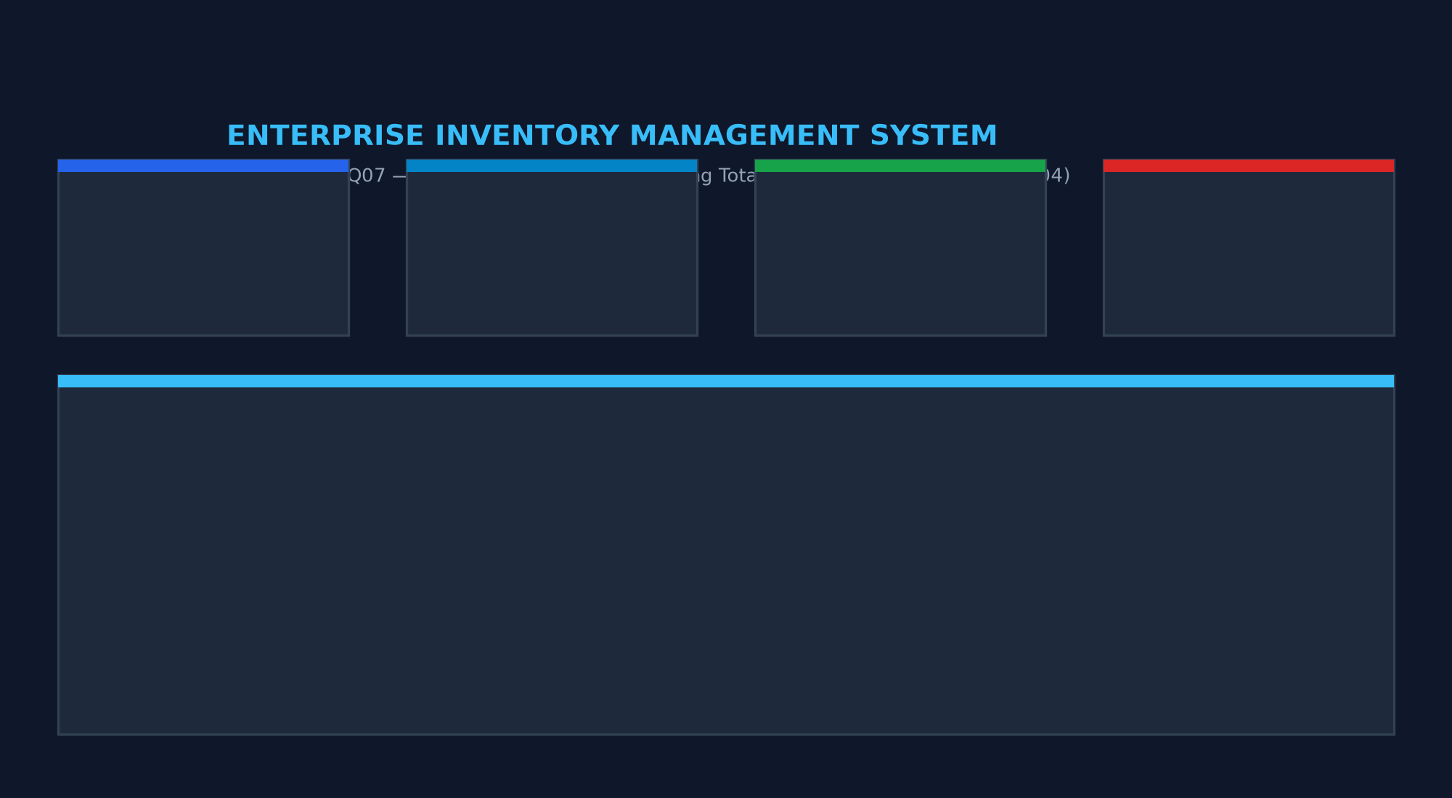
REVIEW 2 — CRUD & CORE FEATURES
Review 2: Working Application & Dashboard
Live SQLite relational metrics, dynamic KPI cards, and recent audit activity feed
Student: Dheeraj Khetwal | Course: BBAT104 — Fundamentals of TQM | Quality Goal: Q07 — Improve Data Accuracy

Slide 14
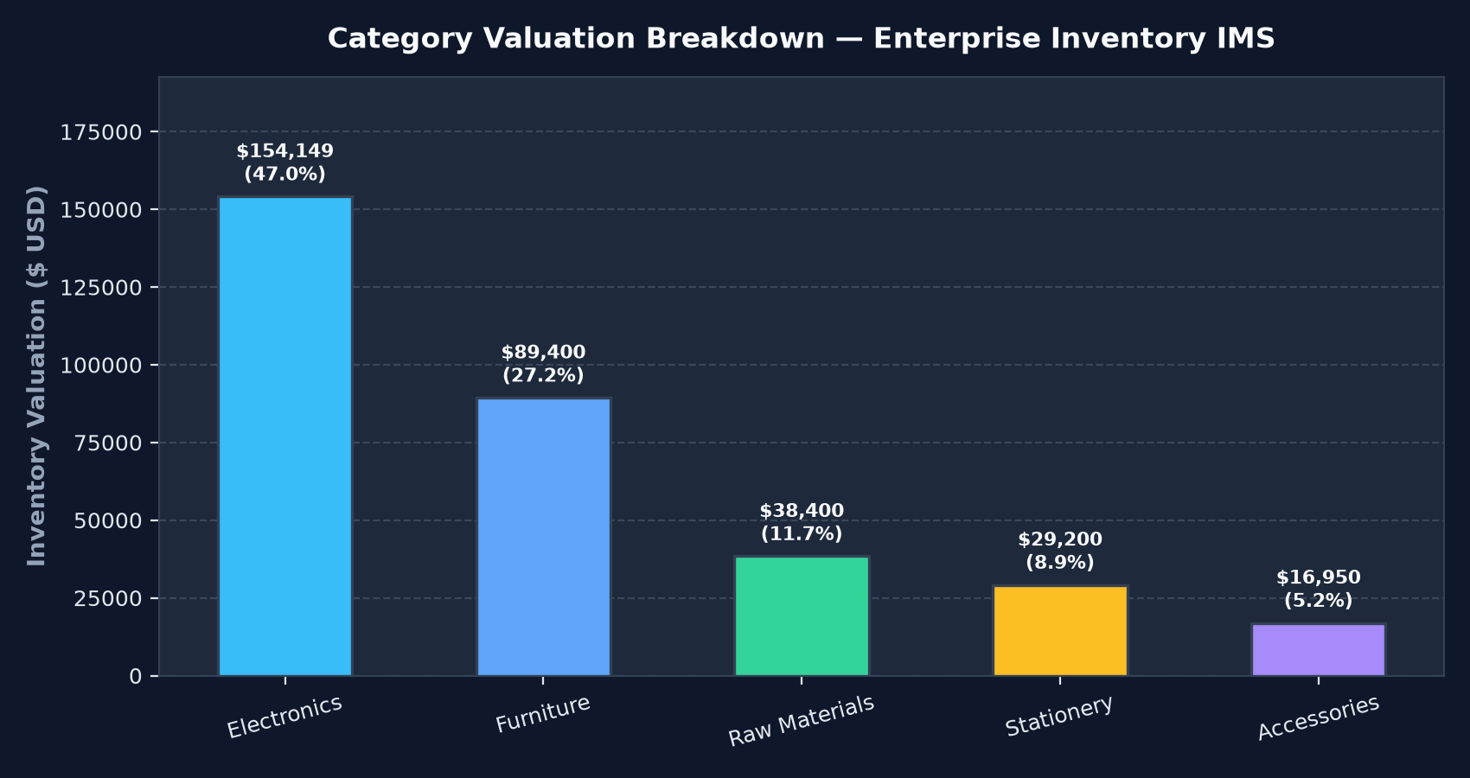
REVIEW 2 — CRUD & CORE FEATURES
Animated Category Valuation Breakdown Chart
Smooth cubic ease-out growth animation and interactive hover tooltips
CHART INNOVATIONS
• Cubic Ease-Out Growth: Bars animate smoothly from height 0 on dashboard load and refresh.
• Interactive Hover Tooltips: Moving cursor over any bar reveals exact valuation ($), percentage share, and inventory counts.
• Visual Bar Highlighting: Hovered bar illuminates while other bars softly dim for focus.
• Dynamic SQLite Updates: Chart recalculates valuation automatically after every stock adjustment.
Student: Dheeraj Khetwal | Course: BBAT104 — Fundamentals of TQM | Quality Goal: Q07 — Improve Data Accuracy

Slide 15
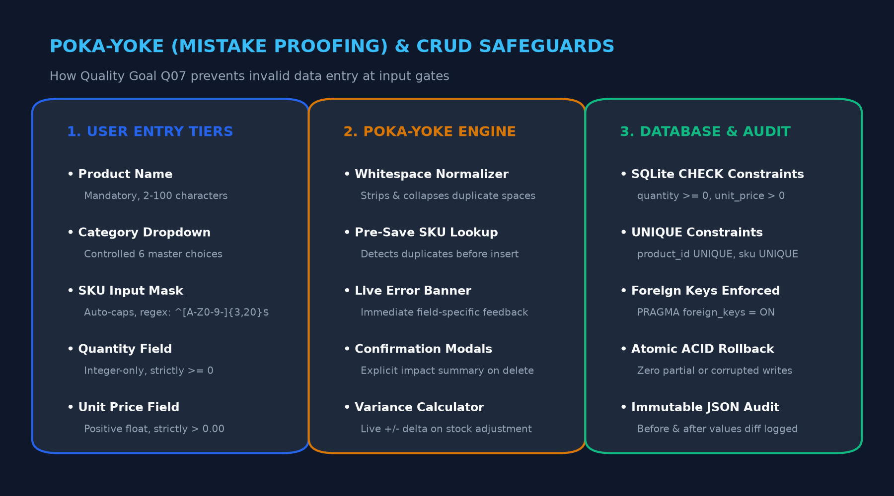
REVIEW 2 — CRUD & CORE FEATURES
Product Catalog CRUD & Input Masking (Q07)
Enforcing data accuracy at the source through automated input gates
Student: Dheeraj Khetwal | Course: BBAT104 — Fundamentals of TQM | Quality Goal: Q07 — Improve Data Accuracy

Slide 16
REVIEW 2 — CRUD & CORE FEATURES
Audited Stock Adjustments & Movement Ledger
Formula: Valuation = Sum(Qty * Price) • Mandatory Reasons & Confirmation Modals
STOCK ADJUSTMENT WIZARD
DISCRETE STOCK MOVEMENTS LEDGER
1. Product Selection: Pick product via autocomplete or dropdown.
2. Verified Physical Count: Enter new count (Integer >= 0).
3. Live Variance Preview: System displays real-time delta (+/- units) with color indicators (green for receipt, red for write-off).
4. Mandatory Audit Reason: Controlled selection from standard reasons (Audit Correction, Damaged Write-off, Customer Return).
5. Confirmation Modal: Displays before/after summary before DB commit.
Complete Historical Movement Ledger:
• INITIAL: Initial stock baseline loading.
• IN: Stock receipt and upward audit corrections.
• OUT: Damaged write-off, disposal, internal dispatch.
• ADJUSTMENT: Verified cycle count reconciliation.
Immutable Record Attributes: Timestamp (UTC), Product ID, Movement Type, Quantity Delta, Previous Qty, New Qty, and Reason.
Zero Orphaned Records: Foreign key cascade guarantees data integrity.
Student: Dheeraj Khetwal | Course: BBAT104 — Fundamentals of TQM | Quality Goal: Q07 — Improve Data Accuracy

Slide 17
REVIEW 2 — CRUD & CORE FEATURES
Immutable Transactional Audit Trail (Q07)
Dedicated audit_logs table storing structured JSON snapshots of old & new values
AUDIT LOG ARCHITECTURE
SIDE-BY-SIDE JSON DIFF INSPECTOR
• Dedicated Table: audit_logs (id, entity_type, entity_id, action, old_values, new_values, reason, timestamp).
• Actions Captured: CREATE, UPDATE, DELETE, and STOCK_ADJUSTMENT.
• Atomic Multi-Table Commit: The product modification and audit log are saved in the same SQLite transaction.
• Rollback Guarantee: If audit write fails, product write rolls back. Zero untracked changes.
• Read-Only Protection: No edit or delete controls exposed to users in the GUI.
PREVIOUS VALUES (OLD - JSON):
{
"quantity": 35,
"unit_price": 1250.00
}
APPLIED VALUES (NEW - JSON):
{
"quantity": 45,
"unit_price": 1300.00
}
Reason: Supplier price adjustment and audit count
Student: Dheeraj Khetwal | Course: BBAT104 — Fundamentals of TQM | Quality Goal: Q07 — Improve Data Accuracy

Slide 18
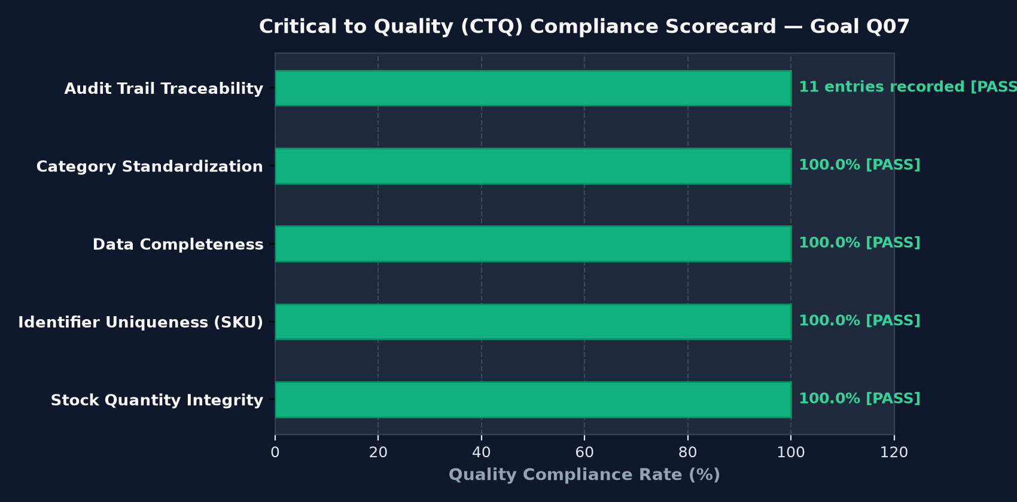
TQM QUALITY & ANALYTICS SUITE
Critical to Quality (CTQ) Scorecard
Live compliance verification across 5 measurable data accuracy characteristics
CTQ METRICS HIGHLIGHTS
CTQ-1: Stock Quantity Integrity -> 100% Non-negative integer compliance [PASS]
CTQ-2: Identifier Uniqueness -> 100% Unique SKU ratio across all catalog items [PASS]
CTQ-3: Data Completeness -> 100% Zero blank mandatory fields [PASS]
CTQ-4: Category Standardization -> 100% Conformance to 6 master taxonomies [PASS]
CTQ-5: Audit Traceability -> >= 100% Transactional change coverage [PASS]
Student: Dheeraj Khetwal | Course: BBAT104 — Fundamentals of TQM | Quality Goal: Q07 — Improve Data Accuracy

Slide 19
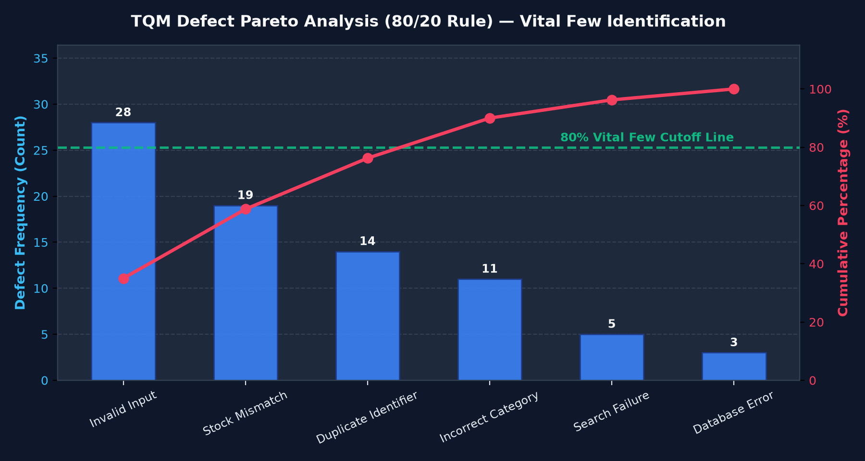
TQM QUALITY & ANALYTICS SUITE
TQM Pareto Analysis (80/20 Rule)
Prioritizing the vital few defect root causes using empirical checksheet data
THE 80/20 PRINCIPLE
Vital Few Identified: Invalid Input (28) and Stock Mismatch (19) account for 62% of historical errors.
80% Cutoff Threshold: Green dashed reference line separates vital root causes from useful many.
Interactive Tooltips: Hovering over bars displays exact frequencies, cumulative %, and classification.
Closed Quality Loop: Defect checksheets directly feed Pareto chart, focusing engineering remediation.
Student: Dheeraj Khetwal | Course: BBAT104 — Fundamentals of TQM | Quality Goal: Q07 — Improve Data Accuracy

Slide 20
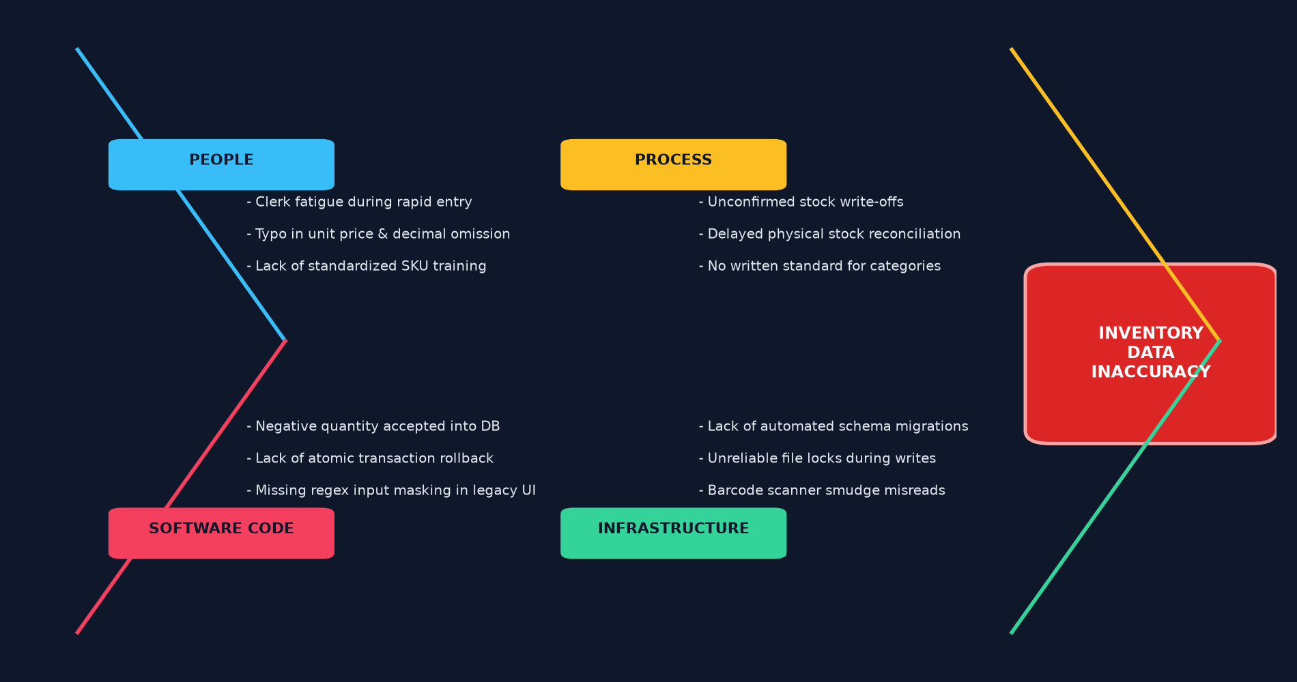
TQM QUALITY & ANALYTICS SUITE
Ishikawa (Fishbone) 4M Cause-and-Effect Analysis
Systematic root-cause exploration across People, Process, Software Code, and Infrastructure
Student: Dheeraj Khetwal | Course: BBAT104 — Fundamentals of TQM | Quality Goal: Q07 — Improve Data Accuracy

Slide 21
TQM QUALITY & ANALYTICS SUITE
Failure Mode and Effects Analysis (FMEA)
Formula: RPN = Severity * Occurrence * Detection (1-10 Scale)
Process Step | Potential Failure Mode | Pre RPN | Q07 Poka-Yoke Safeguard | Post RPN | Risk Drop
Product Registration | Malformed SKU Code | 252 (High) | Regex Mask & SQLite UNIQUE check | 7 (Low) | -97.2%
Stock Receipt | Negative Quantity Entry | 200 (High) | Integer parser & SQLite CHECK (qty>=0) | 8 (Low) | -96.0%
Category Assignment | Spelling Inconsistency | 175 (Med) | Controlled 6-category dropdown | 5 (Low) | -97.1%
Product Deletion | Accidental Catalog Delete | 162 (Med) | Confirmation modal with item summary | 18 (Low) | -88.9%
Stock Adjustment | Unaccounted Variance | 128 (Med) | Mandatory reason & JSON audit diff | 8 (Low) | -93.8%
Student: Dheeraj Khetwal | Course: BBAT104 — Fundamentals of TQM | Quality Goal: Q07 — Improve Data Accuracy

Slide 22
TQM QUALITY & ANALYTICS SUITE
The Closed Quality Loop: Logs -> FMEA -> PDCA
Connecting daily operational transactions with Deming continuous improvement
1. USER ACTION
2. LOG EMISSION
3. STATISTICAL ANALYSIS
4. PDCA CONTINUOUS CYCLE
Clerk enters data or executes stock adjustment.
audit_logs and defects record event & validation rejects.
Pareto 80/20 & CTQ Scorecard aggregate defect frequencies.
PLAN, DO, CHECK, ACT cycles standardize architectural safeguards.
PDCA 4-STAGE CONTINUOUS IMPROVEMENT IN PRACTICE
• PLAN: Identify high rate of input typos and duplicate SKUs causing stock variances.
• DO: Implement ProductValidator regex masking and controlled Category OptionMenu dropdown.
• CHECK: Verify 100% rejection rate in automated pytest suite and inspect zero duplicate entries in live audit logs.
• ACT: Standardize ProductValidator as mandatory gatekeeper for all data endpoints across system.
Student: Dheeraj Khetwal | Course: BBAT104 — Fundamentals of TQM | Quality Goal: Q07 — Improve Data Accuracy

Slide 23
REVIEW 2 — CRUD & CORE FEATURES
Automated Testing & Data Quality Verification
Comprehensive pytest test suite guaranteeing reliability and zero regression
42 / 42 PASSED (100%)
ZERO TEST POLLUTION
Complete automated test suite passing in 0.58 seconds with zero failures.
Tests run on ephemeral temporary SQLite databases via pytest tmp_path fixture.
POKA-YOKE BOUNDARIES
ACID ROLLBACK PROVEN
Extensive test coverage of negative numbers, invalid strings, malformed SKUs.
Verified that failed multi-table transactions roll back both data and audit rows.
Student: Dheeraj Khetwal | Course: BBAT104 — Fundamentals of TQM | Quality Goal: Q07 — Improve Data Accuracy

Slide 24
VIVA VOCE DEFENSE SUMMARY
Summary & The Golden Viva Takeaway
The master summary sentence that synthesizes the entire engineering achievement
THE GOLDEN SENTENCE FOR VIVA
"The UI never writes SQL.
Poka-Yoke validation stops bad data at the front gate.
Every catalog and stock change is transactionally audited in JSON.
And operational logs continuously feed live Pareto, FMEA, and PDCA continuous improvement."
PROJECT DELIVERABLES CHECKLIST
✓ Working Python Desktop Application (CustomTkinter + SQLite3 + Matplotlib)
✓ All 5 Mandatory Q07 Features Implemented & Tested
✓ 42 Automated pytest test cases passing in 0.58s
✓ 11 Complete Documentation Deliverables (SRS, Architecture, DB Design, SIPOC, FMEA, CTQ, PDCA, Manual)
✓ Clean Git Repository pushed to GitHub: https://github.com/dheeraj0204/Inventory-Management-System
Student: Dheeraj Khetwal | Course: BBAT104 — Fundamentals of TQM | Quality Goal: Q07 — Improve Data Accuracy

