Slide 1
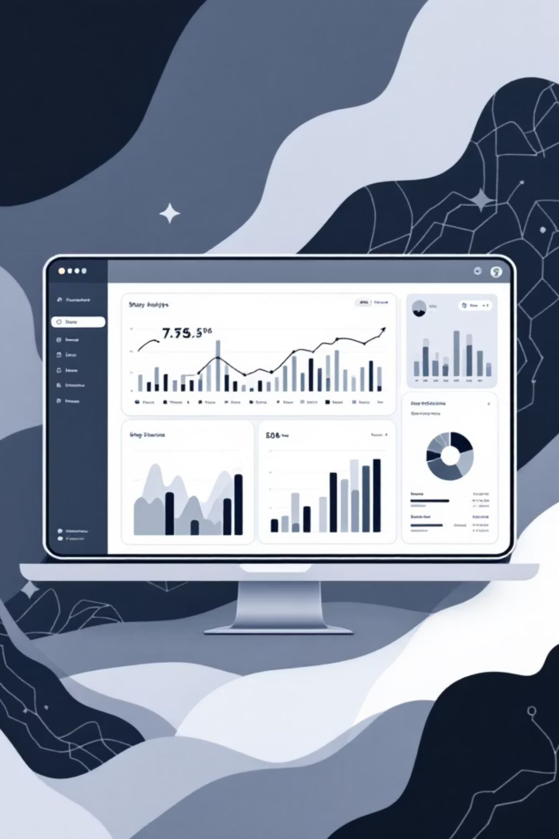
Customer Shopping Behavior Analysis
Uncovering insights from 3,900 transactions across product categories, demographics, and purchase patterns.

Slide 2

Dataset at a Glance
3,900 Rows
Transactions analyzed
18 Columns
Features per record
37 Missing
Review Rating nulls
Demographics · Purchase details · Shopping behavior

Slide 3

Data Preparation in Python
01
02
Load & Explore
Clean & Engineer
pandas, df.info(), .describe()
Imputed ratings · snake_case · age_group · purchase_frequency_days
03
Load to PostgreSQL
Cleaned DataFrame pushed to database for SQL analysis

Slide 4
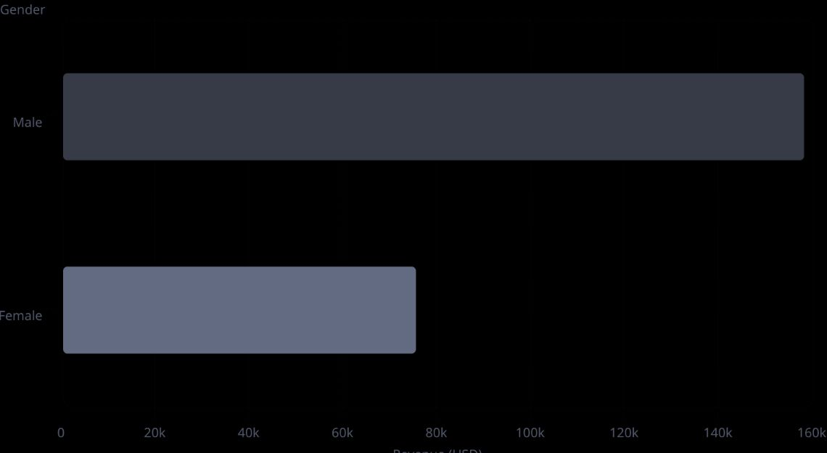
Revenue & Spending Insights
Key Findings
Male customers generate 2× more revenue than female
839 discount users still spent above average
Express shipping avg: $60.48 vs. Standard: $58.46

Slide 5
Customer Segments
3116
701
83
Loyal
Returning
New
80% of all customers
18% of all customers
2% of all customers
Segmented by purchase history. Repeat buyers (>5 purchases): 958 subscribed vs. 2,518 non-subscribed.

Slide 6
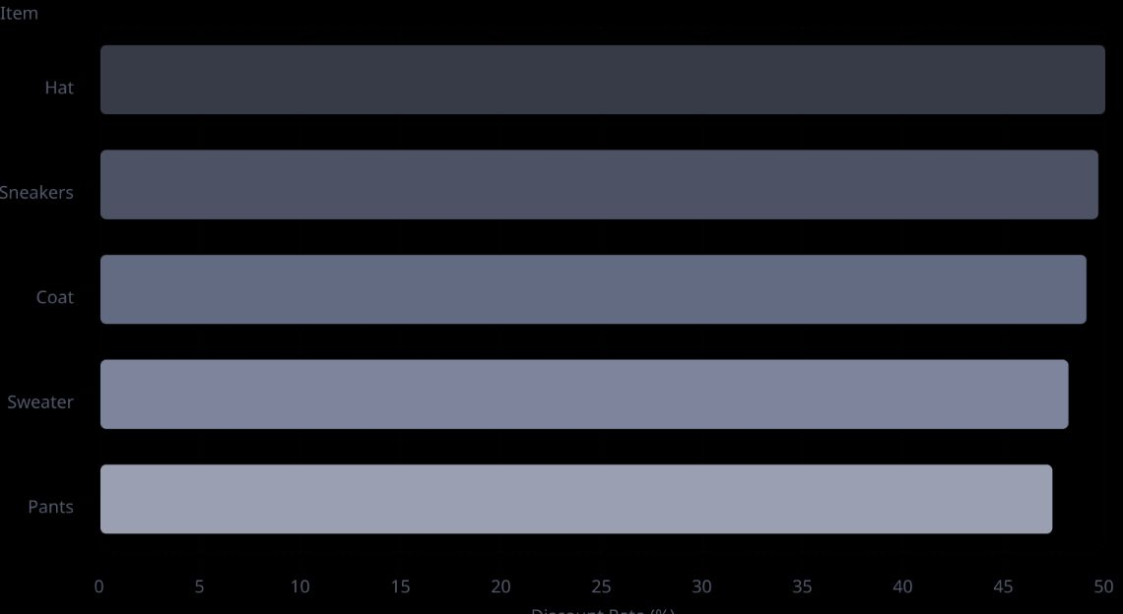
Top Products & Discount Dependency
Top 5 by Rating
Highest Discount Rates
Gloves — 3.86 ⭐
Sandals — 3.84 ⭐
Boots — 3.82 ⭐
Hat — 3.80 ⭐
Skirt — 3.78 ⭐

Slide 7
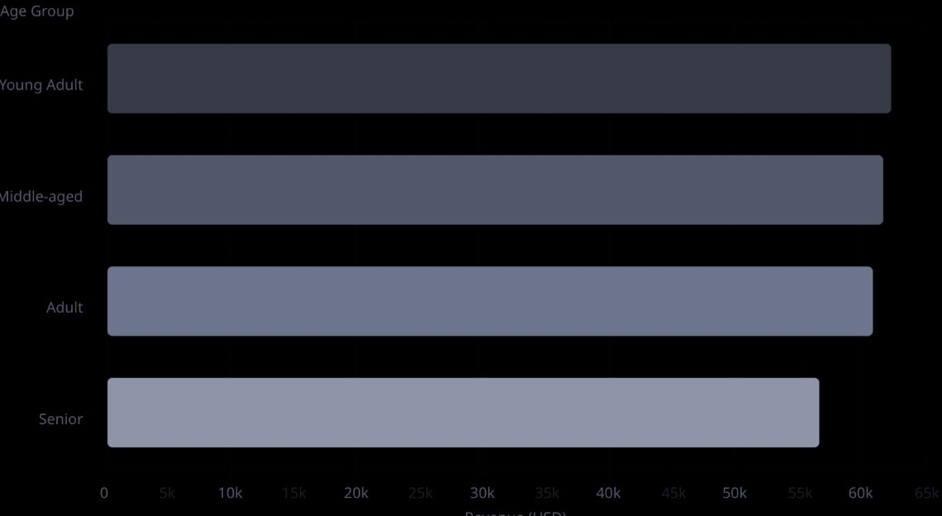
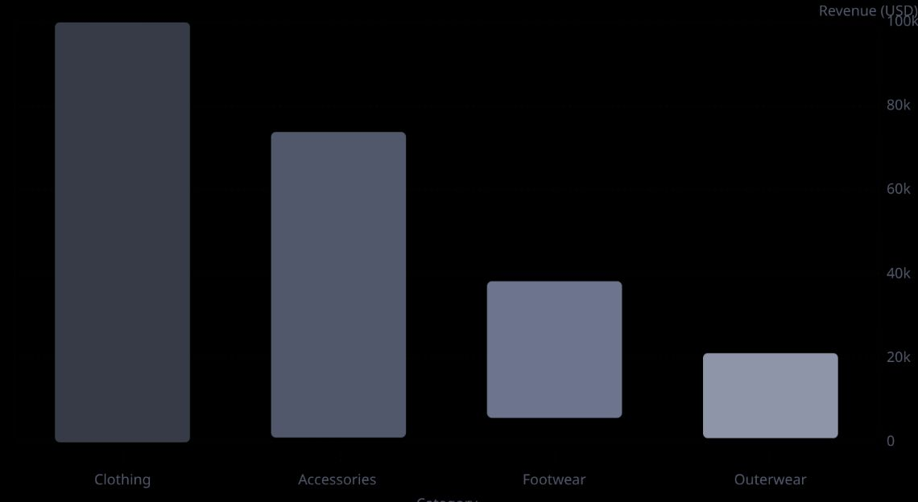
Revenue by Age Group & Category

Slide 8

Subscription Status
Subscribers vs. Non-Subscribers
Subscribers (27%)
Non-Subscribers (73%)
Avg spend: $59.49 · Revenue: $62,645
No·73%
Avg spend: $59.87 · Revenue: $170,436
·73%
·
Yes·27%
·27%
·

Slide 9

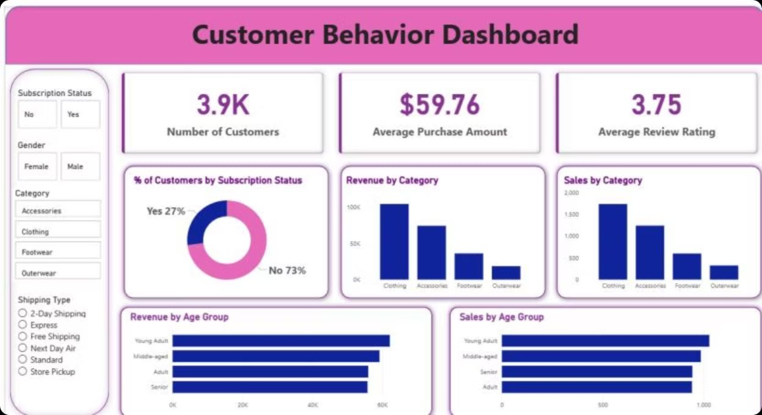
Power BI Dashboard
3.9K customers · $59.76 avg purchase · 3.75 avg rating — interactive filters by gender, category, shipping type, and subscription status.

Slide 10


Business Recommendations
Boost Subscriptions
Promote exclusive subscriber benefits
Loyalty Programs
Reward repeat buyers → move to "Loyal"
Review Discount Policy
Balance sales boosts with margin control
Targeted Marketing
Focus on high-revenue age groups & express-shipping users

