Slide 1

SRM INSTITUTE OF SCIENCE AND TECHNOLOGY SCHOOL OF COMPUTING
DEPARTMENT OF COMPUTING TECHNOLOGIES 18CSE357T - BIOMETRICS- MINI PROJECT
Object Detection in an Image
GUIDE NAME:DR.Vidhyalakshmi M K
DESIGNATION : Assistant Professor
DEPARTMENT: Department of computing Technologies
NAME:CH DHEERAJ
REG -NO:RA2111030010182

Slide 2
object detection in an image
Abstract
Object detection in images plays a crucial role in computer vision applications, enabling machines to identify and locate various objects within a given scene. The You Only Look Once (YOLO) algorithm represents a significant advancement in real-time object detection, offering a balance between accuracy and speed. This study explores the application of YOLO for object detection in images, aiming to enhance the efficiency and effectiveness of computer vision systems.
7/29/2022
2

Slide 3
Object detection in an image
Implement YOLO Algorithm: Develop a robust implementation of the YOLO algorithm, understanding its architecture and intricacies, to enable accurate and real-time object detection in images.
Dataset Preparation: Curate and preprocess a diverse dataset containing annotated images across different object classes. This step is crucial for training and evaluating the YOLO model, ensuring its ability to generalize to various scenarios.
Model Training: Train the YOLO model on the prepared dataset, fine-tuning its parameters to achieve optimal performance in terms of
accuracy, precision, and recall. This involves adjusting hyperparameters and optimizing the model for the specific object detection task.
Real-Time Inference: Implement the YOLO model for real-time object detection, aiming for low-latency and high-accuracy predictions. Evaluate the model's performance on various images and scenarios to assess its robustness and generalization capabilities.
Comparison with Other Models: Conduct comparative analyses with other state-of-the-art object detection models to benchmark the performance of YOLO. Explore the strengths and weaknesses of YOLO in
7/29/20d22ifferent contexts and scenarios.
3

Slide 4
Object Detection in an Image
Optimization Techniques: Investigate and implement optimization techniques to enhance the efficiency of the YOLO algorithm, such as model quantization, pruning, or hardware acceleration, with the goal of achieving real-time performance on resource-constrained devices.
Application Scenarios: Explore practical applications of
YOLO-based object detection, such as surveillance, autonomous vehicles, and augmented reality. Assess the model's adaptability to diverse real-world use cases.
Ethical Considerations: Discuss the ethical implications of object detection technology, addressing issues such as privacy, bias, and potential misuse. Propose ethical guidelines for the responsible deployment of YOLO-based object detection systems.
By achieving these objectives, this research contributes to the advancement of object detection techniques, particularly in the context of YOLO, and provides insights into its practical applications and ethical considerations in real-world scenarios.
7/29/2022

Slide 5
Existing System
The existing system using YOLO for object detection generally follows these key components:
Architecture: YOLO's architecture is typically based on a convolutional neural network (CNN). The network is divided into a grid, and each grid cell predicts bounding boxes and class probabilities. YOLO is known for its single-pass approach, where it simultaneously predicts bounding boxes and class probabilities for all objects in the image.
Training: The YOLO algorithm is trained on a labeled dataset containing images with annotated bounding boxes around the objects of interest. The training process involves optimizing the network's parameters to minimize the detection errors. Commonly used datasets for YOLO training include COCO (Common Objects in Context) and VOC (Visual Object Classes).
Detection: Once trained, the YOLO model can be used for real-time object detection in images. The algorithm divides the image into a grid and predicts bounding boxes and class probabilities for each grid cell. Non-maximum suppression is often applied to eliminate redundant or overlapping bounding box predictions, resulting in a final set of detected objects.
Post-Processing: Post-processing steps involve filtering out low-confidence predictions and refining the final set of detected objects. This ensures that only the most confident and accurate predictions are considered.
Deployment: YOLO models can be deployed on various platforms, including CPUs, GPUs, and specialized hardware like FPGAs (Field-Programmable Gate Arrays) or TPUs (Tensor Processing Units). This flexibility allows YOLO to be used in a variety of applications, from edge devices to cloud-based services.
Community Contributions: YOLO has a large and active community, leading to various versions and improvements. YOLOv2, YOLOv3, and YOLOv4 are some of the major releases, each bringing enhancements in terms of accuracy and speed. The choice of which version to use depends on the specific requirements of the application.
7/29/2022

Slide 6
Proposed System
YOLO Version Selection:
Choose the appropriate version of YOLO based on the specific requirements of the application. Consider factors such as speed, accuracy, and model size.
Advanced Architectures and Techniques:
Explore any recent advancements or modifications to the YOLO architecture. Researchers often propose improvements to the basic architecture, such as feature pyramid networks, attention mechanisms, or other innovations to enhance detection accuracy.
6

Slide 7
Proposed System
Transfer Learning and Fine-Tuning: Implement transfer learning techniques to leverage pre-trained models on large datasets. Fine-tune the model on a specific dataset relevant to your application to adapt it to the characteristics of the target objects and scenes.
Data Augmentation:
Apply advanced data augmentation techniques to artificially increase the diversity of the training dataset. This can include techniques such as rotation, scaling, flipping, and introducing realistic noise to improve the model's robustness.

Slide 8
Proposed System
Hyperparameter Optimization:
Conduct thorough experiments to optimize hyperparameters like learning rate, batch size, and others to achieve the best performance. This may involve using techniques such as grid search or random search.
Ensemble Approaches:
2. Investigate the use of ensemble methods, combining predictions from multiple YOLO models or other object detection architectures to improve overall detection accuracy.

Slide 9
Proposed System
Real-Time Optimization:
Implement optimizations for real-time performance, especially if the system is intended for deployment on edge devices with resource constraints. This might involve model quantization, pruning, or other techniques to reduce the model size and inference time.
Integration with Edge Devices:
2. Consider the deployment environment and integrate the proposed YOLO-based object detection system with edge devices, ensuring compatibility and efficiency in real-world scenarios.

Slide 10
Proposed System
Evaluation Metrics and Comparison:
Define appropriate evaluation metrics to assess the performance of the proposed system. Compare the results with baseline YOLO models or other
state-of-the-art object detection methods to demonstrate improvements.
Documentation and Open Source Contribution:
2. Document the proposed system thoroughly, providing clear guidelines for implementation and usage. Consider contributing to open-source projects if applicable, fostering collaboration and knowledge sharing within the community.

Slide 11
Literature Review
A literature review on object detection using the YOLO algorithm would typically involve summarizing and synthesizing relevant research papers, articles, and studies related to this topic. Below is an example structure for a literature review on object detection using YOLO:
1. Introduction:
Provide a brief introduction to object detection and its significance in computer vision applications.
Introduce the YOLO algorithm and its key characteristics, emphasizing its real-time capabilities and accuracy.
2. Evolution of Object Detection Techniques:
Review the historical development of object detection techniques, from traditional methods to deep learning-based approaches.
Highlight the limitations of earlier methods and the motivation for adopting deep learning for object detection.
3. YOLO Algorithm Overview:
Provide an in-depth explanation of the YOLO algorithm, discussing its architecture, grid-based approach, and single-pass detection mechanism.
Compare YOLO with other popular object detection algorithms like Faster R-CNN and SSD.
4. YOLO Variants and Improvements:
Summarize the evolution of YOLO through different versions (e.g., YOLOv2, YOLOv3, YOLOv4) and highlight the improvements introduced in each version.
Discuss any novel architectures or techniques incorporated in these variants that enhance detection performance.
5. Applications of YOLO in Various Domains:
11
Explore the diverse applications of YOLO in different domains, such as autonomous vehicles,

Slide 12
Literature Review
Transfer Learning and Fine-Tuning:
Investigate the use of transfer learning with YOLO, emphasizing how pre-trained models on large datasets contribute to improved object detection performance.
Highlight studies that focus on fine-tuning YOLO for specific datasets or domains.
7. Challenges and Limitations:
Identify challenges and limitations associated with YOLO, such as handling small objects, dealing with occlusions, and the impact of varying image resolutions.
Discuss how researchers address or mitigate these challenges in their work.
8. Performance Evaluation Metrics:
Review the common evaluation metrics used to assess the performance of YOLO models, including precision, recall, F1 score, and mAP (mean Average Precision).
Discuss studies that propose new metrics or modifications to existing ones for more accurate evaluation.
9. Comparative Studies:
Summarize comparative studies that benchmark YOLO against other state-of-the-art object detection methods. Highlight the strengths and weaknesses of YOLO in various contexts.
10. Future Directions and Open Challenges:
Discuss emerging trends and potential future directions in object detection using YOLO.
Identify open challenges and areas where further research is needed to enhance the capabilities of YOLO.
11. Conclusion:
Summarize key findings from the literature review.
Emphasize the significance of YOLO in advancing object detection and its potential for future research and applications.
12

Slide 13
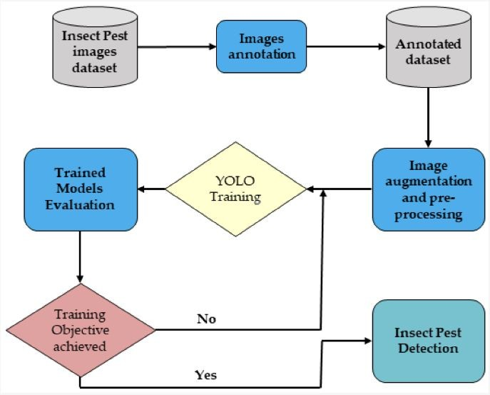
Architecture Diagram

Slide 14
Modules
1. Image Input Module:
Responsible for handling input images or video streams.
Preprocesses input data to the required format for the YOLO model.
2. YOLO Model Module:
Implements the YOLO algorithm for object detection.
Manages the loading, configuration, and execution of the YOLO model.
Handles inference and prediction on input images.
3. Training Module:
Manages the training process of the YOLO model.
Handles data preparation, model configuration, and optimization.
Evaluates the trained model and saves the weights for later use.
4. Dataset Module:
Deals with the organization and preparation of datasets for training and evaluation.
May include functionality for data augmentation to improve model generalization.
5. Evaluation Module:
Implements metrics and methods to evaluate the performance of the YOLO model.
Compares model predictions against ground truth annotations.

Slide 15
Modules
6. Post-Processing Module:
Takes the raw predictions from the YOLO model and applies post-processing techniques.
Filters out low-confidence detections.
Implements non-maximum suppression to remove redundant bounding boxes.
7. User Interface (UI) Module:
Provides a graphical interface for users to interact with the system.
Displays the results of object detection on images or video streams.
8. Real-Time Optimization Module:
Implements optimizations for real-time performance on edge devices.
May include model quantization, compression, or other techniques to reduce computational load.
9. Logging and Reporting Module:
Logs important information during training and inference.
Generates reports on model performance, training progress, and evaluation results.
10. Configuration Module:
Manages configuration parameters for the entire system.
Allows users to set various options such as model version, input size, or confidence thresholds

Slide 16
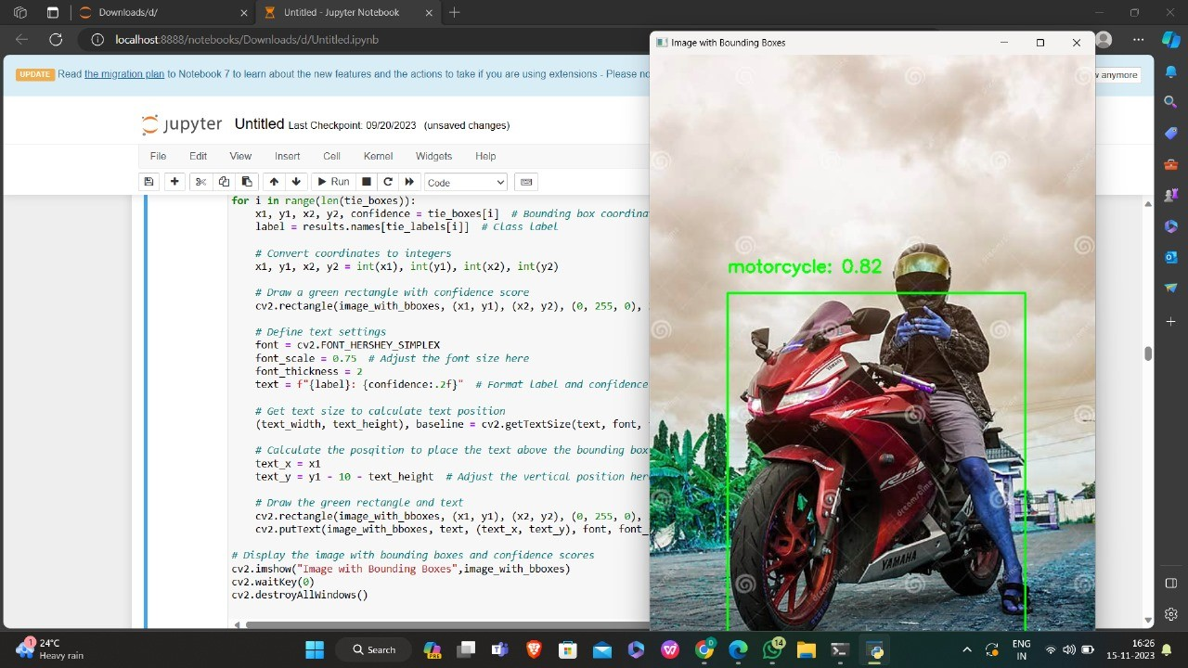
Sample Snapshot

Slide 17
References
"You Only Look Once: Unified, Real-Time Object Detection"
Author: Joseph Redmon, Santosh Divvala, Ross Girshick, Ali Farhadi
Conference: CVPR 2016
Internet.

Slide 18
Conclusion
In conclusion, the field of object detection using the YOLO algorithm has witnessed significant advancements, marked by the evolution of YOLO versions and their widespread applications. The YOLO algorithm, known for its real-time capabilities and unified approach to object detection, has become a cornerstone in computer vision research and practical implementations.
The literature review highlighted the historical context of object detection, tracing the transition from traditional methods to the adoption of deep learning techniques. YOLO's unique architecture, including its grid-based approach and single-pass mechanism, was thoroughly explored. Comparative studies against other state-of-the-art algorithms showcased YOLO's strengths, particularly in real-time scenarios across diverse domains.
Understanding the challenges and limitations associated with YOLO, such as small object detection and handling occlusions, is crucial for refining the algorithm. Transfer learning and fine-tuning strategies emerged as valuable tools for adapting YOLO to specific datasets, while advancements like YOLOv4 introduced optimizations for both speed and accuracy.
The proposed system outlined the modular components essential for developing an object detection system using YOLO. These modules, ranging from image input and model execution to post-processing and real-time optimization, form a comprehensive framework for building a robust and efficient system.
Future research directions were identified, including the exploration of emerging trends and the need for addressing open challenges. Ethical considerations, particularly in the deployment of object detection technology, were emphasized, highlighting the importance of responsible practices to mitigate privacy concerns and potential biases.
As the field continues to evolve, staying abreast of the latest research findings, versions of YOLO, and innovative applications will be essential. Object detection using YOLO remains a vibrant area of research with promising prospects for addressing complex real-world challenges across various domains.

