Slide 1

Finding the best Neighbourhood To live between Two Neighbourhoods Using Data Analysis & Data Visualisation

Slide 2
Introduction
In this capstone project I will be creating a program to compare the neighbourhoods of the two cities namely Brooklyn from New York and Downtown Toronto from Toronto and determine how similar or dissimilar they are.
I will be comparing all the venues , hotspots to visit, number of residential friendly places, etc. As we know both Brooklyn and downtown Toronto are we very huge and diverse containing people from all around the world. These places have a lot of restaurants, cafes, pubs and so on. So by comparing these two neighbourhoods we can find a lot of similarities and see how these places vary.
I will use foursquare api to collect all the details and explore these regions and will be using k means to cluster different cateogaries of data and display it on the exact location using folium maps.
Later I will be using the two maps to differentiate between the neighbourhoods and see how one varies from the other. This analysis is mainly done when people are moving from one place to another for various purposes. They would want to have the same facilities in the new neighbourhood as they have in their current neighbourhood.
Thus by comparing various major cities based on its amenities and venues we make a proper analysis and visualize the data obtained using Data Science.

Slide 3
Data souece and cleaning
As I said in the introduction I will be creating a program to analyse Brooklyn and Downtown Toronto. I will be web scraping to obtain the table of Canada’s neighbourhoods from Wikipedia and converted it into a Dataset using pandas and cleaned it so that it fits for my analysis.
Later I will make new data frame which comprises of Downtown Toronto data only.
Link had been obtained from previous labs from coursera:
https://en.wikipedia.org/wiki/List_of_postal_codes_of_Canada:_M
I will also be needing the New York dataset so that I can extract all the information from Brooklyn. I obtained This data set from the lab as well:
https://cocl.us/new_york_dataset
The above json file will be cleaned and only a dataframe containing only Brooklyn data will be formed.

Slide 4
I will also require a geospatial coordinate dataset which contains all the latitude and longitude information of the cities. This link was also available in the labs.
http://cocl.us/Geospatial_data
I will be using jupyter notebook to create the program. Foursquare api will be used to explore the data.
All the modules which I will be using in the program are listed below:
Numpy
Pandas
Matplotlib
Seaborn
Json
Geopy
Requests
Sklearn
Folium

Slide 5
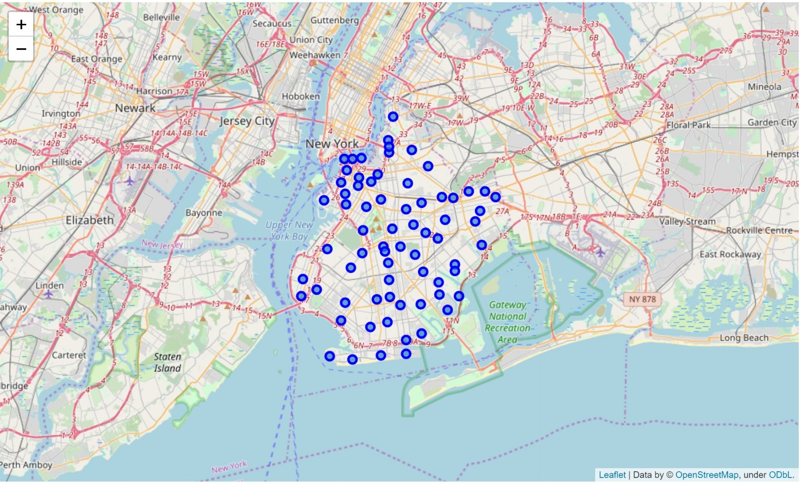
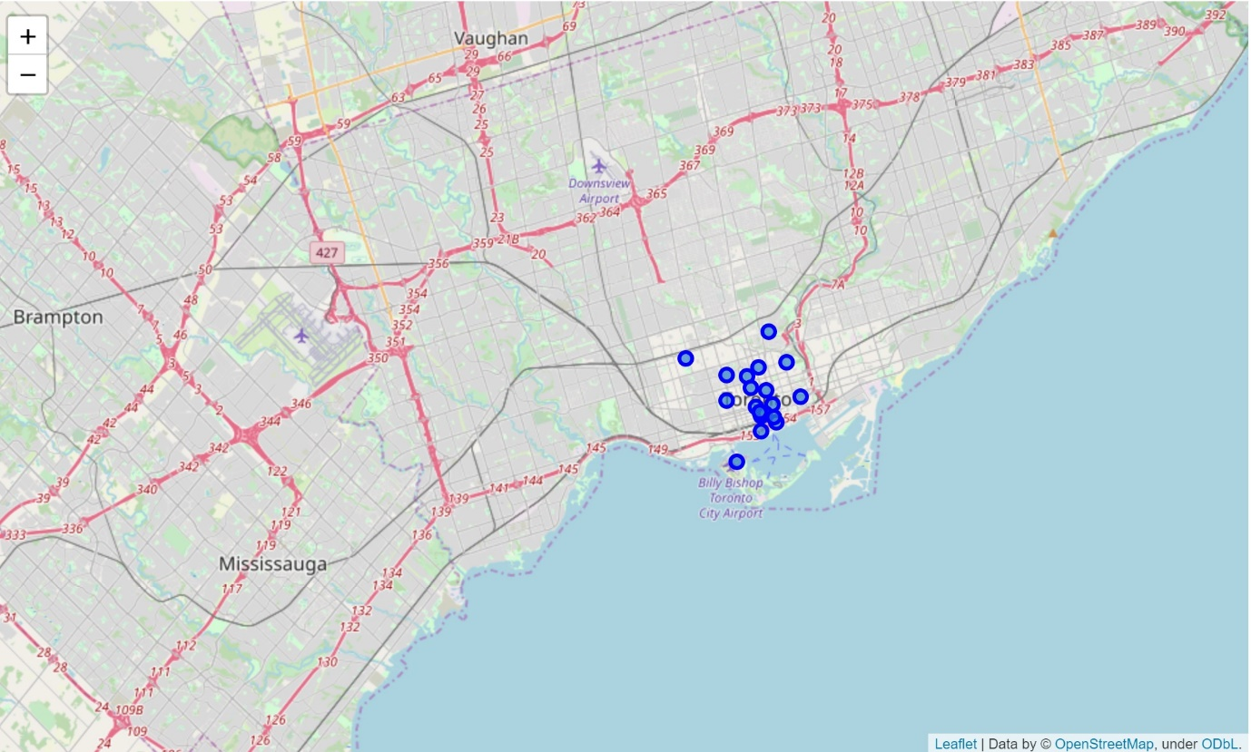
Methodology
The foursquare api client details and version where initialized to the variables. In order to create a url to get requests.
First I did a exploration through visualization of both the cities of Downtown Toronto and Brooklyn. I requested the venues in that place a marked all of them in their repective maps using folium.
Brooklyn map:
Downtown Toronto map:

Slide 6
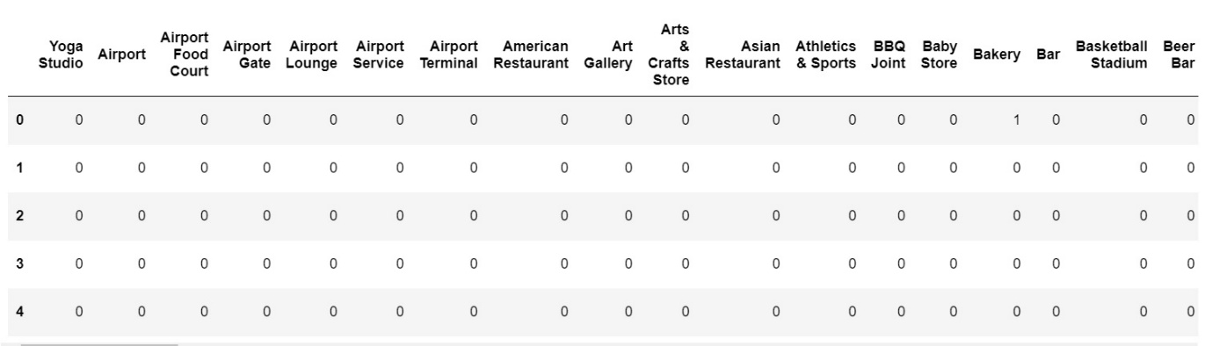
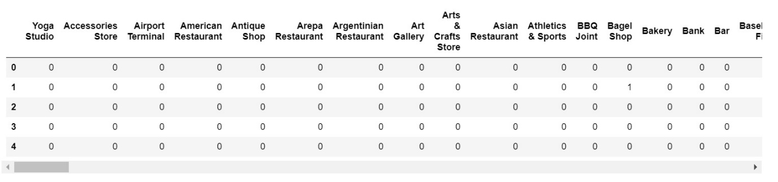
Statistical Anaysis
I retrieved all the data life information of rating , location, etc on all the venues located in the above maps using a Jason file for each particular location .
Then performed one hot coding to divide them into particular categories so it will be easy while clustering them later.
Downtown Toronto:
Brooklyn:

Slide 7
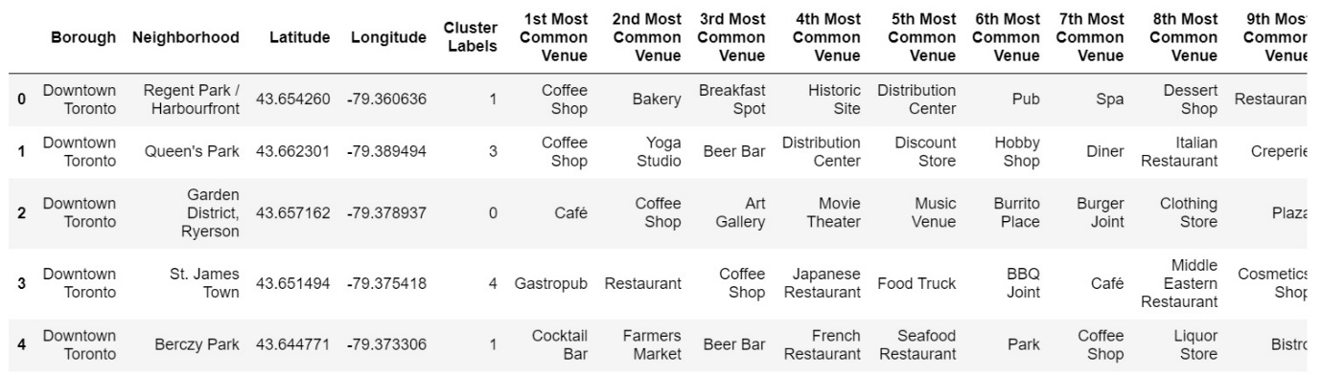
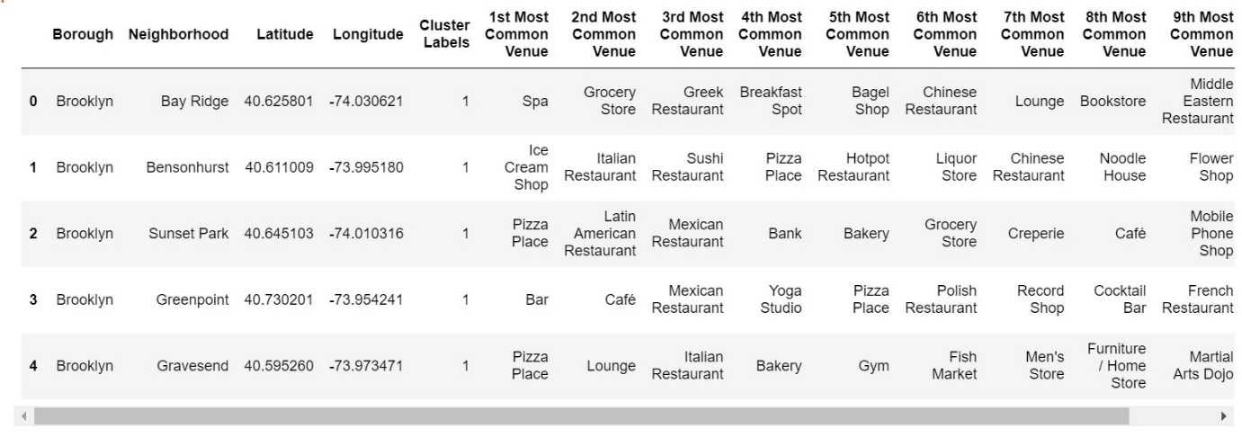
Later we created the top 10 venues in a neighbourhood and multiplied it with the one hot coding so that each venue falls in a certain cateogory and is divided into 4 proper clustrers as seen below.
Downtown Toronto:
Brooklyn:

Slide 8
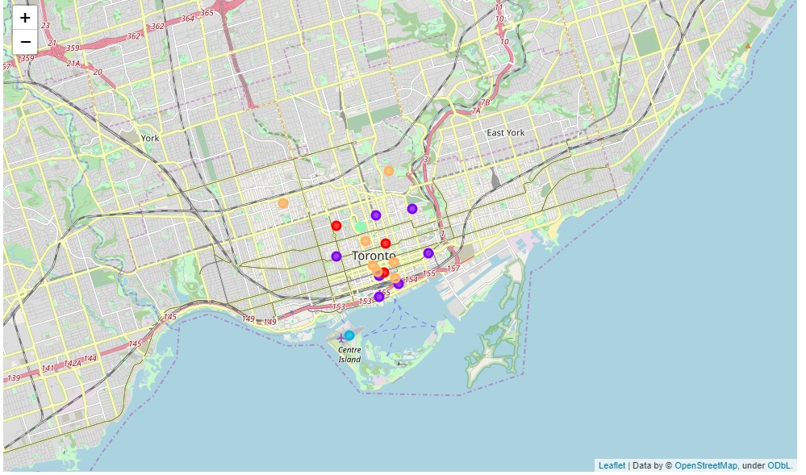
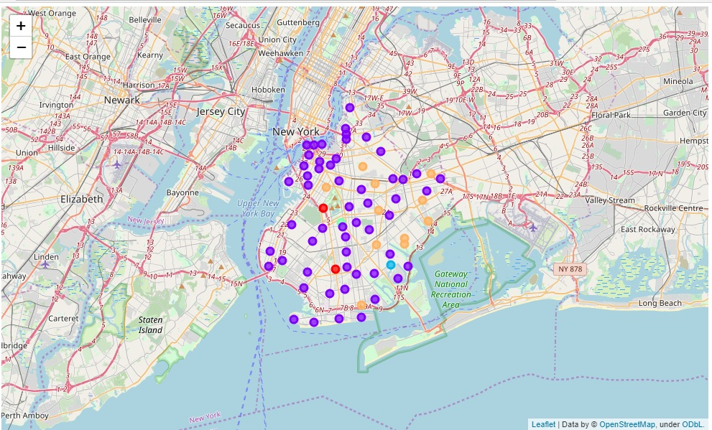
After getting all the information all the clusters where placed on a folium map. This showed us how many different amenities and places are there in the city and exactly where they are located in the neighbourhood.
Downtown Toronto:
Brooklyn:

Slide 9
Result
After analysing the data both the neighbourhoods have a high tourist attraction , lot of restaurants and cafes. They also have a lot of good residential areas like parks etc and proper amenities places like airports and train.
The major difference is that they have different historical places and different origins. This includes monuments ,parliamentary buildings and so on.
Observations and Discussion
Brooklyn is bigger than downtown Toronto it has 3 times more venues than its counterpart as we can see on the map. Not only that the people are diverse as it is evident from the diverse array of restaurants available and the places to visit.
The airport and other transport facilities are nearby and many residential areas are available in Brooklyn than in downtown Toronto.
Conclusion
Based on a the analysis the Brooklyn neighbourhood is more suitable for a highly active and busy person who always wants to enjoy and keep traveling without any financial barriers.
On the other hand if you want a simpler life with balance of nature and entertainment downtown Toronto is the best option and is also a solution financially.

