Slide 1

TECHNICAL SEMINAR ON DEEP WEB
BACHELOR OF TECHNOLOGY
IN
COMPUTER SCIENCE AND ENGINEERING
BY
M.DHEERAJ REDDY(16VE1A05F0)
UNDER THE GUIDANCE OF
HOD
Dr.V.Goutham

Slide 2
Abstract
The deep web is also known as invisible web or hidden web are parts of the world wide web and its contents are not indexed by standard search engines for any sort of reason.
The content of deep web is hidden behind HTML forms. The surface web is the opposite term to deep web.
Deep web is anonymous internet where it is much difficult for hackers, or spies to track internet users on which websites they are using and what are they doing there.

Slide 3
Deep web-Introduction
The Deep web Is the world wide web content that is not part of the surface web.
It is also called the Deepnet , Invisible Web or Hidden Web.
It is the largest growing category of new information on the internet.
It consists of 400-550 times more public information than surface web.

Slide 4
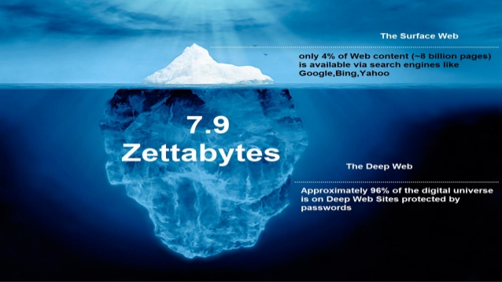

Slide 5
What’s in the deep web?
Searchable Databases.
Downloadable files and Spreadsheets.
Large number of datasets.
Lots of Government Information.
More relevant results than the same search in surface web.

Slide 6
Searching Deep web vs surfaceweb
When using a deep web index, you are first searching through a collection of databases, but not looking for a piece of information.
Each database is it’s own searchable collection of information. Once you type in a word, you are looking for databases containing that keyword.

Slide 7
The Onion Router(TOR)
Tor is a software that installs into your browser and sets up the specific connections you need to access deep web sites.
Onion routing refers to process of removing encryption layers from internet communications, similar to peeling back the layers of an onion.
Using TOR makes it more difficult to be traced as TOR uses layered encryption technology.

Slide 8
Continued…
Instead of seeing domains that end in .com or .org, these hidden sites end in .onion
The most infamous of these onion sites was the now-defunct silk road, an online marketplace where one can buy and sell drugs, weapons etc.
Tor is so effective in providing anonymity but it didn’t take long for the criminal-minded to take over it.

Slide 9
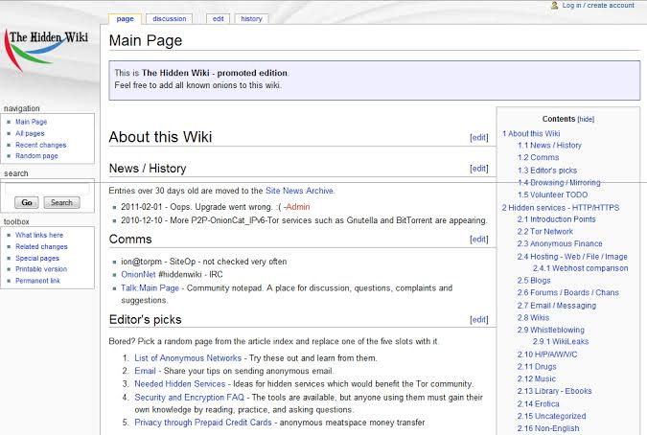

Slide 10
Transactions on Deep Web
You may wonder how money-related transactions can happen when sellers and buyers can’t identify each other.
That’s where Bitcoin comes in.
Bitcoin is basically an encrypted digital currency.
Like regular cash, bitcoin is good for all kinds of transactions, no one can trace a purchase, illegal or otherwise.

Slide 11
The Brighter Side of Darkness
The deep web is home to alternate search engines , e-mail services, file storages, etc.
The deep web also contains sites that provide a safer meeting ground for the people who may find themselves on the fringes of society.
Bitcoin may not be entirely stable, but it offers privacy, which is something your credit card company most certainly does not.
For citizens in totalitarian countries, the deep web offers a more secure way to communicate with like-minded individuals.

Slide 12
Disadvantages of Darkness
Deep web search engines tend to be slower than the standard surface web search engines.
Exploring deep web could be dangerous if not used in a proper way.
Many disturbing activities like smuggling, terrorism, weaponization can be found on the dark web.
We can never know if the sites on dark web are real, many can lead us to get attacked by malware.

Slide 13
Future
The lines between search engine content and the deep web have begun to blur, as search services start to provide access to part or all of once-restricted content.
An increasing amount of deep web content is opening up to free search as publishers and libraries make agreements with large search engines.
In the future, deep web content may be defined less by opportunity for search than by access fees or other types of authentication.

Slide 14
CONCLUSION
The deep web will continue to perplex and fascinate everyone who uses the internet.
It contains an enthralling amount of knowledge that could help us evolve technologically.
And of course, it’s darker side will be lurking too, just as it always does in the human nature.

Slide 15
THANK YOU!!

