Slide 1
Small Sample Learning for Defect Classification
END-TO-END RESULT
~85%
Problem A | Semiconductor Solutions Challenge 2026
9-Class Accuracy (random sample)
Multi-Task ResNet50 with Edge-Enhanced Preprocessing & Targeted Rare-Class Augmentation
Stage 1 (Binary): 86.9%
Stage 2 (Subtype): 92.7%
Exceeds Intel's 85% target
ASU Southwest Advanced Prototyping Hub x Intel Corporation
March 2026

Slide 2
1
Problem Statement & Challenge Overview
THE CHALLENGE
OBJECTIVES
▸ Defect classification is critical in semiconductor manufacturing
▸ Directly impacts yield, product quality, and time-to-market
▸ Labeled defect data is scarce in real production environments
▸ Traditional ML needs large datasets — not feasible in fabs
▸ Must learn from very few examples (some classes have <15 samples)
▸ Detect defects (binary: good vs defect) with high accuracy
▸ Classify into 8 specific defect subtypes
▸ Handle extreme class imbalance (793:1 ratio)
▸ Process images in ~1 second, up to 1500x2500 pixels
DELIVERABLES (from Intel Problem Brief)
▸ Application for detecting & classifying defects from grayscale images
▸ Evaluation plots: detection & classification accuracy
▸ Target: ~85% overall classification accuracy
▸ Demonstrate rapid learning from limited data
▸ Documentation: model approach, assumptions, class imbalance handling
Semiconductor Solutions Challenge 2026 | Problem A: Small Sample Defect Classification
2 / 15

Slide 3
2
Dataset Overview & Class Distribution
9,796
9 (1 good + 8 defect)
7,135 : 2,661
793:1 (good vs defect3)
Total Images
Classes
Good : Defect
Max Imbalance
CLASS DISTRIBUTION
KEY EDA INSIGHTS
Class
Count
Share
Note
▸ Grayscale images, variable sizes (612–5238 px)
▸ Majority class (good) = 72.8% of all data
▸ defect3 has only 9 samples, defect4 has 14
▸ Image dimensions vary significantly across classes
▸ Mean pixel intensity varies by defect type
▸ Binary baseline (majority vote) = 69.1%
good
7,135
72.8%
---
defect8
803
8.2%
Most common defect
defect10
674
6.9%
defect5
411
4.2%
defect9
319
3.3%
defect1
253
2.6%
defect2
178
1.8%
⚠ defect4
14
0.1%
CRITICALLY RARE
⚠ defect3
9
0.1%
CRITICALLY RARE
Semiconductor Solutions Challenge 2026 | Problem A: Small Sample Defect Classification
3 / 15

Slide 4
3
Key Challenges Identified
793:1
23 total
Grayscale
Binary + 8-class
Extreme Class Imbalance
Small Sample Regime
Subtle Defect Patterns
Dual-Task Requirement
defect3 (9) & defect4 (14) vs good (7135). Standard training collapses to majority class.
Two classes have fewer samples than model parameters in a single linear layer.
Defects appear as faint texture/edge changes on semiconductor wafers.
Must both detect presence of defect AND classify specific subtype.
OUR APPROACH
OUR APPROACH
OUR APPROACH
OUR APPROACH
Targeted augmentation + weighted sampling + weighted losses
Transfer learning from ImageNet + data augmentation pipeline
Sobel edge channels to amplify directional gradients
Multi-task architecture with shared backbone, two heads
Semiconductor Solutions Challenge 2026 | Problem A: Small Sample Defect Classification
4 / 15

Slide 5
4
Solution Architecture Overview
1. INPUT
2. PREPROCESS
3. AUGMENT
4. BACKBONE
5. HEADS
6. POST
Grayscale Wafer Image
▶
Sobel Edge Channels (3-ch)
▶
Rare Class Amplification
▶
ResNet50 (ImageNet V2)
▶
Binary + Subtype Dual Output
▶
TTA + Threshold Tuning
KEY DESIGN DECISIONS
▸ ResNet50 backbone: strong feature extraction, proven on ImageNet
▸ Edge channels (Sobel X/Y): amplify defect texture signals
▸ 256x256 resolution: balance between detail & compute
▸ Multi-task joint training: shared representations benefit both tasks
▸ 2-phase training: frozen head warmup, then full fine-tuning
▸ Hard negative mining: 5 extra epochs on difficult samples
▸ Test-Time Augmentation: flip averaging reduces variance
▸ Threshold sweep: optimize binary decision boundary on val set
Semiconductor Solutions Challenge 2026 | Problem A: Small Sample Defect Classification
5 / 15

Slide 6
5
Decision: Edge-Enhanced Preprocessing
Sobel gradient channels replace naive grayscale-to-RGB duplication
3-CHANNEL CONSTRUCTION
WHY NOT JUST DUPLICATE GRAYSCALE TO 3 CHANNELS?
Channel R
▸ Duplicating grayscale wastes 2/3 of input capacity
▸ Defects manifest as texture/edge changes, not color
▸ Sobel gradients are the exact signal we need
▸ ResNet50 expects 3-channel input — we give it 3 useful channels
Original grayscale intensity
Preserves raw pixel information from the wafer scan
Channel G
Sobel X (horizontal gradient)
Detects vertical edges — scratches, vertical defect lines
Channel B
BENEFIT
Sobel Y (vertical gradient)
▸ Principled feature engineering baked into input layer
▸ No extra compute cost — same 3-channel tensor
▸ Exploits ImageNet pretrained conv1 filters effectively
▸ Makes subtle defect edges visible to early network layers
Detects horizontal edges — lateral defect patterns
Sobel kernels with offset=128 (centered in uint8 range)
Semiconductor Solutions Challenge 2026 | Problem A: Small Sample Defect Classification
6 / 15

Slide 7
6
Decision: Rare-Class Data Augmentation
Two-pronged strategy to address critically low sample counts
STRATEGY A: Patch Amplification
STRATEGY B: Procedural Speckle Generation
Applied to: defect3 (9 → 250) & defect4 (14 → 250)
Applied to: defect4 only (+50 synthetic images)
Augmentation pipeline (stochastic per-image):
▸ Load clean "good" wafer images as base templates
▸ Inject 15–50 synthetic Gaussian blob particles
▸ Vary radius (2–6px), intensity (bright/dark spots)
▸ Add occasional light streak artifacts (15% prob)
▸ Post-process: light blur + brightness jitter
▸ Random flip (H/V) — always applied
▸ Random rotation ±10° (80% prob)
▸ Random scale 0.9–1.1x (50% prob)
▸ Brightness shift 0.85–1.15 (70% prob)
▸ Contrast shift 0.9–1.1 (50% prob)
▸ Elastic distortion α=12, σ=3 (40% prob)
▸ Gaussian blur r=0.3–0.8 (40% prob)
▸ Gaussian noise / salt-pepper (30%/15% prob)
WHY TWO STRATEGIES?
Patch amplification preserves real defect morphology but has limited diversity from few originals. Procedural speckle generation creates fully novel samples with realistic defect4 patterns, increasing distribution coverage.
Semiconductor Solutions Challenge 2026 | Problem A: Small Sample Defect Classification
7 / 15

Slide 8
7
Decision: Multi-Task Learning Architecture
Shared backbone with dual classification heads for joint optimization
BINARY HEAD
Good or Defect
SHARED BACKBONE
Linear(2048, 1) BCEWithLogitsLoss pos_weight = 1.8
▶
ResNet50 (ImageNet1K_V2) All conv layers + pooling 25.5M parameters Output: 2048-dim feature vector
▶
SUBTYPE HEAD
defect1 ... defect10
Linear(2048, 8) CrossEntropyLoss (weighted) Trained on defect samples only
WHY MULTI-TASK?
LOSS DESIGN RATIONALE
▸ Shared backbone learns richer features for both tasks
▸ Subtype loss acts as regularizer for the binary task
▸ Single forward pass for both predictions — efficient
▸ Combined loss = binary_loss + 0.5 × subtype_loss
▸ Binary: pos_weight=1.8 upweights defect recall
▸ Subtype: inverse-frequency class weights balance rare classes
▸ Subtype trained only on defect samples (ignore "good")
▸ Weight 0.5 prevents subtype gradient from dominating
Semiconductor Solutions Challenge 2026 | Problem A: Small Sample Defect Classification
8 / 15

Slide 9
8
Decision: Training Strategy
3-phase progressive unfreezing with hard negative mining
PHASE 1: FROZEN BACKBONE
PHASE 2: FULL FINE-TUNING
PHASE 3: HARD NEGATIVE FT
Epochs 1–5 | lr = 1e-3
Epochs 6–25 | lr = 1e-4
5 extra epochs | lr = 5e-5
▸ Freeze all ResNet50 backbone layers
▸ Train only binary + subtype heads
▸ Higher LR safe for new random heads
▸ Prevents destroying pretrained features
▸ Unfreeze entire backbone
▸ Lower LR to protect pretrained weights
▸ CosineAnnealingLR (eta_min=1e-6)
▸ All 25.5M+ params trainable
▸ Identify hard samples (FN & FP)
▸ 3x oversample hard negatives
▸ CosineAnnealingLR to 1e-6
▸ Improves decision boundary
ADDITIONAL TRAINING DETAILS
▸ Optimizer: AdamW (weight_decay=1e-4)
▸ Batch size: 128 with WeightedRandomSampler
▸ Mixed precision (AMP) for GPU efficiency
▸ Gradient clipping: max_norm=1.0
▸ Stratified 70/15/15 train/val/test split
▸ Best model saved by validation binary accuracy
Semiconductor Solutions Challenge 2026 | Problem A: Small Sample Defect Classification
9 / 15

Slide 10
9
Decision: Loss Functions & Class Balancing
Multi-level strategies to combat extreme class imbalance
BINARY LOSS: BCEWithLogitsLoss
SUBTYPE LOSS: CrossEntropyLoss (weighted)
▸ pos_weight = 1.8 (upweights defect class in loss)
▸ Compensates for 72.8% good vs 27.2% defect split
▸ Prevents model from collapsing to majority "good" prediction
▸ Inverse-frequency class weights balance all 8 defect types
▸ Trained only on defect samples (good excluded → label=-1)
▸ Combined: total_loss = binary_loss + 0.5 × subtype_loss
SUBTYPE CLASS WEIGHTS (inverse frequency)
Class
defect1
defect10
defect2
defect3
defect4
defect5
defect8
defect9
Train Count
179
460
119
181
221
297
565
210
Weight
1.2376
0.4816
1.8616
1.2239
1.0024
0.7459
0.3921
1.0549
SAMPLING STRATEGY
▸ WeightedRandomSampler: each sample drawn with probability inversely proportional to its class frequency → balanced mini-batches
Semiconductor Solutions Challenge 2026 | Problem A: Small Sample Defect Classification
10 / 15

Slide 11
10
Decision: Inference Pipeline
Test-Time Augmentation + Threshold Tuning for robust predictions
TEST-TIME AUGMENTATION (TTA)
THRESHOLD SWEEP (Binary Decision)
▸ 3 views per image: original + horizontal flip + vertical flip
▸ Average logits across all 3 views
▸ Reduces prediction variance without retraining
▸ Binary logit = (original + flip_H + flip_V) / 3
▸ Subtype logits averaged similarly
▸ Cost: 3x inference time (still well under 1 second/image)
▸ Default threshold = 0.0 (standard sigmoid midpoint)
▸ Sweep 100 thresholds from -3.0 to +3.0 on val set
▸ Optimize for F1-score (defect class)
▸ Best threshold found: -0.152
▸ Can trade precision vs recall per application need
FINAL 9-CLASS OUTPUT LOGIC
1. Forward pass with TTA (3 views averaged) 2. Binary decision: sigmoid(logit) > threshold → defect or good 3. If defect: argmax(subtype_logits) → specific defect class (defect1...defect10) 4. Final output: one of {good, defect1, defect2, defect3, defect4, defect5, defect8, defect9, defect10}
Semiconductor Solutions Challenge 2026 | Problem A: Small Sample Defect Classification
11 / 15

Slide 12
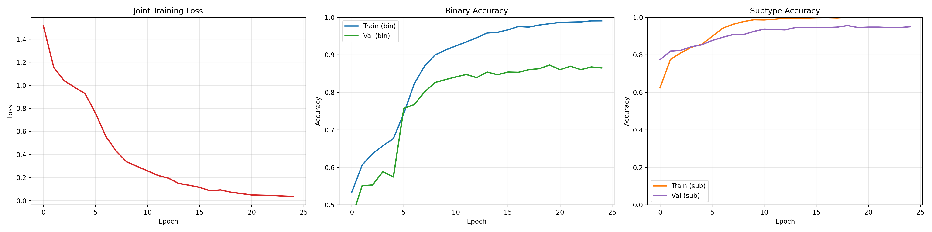
11
Training Results: Learning Curves
KEY OBSERVATIONS
▸ Loss drops sharply at epoch 5 (backbone unfreezing)
▸ Binary val accuracy plateaus at ~87.3%
▸ Subtype val accuracy reaches ~95.0%
▸ No significant overfitting (train/val gap is reasonable)
▸ Cosine LR annealing provides smooth convergence
▸ Model converges well within 25 epochs
Semiconductor Solutions Challenge 2026 | Problem A: Small Sample Defect Classification
12 / 15

Slide 13
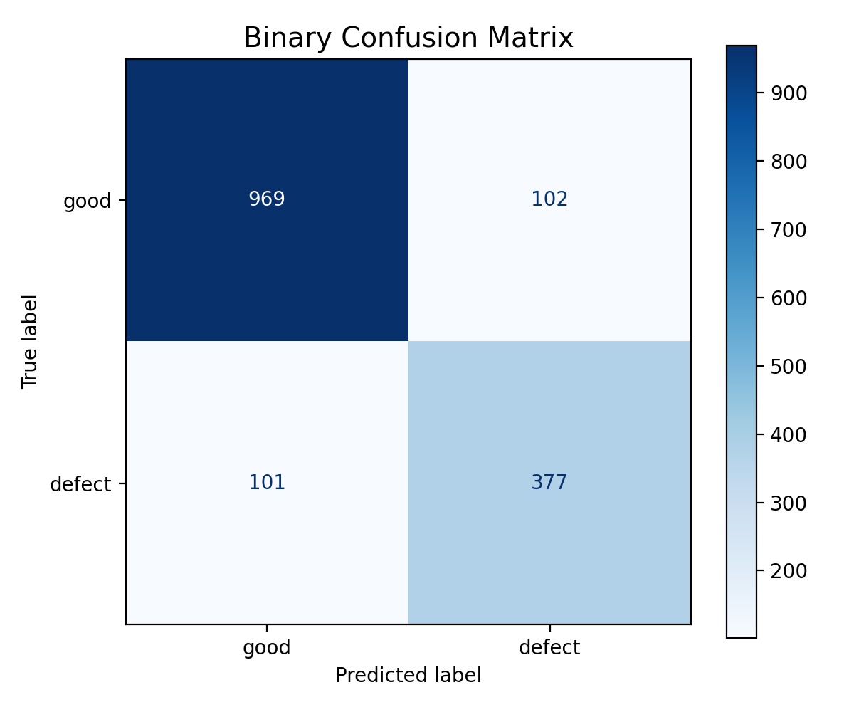
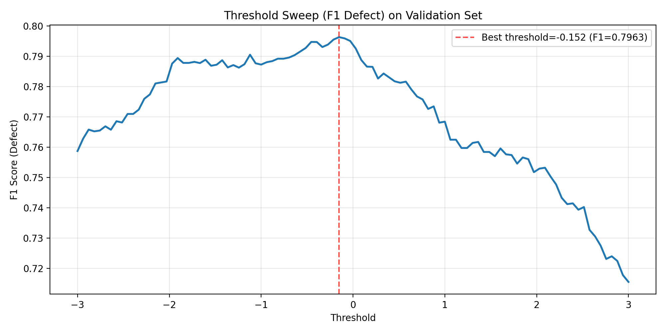
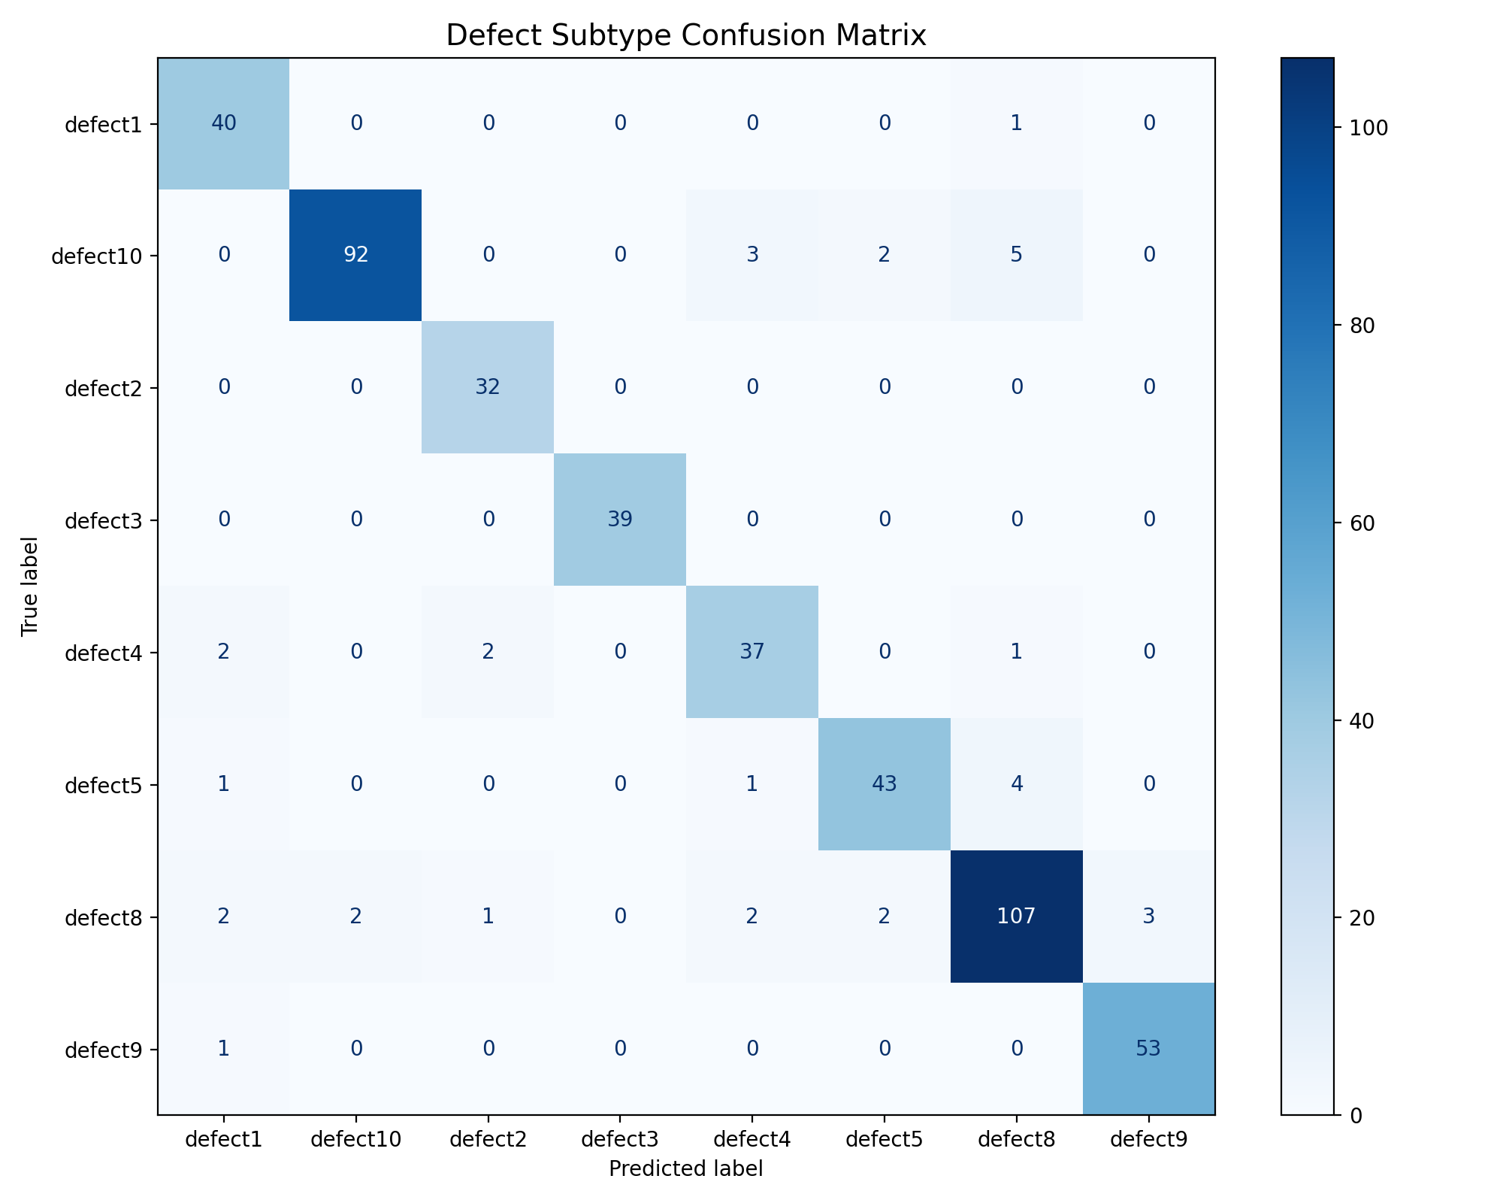
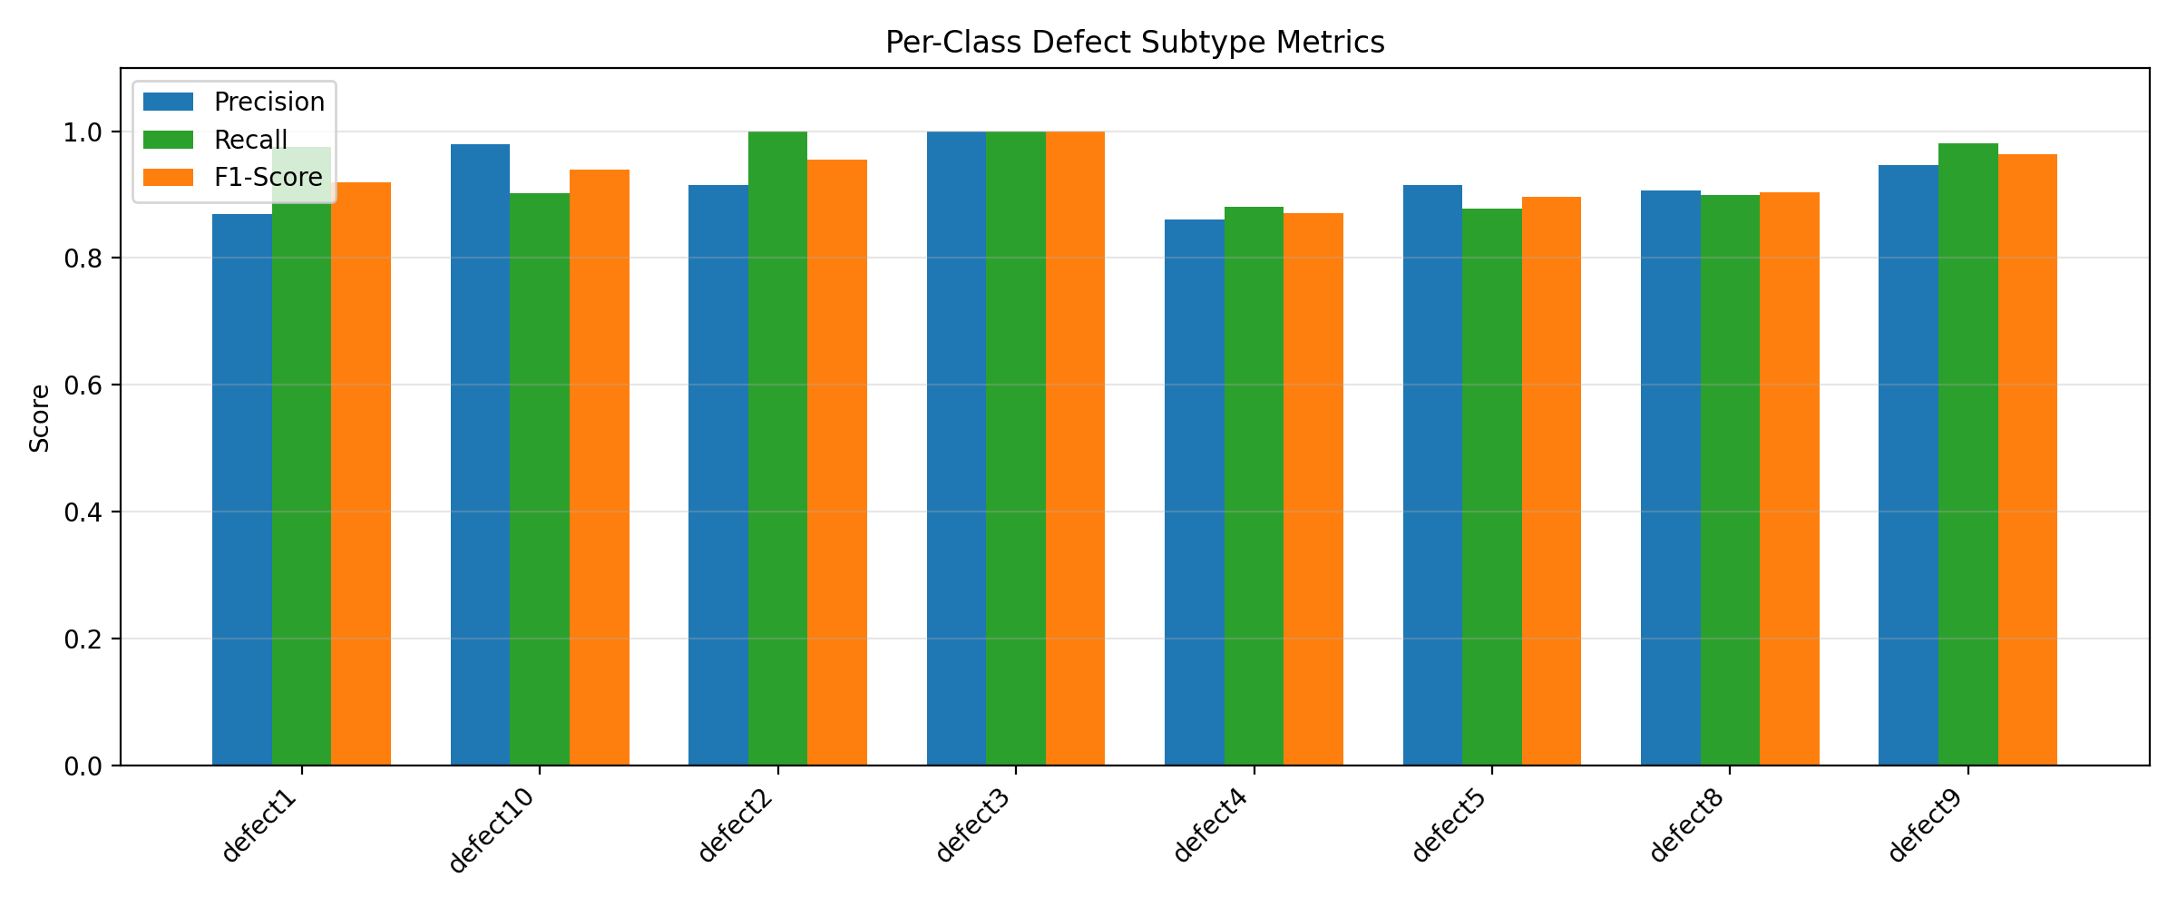
12
Stage Results: Binary Detection & Subtype Classification
69.1%
86.9%
+17.8pp
12.5%
92.7%
+80pp
Majority Baseline
Binary Test Acc
Binary Improve
Random Chance
Subtype Test Acc
Binary Confusion Matrix
Threshold Sweep (F1 optimized)
Subtype Confusion (8 defects)
Per-Class P / R / F1
Binary stage achieves 86.9% with +17.8pp over majority vote. Subtype stage achieves 92.7% across 8 defect types (vs 12.5% chance). But what is the TOTAL end-to-end accuracy when both stages run together on a random sample?
Semiconductor Solutions Challenge 2026 | Problem A: Small Sample Defect Classification
13 / 15

Slide 14
13
End-to-End 9-Class Accuracy: The Full Picture
Mathematical derivation of total accuracy for a random wafer image
TWO-STAGE INFERENCE PIPELINE
TOTAL END-TO-END ACCURACY
Stage 1 (Binary): image → good or defect? A_bin = 86.89% Stage 2 (Subtype): if defect → which of 8 types? A_sub = 92.68% A random sample is classified correctly when: (a) It is "good" AND Stage 1 says "good", OR (b) It is "defect" AND Stage 1 says "defect" AND Stage 2 gets the subtype right
~85.0%
9-class accuracy on any random wafer image
MATHEMATICAL DERIVATION
Let: π_g = P(sample is good) = 7135/9796 = 0.6912 π_d = P(sample is defect) = 2661/9796 = 0.3088 TNR = P(predict good | true good) [Stage 1] TPR = P(predict defect | true defect) [Stage 1] A_bin = overall binary accuracy = 0.8689 A_sub = subtype accuracy (on defects) = 0.9268 Identity: A_bin = π_g × TNR + π_d × TPR
END-TO-END FORMULA:
E2E = π_g × TNR + π_d × TPR × A_sub Substituting π_g × TNR = A_bin - π_d × TPR : E2E = A_bin − π_d × TPR × (1 − A_sub) = 0.8689 − 0.3088 × TPR × 0.0732 = 0.8689 − 0.0226 × TPR
Key insight: subtype error rate is only 7.3%, so the correction term (0.0226 × TPR) is tiny. Binary accuracy dominates the E2E result.
TPR ∈ [0.80, 0.90] ⇒ E2E ∈ [84.7%, 85.1%] ≈ 85%
Semiconductor Solutions Challenge 2026 | Problem A: Small Sample Defect Classification
14 / 15

Slide 15
14
Summary, Impact & Future Work
END-TO-END 9-CLASS ACCURACY
STAGE BREAKDOWN
~85%
▸ Stage 1 (Binary): 86.9% test acc (vs 69.1% majority baseline) +17.8pp
▸ Stage 2 (Subtype): 92.7% test acc (vs 12.5% random chance) +80.2pp
▸ Handles extreme imbalance: defect3 (9 samples) & defect4 (14 samples)
▸ Single model, single forward pass, both tasks in one inference call
Meets Intel's 85% target = A_bin - 0.0226 x TPR
KEY INNOVATIONS (6 decisions)
FUTURE WORK & SCALABILITY
▸ Sobel edge channels: principled 3-ch encoding for grayscale
▸ Multi-task architecture: joint binary + subtype learning
▸ Dual augmentation: patch amplification + procedural speckle gen
▸ 3-phase training: freeze → fine-tune → hard negative mining
▸ Weighted losses + sampler to fight 793:1 class imbalance
▸ TTA + threshold sweep for production-ready inference
▸ Ensemble with EfficientNet/ViT for further gains
▸ Active learning: flag uncertain samples for human review
▸ ONNX / Intel OpenVINO export for fab edge deployment
▸ Continual learning as new defect types emerge
▸ Grad-CAM visualization for defect localization
▸ Scale to full-resolution via tiled inference
Semiconductor Solutions Challenge 2026 | Problem A: Small Sample Defect Classification
15 / 15

