Slide 1


Slide 2
Blockchain Network Attacks
A blockchain network includes nodes that create and run transactions and provide other services. For instance, the Bitcoin network is formed by nodes that send and receive transactions and miners that add approved transactions to blocks. Cybercriminals look for network vulnerabilities and exploit them with the following types of attacks.

Slide 3
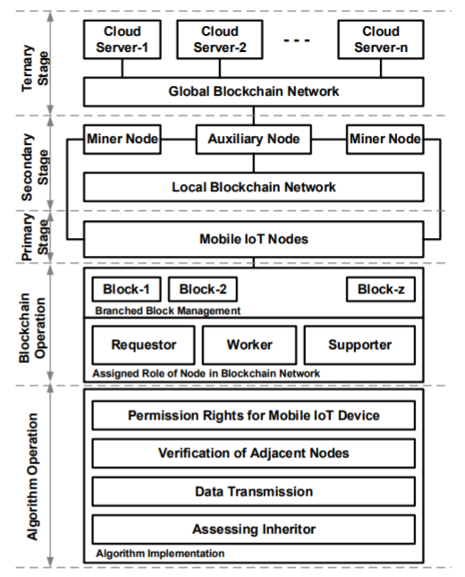

Slide 4
Distributed Denial of Service
Distributed denial of service (DDoS) attacks are hard to execute on a blockchain network, but they’re possible.
When attacking a blockchain network using DDoS, hackers intend to bring down a server by consuming all its processing resources with numerous requests. DDoS attackers aim to disconnect a network’s mining pools, e-wallets, crypto exchanges, and other financial services. A blockchain can also be hacked with DDoS at its application layer using DDoS botnets.
In 2017, Bitfinex suffered from a massive DDoS attack. It was especially inconvenient for the IOTA Foundation, which had launched their IOTA token on the platform the day before Bitfinex informed users about the attack. Three years later, in February 2020, Bitfinex experienced another DDoS attack just a day after the OKEx cryptocurrency exchange noticed a similar attack.

Slide 5
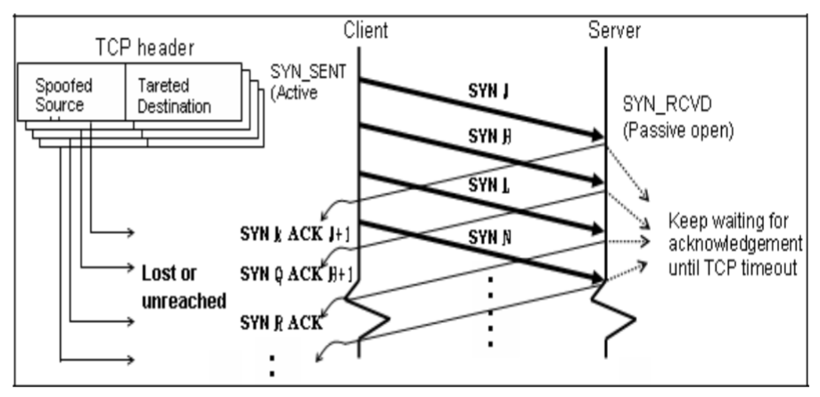

Slide 6
Transaction Malleability Attacks
A transaction malleability attack is intended to trick the victim into paying twice. In the Bitcoin network, every transaction has a hash that’s a transaction ID. If attackers manage to alter a transaction’s ID, they can try to broadcast the transaction with a changed hash to the network and have it confirmed before the original transaction. If this succeeds, the sender will believe the initial transaction has failed, while the funds will still be withdrawn from the sender’s account. And if the sender repeats the transaction, the same amount will be debited twice. This hack is successful once the two transactions are confirmed by miners.
Mt. Gox, a Bitcoin exchange, went bankrupt as the result of a malleability attack in 2014. However, Bitcoin seems to have solved this issue by introducing the Segregated Witness (SegWit) process, which separates signature data from Bitcoin transactions and replaces it with a non-malleable hash commitment to each signature.

Slide 7
Timejacking Attack
Timejacking exploits a theoretical vulnerability in Bitcoin timestamp handling. During a timejacking attack, a hacker alters the network time counter of the node and forces the node to accept an alternative blockchain. This can be achieved when a malicious user adds multiple fake peers to the network with inaccurate timestamps. However, a timejacking attack can be prevented by restricting acceptance time ranges or using the node’s system time.
The timejacking attack is also an extension of the Sybil attack. Each node maintains a time counter which is based on the median time of its peers, and if the median time differs from the system time by a certain value, then the node reverts to the system time. An attacker can flood the network with nodes reporting inaccurate timestamps, which can cause the network to slow down or speed up, leading to a desynchronization.

Slide 8
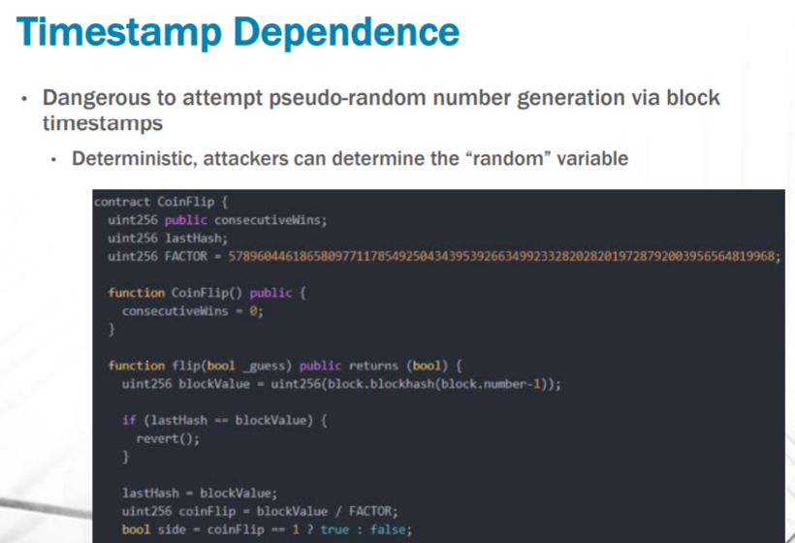

Slide 9
Routing Attacks on Cryptocurrencies
A routing attack can impact both individual nodes and the whole network. The idea of this hack is to tamper with transactions before pushing them to peers. It’s nearly impossible for other nodes to detect this tampering, as the hacker divides the network into partitions that are unable to communicate with each other. Routing attacks actually consist of two separate attacks:
A partition attack, which divides the network nodes into separate groups
A delay attack, which tampers with propagating messages and sends them to the network

Slide 10
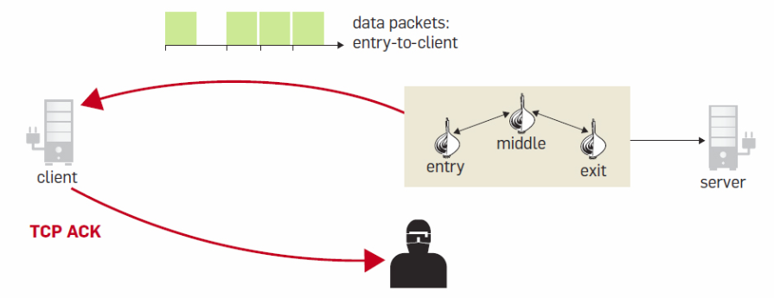

Slide 11
Eclipse Attacks on Ethereum
In this technical report, we present three vulnerabilities affecting the Ethereum blockchain network and client. First, we outline an eclipse attack that allows an adversary to partition the peer-to-peer network without monopolizing the connections of the victim. This is attack is possible by exploiting the block propagation design of Ethereum. Second, we present an exploit to force a node to accept a longer chain with lower total difficulty than the main chain. Finally, we outline a bug in Ethereum’s difficulty calculation. We provide countermeasure proposals for each reported vulnerability

Slide 12
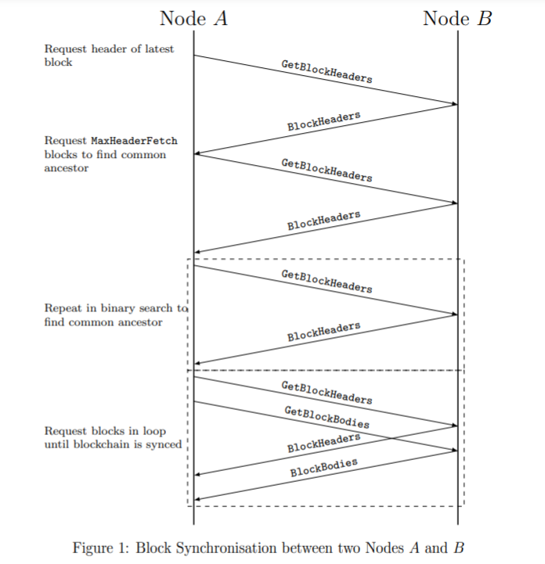

Slide 13
Flawed Key Generation
Exploiting vulnerabilities in key generation, the hacker known as Johoe got access to private keys provided by Blockchain.info in December 2014. The attack happened as the result of a mistake that appeared during a code update that resulted in poor randomness of inputs for generating public user keys. Though this vulnerability was quickly mitigated, the flaw is still possible with the ECDSA algorithm.

Slide 14
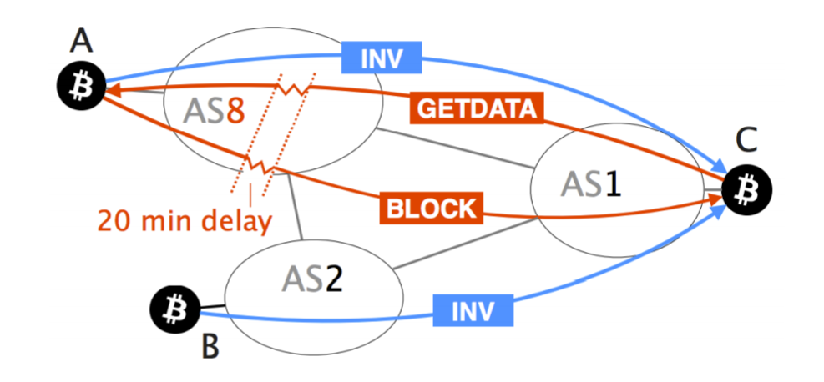

Slide 15
Name: Dheeraj Kumar
Branch: CSBS
Roll no.: 42
Session: 2020-2024
Enrollment no.: 12020002018049

