Slide 1

Finding People At Risk
Clustering Can Help People!

Slide 2

Siege Analytics
Siege /siːdʒ/ v.
To blockade a city or fortress
with intent to conquer by attrition
or a well-prepared assault.

Slide 3
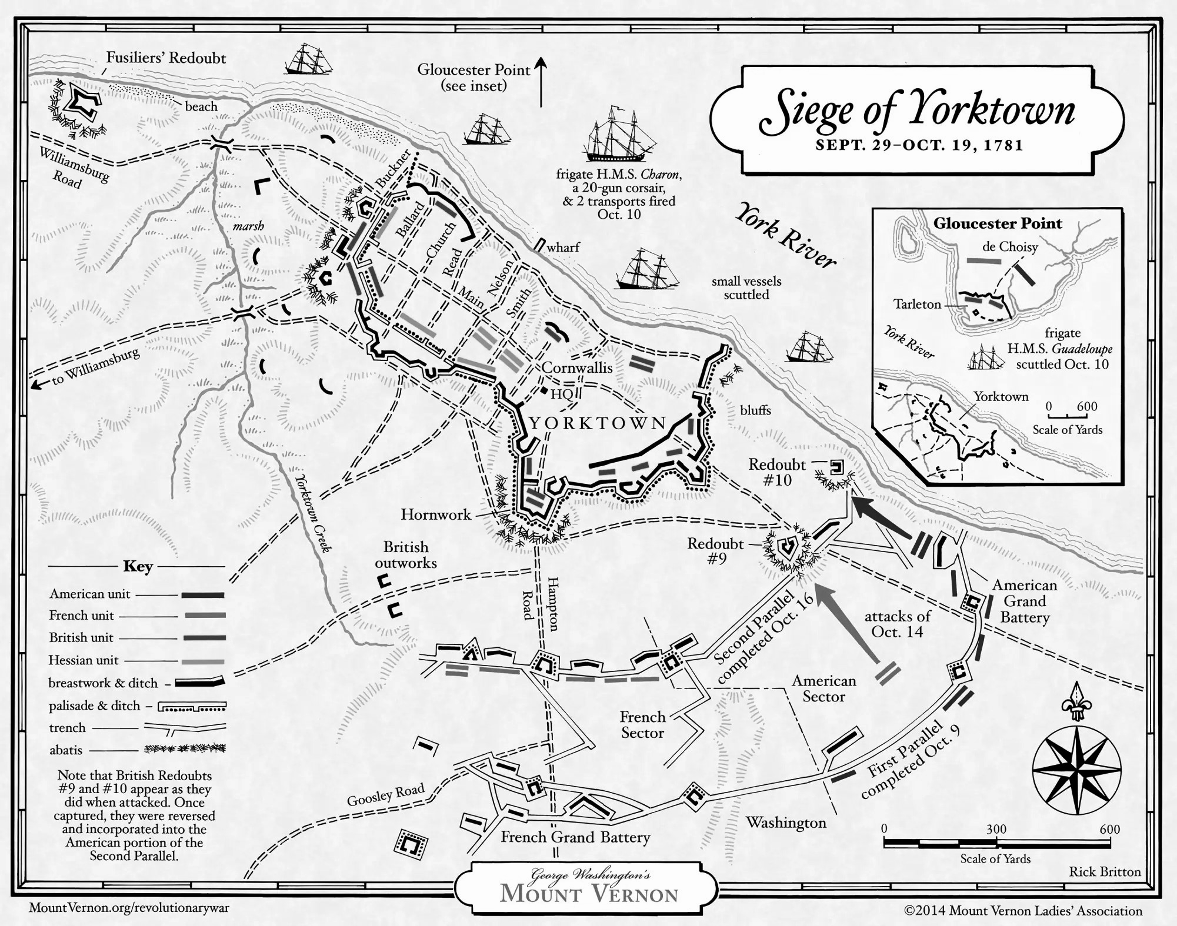
Map It Out: People Live In Places
Maps are not “neat”, they are necessary tools. People live in places. Maps show us those places and let us understand them as places.

Slide 4
So what is a cluster?
A cluster is a subset of a set of observations that have something in common.
Put another way, a cluster is the groups in your data that are more similar to each other than all others with respect to some things.
Made even more simple, clusters are things that are more alike than not, natural organisations of things.

Slide 5

Thanks to New Virginia Majority for Participating
All data are courtesy of New Virgina Majority.
Most code and data available on GitHub (Need Final Permission).

Slide 6
Let’s Cluster Up At Risk People
Data & Tools
Standard NGPVAN export
Geographical information
Demographic information
PostGIS for computation
QuantumGIS (QGIS) for maps
Targets
For demonstration purposes, this is generic
Targets
Black people
Over fifty
Addresses within 20m of each other
Obviously, you can add whatever information you want to to make this specific to your needs

Slide 7
Clustering Parameters: What do we need to know?
How close to each other?
This is the spatial parameter
How close do things have to be to each other to be counted?
If something is too close, we may not want it.
If something is too far, we may not want it.
We use 20m.
How many cases?
What is the number of cases that we need to constitute a subset?
Too few could just be noise.
Picking this is tough.
For this demo, we say 5.

Slide 8
Let’s look at the maps!
Words are not helpful here.
But.Maps. Are.

Slide 9
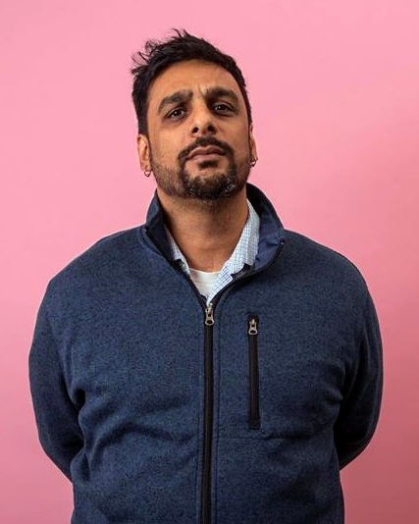
The Team
Dheeraj was born in Queens, New York, and grew up traveling all over Asia. Traveling made him question the relationships between boundaries, physical geography, culture, and ethnic identity, all relevant to his work in political analytics and spatial analysis. Prior to Siege, he worked for polling firms, labor unions, and CRM software manufacturers, and also spent two years in humanitarian technology.
In his spare time, Dheeraj avidly studies Ving Tsun Kung Fu, plays his guitar, and spends time with his family.
DHEERAJ
CHAND
Partner

Slide 10
Thanks for your time!
30.2672° N, 97.7431° W
dheeraj@siegeanalytics.com

