Slide 1
Predictive Maintenance for NASA Turbofan Jet Engines
Introduction to Data Science EN.553.636
Team Members:
Aswath Sivakumar
Dheeraj Dhanvee Kairamkonda
Priyanka Kotha
Krishnan Venkataraman

Slide 2
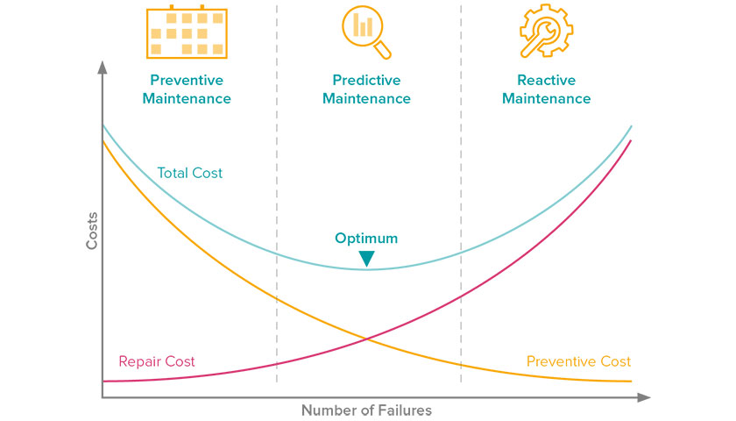

What is Predictive Maintenance?
Data-driven, proactive methods – Designed to analyse condition of Machines/Equipments
Predict – ‘when maintenance should be performed’ – so that it is
optimum
Predict possible failure before they occur
Goal of our Project
Provide predictive maintenance-based solutions for NASA turbofan jet engines
We have taken 4 problem statements – Analysed them and tried to provide solutions for the same
Figure referenced from [4]

Slide 3
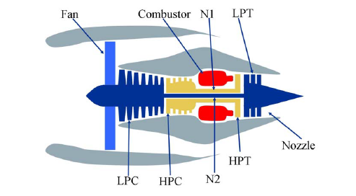
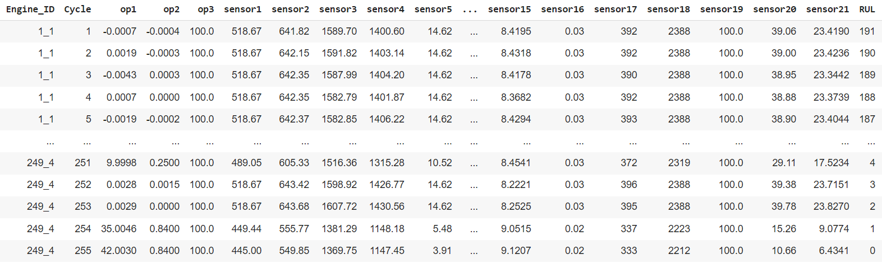
Dataset
NASA Turbo fan Jet engine degradation dataset
4 different sets generated over 100 different jet engines under different combinations of operational conditions and fault modes
In all the four datasets – Jet engines are run till end of life. ‘N’ number of cycles unique for each jet engine depending on its wear and tear from starting
Figure showing simplified NASA turbofan jet engine - referenced from [3]
Concatenated Main dataset contains:
27 Columns – Engine ID, Cycle number, Operation settings 1-3,
sensor measurements 1-21 , RUL(Remaining Useful Life) –
Number of cycles remaining till failure from this current cycle
160,359 Rows - Number of records
Snippet of Main Data frame

Slide 4
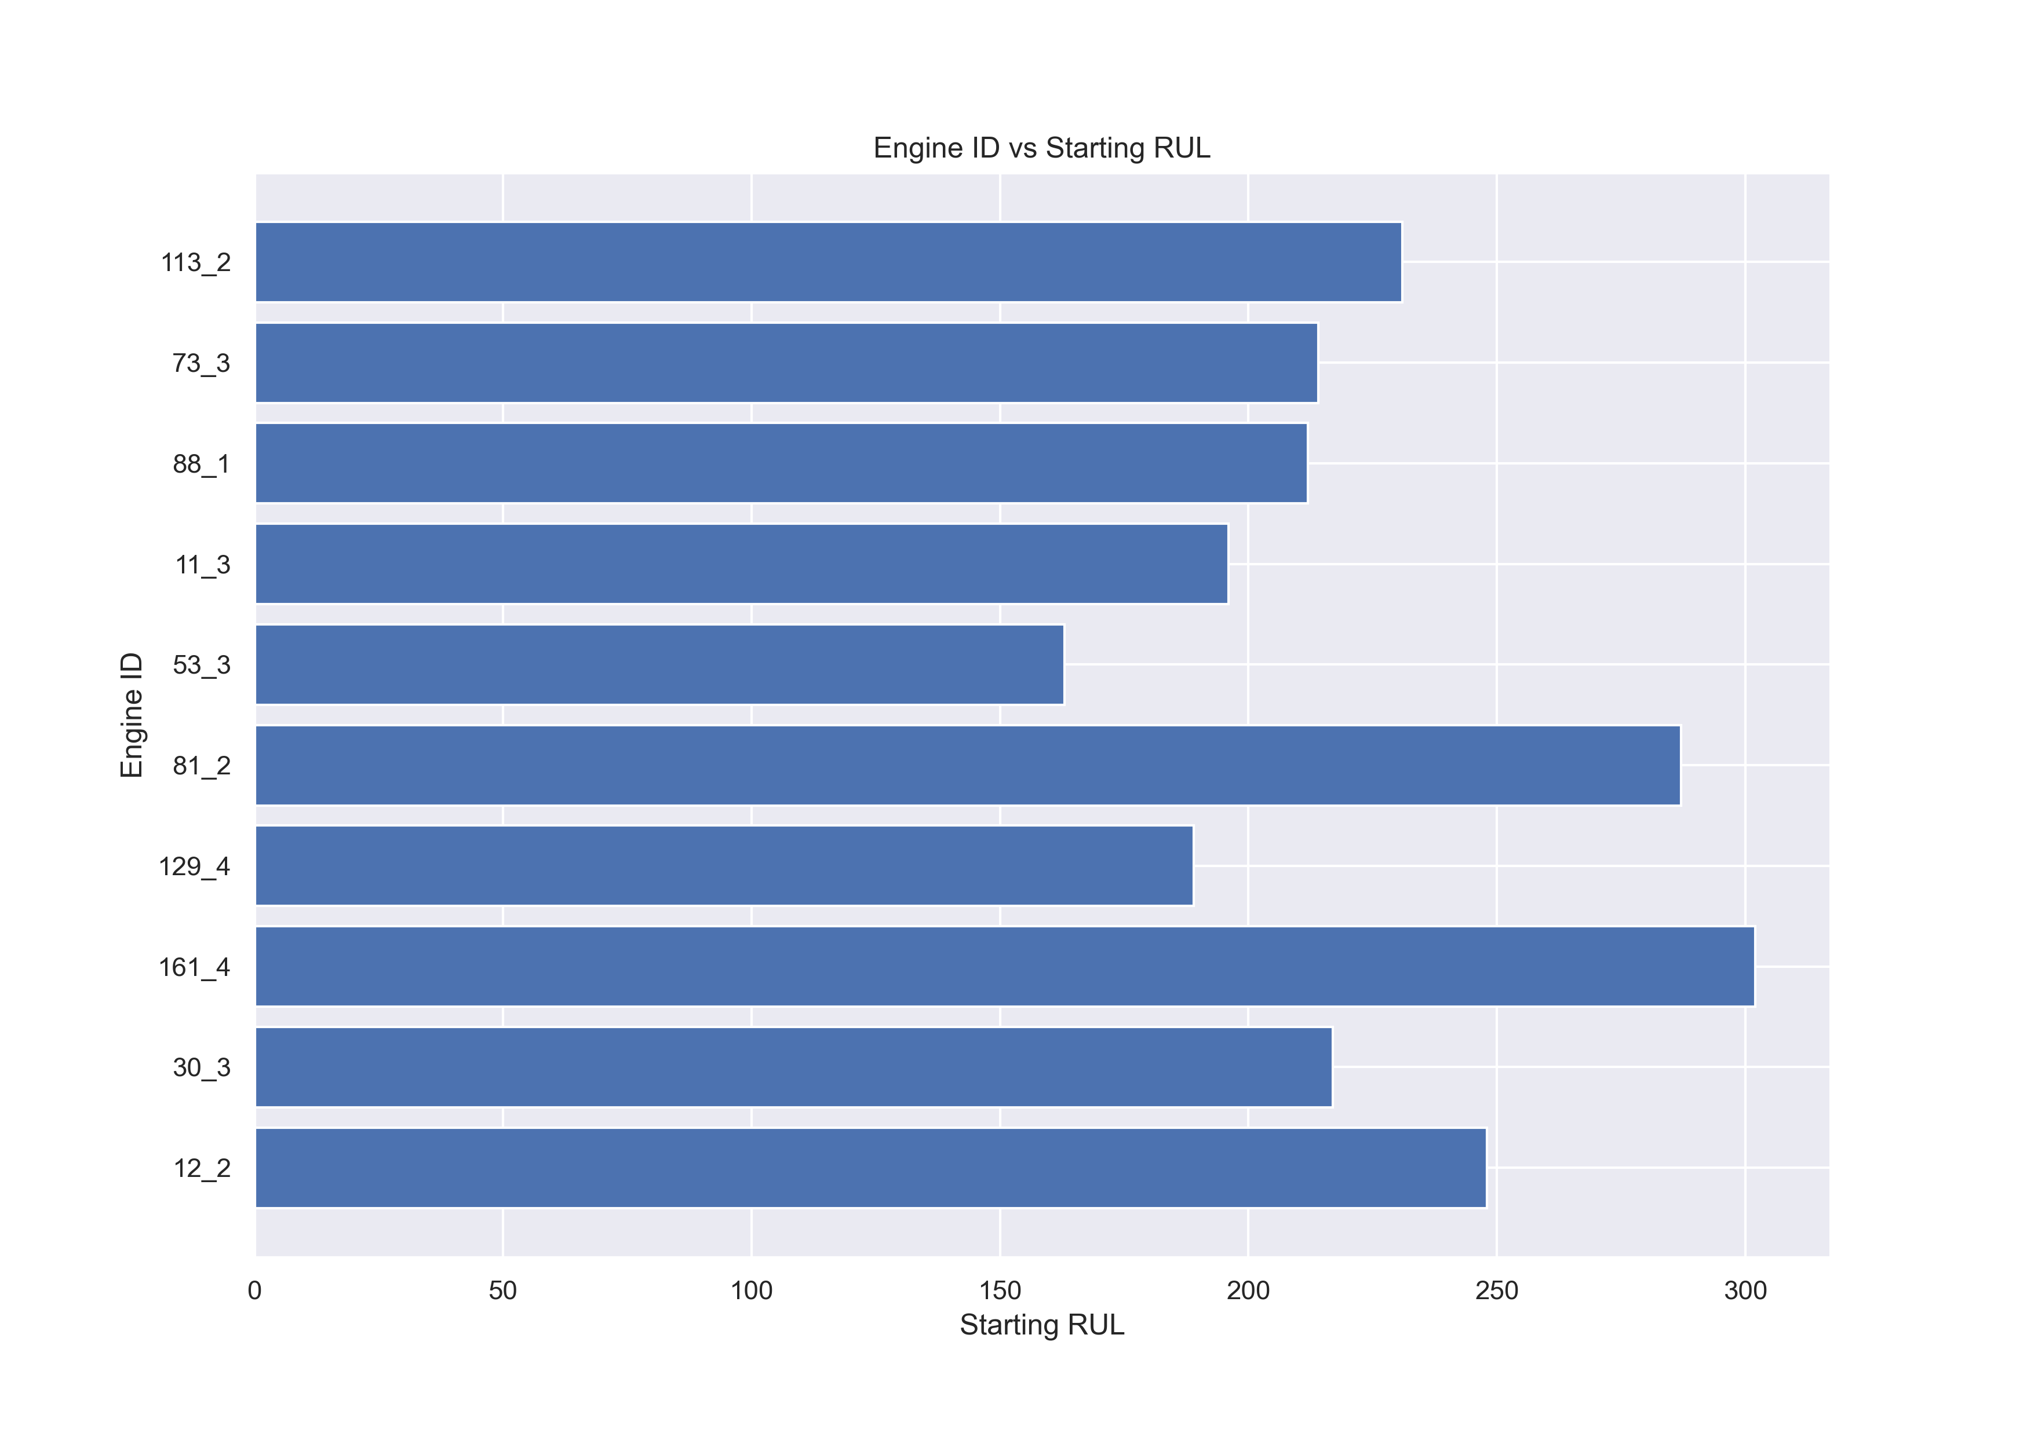
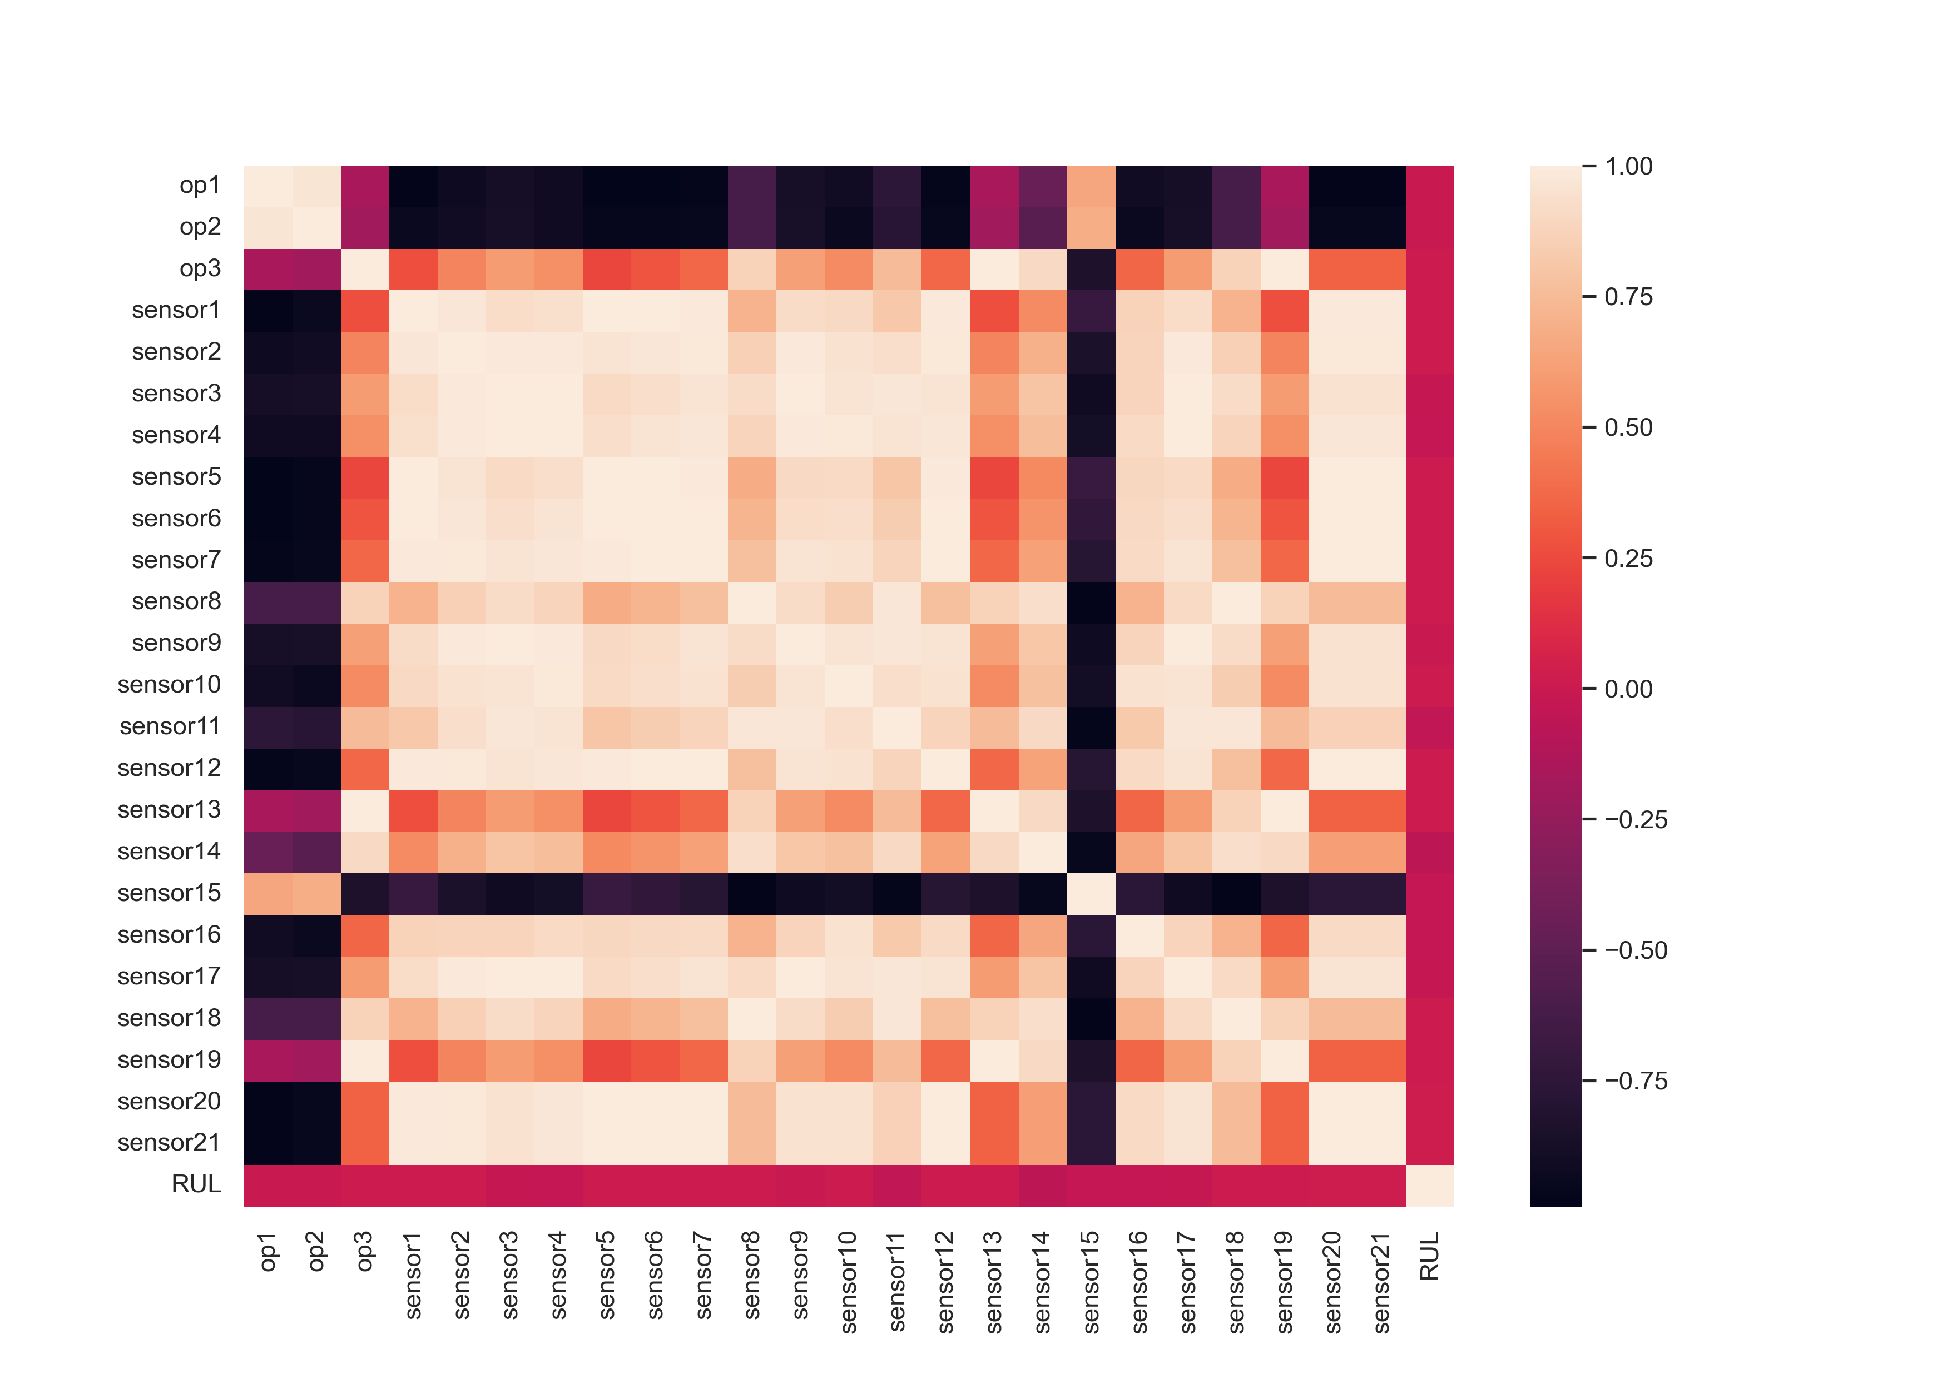
Dataset – Preliminary Analysis
Analysed the mean,sd,min,max values for each column
Analysed the correlation between each columns with one another
Analysed how the starting RUL is varying between each engines

Slide 5
Problem 1
Given the sensor values and the operation parameters of an engine at a point in time,
Can we predict the Remaining useful life (RUL) ?
Proposed Solution
Regression Problem 1 – Overall Approach
Cleaning and structuring the features and doing train-test split
Building regression models and optimising them
Linear regression
Random Forest based regression
Bayesian regression
Comparing the models and evaluating the test results – RMSE score
Visualising the results

Slide 6
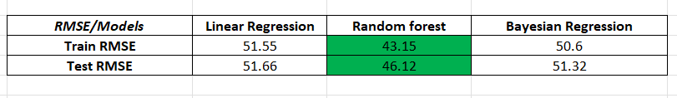
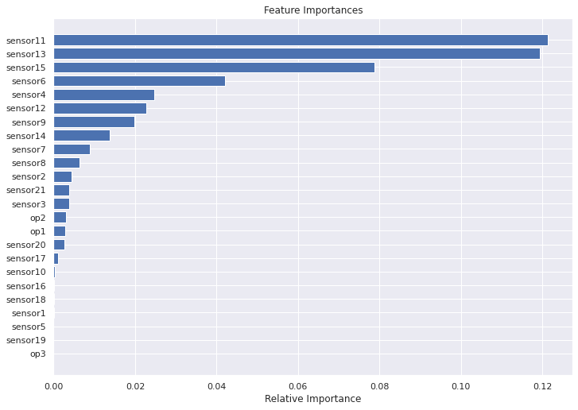
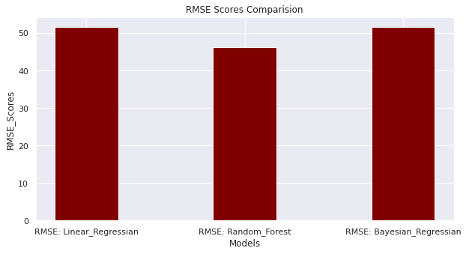
Evaluation And Analysis

Slide 7
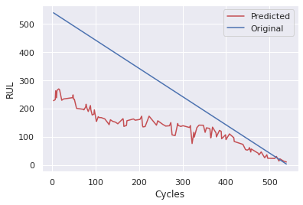
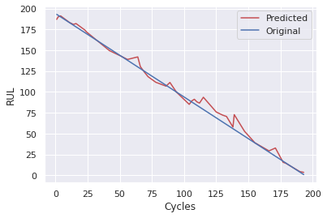
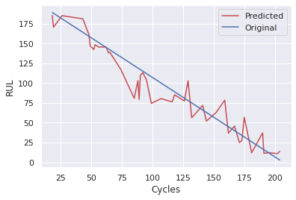
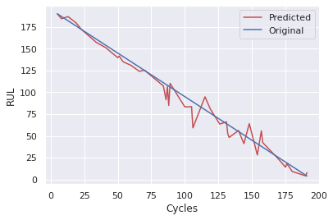
Visual Results
Engine in test set for which model performed worst
Engine in test set for which model performed best
Random Engine from test set
Random Engine from test set

Slide 8
Problem 2
Instead of predicting the RUL, Can we predict the percentage Health left?
Intuition behind the Idea:
Since each engine is different (could be different versions, different manufacturers for the parts) , if we could predict health – then that health would be more personalised to that engine
“Engine 1” – 10% health could 100 cycles | “Engine 2” – 10 % health could be 50 cycles
This would gives us more control outside the model . Something like introducing a calibration factor based on engine make or versions.
Proposed Solution
Regression Problem 2 – Overall Approach
Creating a health% label based on RUL and total life of engine at each cycle
Cleaning and structuring the features – doing train-test split
Building regression models – optimising and evaluate them
Linear regression
Random Forest based regression
Bayesian regression

Slide 9

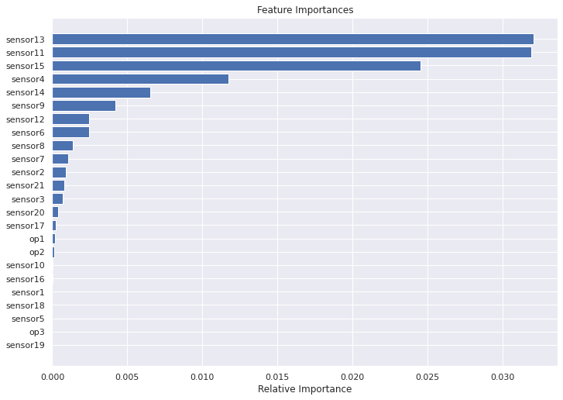
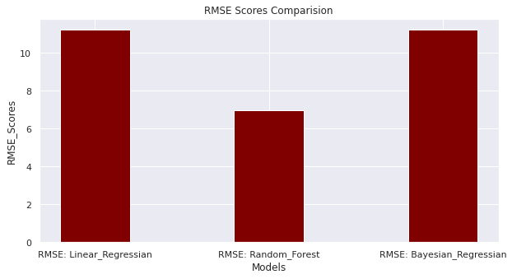
Evaluation And Analysis

Slide 10
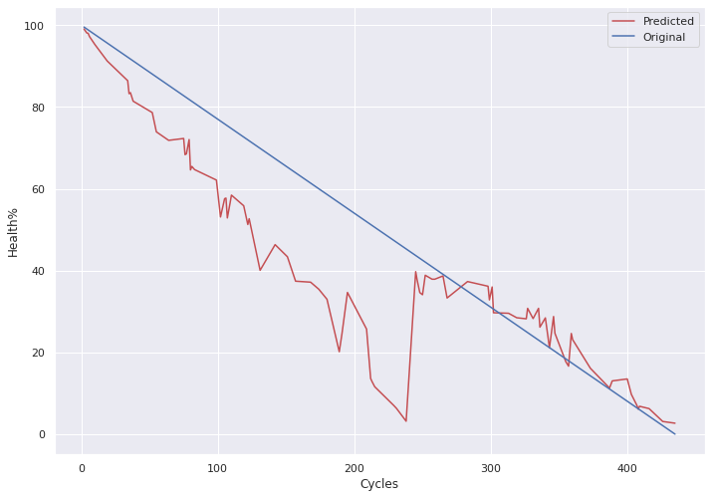
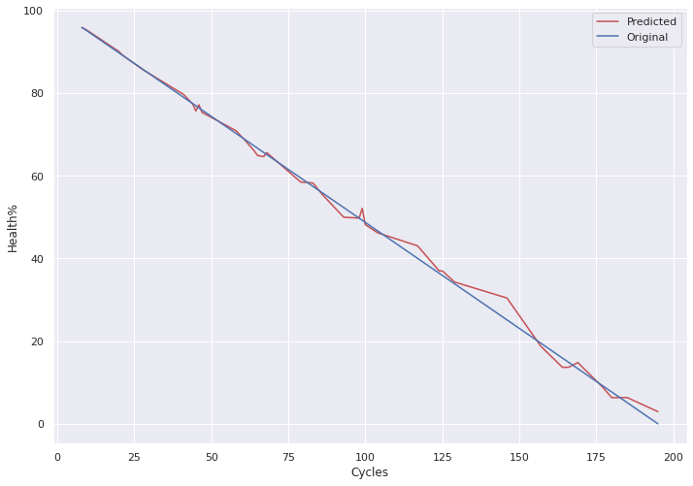
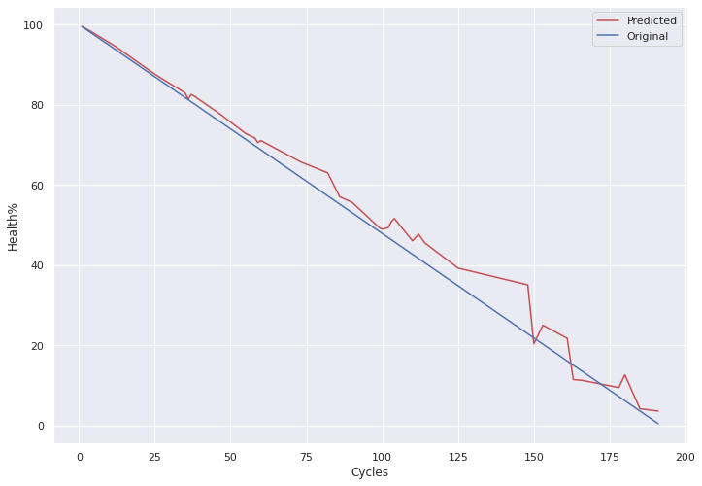
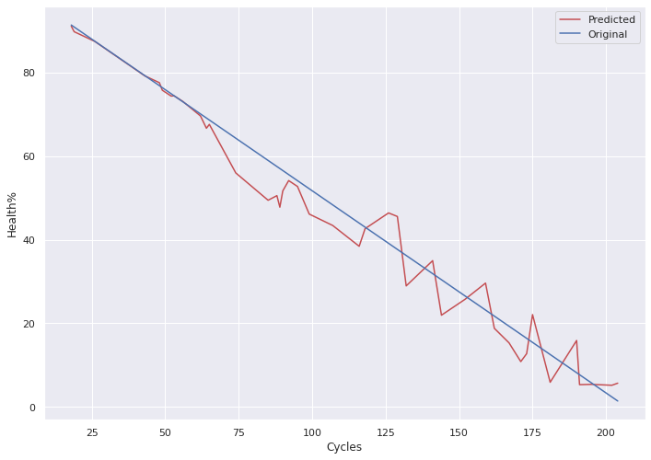
Visual Results
Engine in test set for which model performed worst
Engine in test set for which model performed best
Random Engine from test set
Random Engine from test set

Slide 11
Problem 3
Can we predict the Status of Engine at any point?
Provide an Alarm based system – Normal , Warning , Critical
Proposed Solution
Classification Problem – Overall Approach
Creating working, warning and critical labels using health%
Cleaning and structuring the features – doing train-test split
Building and optimising classification models
Random forest
KNN
SVM
Evaluating and comparing models

Slide 12
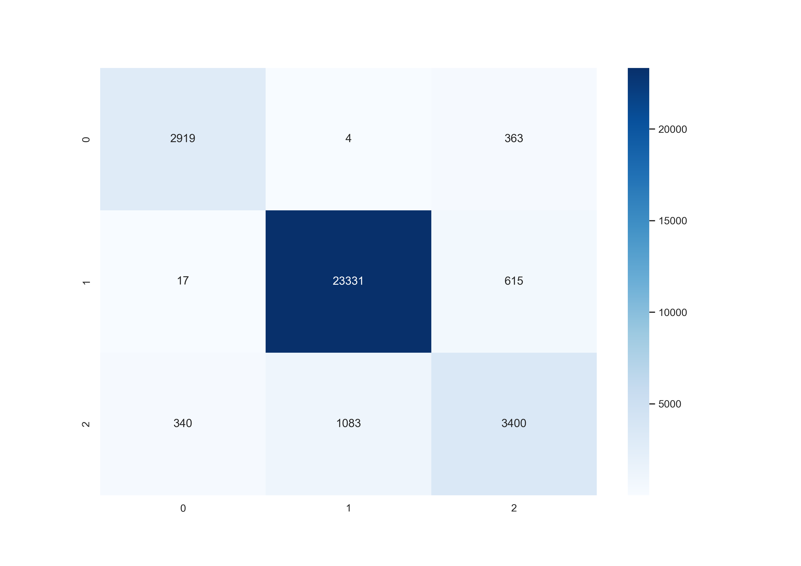
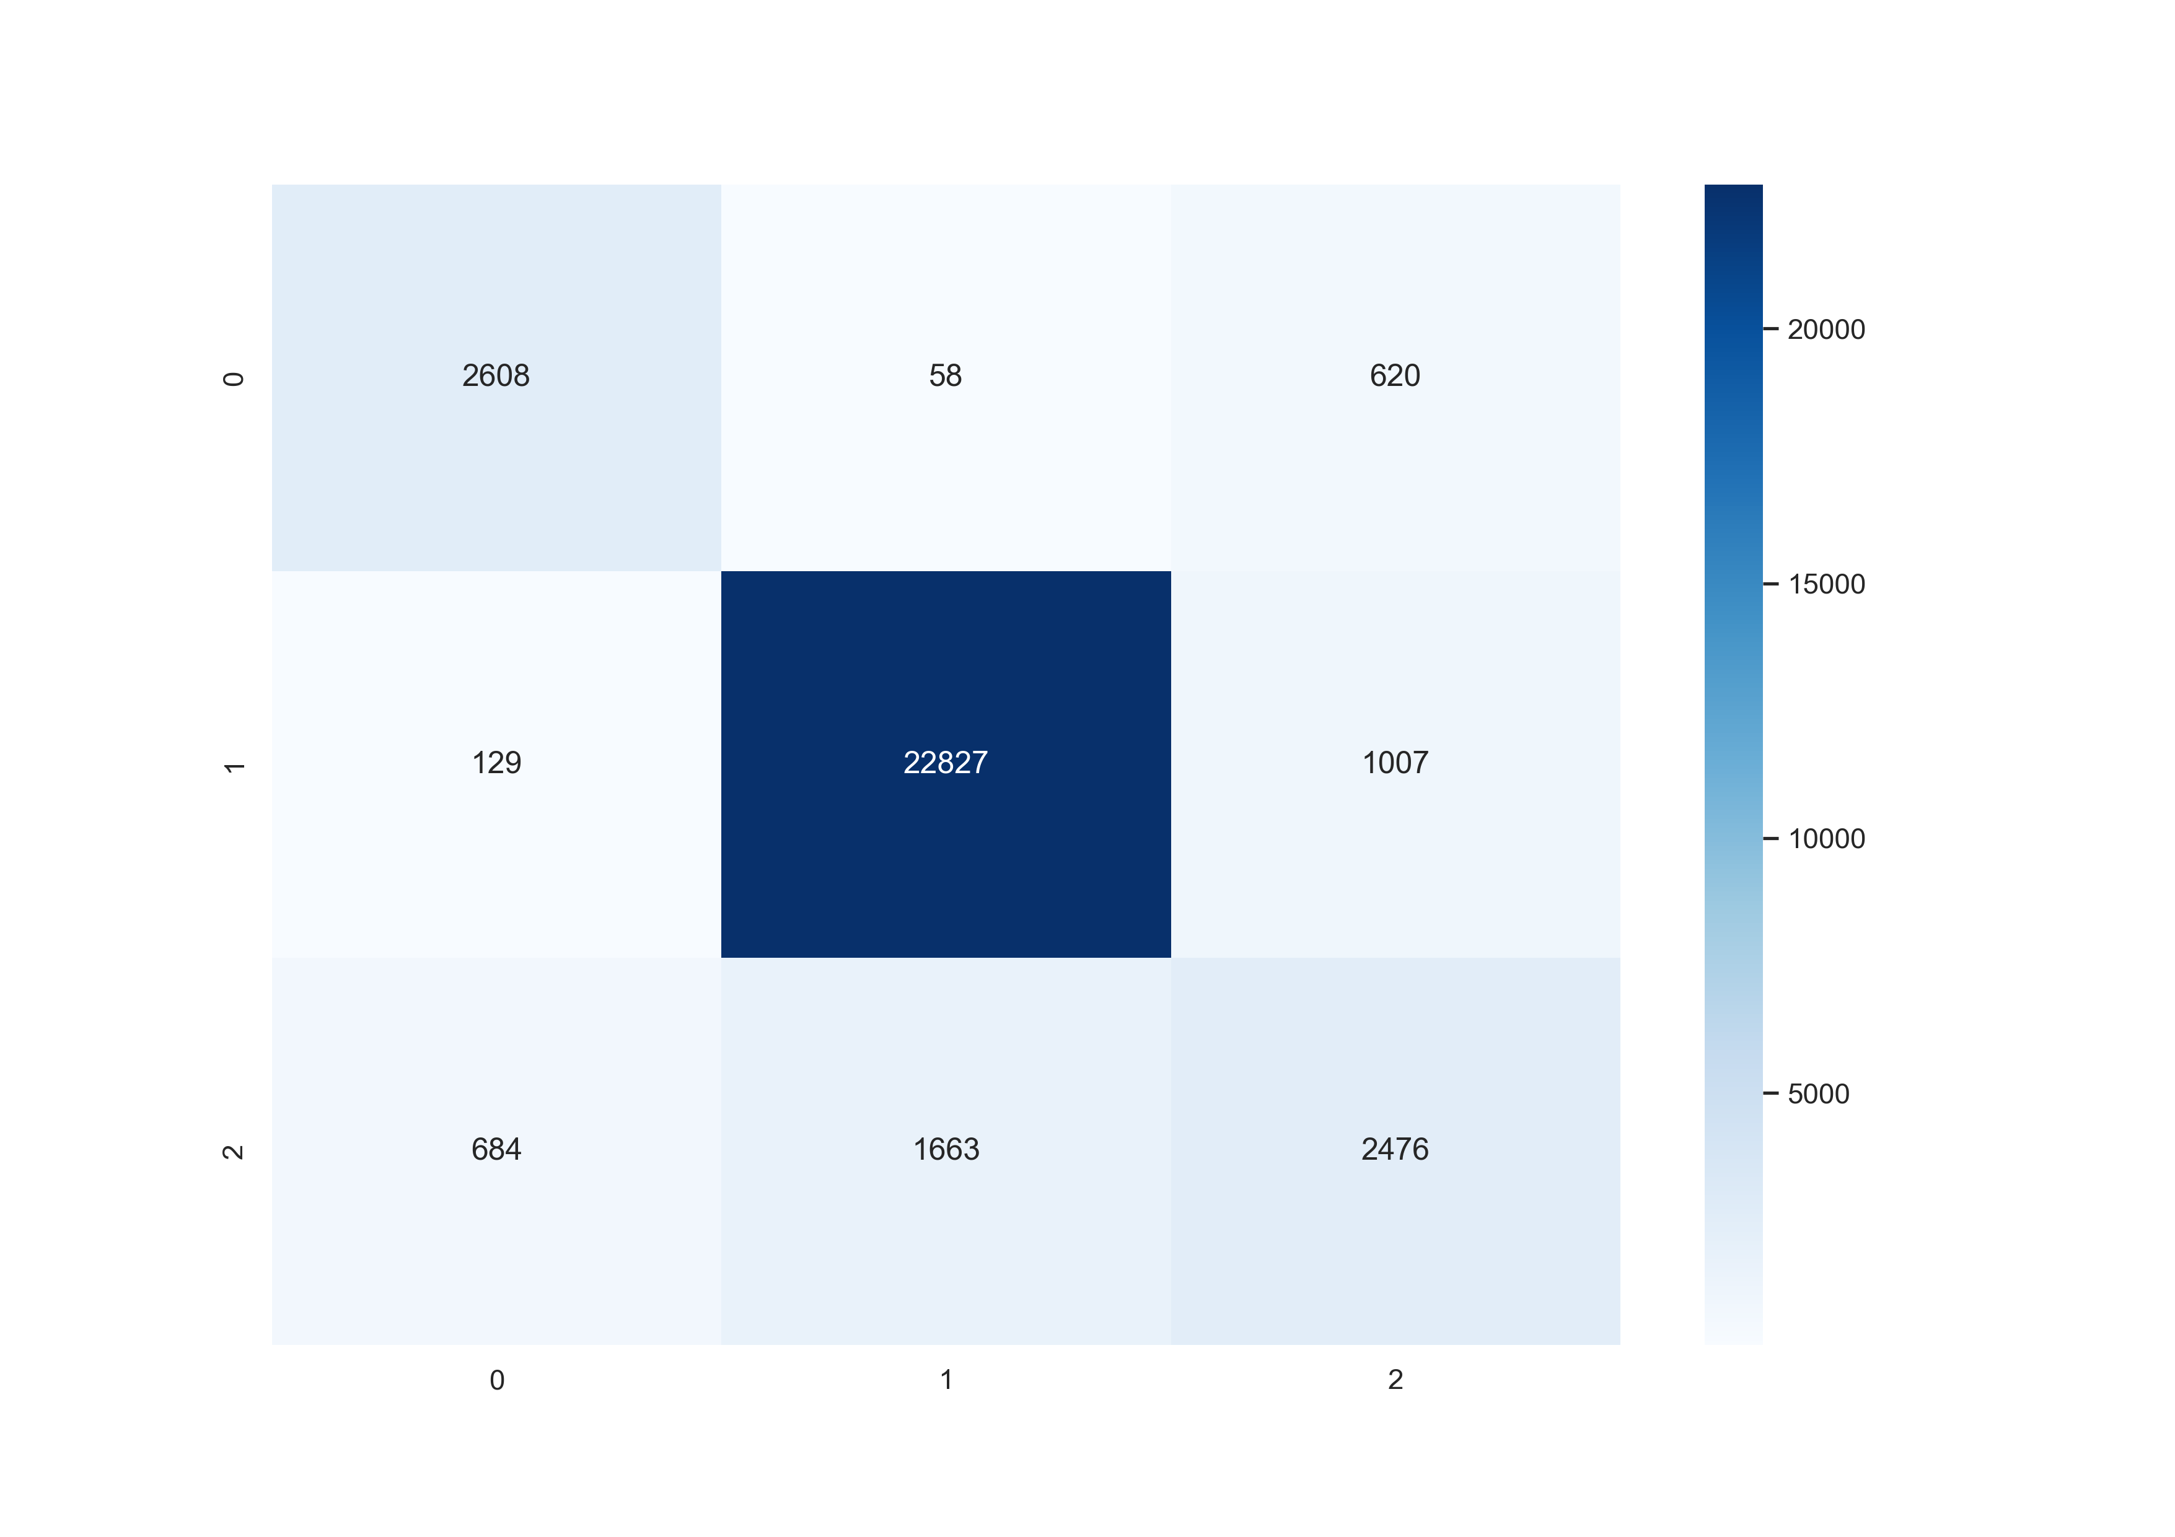
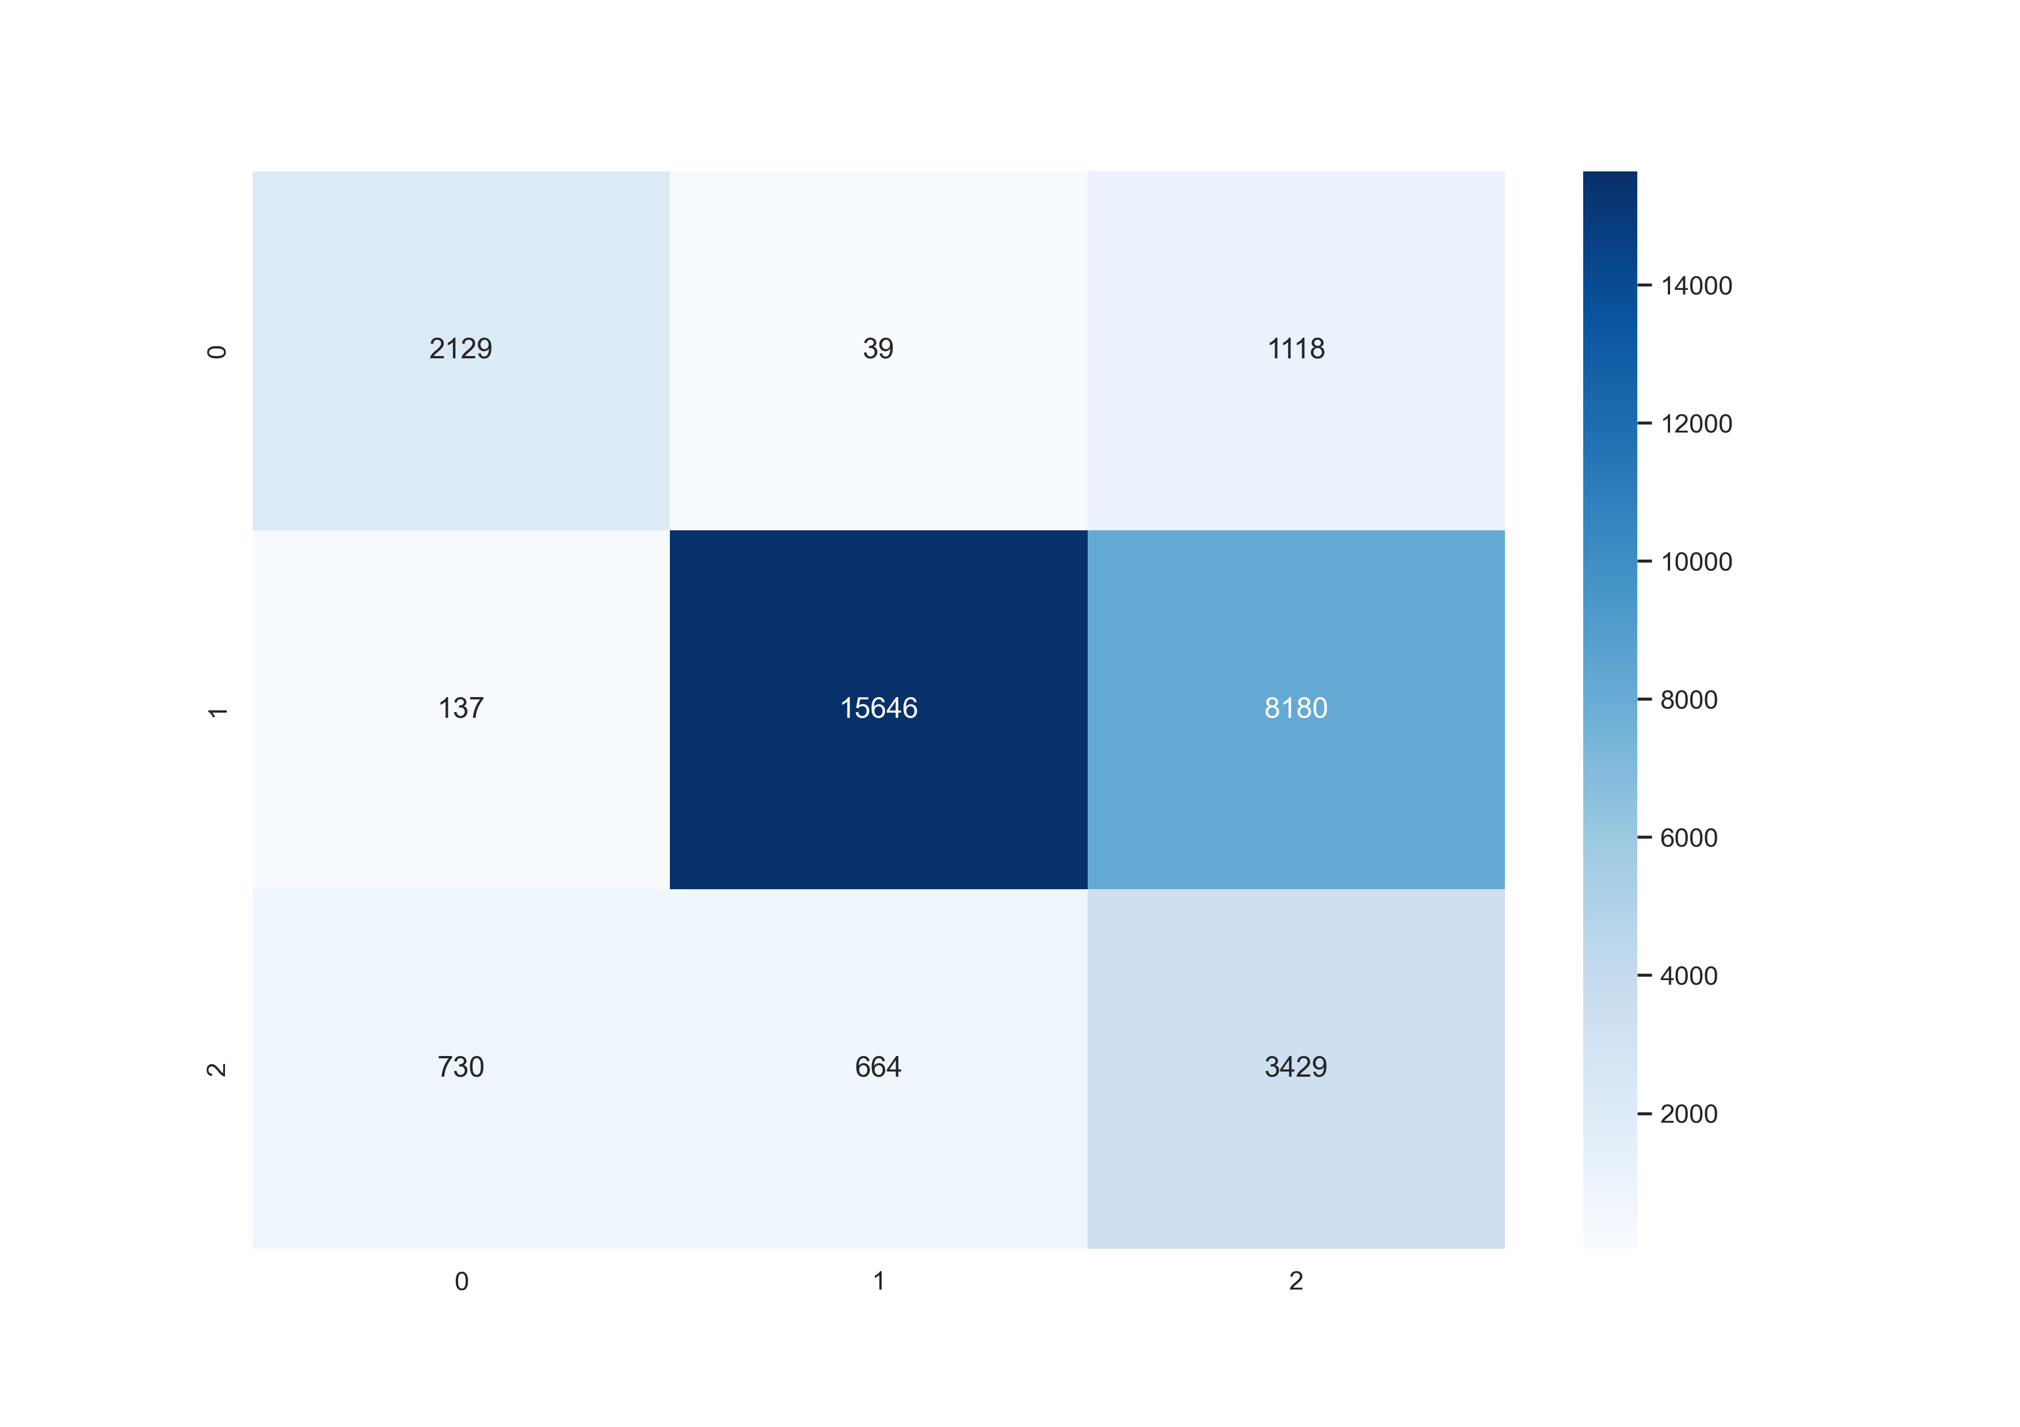
Evaluation
Random Forest Model - CF
KNN Model - CF
SVM Model - CF
From the CFs we see that accuracy: RF =92.44% | KNN = 87.02% | SVM =66.11%
0 - Critical
1 - Normal
2 - Warning

Slide 13
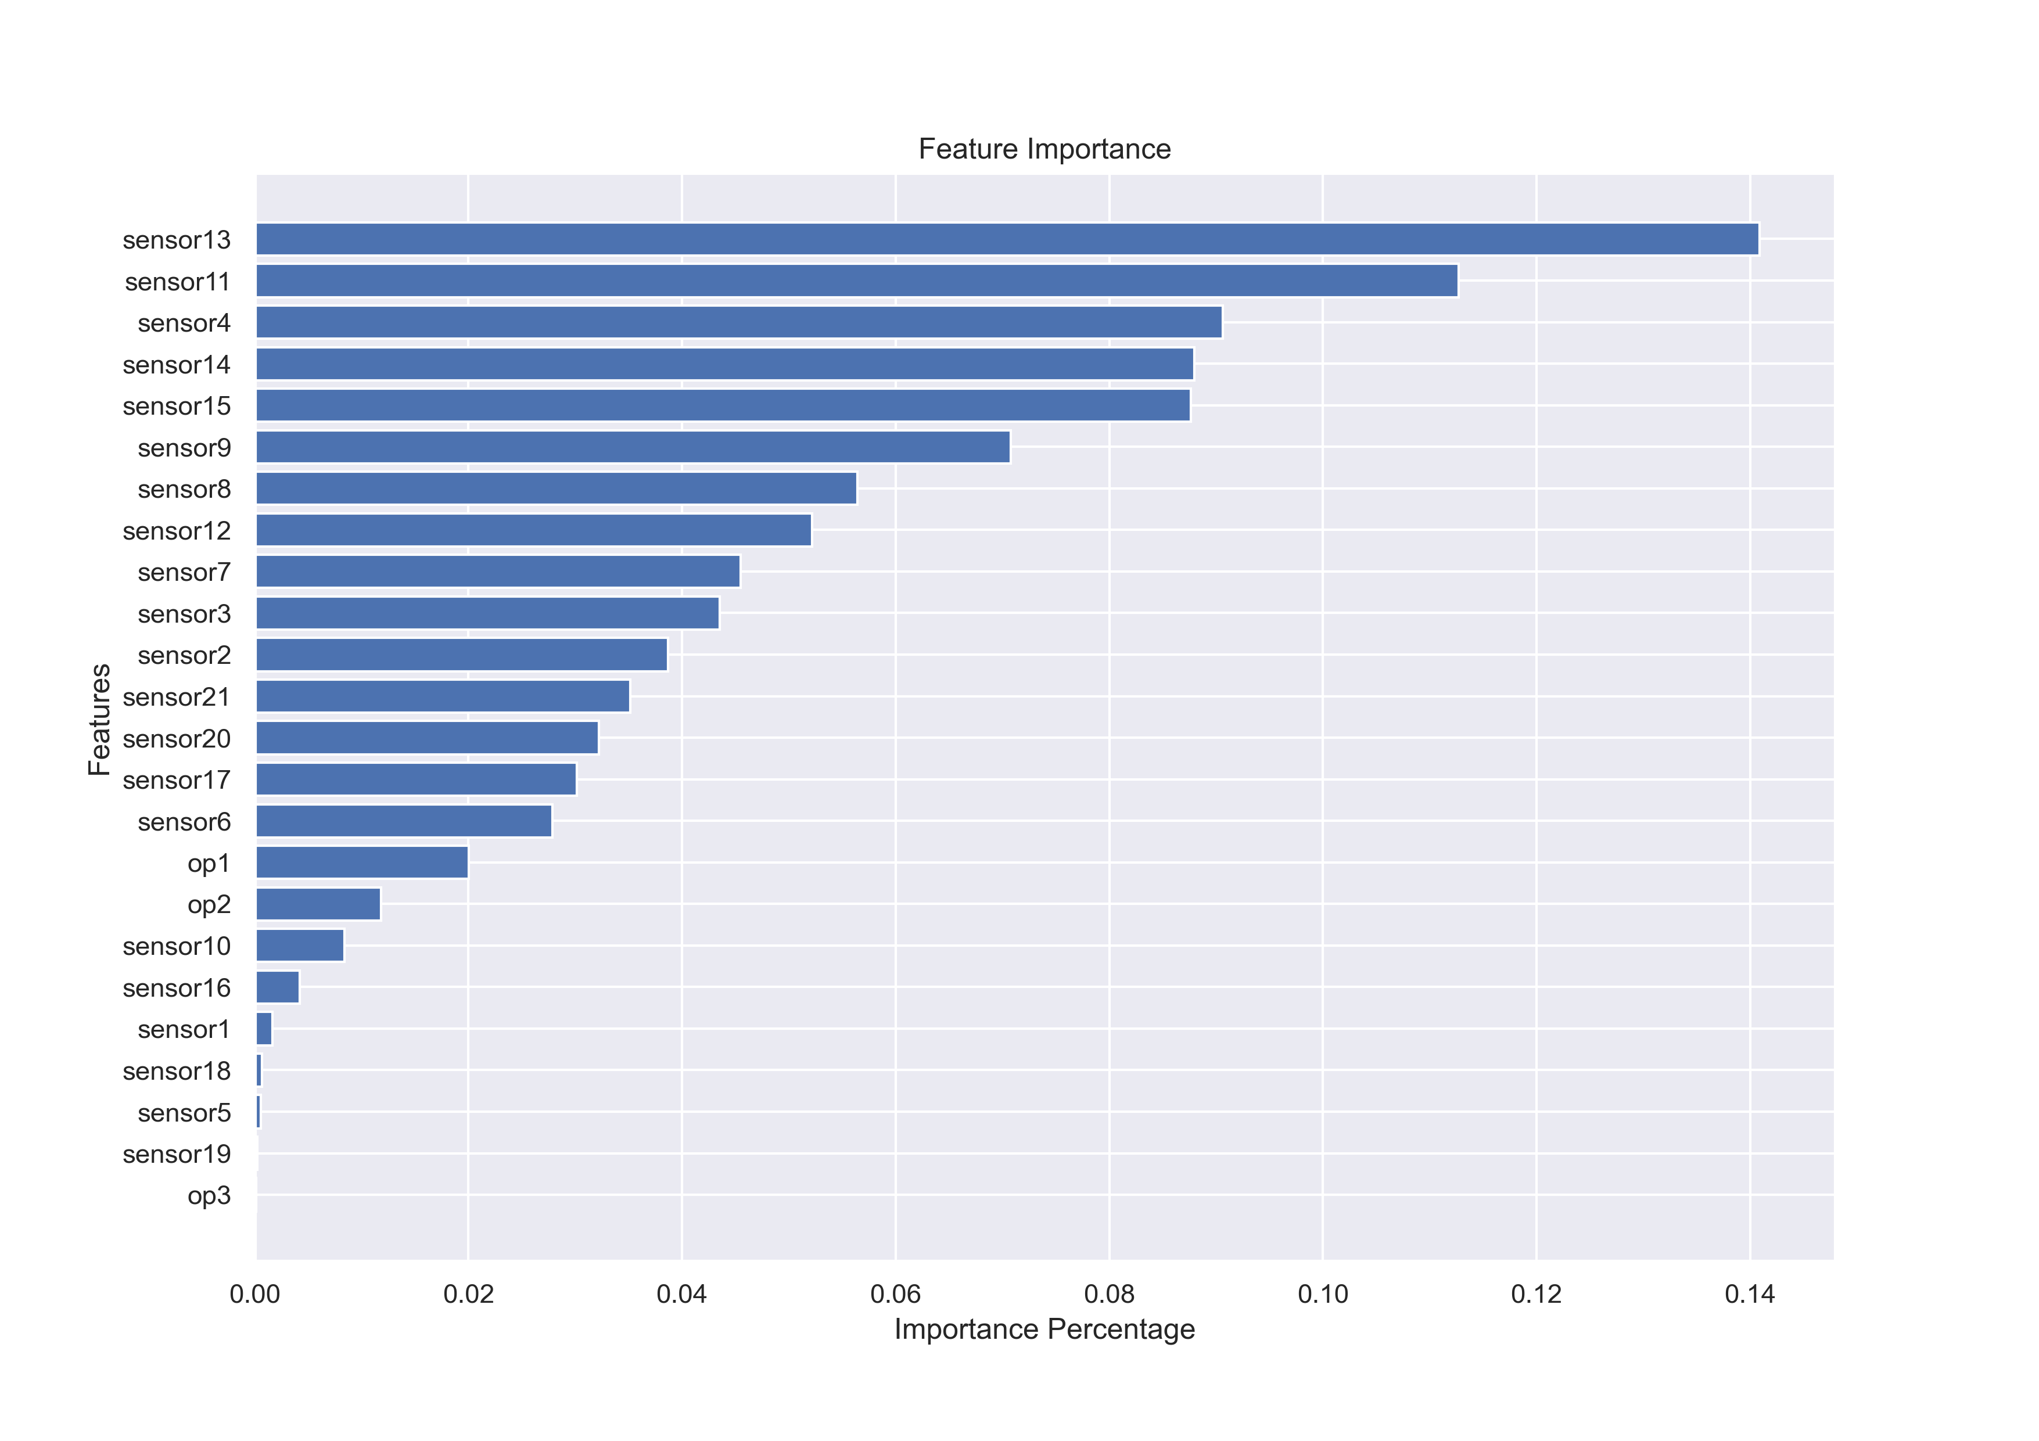
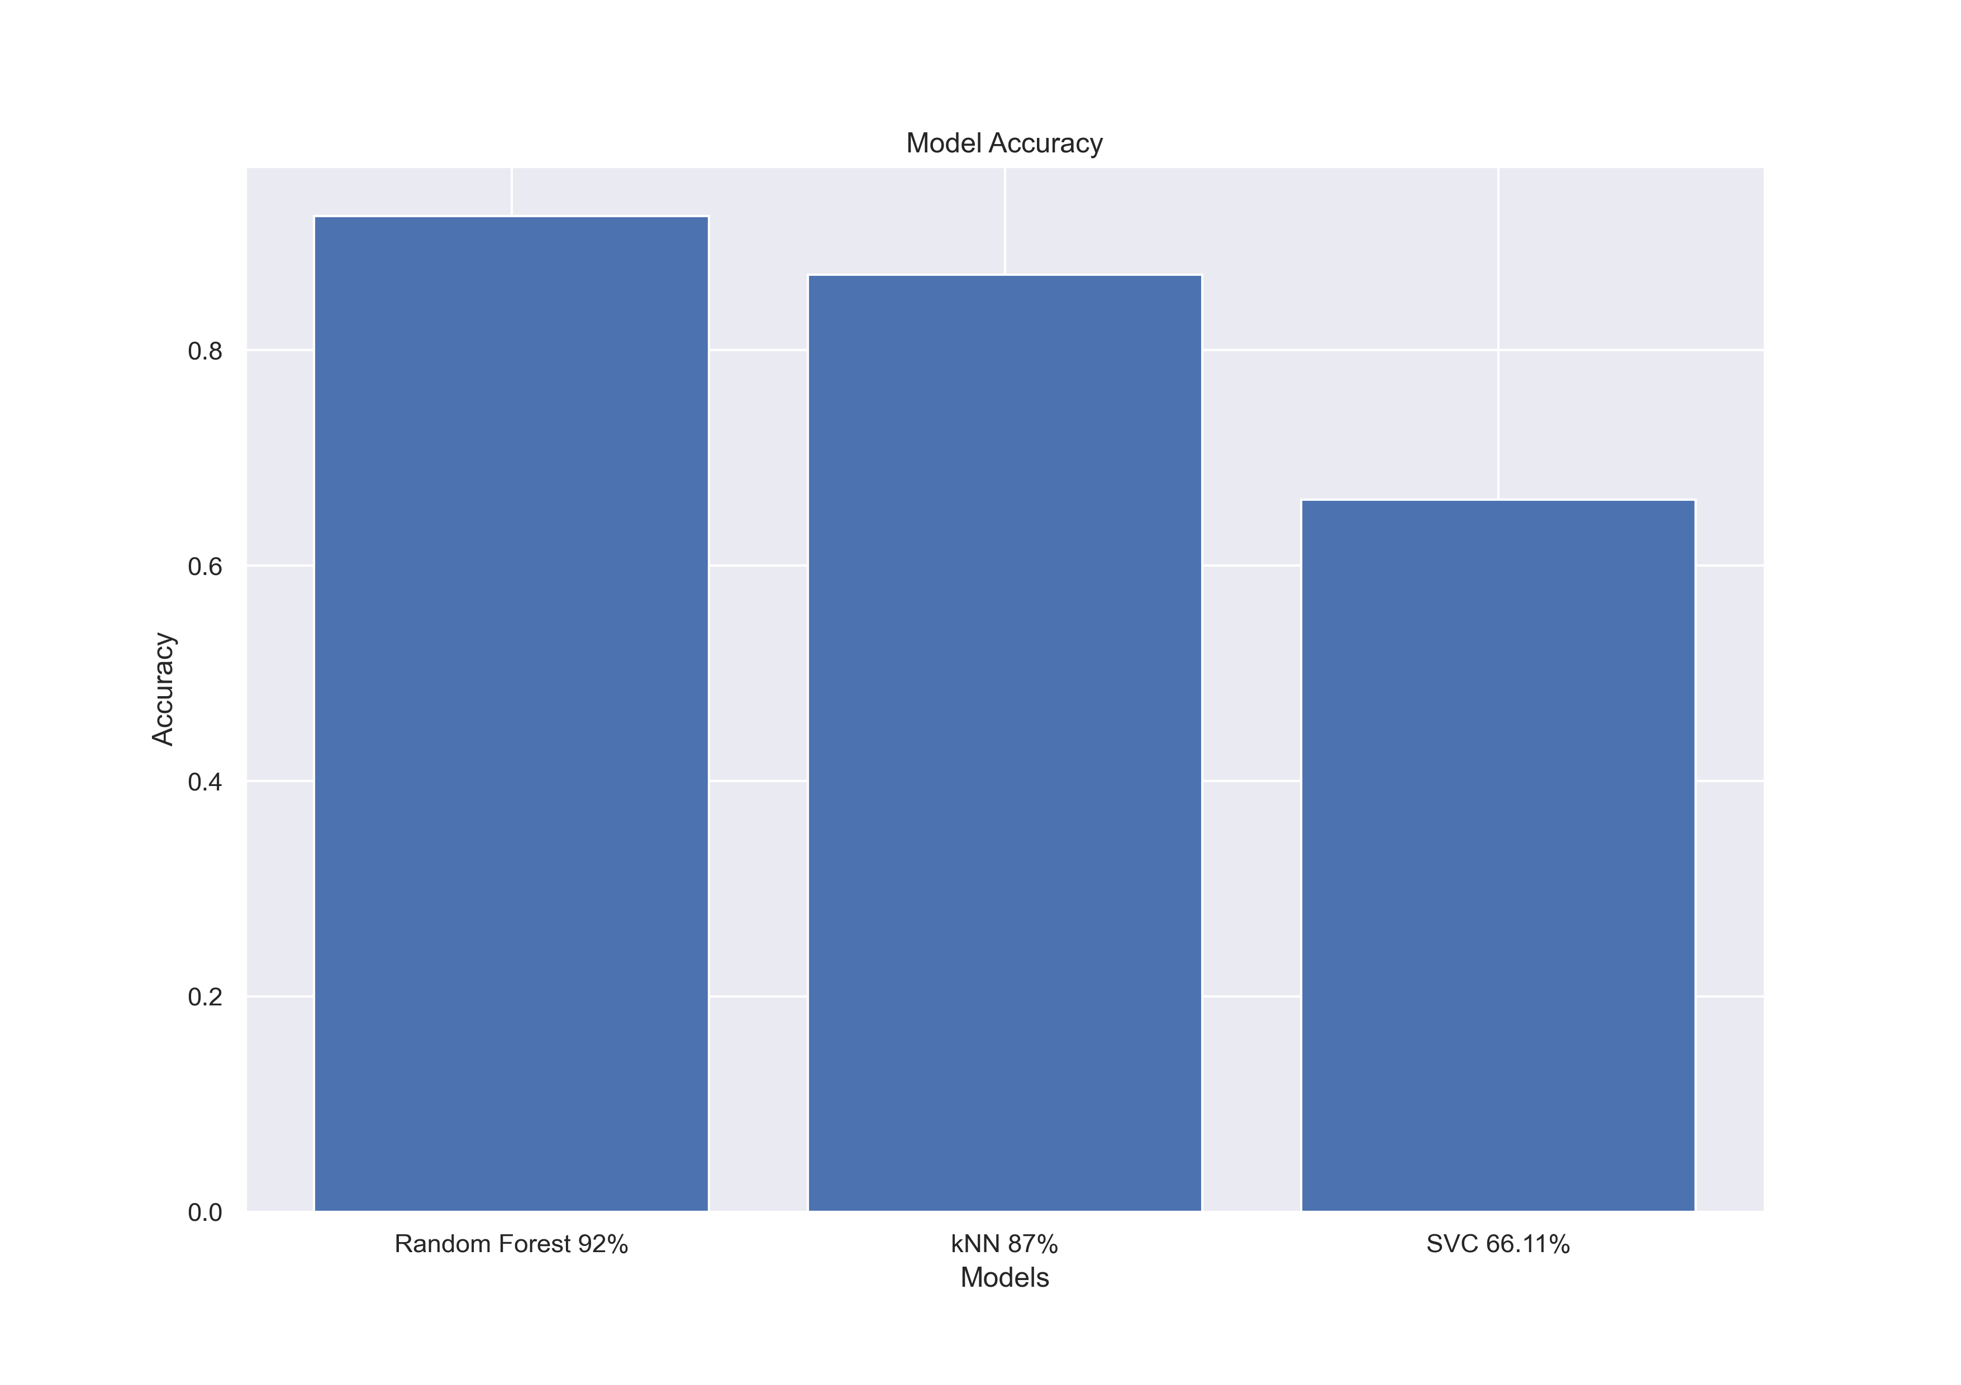
Results
Feature Importance Analysis for the proposed RF model
Model Accuracies

Slide 14
Problem 4
We have so many sensor values ,operation modes etc. in our data,
Can we reduce the dimensions?
Can we visualize how the engines are distributed over the entire space?
Can we find anything more interesting ? That could help previous models?
Proposed Solution
PCA – Overall Approach
Applied PCA to the overall dataset
Analysed how many components explain the variance at each %
Visualised the results
Generated useful information that could help our confidence in prediction

Slide 15
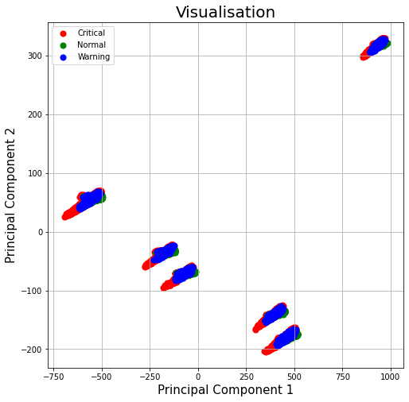
PCA Applied on the Dataset
We see that 3 principal components explain almost 99% of the variance in the data
1st PC – 90.487% | 2nd PC – 6.83 % | 3rd PC – 2.342 %
Observations:
The Data can be reduced from 25 features to 3 features – to explain about 99% variance
From the plots even though we see multiple clusters, in each cluster we see boundaries between normal , warning and critical
We see 6 clusters . What are they ?

Slide 16
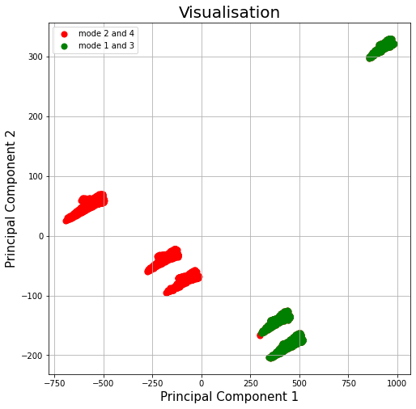
Understanding the PCA plot
Analysis:
From the clusters we filtered out each cluster based on their PC 1 and PC2 ranges
For each cluster we identified which engine they belong to
Surprisingly we see that there are clusters made up of engines which have been run in different modes – like different environment settings
This analysis helps us in a way that , if we could first find the location our test engine (its cluster). Then we can use that information for our regression and classification models for calibration or confidence of prediction estimation.

Slide 17
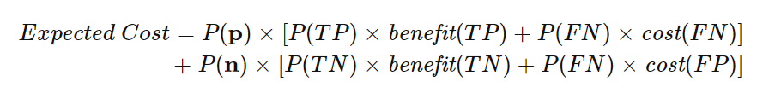
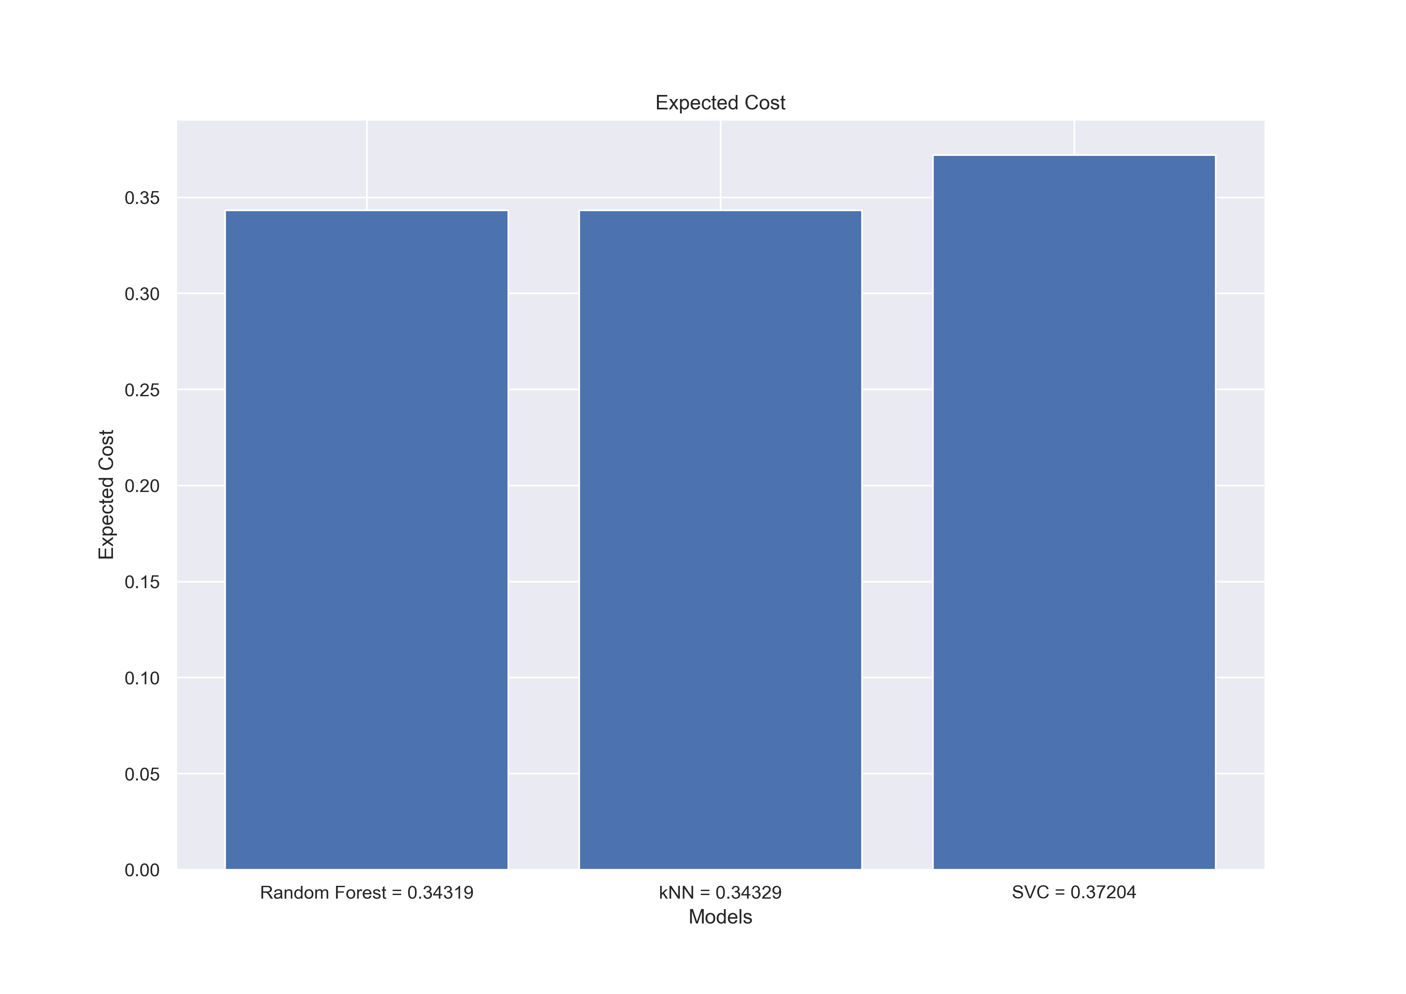
Conclusion
Business Perspective:
From business perspective, expected cost (or expected benefit) is a popular metric of evaluating these types of models – reference [5]
In this study, we assign 0.5 benefit of true negatives, 0.99 benefit of true positives, 0.4 cost of false positives, and 0.99 cost of false negatives – These weights can be adjusted based on the business needs
From all the models built, we see that the Random forest classifier gives the lowest cost as well as the highest accuracy.
Overall both the regression as well the classification solutions proposed, should help in performing better with respect to maintenance tasks.

Slide 18
References
NASA, "Prognostics Center of Excellence Data Repository",http://ti.arc.nasa.gov/projects/data_prognostics
https://www.kaggle.com/datasets/behrad3d/nasa-cmaps
Damage Propagation Modeling for Aircraft Engine Run-to-Failure Simulation. https://ti.arc.nasa.gov/m/pub-archive/154/154_Saxena.pdf.
https://www.wipotec-ocs.com/us/dynamic-weighing-systems-cep/predictive-maintenance - Fig source in slide 2
F. Provost and T. Fawcett (2013). Data Science for Business (Chapter 7). O’Reilly Media, Inc.

Slide 19
Thank You !

