Slide 1
Data Science Master’s Defense
Dheeraj Gadhiraju

Slide 2
Project Overview
Introduction
Data Visualization
Variable selection
Model Selection
Prediction
Summary

Slide 3
Introduction and Purpose
Data represents 20 years of basketball shots made by Kobe Bryant
Purpose:
Choose significant features to build better models
Build prediction models
Make predictions on the unlabeled data.

Slide 4
Data Description
Data has a total of 30,697 observation
Response Variable : shot made flag
Independent Variables: game event id, game id, shot id, team id, team name, game date, action type, combined shot type, lat, lon, loc x, loc y, minutes remaining, seconds remaining, period, playoffs, season, shot zone area, shot zone basic, shot zone range, shot distance, shot type, opponent, matchup (24)
5000 observations of shot made flag are unlabeled and these observations belong to test set
The rest of 25,697observations belong to the training set

Slide 5
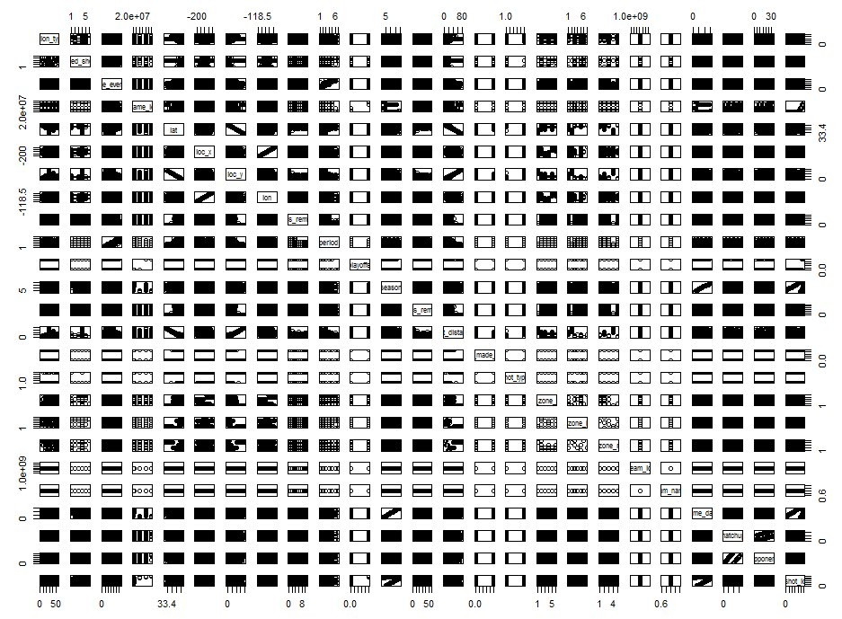
Pairs plot

Slide 6
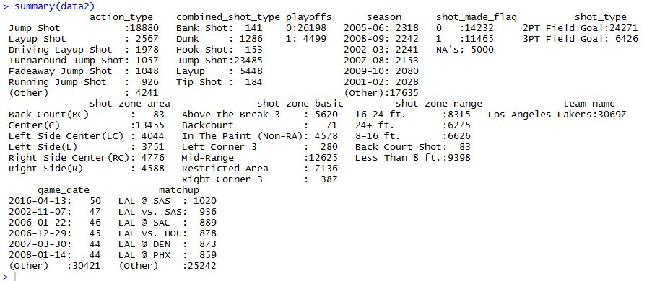
Data Summary
Categorical features descriptive statistics

Slide 7
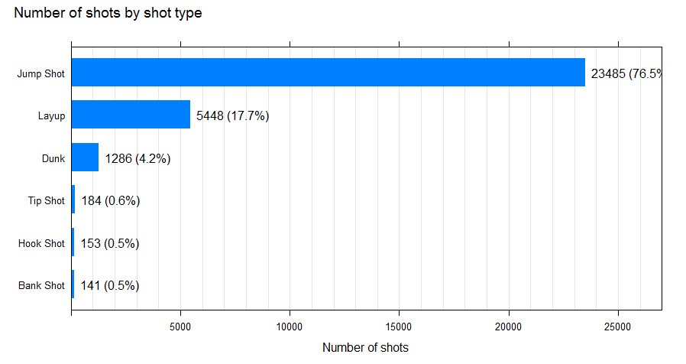
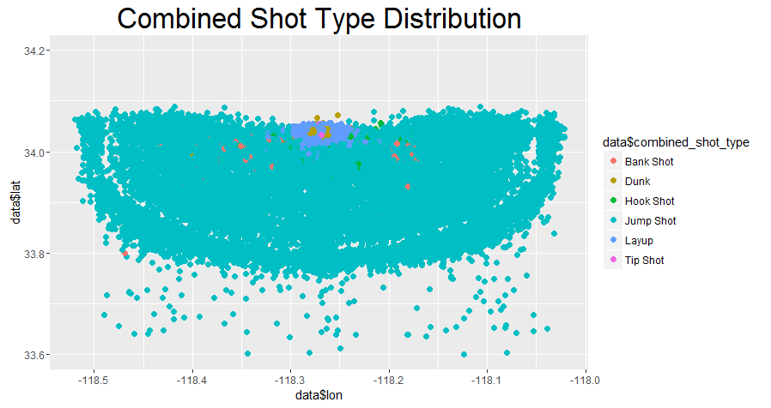
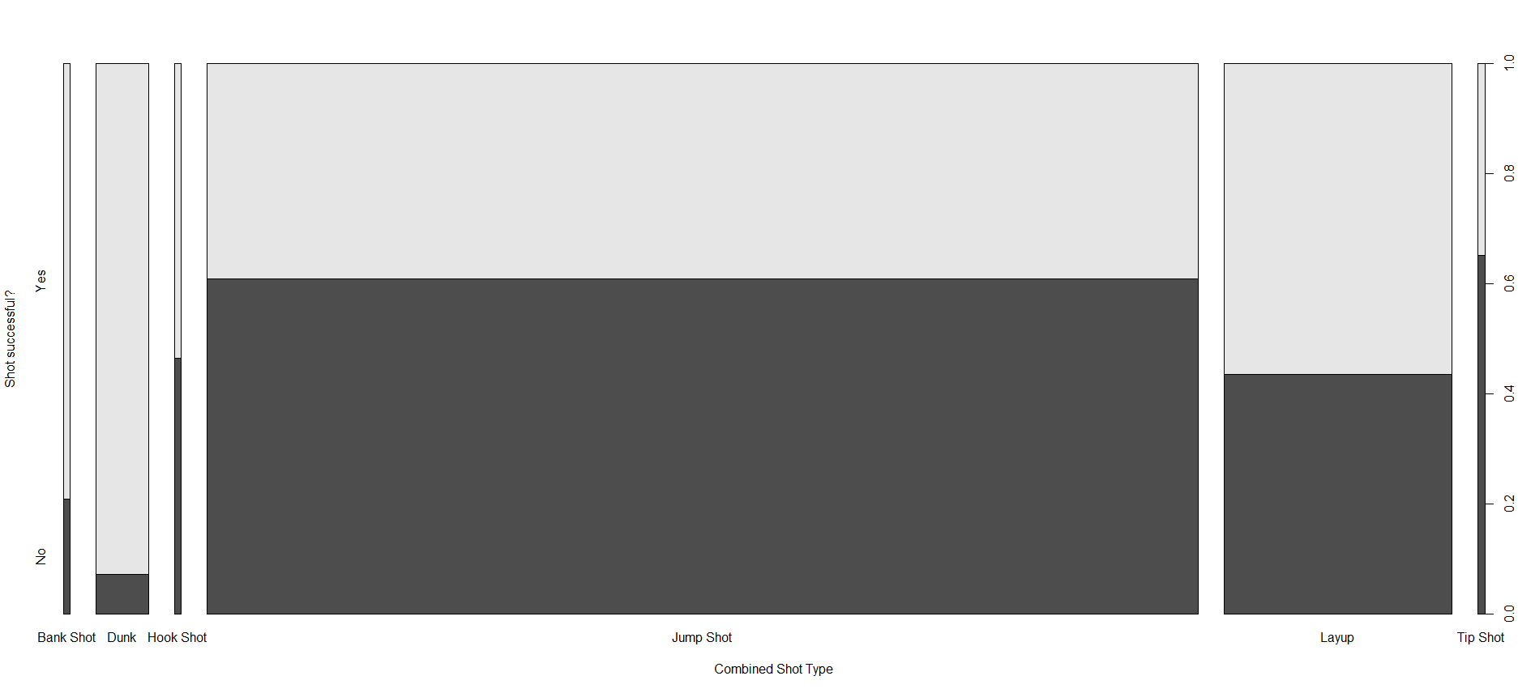
Data Visualization
Combined shot type

Slide 8
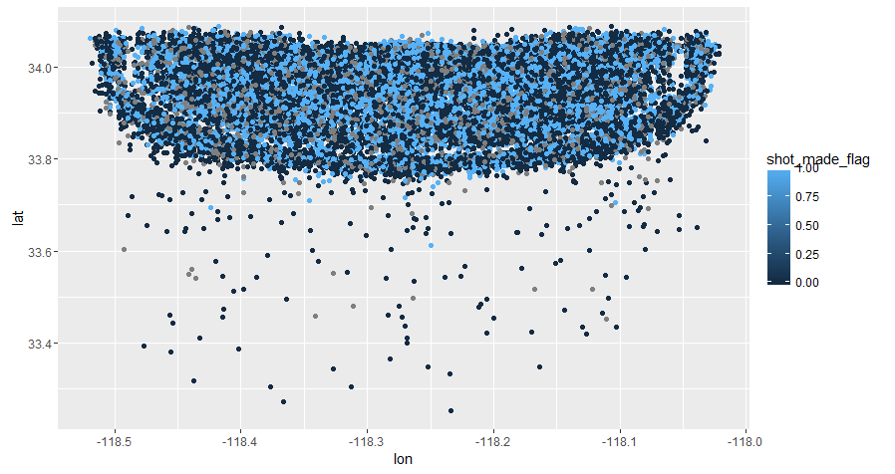
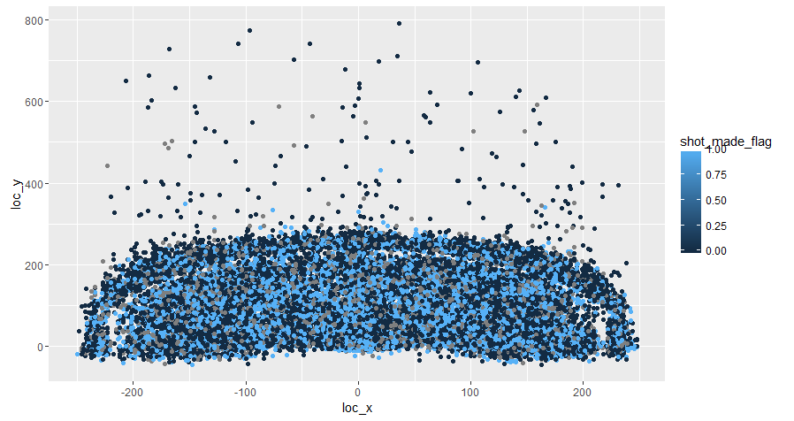
Data Visualization
lat and lon vs loc x and loc y

Slide 9
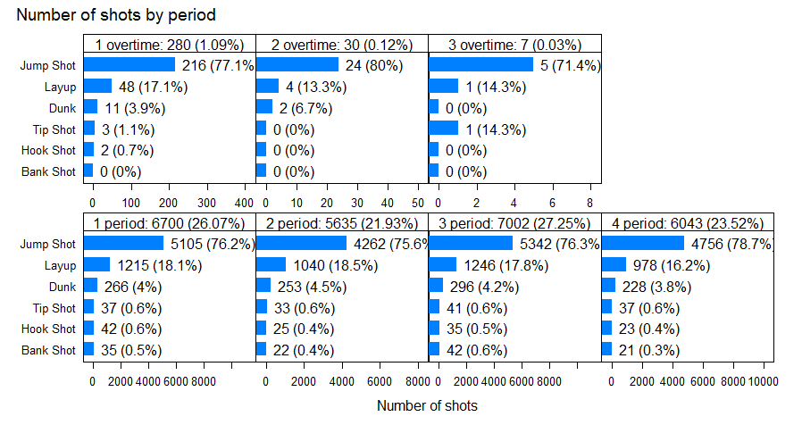
Data Visualization
Period

Slide 10
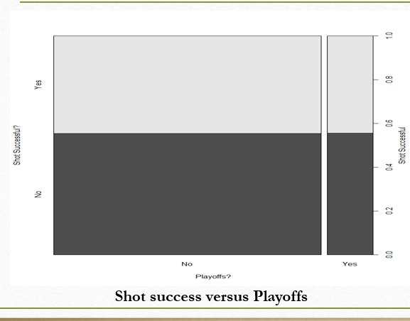
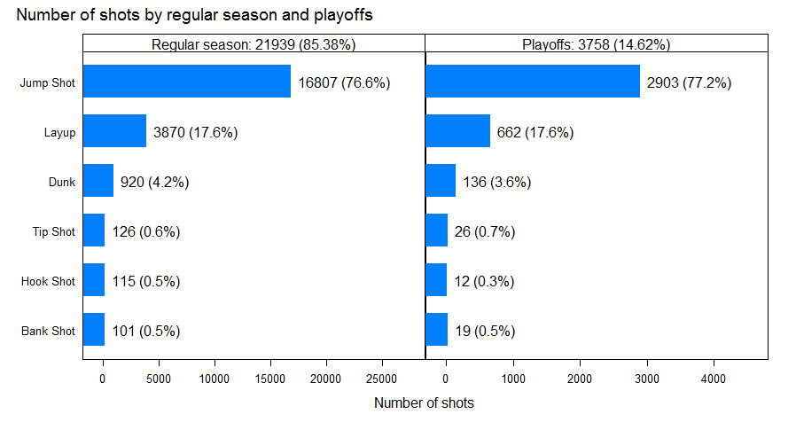
Data Visualization
Playoffs

Slide 11
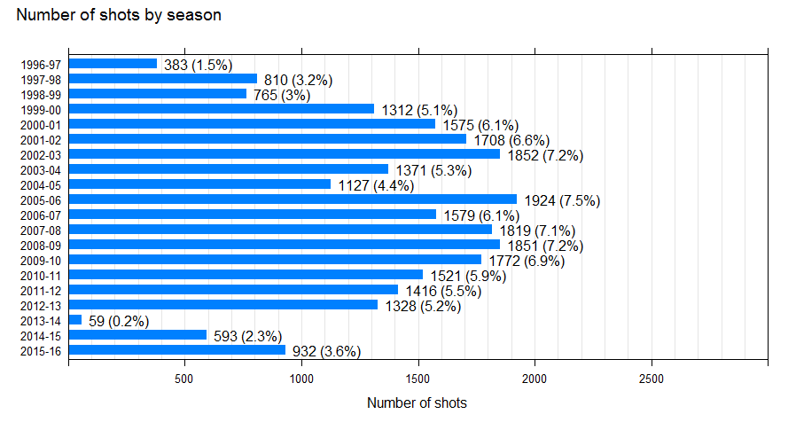
Data Visualization
Season

Slide 12
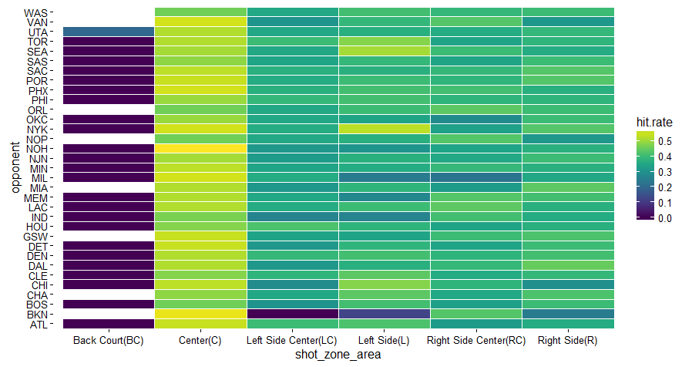
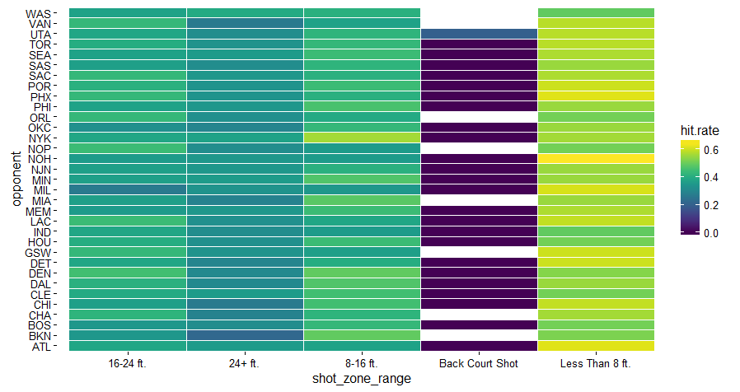
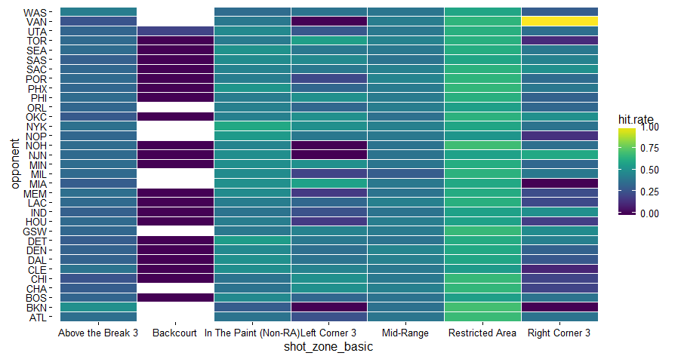
Data Visualization
Shot zone area, shot zone basic and, shot zone range

Slide 13
Data Cleaning
Team name, team id, shot id, game event id contain data related to id’s and are removed
Action types are grouped into combined shot types. So, action type has been removed too
Opponent and matchup contain the opposite team details. However, removed opponent because matchup also indicates, if the game was played at home or away.
Removed lat and lon since, loc x and loc y indicate similar data

Slide 14
Data Cleansing
Minutes remaining and seconds remaining were captured in a new variable, total seconds remaining.
The selected variables are:

Slide 15
Variable Selection
Interaction terms introduced:
Period and total seconds remaining
Shot distance and shot zone range
Loc y and period
Combined shot type and period

Slide 16
Variable Selection
Three way variable selection:
Stepwise selection
LASSO
Best Subset selection
The interaction terms were added to the variable selection models to capture their effects.

Slide 17
Variable Selection
Stepwise
LASSO
Best Subset

Slide 18
Data Cleansing
Model Comparison by cross validation
The Stepwise selection model has the least error rate with 0.2298.
Variable selection models | Error rate
Stepwise | 0.2298
LASSO | 0.2318
Regular Subset Selection | 0.2317

Slide 19
Data Cleansing
The 24 independent features are finally reduced to 6 features by using a Stepwise selection method
Variable selection models | Error rate
Combined Shot type | Type of shot made
Season | Shot belongs to a game of a season
Loc y | y-coordinate of the shot location
Total seconds remaining | Total seconds remaining for the period to end
period | Period of the shot along with over times
Shot distance: shot zone range(*) | Interaction term *
The 6 predictors used in the model building process

Slide 20
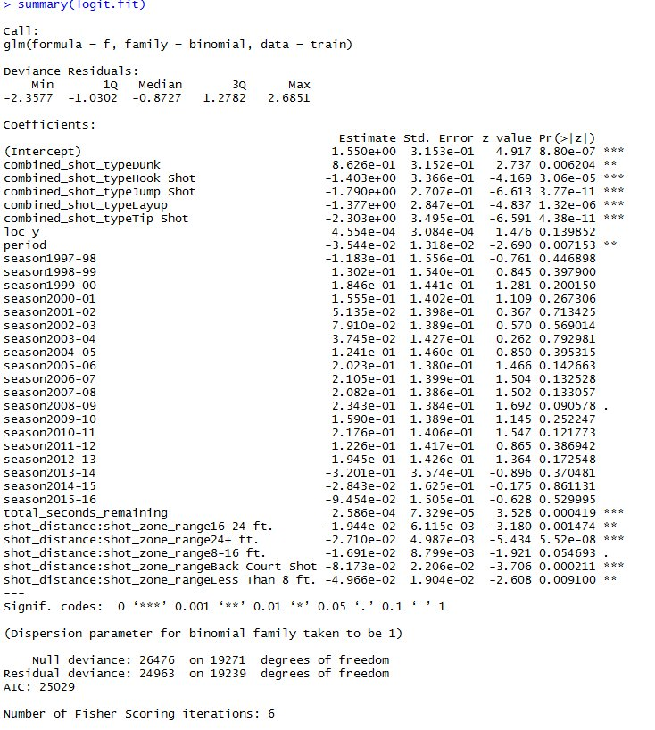
Model Selection
Logistic regression is a widely used classification technique. The response variable is categorical in nature and the predicted probabilities lie between 0 and 1
Summary

Slide 21
Model Selection
Logistic regression Performance
The Logistic regression model obtained a 10-fold CV misclassification rate (MCR) of 38.28%.
The confusion matrix below shows that a validation set approach (VSA) yielded an MCR of 39.34%, a true positive rate (TPR) of 31.43%, and a true negative rate (TNR) of 84.74%.
 | True No | True Yes
Predicted No | 2984 | 1991
Predicted Yes | 537 | 913

Slide 22
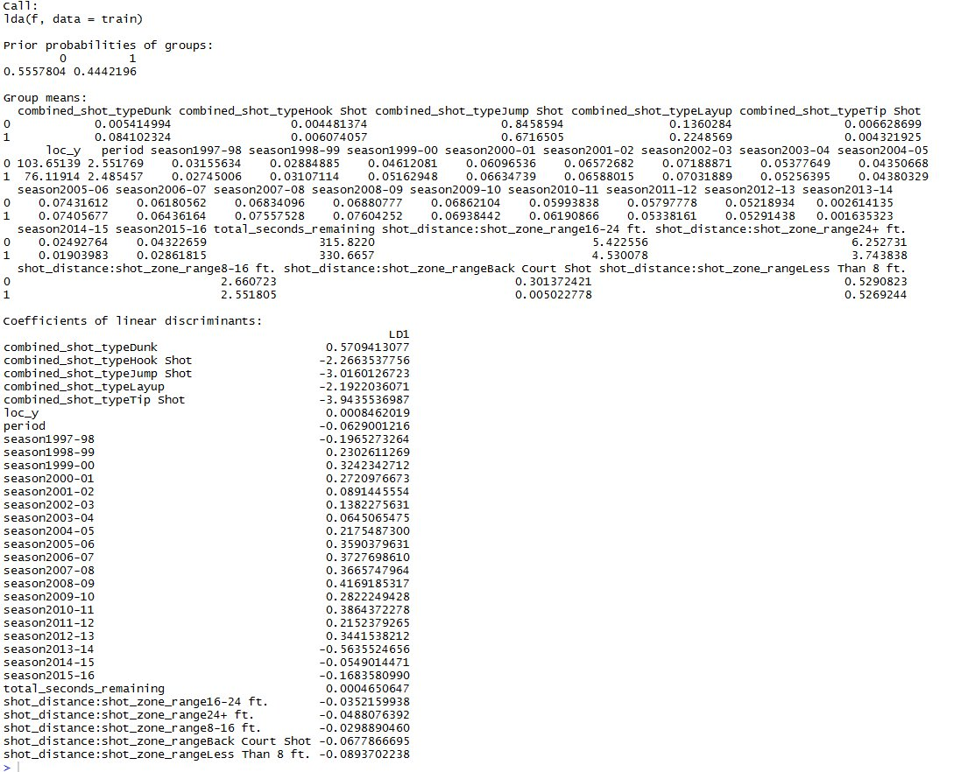
Model Selection
Linear Discriminant Analysis (LDA) assumes that the distribution of the data is Gaussian. LDA is chosen when response variable has more than 2 classes.
Summary

Slide 23
Model Selection
LDA Performance
The LDA model obtained a 10-fold CV misclassification rate (MCR) of 38.52%.
The confusion matrix below shows that a validation set approach (VSA) yielded an MCR of 39.61%, a true positive rate (TPR) of 62.65%, and a true negative rate (TNR) of 59.83%.
 | True No | True Yes
Predicted No | 2968 | 553
Predicted Yes | 1992 | 912

Slide 24
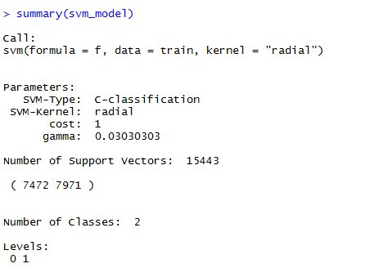
Model Selection
Support Vector Machines(SVM) are based on the concept of decision planes that define decision boundaries. SVM works good when the classes are separated we..
Summary

Slide 25
Model Selection
SVM Performance
The SVM model obtained a 10-fold CV misclassification rate (MCR) of 38.93%.
The confusion matrix below shows that a validation set approach (VSA) yielded an MCR of 39.37%, a true positive rate (TPR) of 31.47%, and a true negative rate (TNR) of 84.66%.
 | True No | True Yes
Predicted No | 2981 | 1990
Predicted Yes | 540 | 914

Slide 26
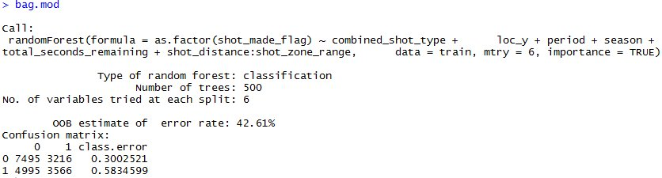
Model Selection
Bagging is an ensemble technique in which multiple classifiers are trained using random sampling. Bagging tries to reduce variance and helps avoid overfitting.
Summary

Slide 27
Model Selection
Bagging Performance
The Bagging model obtained a 10-fold CV misclassification rate (MCR) of 40.86% and an Out of bag error of 42.61%
The confusion matrix below shows that a validation set approach (VSA) yielded an MCR of 42.75%, a true positive rate (TPR) of 32.97%, and a true negative rate (TNR) of 71.40%.
 | True No | True Yes
Predicted No | 2546 | 1740
Predicted Yes | 975 | 1164

Slide 28
Model Selection
Random Forest is an ensemble technique in which multiple classifiers are trained by sampling observations as well as predictors. Predictions aore better if the sub-models are un-correlated.
Summary

Slide 29
Model Selection
Random Forest Performance
The Random forest model obtained a 10-fold CV misclassification rate (MCR) of 38.36% and an Out of bag error of 38.36%
The confusion matrix below shows that a validation set approach (VSA) yielded an MCR of 39.40%, a true positive rate (TPR) of 31.85%, and a true negative rate (TNR) of 84.29%.
 | True No | True Yes
Predicted No | 2968 | 1979
Predicted Yes | 553 | 925

Slide 30
Model Comparison
Summary
Model | VSA | True Positive | True Negative | 10-fold | OOB* | Log Loss
Logistic | 39.34% | 31.43% | 84.74% | 38.28% |  | 0.65320
LDA | 39.61% | 62.65% | 59.83% | 38.52% |  | 0.65483
Bagging | 42.75% | 39.97% | 71.40% | 42.61%* | 40.86% | 0.69067
Random Forest | 39.40% | 31.85% | 84.29% | 38.64%* | 38.36% | 0.65567
SVM | 39.37% | 31.47% | 84.66% | 38.93% |  | 1.116707
Comparison values for the different models

Slide 31
Model Comparison
Logistic regression has the best performance compared to the other models.

Slide 32
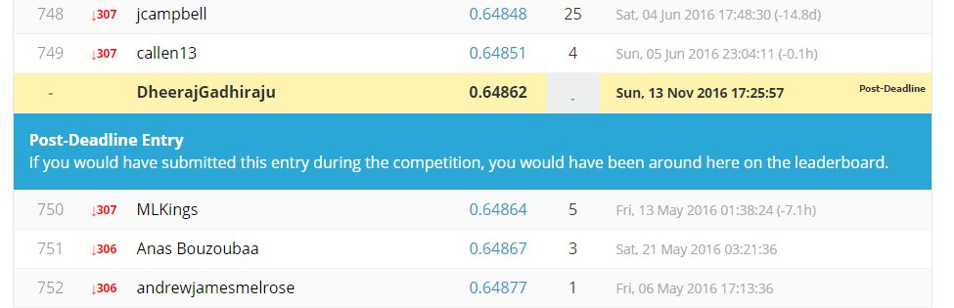
Conclusion
Logistic Regression was chosen as a prediction model and the predictions were made on the 5000 test observations.
The log loss obtained from Kaggle upon submission was 0.64862

Slide 33
References
https://ncss-wpengine.netdna-ssl.com/wp-content/themes/ncss/pdf/Procedures/NCSS/Stepwise_Regression.pdf
http://statweb.stanford.edu/~tibs/lasso/lasso.pdf
https://cran.r-project.org/web/packages/leaps/leaps.pdf
http://web.pdx.edu/~newsomj/da2/ho_logistic.pdf
https://www.reddit.com/r/MachineLearning/comments/15zrpp/please_explain_support_vector_machines_svm_like_i/
http://www.statsoft.com/Textbook/Support-Vector-Machines

