Slide 1
CPU Scheduling
Multi-programmed Operating System maximize utilization by switching the CPU between competing processes.
  goal is to always have some process running
  one process runs until it must wait for some event (for example an I/O operation)
  rather than remaining idle the OS removes the waiting process from the CPU and inserts another “ready” process onto the CPU

Slide 2
Introduction with scheduling types
Priority Scheduling
Associate priority with each process and select highest priority when making scheduling decision
  Preemptive or non-preemptive
  Round Robin (RR)
Each process assigned a time quantum, typically 10-100ms (40ms).
  At quantum expiration process moved to tail of Ready Q
if n processes in ready queue, time quantum = q, then each process receives 1/n of CPU time in chunks of at most q units.
  No process waits more than (n-1)q time units for CPU.

Slide 3
Analysis of misses with tasks and processors
Round Robin Scheduling
#Misses increases with increasing #tasks
#Misses decreases with increasing #processors
Preemptive Scheduling
#Misses are always around Zero with #tasks
#Misses are always around Zero with #processors
For preemptive there always exist a scheduling with zero misses

Slide 4
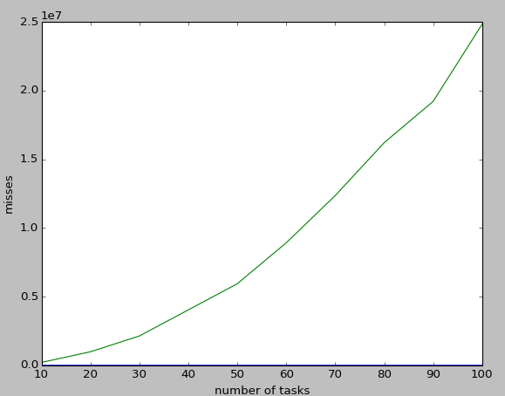
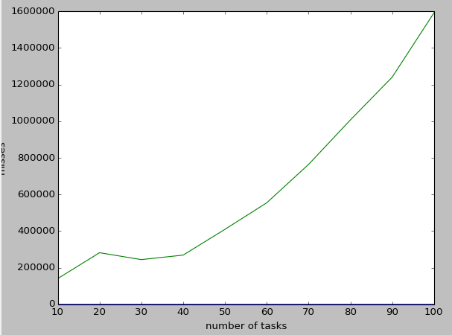
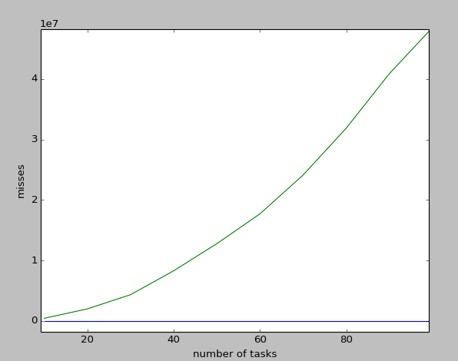
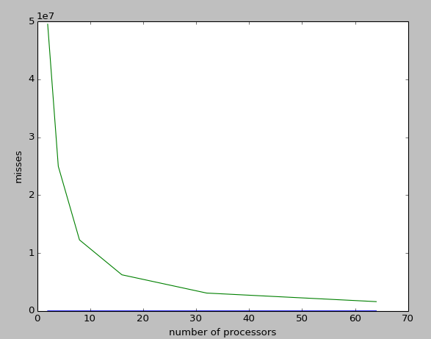
Graphical Analysis
Misses with increasing number of tasks
Misses with increasing number of processors

