Slide 1
Yelp
Team 47
Paul Moreno
Ilean Monterrubio Jr

Slide 2
Vertical Search Engine
Popular
Use implicit data avaliable
Mobile devices, location
Limited scope
Specific to unique

Slide 3
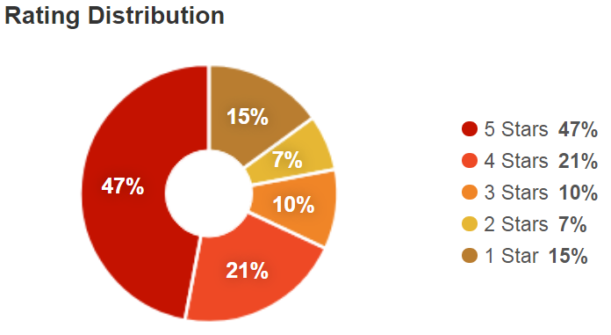
Yelp
Review
Any can review a business
Business on yelp
Rate
5 to 1 stars

Slide 4
Current Yelp Tools
Focus on consumer side
Grubhub
Postemates
etc

Slide 5
Tool Envisioned
Targets business
Business fall in 2 categories
Goods
Services

Slide 6
Data
Yelp Open Dataset
JSON vs SQL
JSON to CSV
Review Classification:
Goods, i.e. food, coffee, clothing
Service, i.e. restaurant, dry cleaners, movie theaters

Slide 7
Installation of Tool
Linux
Download tool:
https://github.com/ileanmjr88/CS410-Project
Either clone using git or download as zip file.
Install using using terminal:
$ cd (user directory)/CS410-Project
$ sudo pip install –e . (period required)
$ python download_nltk.py

Slide 8
Use Tool
Command line tool
It broken up in 2 parts
yelp_clean.py
This script cleans and find the word distribution
yelp_classify.py
This script classifies the first 400 comments
To change the reviews being entered
Change fname variable in each file
File must contain a minimum of 1k comments

Slide 9
Use Tool cont’l
Open Terminal
Navigate to directory
$ cd (user directory)/CS410-Project
$ python yelp_clean.py
Terminal output:
yelp_clean.py::starting
yelp_clean.py::complete

Slide 10
Use Tool cont’l
Once yelp_clean.py complete
Terminal command:
$ python yelp_classify.py
Terminal output:
yelp_classify.py::starting
(Metrics of both classifiers used, output)
yelp_classify.py ::completed

Slide 11
Use Tool cont’l
Inside directory they are 2 graphs
Naivebayes.png
LinearSVC.png
These graphs are bar graphs
They graph Service in Red and Goods in Blue
Star rating vs number of comment
This graph help the business if they are excelling in one category on a star rating level

Slide 12
Example
Tool preloaded demo
$ python yelp_clean.py
Terminal output:
yelp_clean.py::starting
yelp_clean.py::complete

Slide 13
Example
Tool preloaded demo
$ python yelp_classify.py
Terminal output:
yelp_classify.py::starting
Context Classification:
('Naive Bayes Classifier accuracy: ', 0.68)
('Precision of goods:', 0.3625)
('Recall of goods:', 0.7467811158798283)
('Fmeasure of goods:', 0.4880785413744741)
('Precision of service:', 0.33059548254620125)
('Recall of service:', 0.7666666666666667)
('Fmeasure of service:', 0.4619799139167862)
('LinearSVC Classifier accuracy:', 0.6571428571428571)
('Precision of goods:', 0.33689024390243905)
('Recall of goods:', 0.9484978540772532)
('Fmeasure of goods:', 0.4971878515185602)
('Precision of service:', 0.30579964850615116)
('Recall of service:', 0.8285714285714286)
('Fmeasure of service:', 0.4467265725288832)

Slide 14
Example
Tool preloaded demo
Terminal output:
Sentiment Analysis:
('Naive Bayes Classifier accuracy: ', 0.662)
('Precision of pos:', 0.8091397849462365)
('Recall of pos:', 0.8918518518518519)
('Fmeasure of pos:', 0.8484848484848485)
('Precision of neu:', 0.6320754716981132)
('Recall of neu:', 0.4557823129251701)
('Fmeasure of neu:', 0.5296442687747036)
('Precision of neg:', 0.7)
('Recall of neg:', 0.5898876404494382)
('Fmeasure of neg:', 0.6402439024390244)
('LinearSVC Classifier accuracy:', 0.664)
('Precision of pos:', 0.8121059268600253)
('Recall of pos:', 0.9540740740740741)
('Fmeasure of pos:', 0.8773841961852861)
('Precision of neu:', 0.5859872611464968)
('Recall of neu:', 0.6258503401360545)
('Fmeasure of neu:', 0.6052631578947368)
('Precision of neg:', 0.6388888888888888)
('Recall of neg:', 0.7752808988764045)
('Fmeasure of neg:', 0.700507614213198)
yelp_classify.py::completed

Slide 15
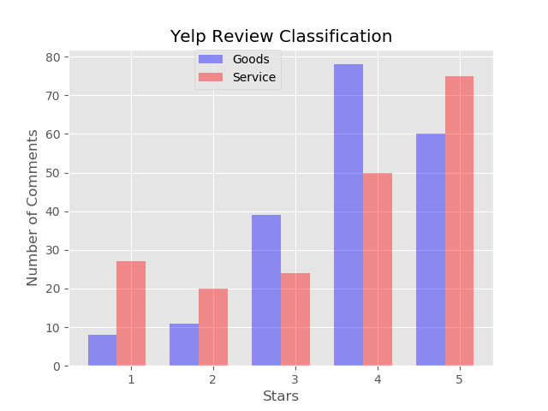
Naïve Bayes Graph Output

Slide 16
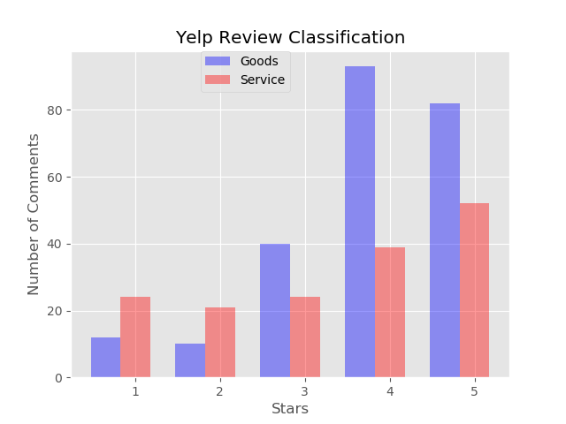
LinearSVC Graph Output

