Slide 1
Yelp
Team 47
Paul Moreno
Ilean Monterrubio Jr

Slide 2
Vertical Search Engine
Popular
Use implicit data avaliable
Mobile devices, location
Limited scope
Specific to unique

Slide 3
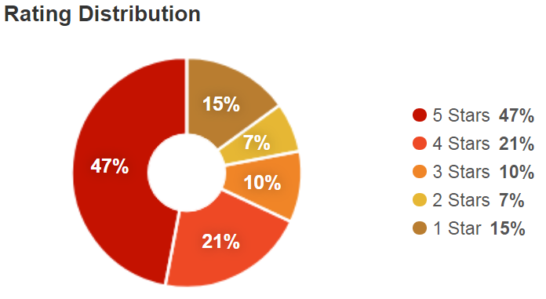
Yelp
Review
Any can review a business
Business on yelp
Rate
5 to 1 stars

Slide 4
Current Yelp Tools
Focus on consumer side
Grubhub
Postemates
etc

Slide 5
Tool Envisioned
Targets business
Business fall in 2 categories
Goods
Services

Slide 6
Data
Yelp Open Dataset
JSON vs SQL
JSON to CSV
Review Classification:
Goods, i.e. food, coffee, clothing
Service, i.e. restaurant, dry cleaners, movie theaters

Slide 7
Installation of Tool
Linux
Download tool:
https://github.com/ileanmjr88/CS410-Project
Either clone using git or download as zip file.
Install using using terminal:
$ sudo pip install –e . (period required)
$ python download_nltk.py

Slide 8
Use Tool

