Slide 1
Nyan Gab
Analysis of hate speech on gab

Slide 2
Method
Based on “Automated Hate Speech Detection and the Problem of Offensive Language” – T Davidson, D Warmsley, M Macy, I Weber
Model – Linear SVM
3 Classes – Hate Speech, Offensive, Neither

Slide 3
Data
Using Gab’s API, we crawl the social network using a snowball methodology –
Obtain data for most popular users on Gab
Simple BFS to collect data from all their followers and all their followers
18,562 Gabs collected so far (Goal is to collect 100,000)

Slide 4
Warning: Due to the nature of the project, a lot of the following slides are NSFW (explicit language)

Slide 5
Results
Surprisingly, only ~10% of Gabs collected were offensive / hateful in nature
0.87% of posts are hate posts
8.1% of posts are offensive
91% are neither hateful nor offensive
However, the hateful and offensive posts are very gruesome, unlike on other OSM

Slide 6
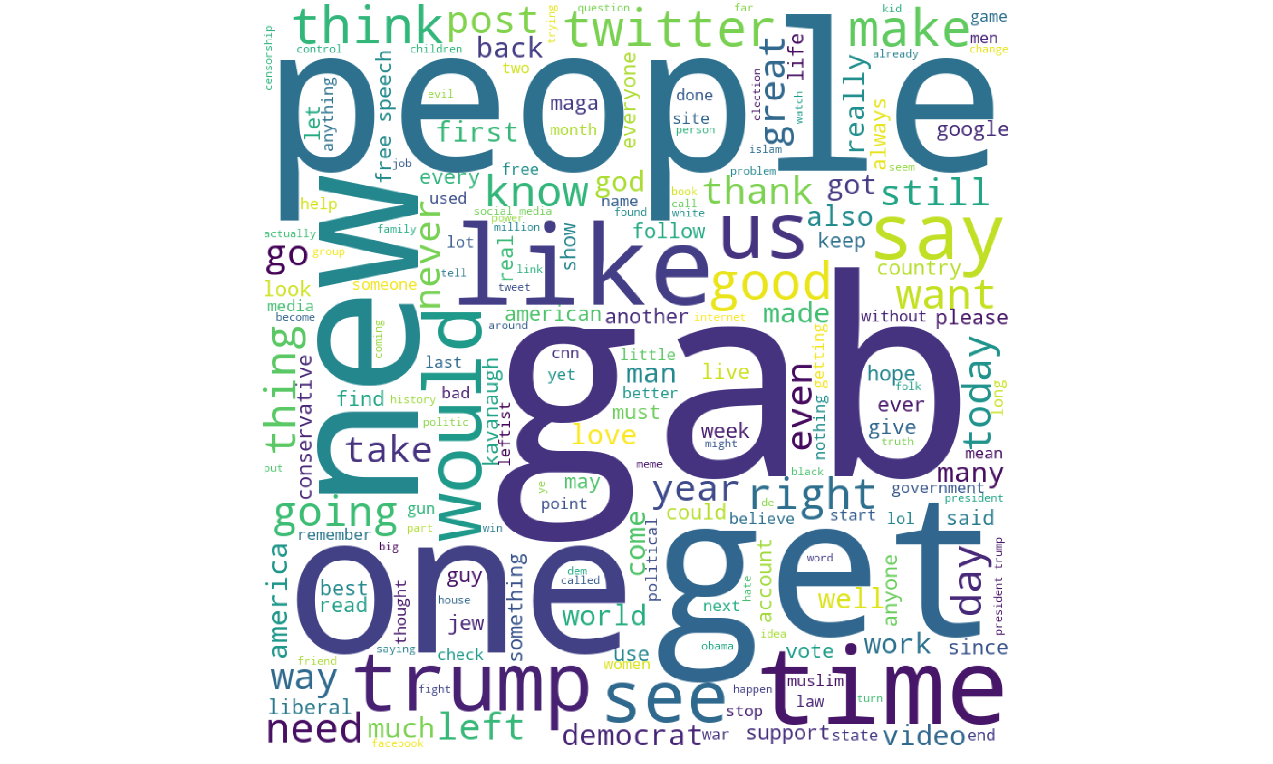
Neutral Gabs

Slide 7
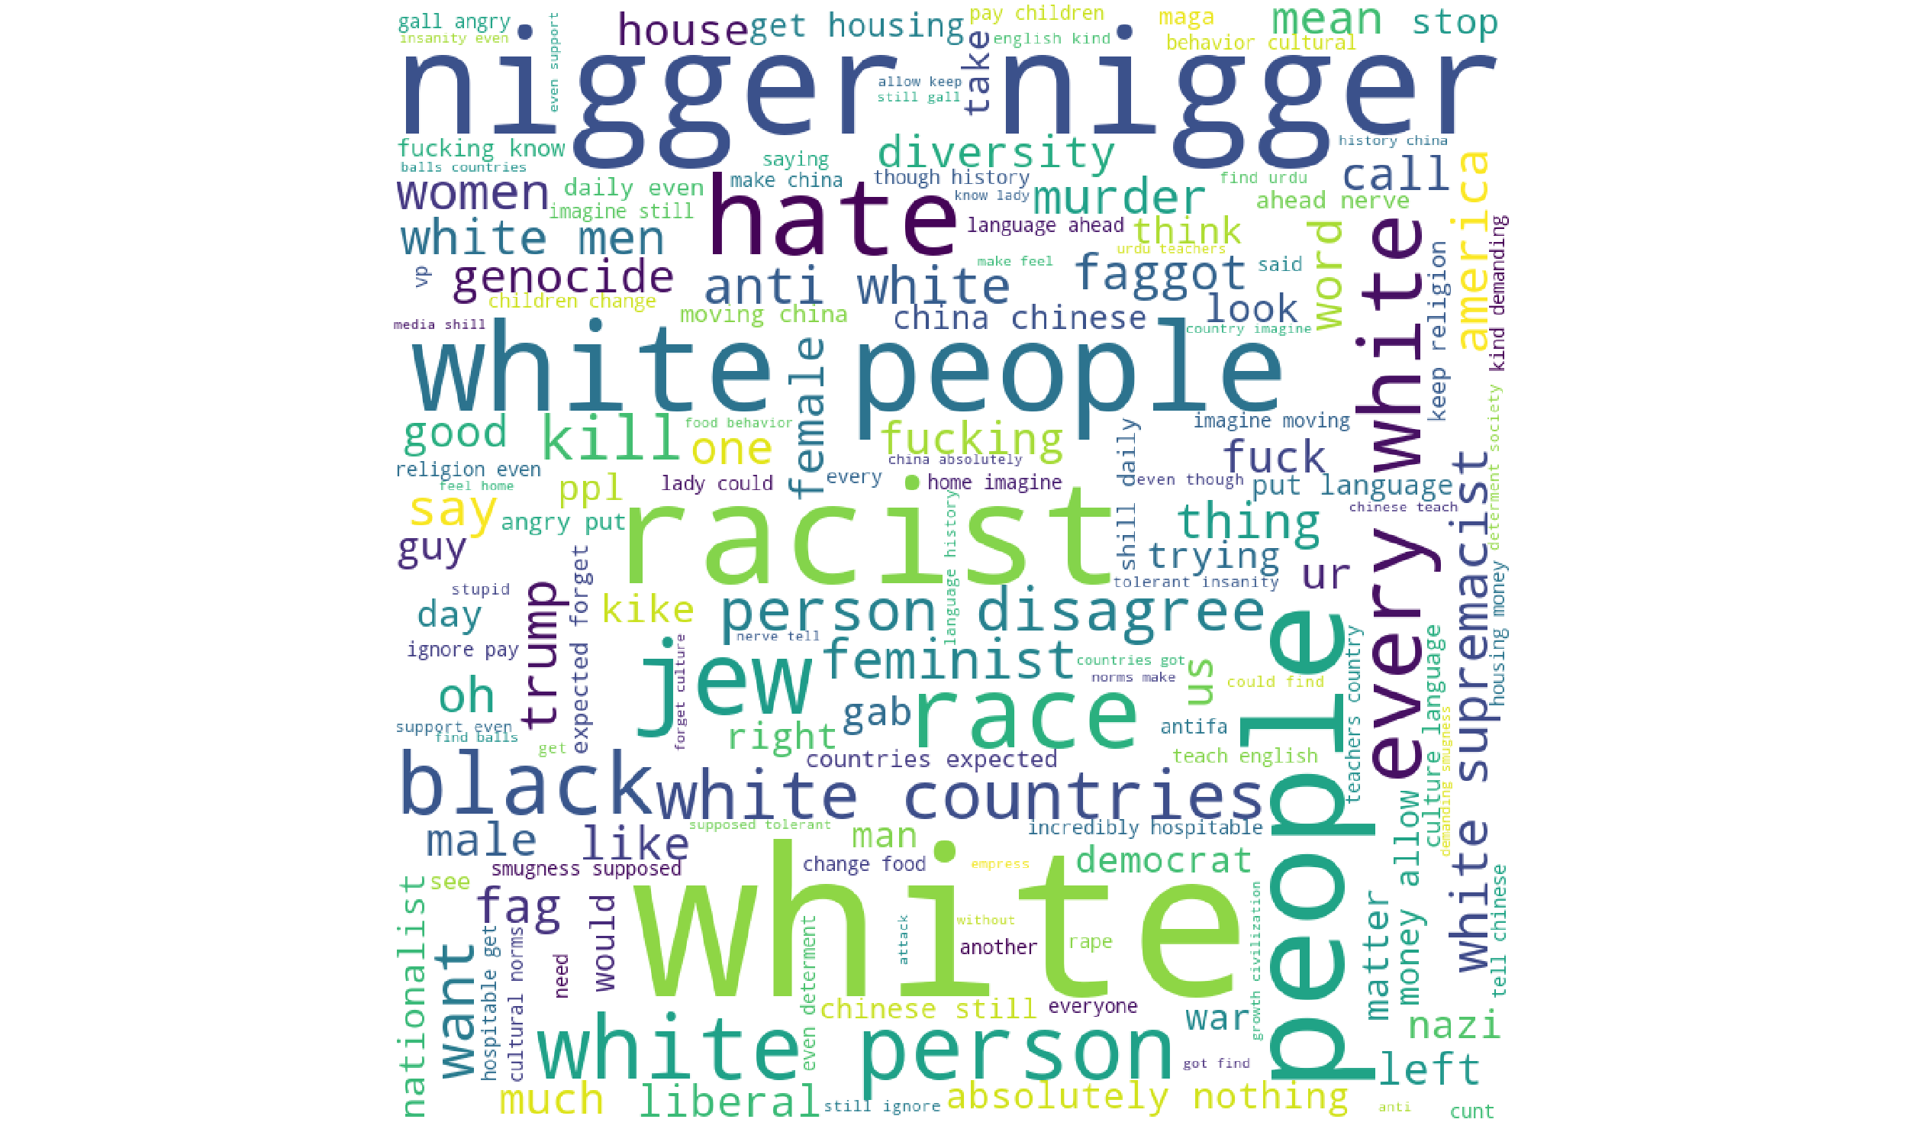
Hateful Gabs

Slide 8
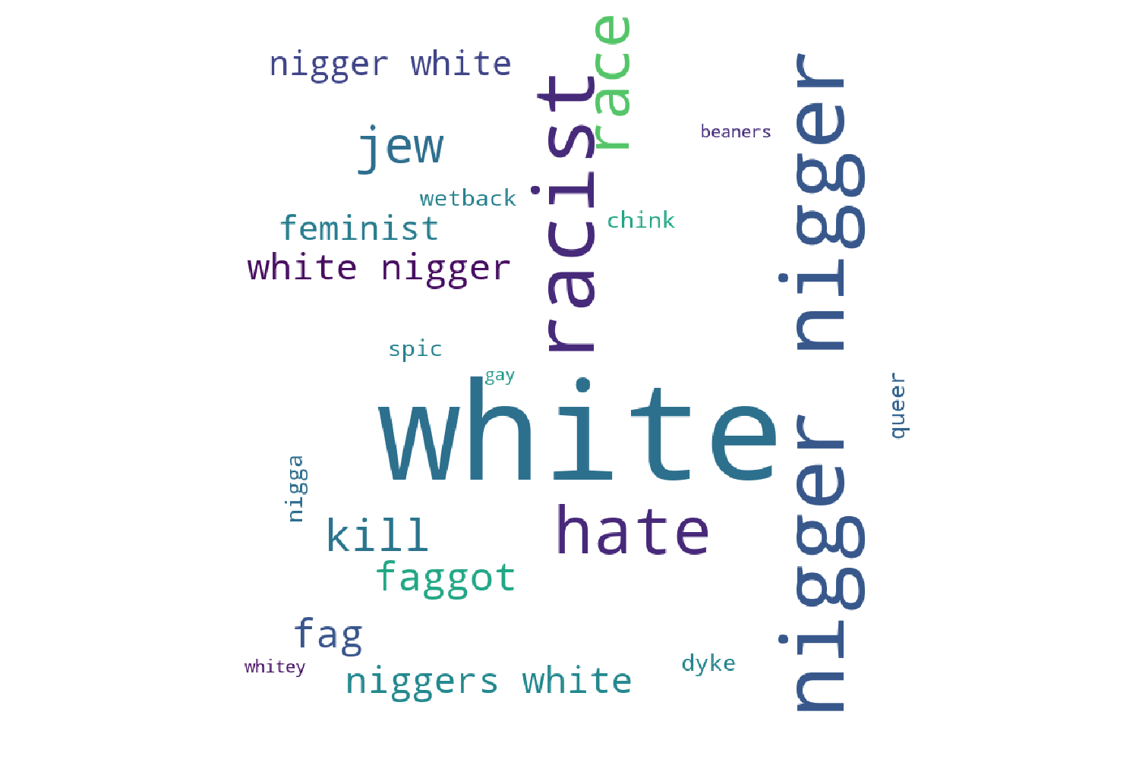
Hateful words

Slide 9
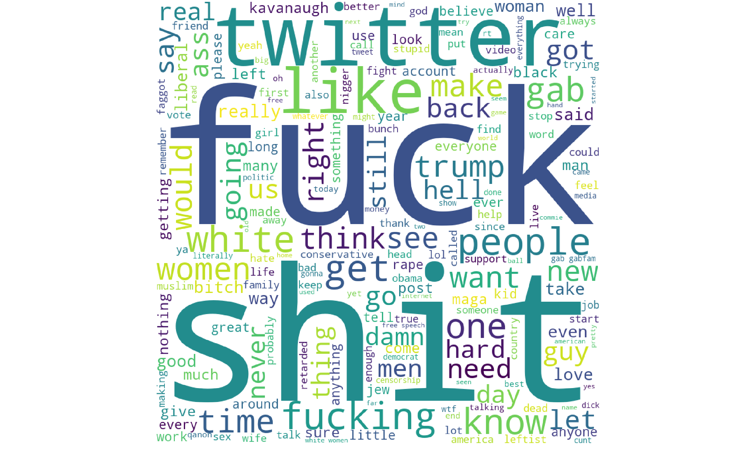
Offensive Gabs

Slide 10
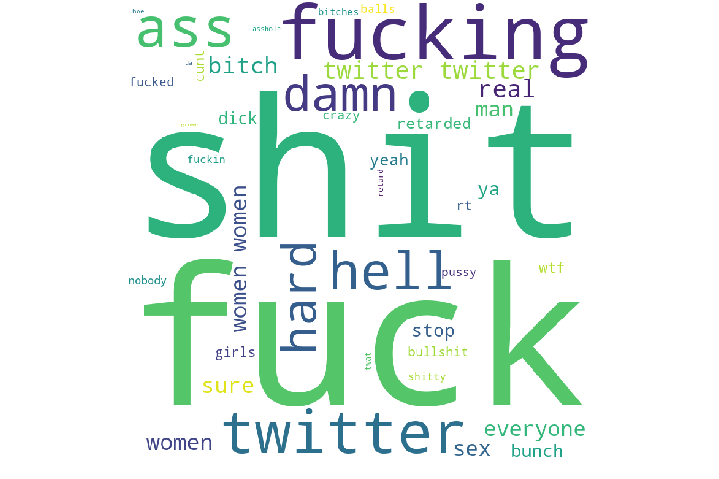
Offensive Words

Slide 11
What next?
Analysing trending posts and trending hashtags
Network analysis over spread of hate / offensive posts

