Slide 1
Nyan Gab
Analysis of hate speech on gab

Slide 2
Method
Based on “Automated Hate Speech Detection and the Problem of Offensive Language” – T Davidson, D Warmsley, M Macy, I Weber
Model – Linear SVM
3 Classes – Hate Speech, Offensive, Neither

Slide 3
Data
Using Gab’s API, we crawl the social network using a snowball methodology –
Obtain data for most popular users on Gab
Simple BFS to collect data from all their followers and all their followers
18,562 Gabs collected so far (Goal is to collect 100,000)

Slide 4
Warning: Due to the nature of the project, a lot of the following slides are NSFW (explicit language)

Slide 5
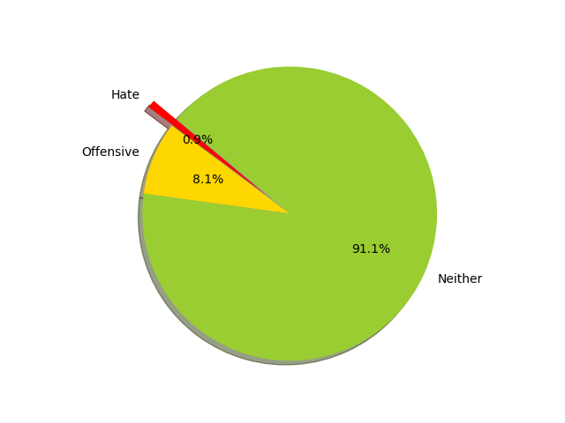
Results
Surprisingly, only ~10% of Gabs collected were offensive / hateful in nature

Slide 6
Popular hate bigrams and trigrams
nigger nigger | nigger nigger nigger
white people | every white person
white person | white person i
every white | person i disagree
i disagree | only white countries
white countries | white people white
person i | racist people fucking
white supremacist | countries got to
white men | countries expected forget
we re | could find urdu

Slide 7
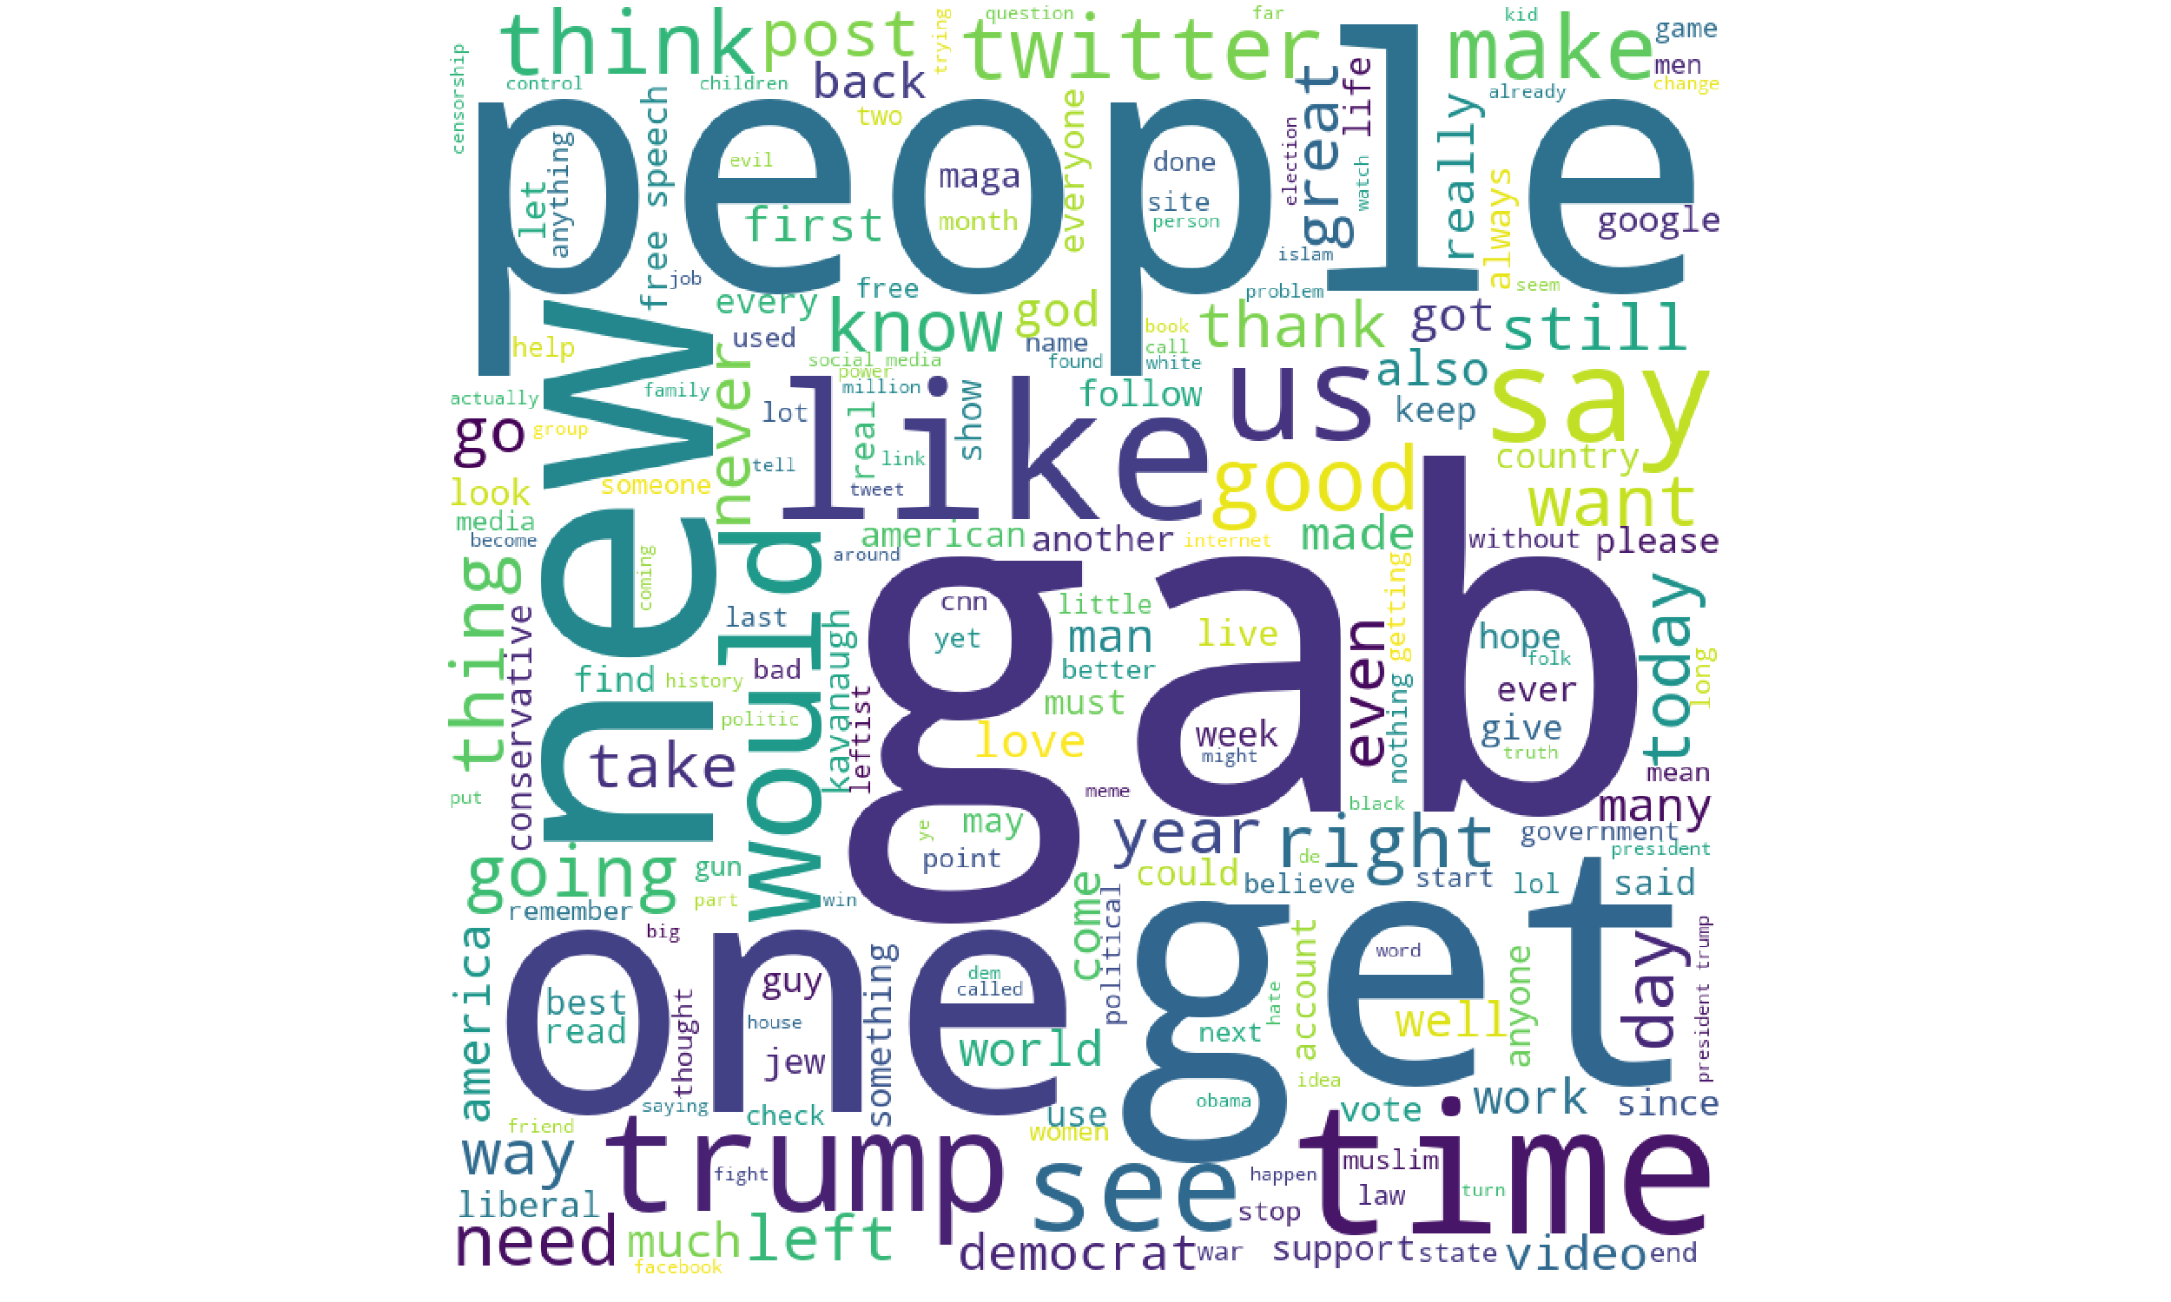
Neutral Gabs

Slide 8
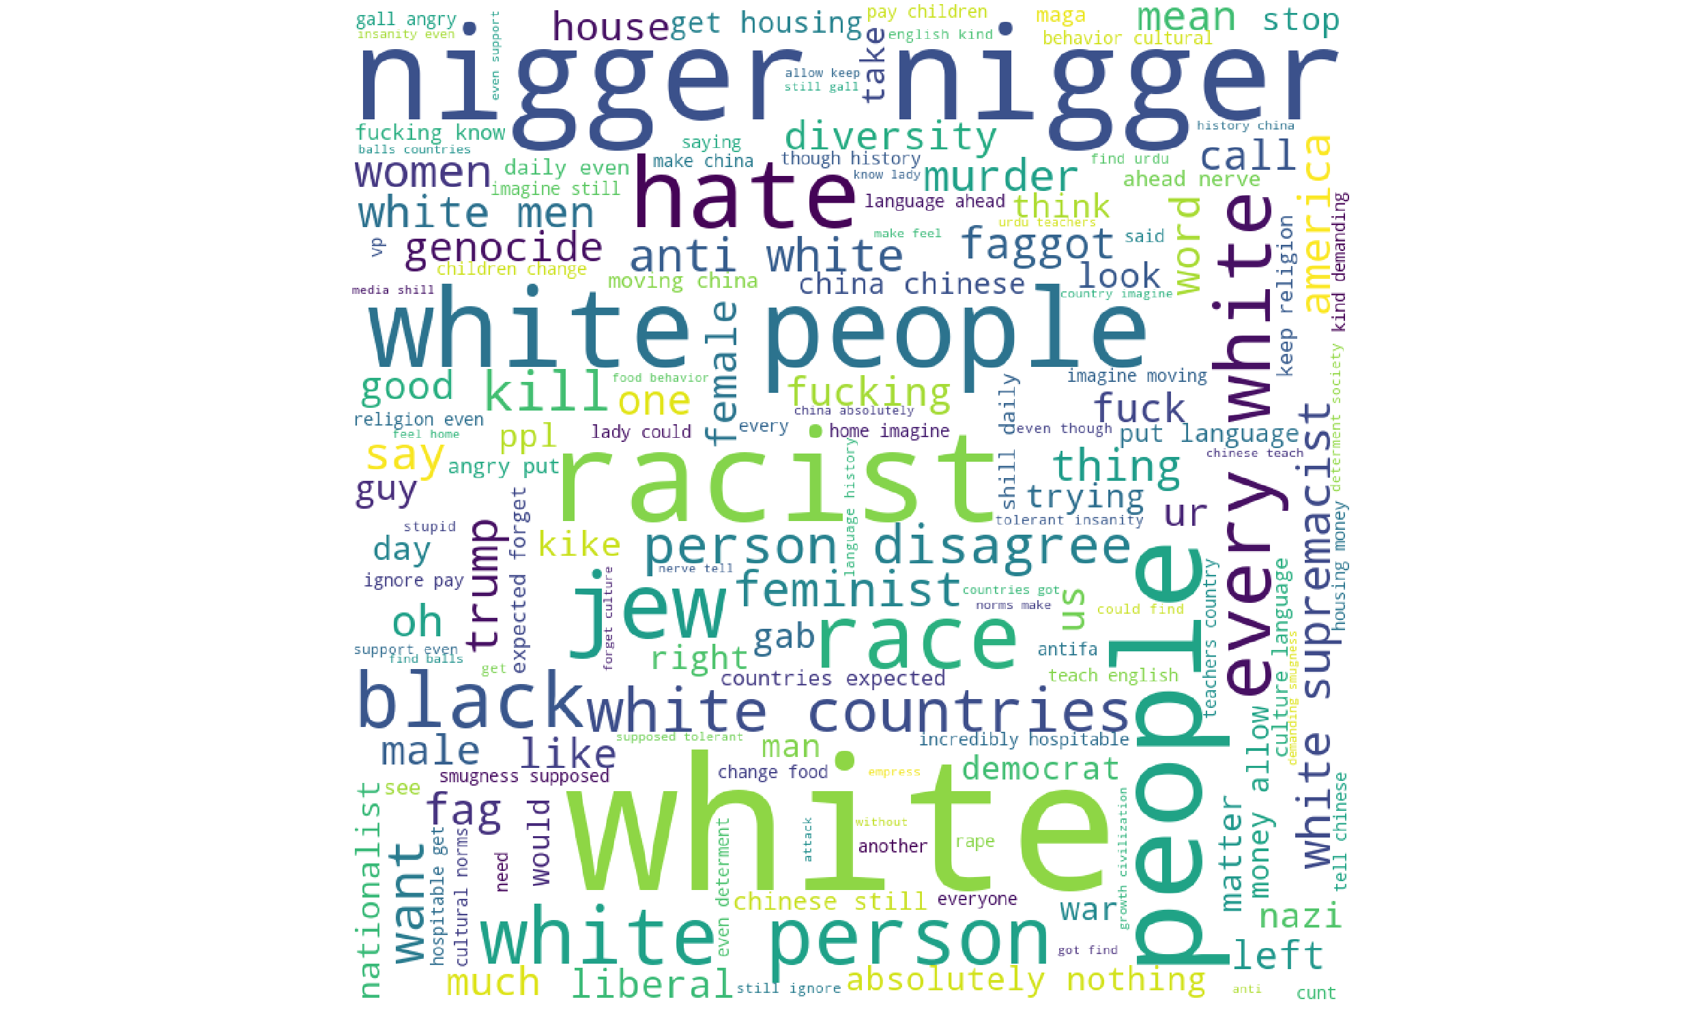
Hateful Gabs

Slide 9
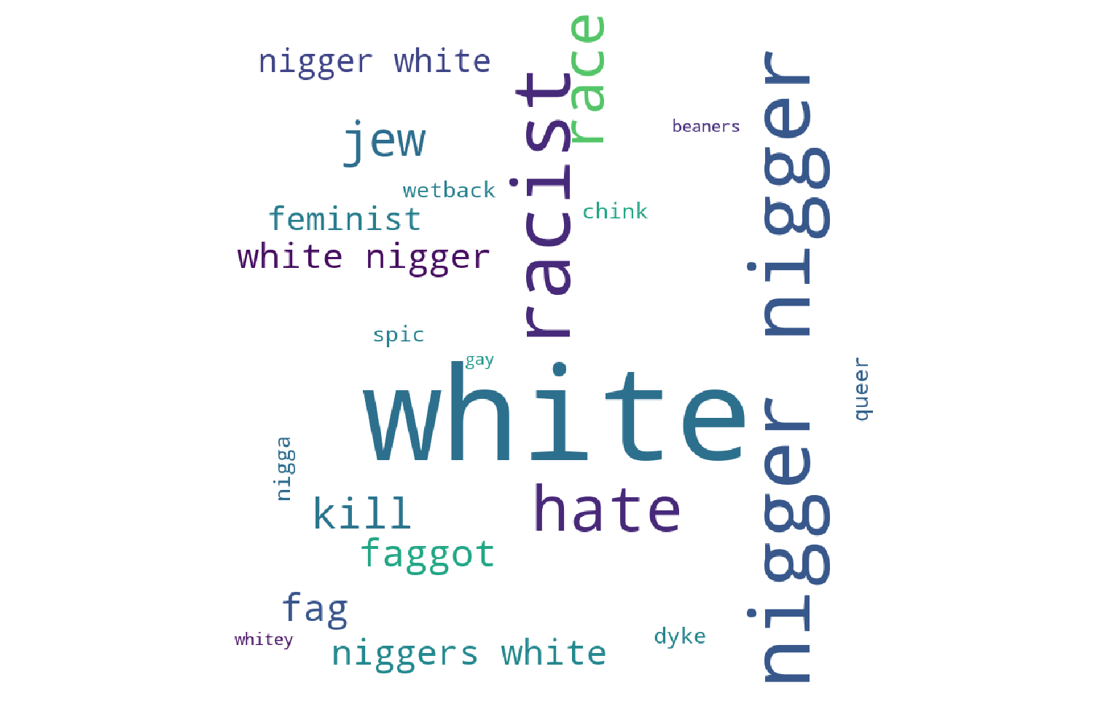
Hateful words

Slide 10
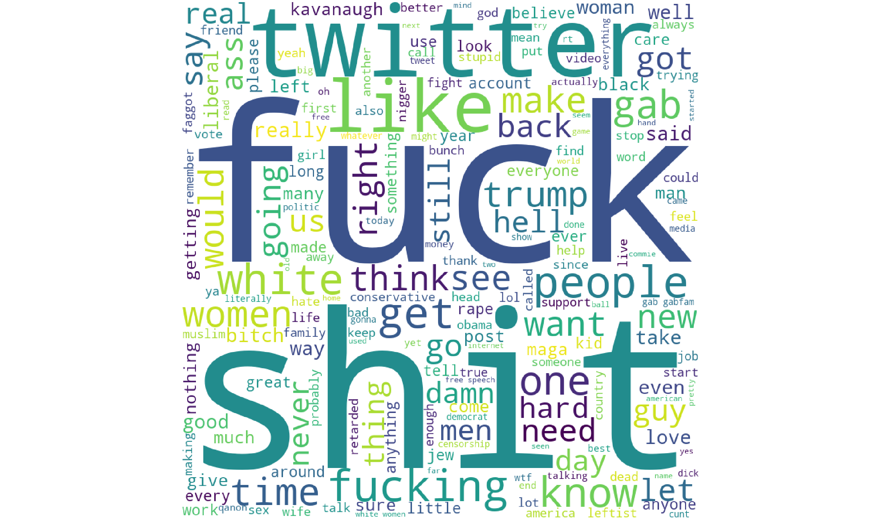
Offensive Gabs

Slide 11
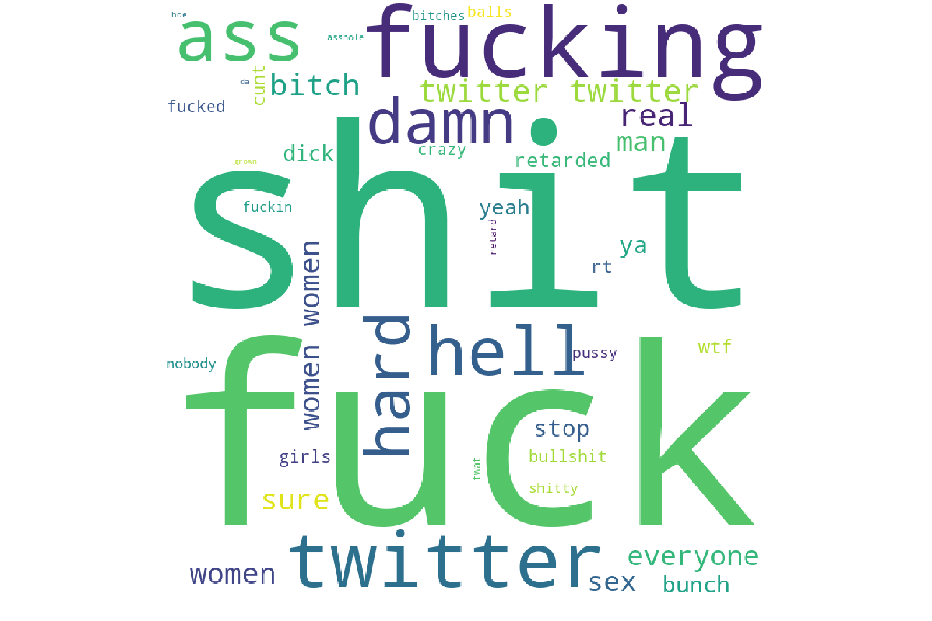
Offensive Words

Slide 12
What next?
Analysing trending posts and trending hashtags
Network analysis over spread of hate / offensive posts

