Slide 1
Nyan Gab
Analysis of hate speech on gab

Slide 2
Recap
Method – Linear SVM to classify Gabs as hate, offensive or neither
Data collected – 18,562 Gabs collected using snowball methodology
Since then
Data collected – 10,000 users (username, gabs, followers, following, etc.)
Preliminary network analysis done

Slide 3
Network Analysis
For each user, all gabs classified as hate/offensive/neither using SVM
If user has at least one hateful/offensive post, classified as hateful/offensive user
Network graphs plotted using Gephi for each category of user: haters, offenders, neither

Slide 4
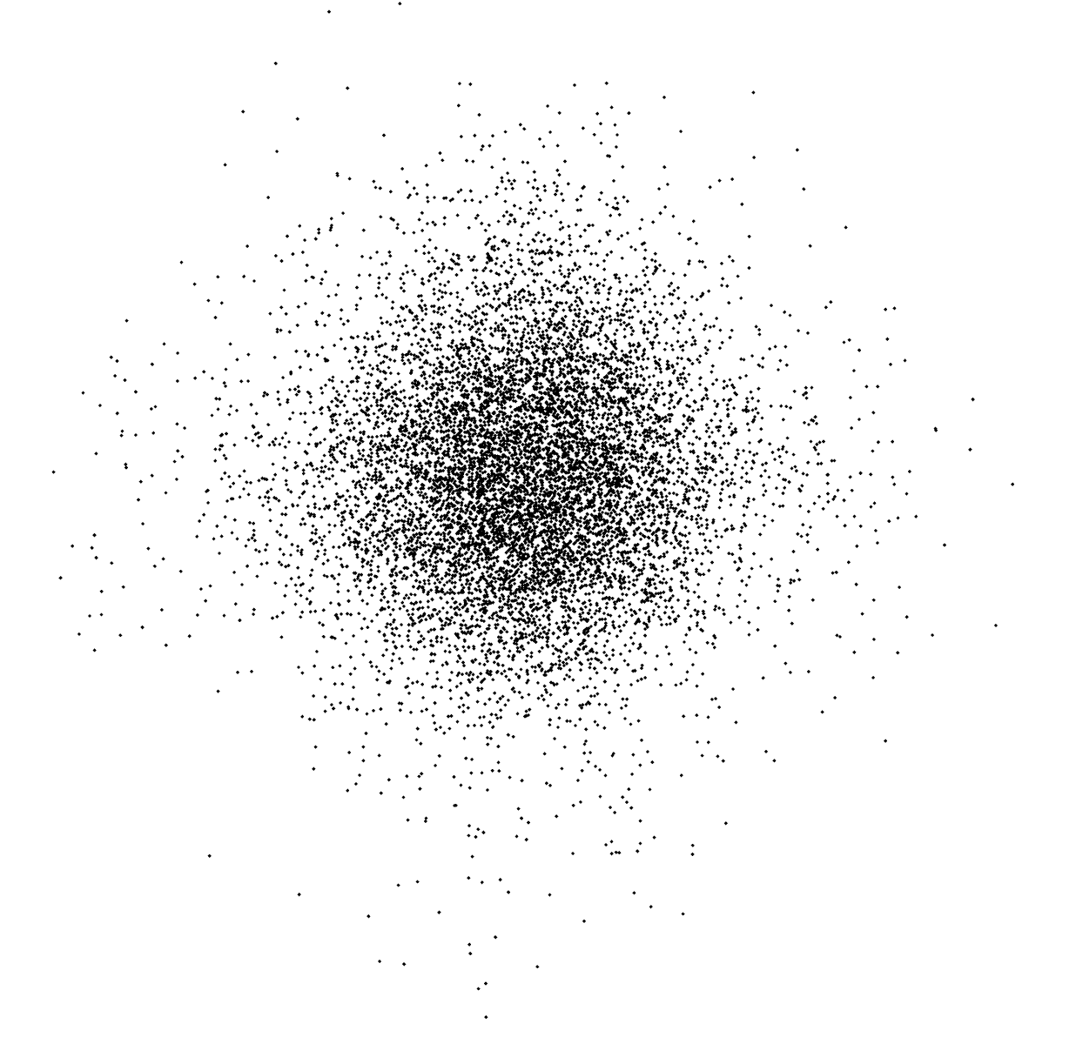
All Users

Slide 5
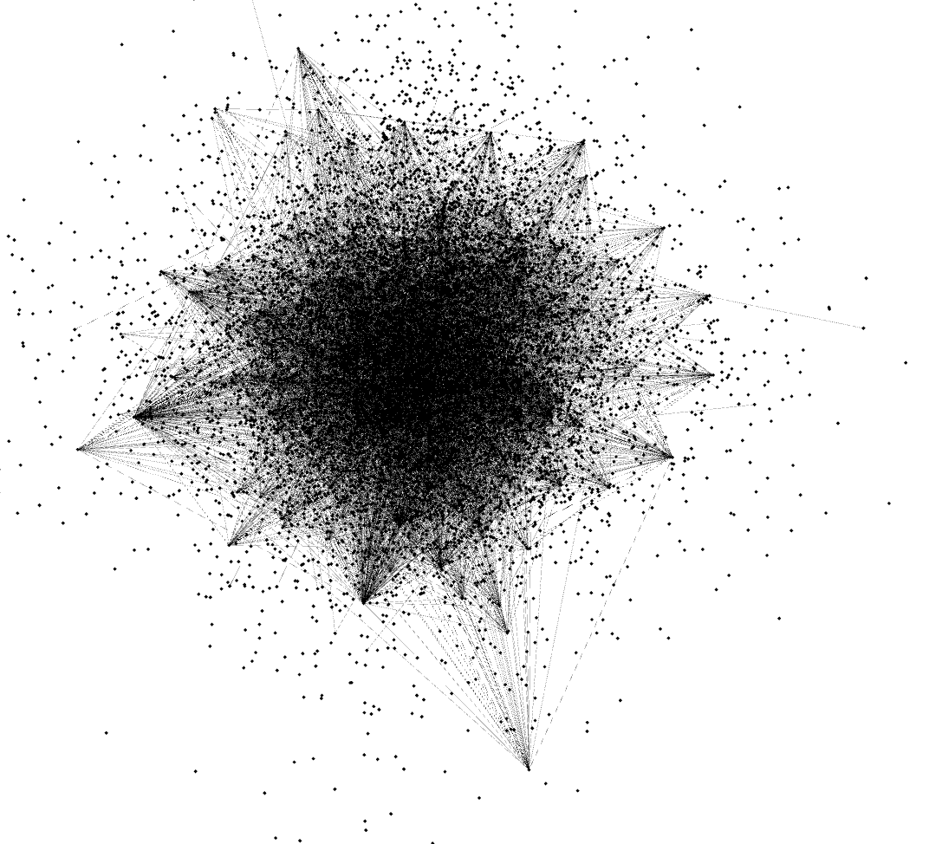
All Users

Slide 6
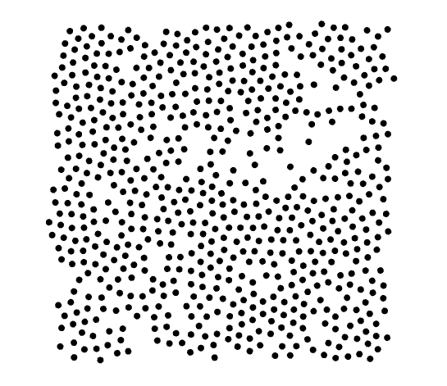
Haters

Slide 7
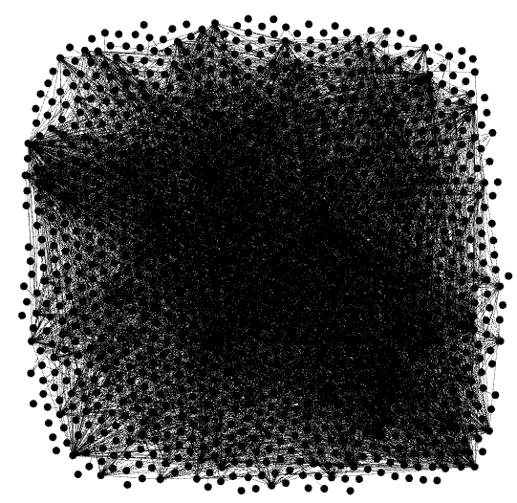
Haters

Slide 8
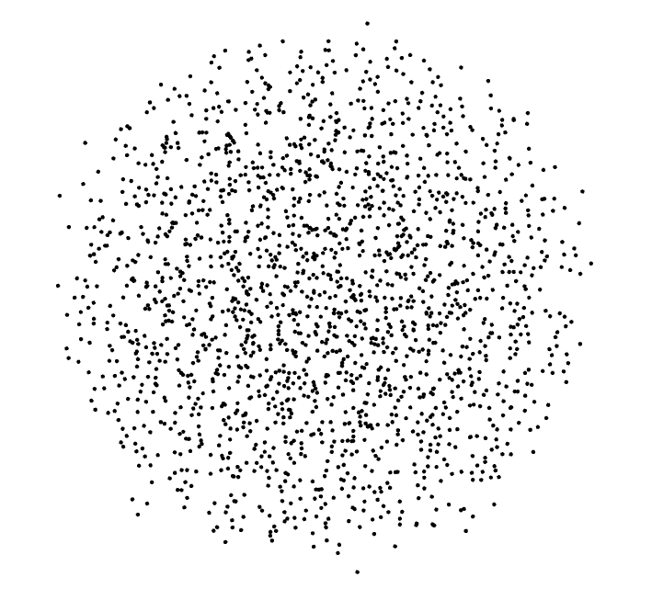
Offenders

Slide 9
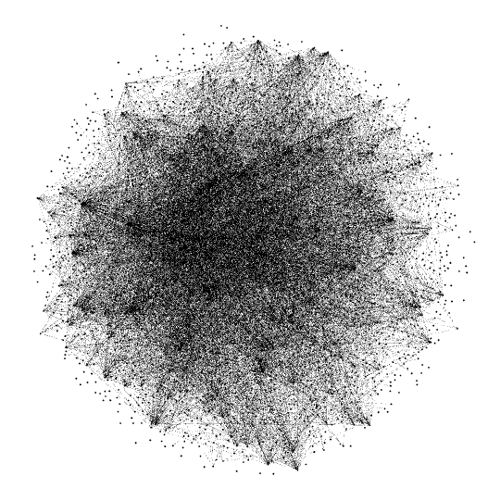
Offenders

Slide 10
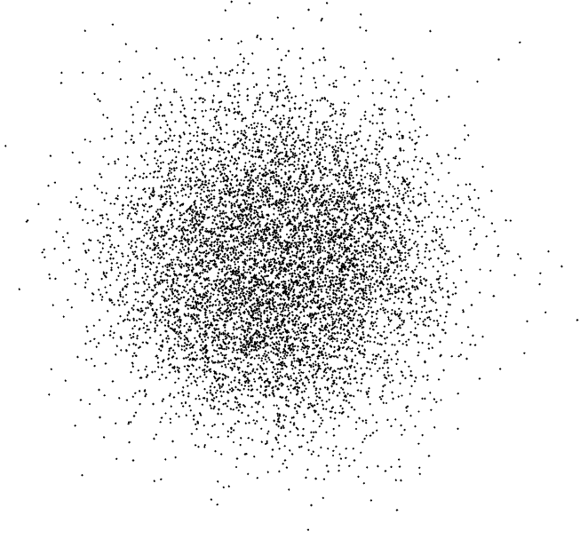
Neither

Slide 11
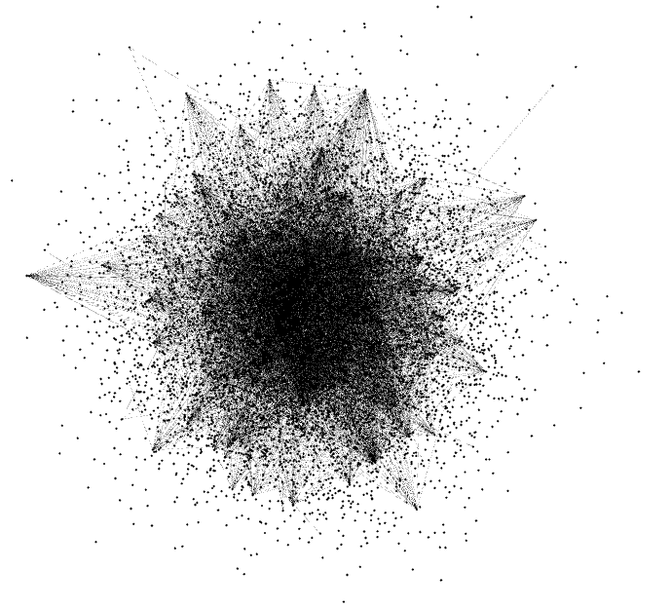
Neither

Slide 12
Comparison
Property | All Users | Haters | Offenders | Neither
Number of Users | 10,000 | 658 | 1940 | 8036
Average Degree | 0.63 | 5.369 | 2.789 | 0.76
Network Diameter | 6 | 6 | 6 | 6
Graph Density | 0 | 0.005 | 0.001 | 0
Modularity | 0.297 | 0.302 | 0.295 | 0.299
Connected Components | 9378 | 558 | 1649 | 7712
Avg. Clustering Coefficient | 0.007 | 0.062 | 0.032 | 0.009
Avg. Path Length | 3.03 | 3.03 | 3.03 | 3.03

Slide 13
Interesting observations
Last time, we showed only 0.9% of all Gabs were hateful. But these 0.9% of posts come from only 0.06% of the users. However, offensive posts (9.1%) come from 19.4% of the users. In total, hateful and offensive posts come from 26% of the users on Gab.
From the avg. degree values, it is clear that haters are 8.5 times more likely to follow each other than average users. Similarly, offenders are 4.5 times more likely.
Haters and offenders are clustered to a much higher degree than average users.

Slide 14
What next?
Further network analysis to see how hate spreads
Analysing trending posts and trending hashtags on Gab

