Slide 1
● LIVE PLATFORM DEMO · MAY 2026
Virtual
Coach
AI-powered multilingual sales training — from PowerPoint upload to scored quiz, in minutes.
12
65%
6
847
Trainings
Avg Score
Languages
Learners
🖥️ CMS Portal
📱 Mobile App
🧠 GPT-4o Eval
💬 RAG Chatbot
🌐 6 Languages
Samsung GenAI Lab · genailab.gem3@samsung.com
1 / 14

Slide 2
SYSTEM ARCHITECTURE
Two apps. One shared AI brain.
Content managers build on the CMS. Learners engage on mobile. Both share the same SQL Server database.
🖥️ CMS Portal · :3000
⚡ AI Services
📱 Mobile App · :8083
Upload PPTX + Excel
GPT-4o (Eval + RAG)
Slide Player + Audio
Ingestion Pipeline
Embeddings 3-small
AI Quiz (text + voice)
Training & Assignment Mgmt
TTS Audio Engine
FAQ Chatbot (RAG)
Dashboard Analytics
⇄
Azure STT Transcription
⇄
Progress Tracking
Missed FAQ Review
6 Language Switcher
Spring Boot :8080 · Next.js :3000
Azure OpenAI · GCS · ElevenLabs
Spring Boot :8081 · Expo RN :8083
2 / 14

Slide 3
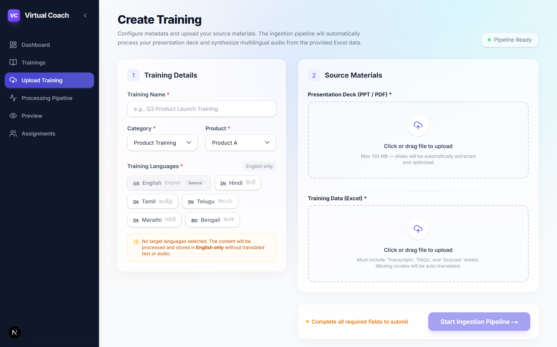
CMS · STEP 1
localhost:3000/upload-training
Upload & Configure
Drop a PowerPoint deck and an Excel data sheet. Select languages, then launch the ingestion pipeline with a single click.
📊 PPTX → slides auto-extracted via Apache POI
📋 Excel → FAQ rows + quiz questions parsed
🌐 6 locales: EN / HI / TA / TE / MR / BN
🚀 One click starts the full ingestion pipeline
3 / 14

Slide 4
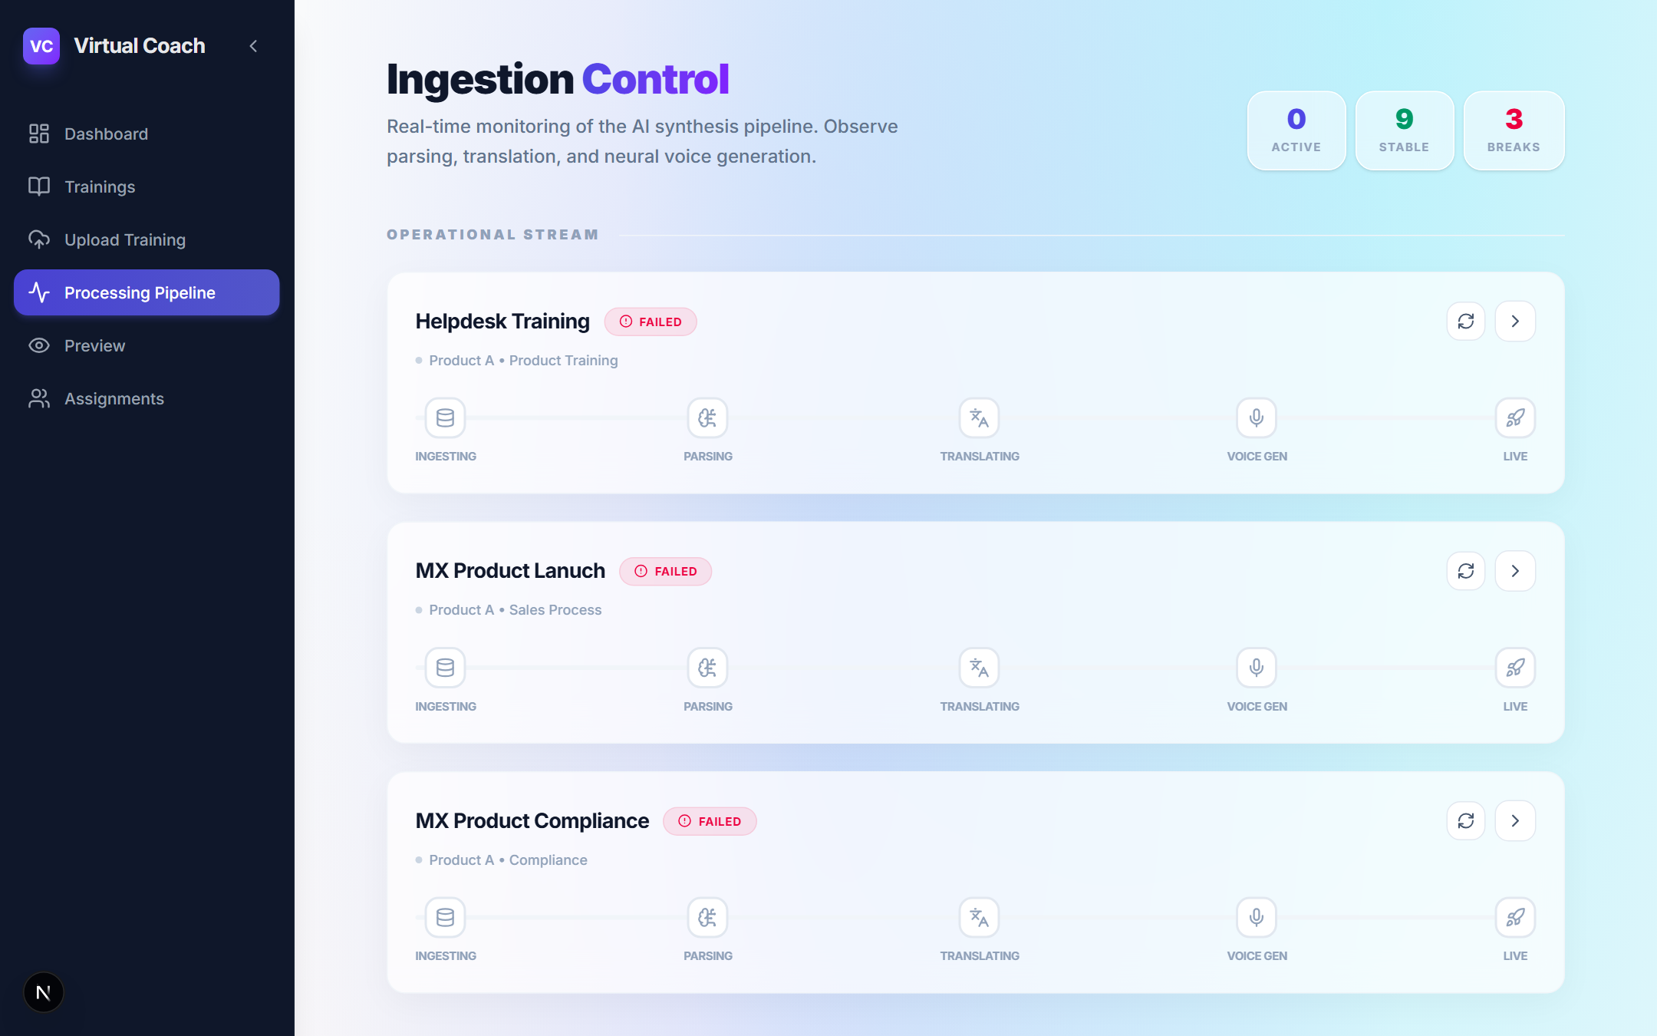
CMS · INGESTION PIPELINE
localhost:3000/processing
Real-time Processing Monitor
Watch each training move through the AI synthesis pipeline. Five stages: Ingesting → Parsing → Translating → Voice Gen → Live.
📥 Ingesting — slides parsed from PPTX
🔤 Parsing — FAQ + quiz rows extracted
🌐 Translating — content localised per language
🎵 Voice Gen — TTS audio per locale
✅ Live — training published & assigned
4 / 14

Slide 5
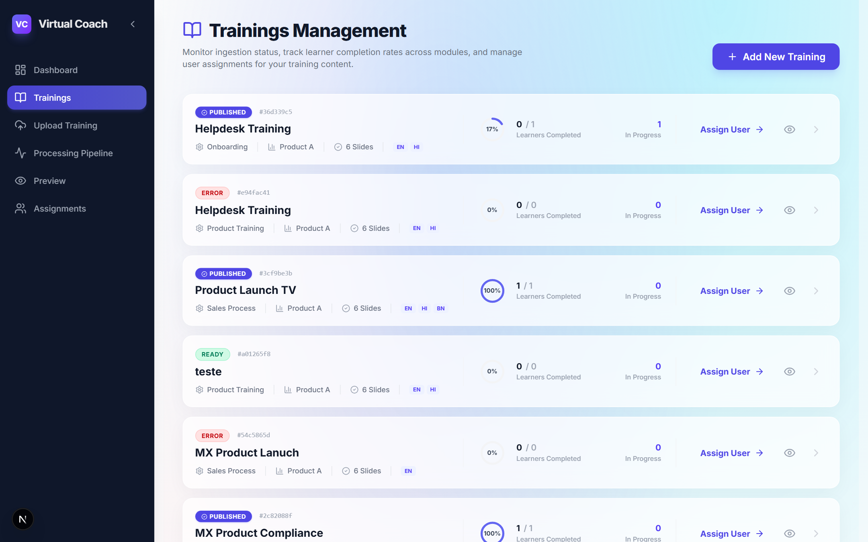
CMS · CONTENT LIBRARY
localhost:3000/trainings
Trainings Management
Full inventory of training modules with status, locale badges, learner progress counts, and quick-action buttons.
🟢 PUBLISHED — live and assignable
🔴 ERROR — pipeline failed, one-click re-run
🟡 READY — processed, not yet published
🌐 Locale flags show which languages are live
👤 Assign User button inline per training
5 / 14

Slide 6
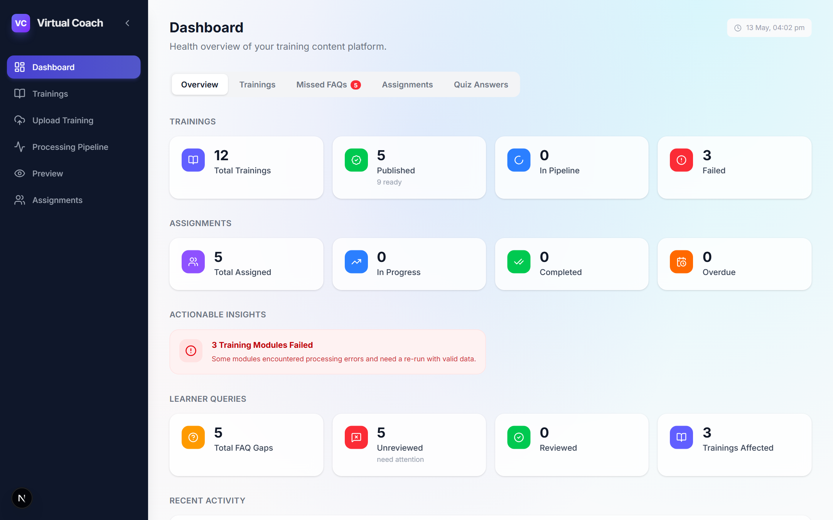
CMS · DASHBOARD OVERVIEW
localhost:3000/dashboard
Platform Health at a Glance
12 trainings · 5 published · Learner queries · Actionable insights — all on one overview screen.
📊 12 total trainings, 5 published & live
👥 5 assignments tracked with status
❓ 5 total FAQ gaps, 5 unreviewed queries
⚠️ Actionable insights — 3 failed modules flagged
📅 Recent activity feed at bottom
6 / 14

Slide 7
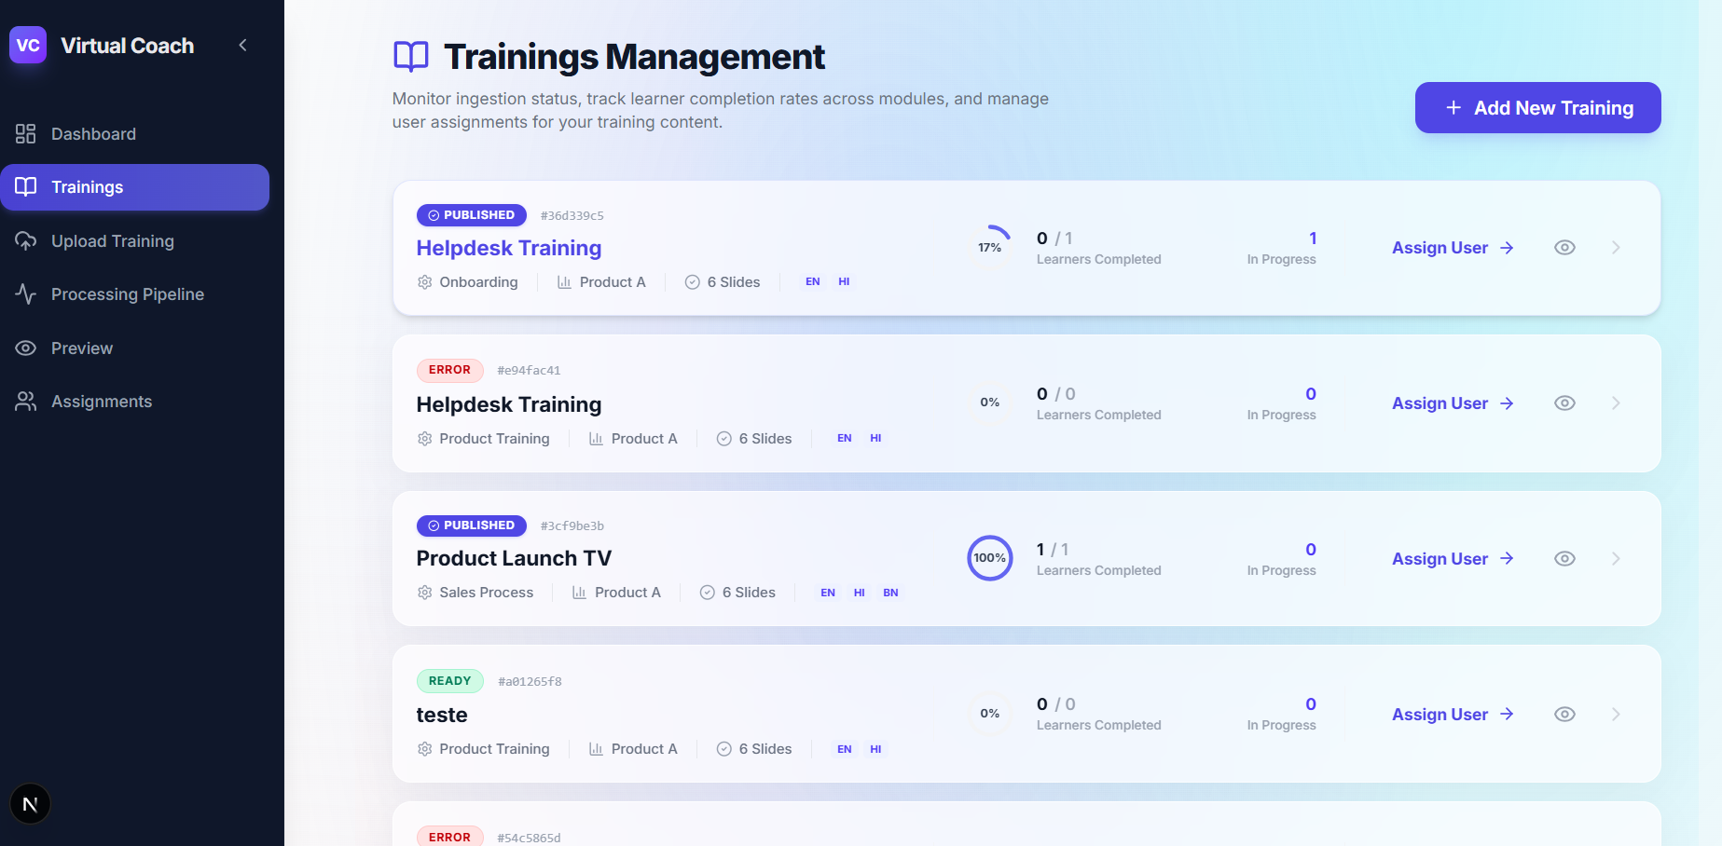
CMS · DASHBOARD → TRAININGS
localhost:3000/dashboard → Trainings
All Trainings in One Table
Filter by READY / PROCESSING / ERROR / DRAFT. See locale availability, publish date, and status at a glance.
🟢 READY rows are live on the mobile app
🔴 ERROR rows show the failure reason inline
🌐 EN / HI / BN locale chips per training
📅 Published and created dates tracked
🔢 Slide count per training visible at a glance
7 / 14

Slide 8
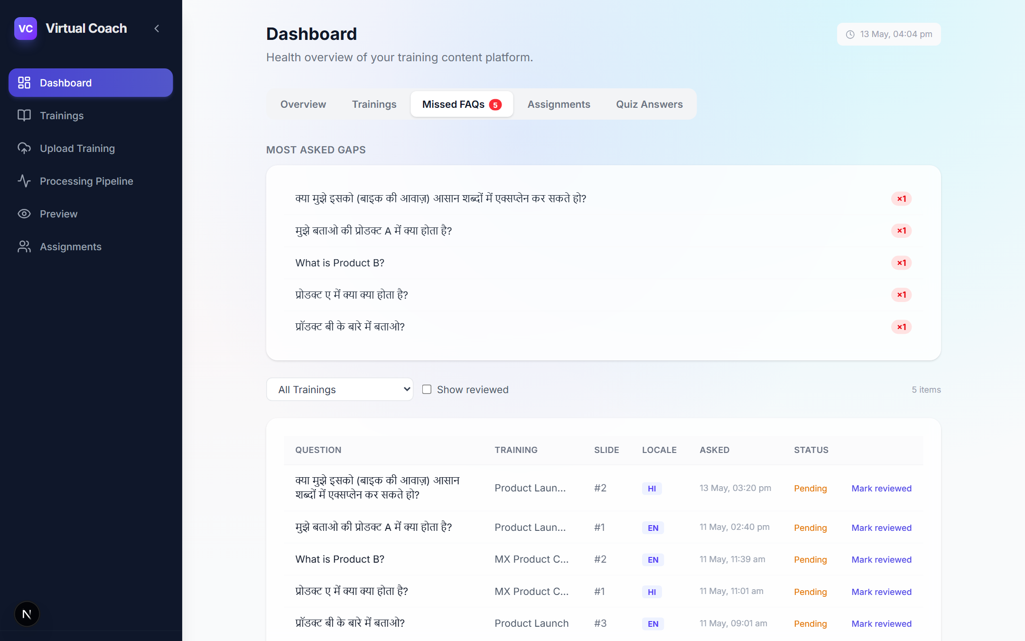
CMS · DASHBOARD → MISSED FAQS
localhost:3000/dashboard → Missed FAQs
Closed Feedback Loop
Every question the AI couldn't answer is logged here. Review, then add to Excel to enrich future training content.
❓ Most-asked gaps surfaced at the top
🌐 Questions shown in original locale (HI, EN…)
📌 Slide number + training linked per question
✅ Mark Reviewed to clear the admin queue
8 / 14

Slide 9
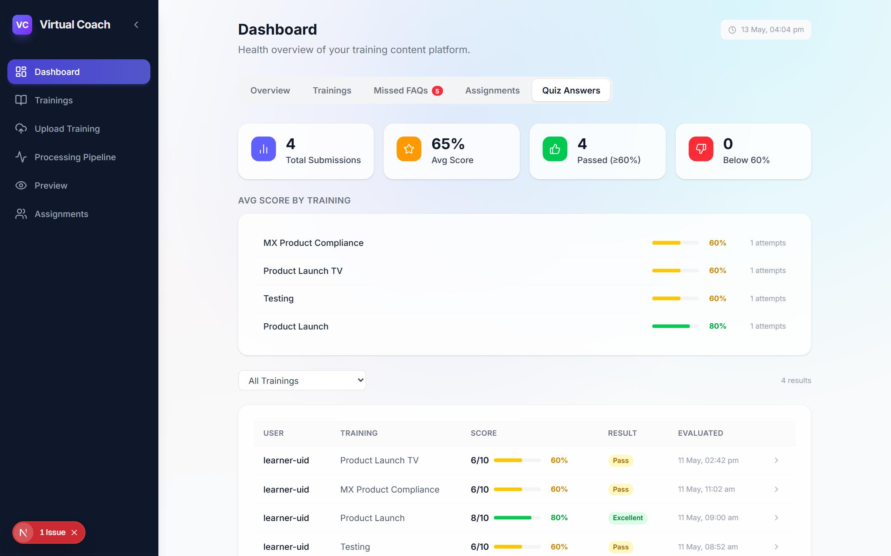
CMS · DASHBOARD → QUIZ ANSWERS
localhost:3000/dashboard → Quiz Answers
AI-Scored Quiz Results
4 submissions · 65% avg score · GPT-4o evaluates free-text answers against a rubric. Pass / Excellent thresholds enforced.
📊 Score bars per training module
🏅 Pass / Excellent / Below 60% thresholds
👤 Per-learner score table with evaluation date
🤖 Evaluated by GPT-4o, not manual grading
🔢 8/10 scores with 80% pass rate shown
9 / 14

Slide 10
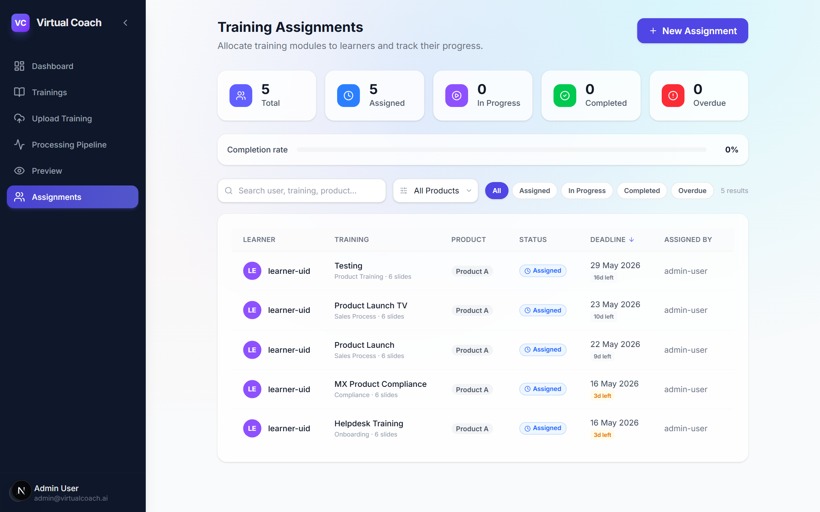
CMS · ASSIGNMENTS
localhost:3000/assignments
Assign & Track
Allocate any training to any learner with a deadline. Track status across the entire cohort from a single screen.
👥 5 total assigned, sorted by deadline
📅 Due dates with urgency countdown shown
🔍 Filter by product, status, or learner
⚡ New Assignment modal — one click
📊 Completion rate tracked at top of page
10 / 14

Slide 11
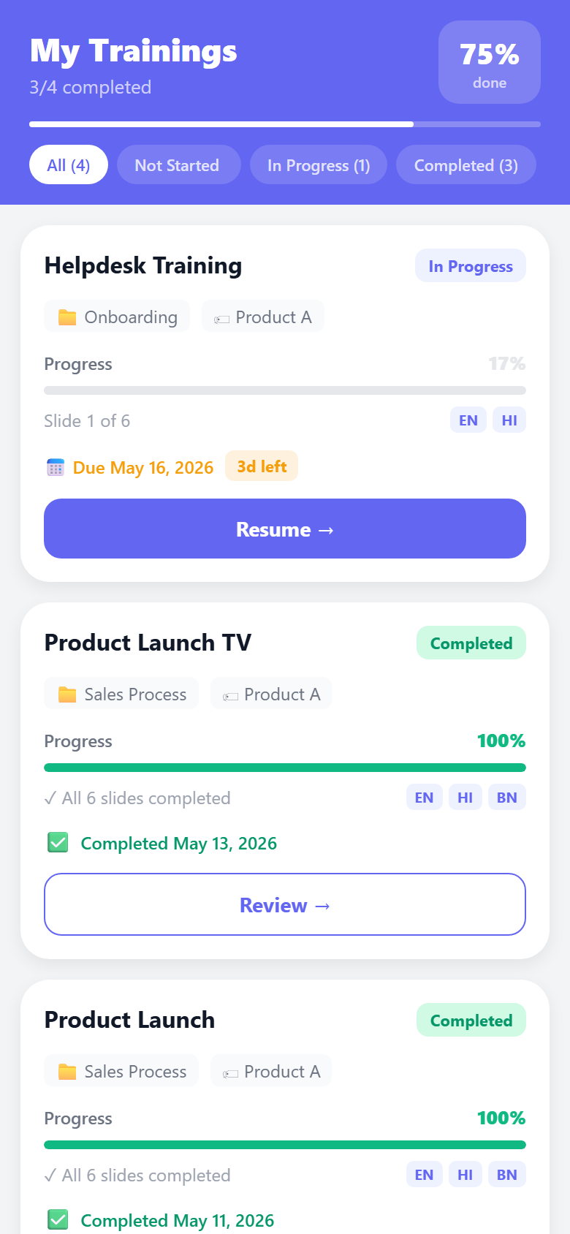
MOBILE APP · LEARNER HOME
Personalised Training Feed
Smart-sorted assignments — In Progress first, then by deadline.
3/4 completed · 75% overall done.
Smart Sorting
In Progress → nearest deadline → Not Started → Completed. Urgent items always surface first.
Resume in One Tap
Backend persists slide index. Learner resumes exactly where they left off across sessions.
Tab Filters
All (4) · Not Started · In Progress (1) · Completed (3). Instant filter without reload.
Multi-locale Chips
EN · HI · BN locale availability shown per card. Switch language inside the player.
11 / 14

Slide 12
MOBILE APP · TRAINING CARDS
Completion & Progress Tracking
Real-time progress synced from backend — survives app restarts and device switches.
In Progress — Helpdesk Training
17% · Slide 1 of 6 · Due in 3 days. Resume button takes learner straight to current slide.
Completed — Product Launch TV
100% · All 6 slides done · Completed May 13, 2026. Review mode available.
Completed — Product Launch
100% · All 6 slides done · EN · HI · BN locales available.
Progress Persistence
Progress ID = userId + "_" + trainingId. Stored in SQL Server via mobile backend.
12 / 14

Slide 13
PLATFORM CAPABILITIES
Everything in one platform
📤
Content Ingestion
🎵
Multilingual Audio
🧠
AI Quiz Evaluation
PPTX + Excel → slides, FAQs, quizzes. Fully automated. Apache POI extraction, parallel embedding.
6 languages auto-generated: EN, HI, TA, TE, MR, BN. Distinct AI voice per locale. Zero manual recording.
GPT-4o scores free-text and voice answers against rubrics. Pass/Excellent thresholds. Per-learner feedback.
💬
RAG FAQ Chatbot
📊
Admin Analytics
📱
Mobile Experience
Cosine similarity search over embedded FAQs. GPT-4o grounded answers. Unanswered questions logged.
Score distributions, completion rates, missed FAQ queue, assignment tracking — all in the CMS dashboard.
Expo React Native. Slide player, audio switcher, AI chat, quiz modal. Progress persists across sessions.
13 / 14

Slide 14
VirtualCoach · 2026
Train smarter.
Sell better.
Full-stack AI training platform — from PowerPoint upload to multilingual
interactive learning with measurable, AI-scored outcomes.
📧 genailab.gem3@samsung.com
🖥️ CMS: localhost:3000
📱 Mobile: localhost:8083
Spring Boot 3.3
Next.js 16
React Native Expo 54
Azure GPT-4o
SQL Server
RAG + Embeddings
14 / 14

