Slide 1
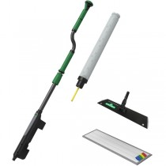
Floor Cleaning Kit

