Slide 1

bluestock
Mutual Fund Analytics Platform
End-to-End Data Engineering, Analytics & Dashboard Project
40 schemes · 64,320 daily NAVs · 32,778 transactions
Dheeraj Reddy Thumma
Data Analyst Intern · Bluestock
June 2026
Internship Capstone · Status: COMPLETE
Notes:
30-second intro: an end-to-end mutual fund analytics platform — from raw, fragmented data to an executive Tableau dashboard, plus forward-looking simulations.

Slide 2
CONTEXT
bluestock
Problem Statement & Objectives
Mutual Fund Analytics
OUR OBJECTIVES
THE PROBLEM
▪
Build an automated ETL pipeline
▪
Create an analytics database
Mutual fund data is fragmented across NAV, transactions, performance, AUM, benchmark and investor datasets - no single source of truth.
▪
Perform fund performance analysis
▪
Study investor behaviour
▪
Develop a recommendation engine
▪
Build an executive dashboard
Mutual Fund Analytics Platform · Internship Capstone
2 / 13
Notes:
Fragmentation across six data families means no one can easily answer 'which fund, for whom, at what risk?'. The objective: unify it and turn it into decisions.

Slide 3
bluestock
FOUNDATION
Mutual Fund Analytics
Data Sources
NAV History
Investor Transactions
Fund Master
Scheme Performance
AUM History
Benchmark Data
Holdings Data
40
32,778
64,320
2022–2026
Funds analyzed
Investor records
Daily NAV records
Date coverage
10 fund houses
transactions
after cleaning
Jan 2022 → May 2026
Mutual Fund Analytics Platform · Internship Capstone
3 / 13
Notes:
Seven dataset families, ~120k records over 4.4 years. Variety enables performance, risk and behavioural analytics no single file could support.

Slide 4
bluestock
HOW IT WORKS
Mutual Fund Analytics
Project Architecture
Raw Data
Validation
ETL
SQLite Database
EDA
Performance Analytics
Advanced Analytics
Tableau Dashboard
Python
Pandas
SQLite
Tableau
Fail-fast · output-validated · one-command rebuild
Mutual Fund Analytics Platform · Internship Capstone
4 / 13
Notes:
A linear, reproducible pipeline: validate, clean, load to a SQLite star schema; notebooks layer EDA, performance, advanced and bonus analytics; Tableau delivers.

Slide 5
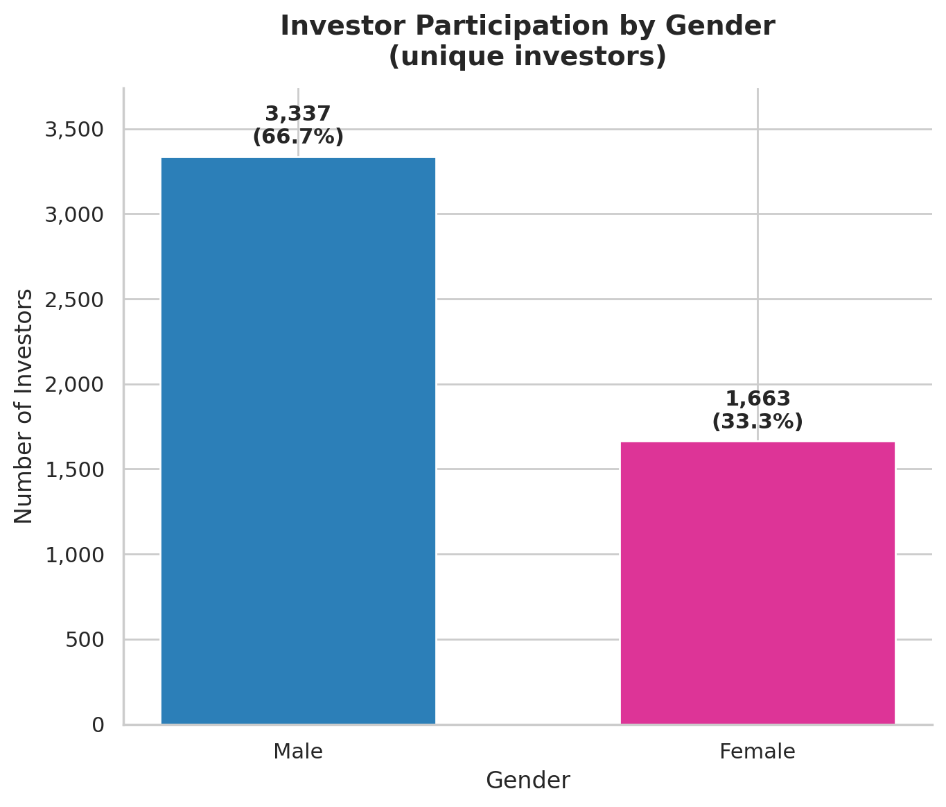
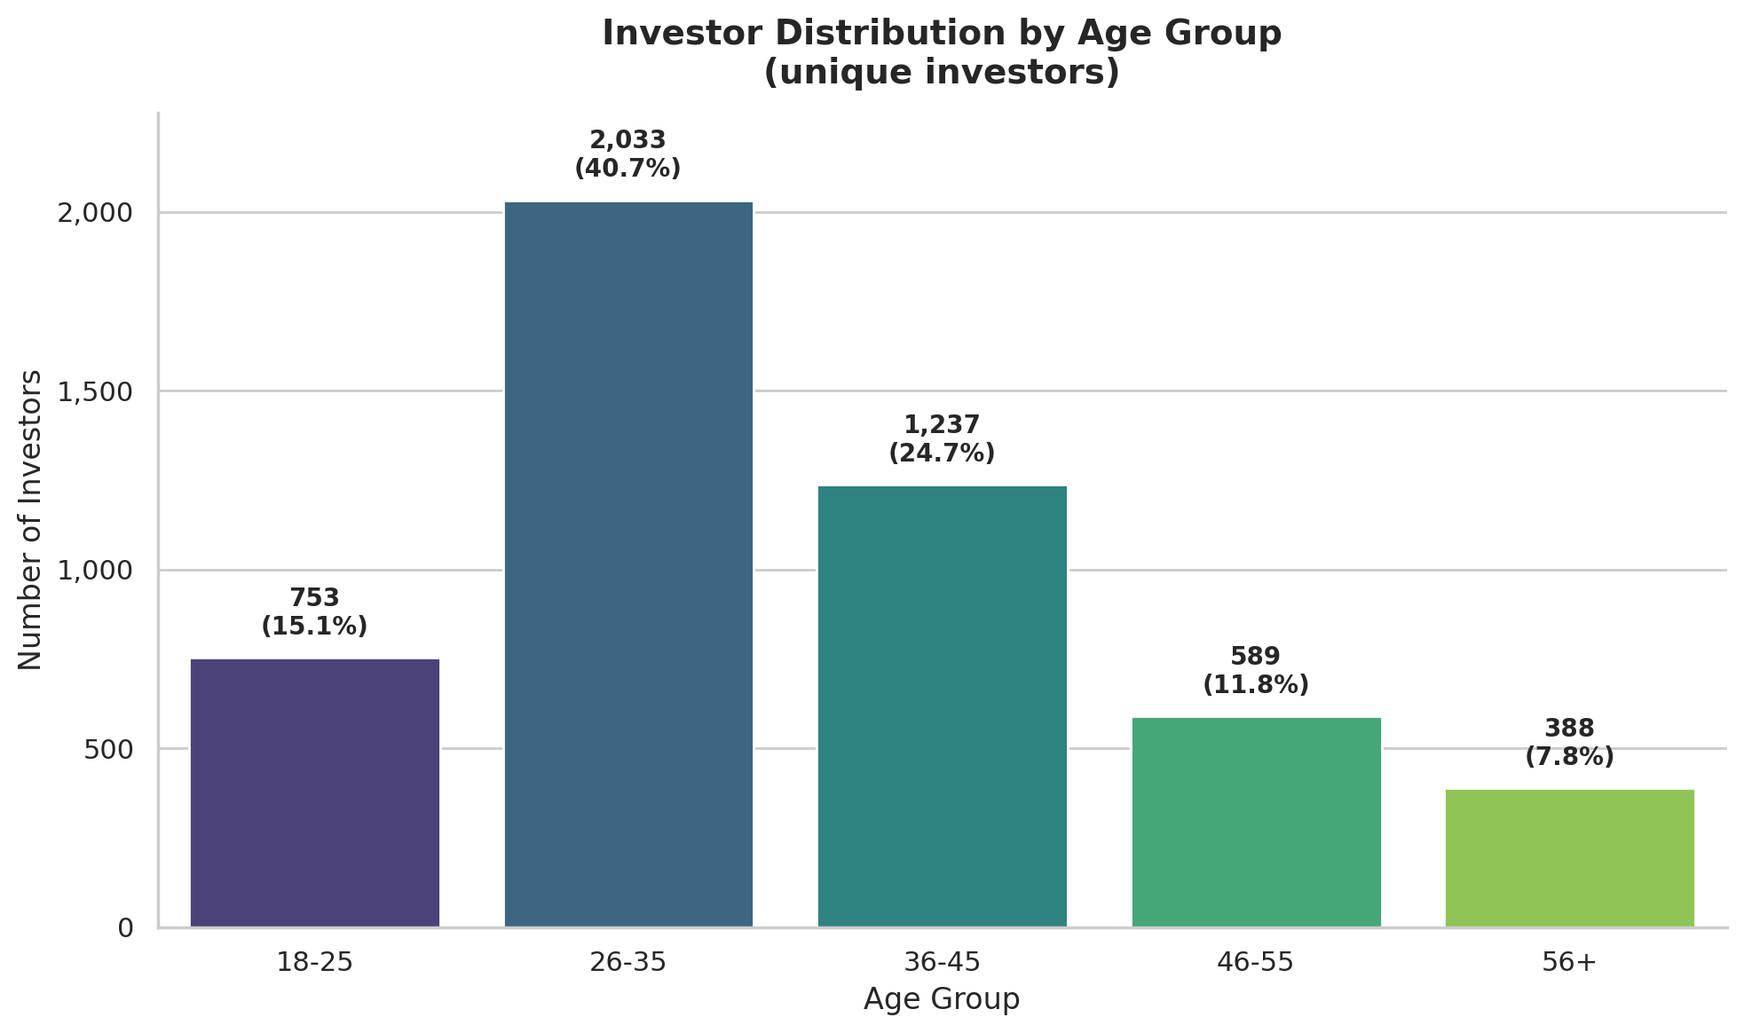
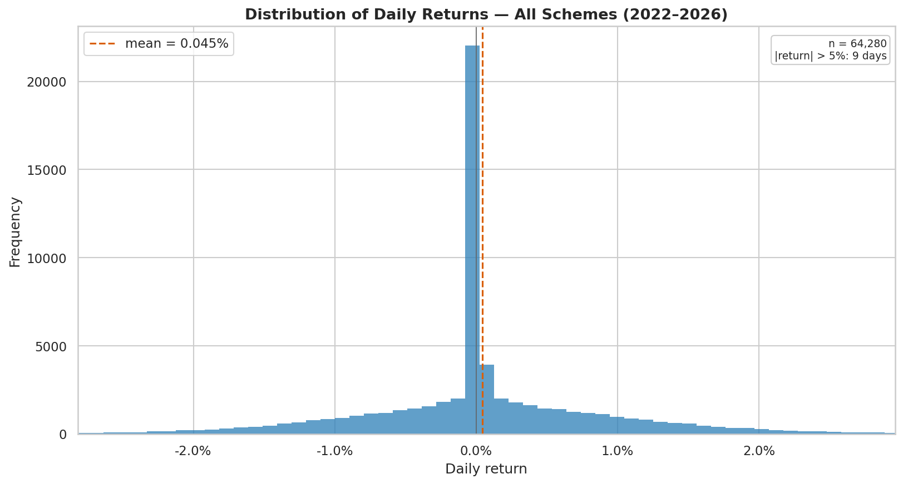
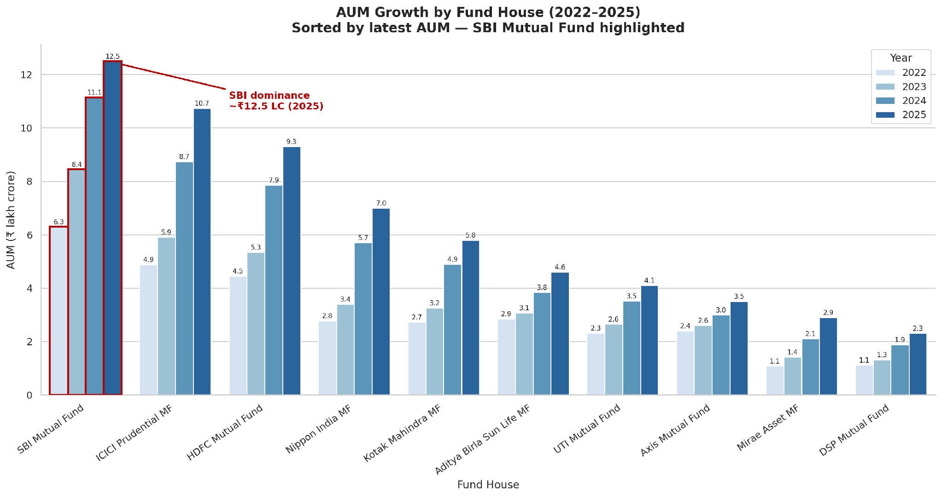
WHAT THE DATA SHOWS
bluestock
EDA Highlights
Mutual Fund Analytics
Demographics — 66% male / 34% female
Transaction trends by age
Daily return distribution — fat tails
AUM concentration & growth
Mutual Fund Analytics Platform · Internship Capstone
5 / 13
Notes:
85% equity universe; investors skew male (66%) and T30 metros (66%); daily returns are fat-tailed (excess kurtosis +3.10); AUM compounds steadily.

Slide 6
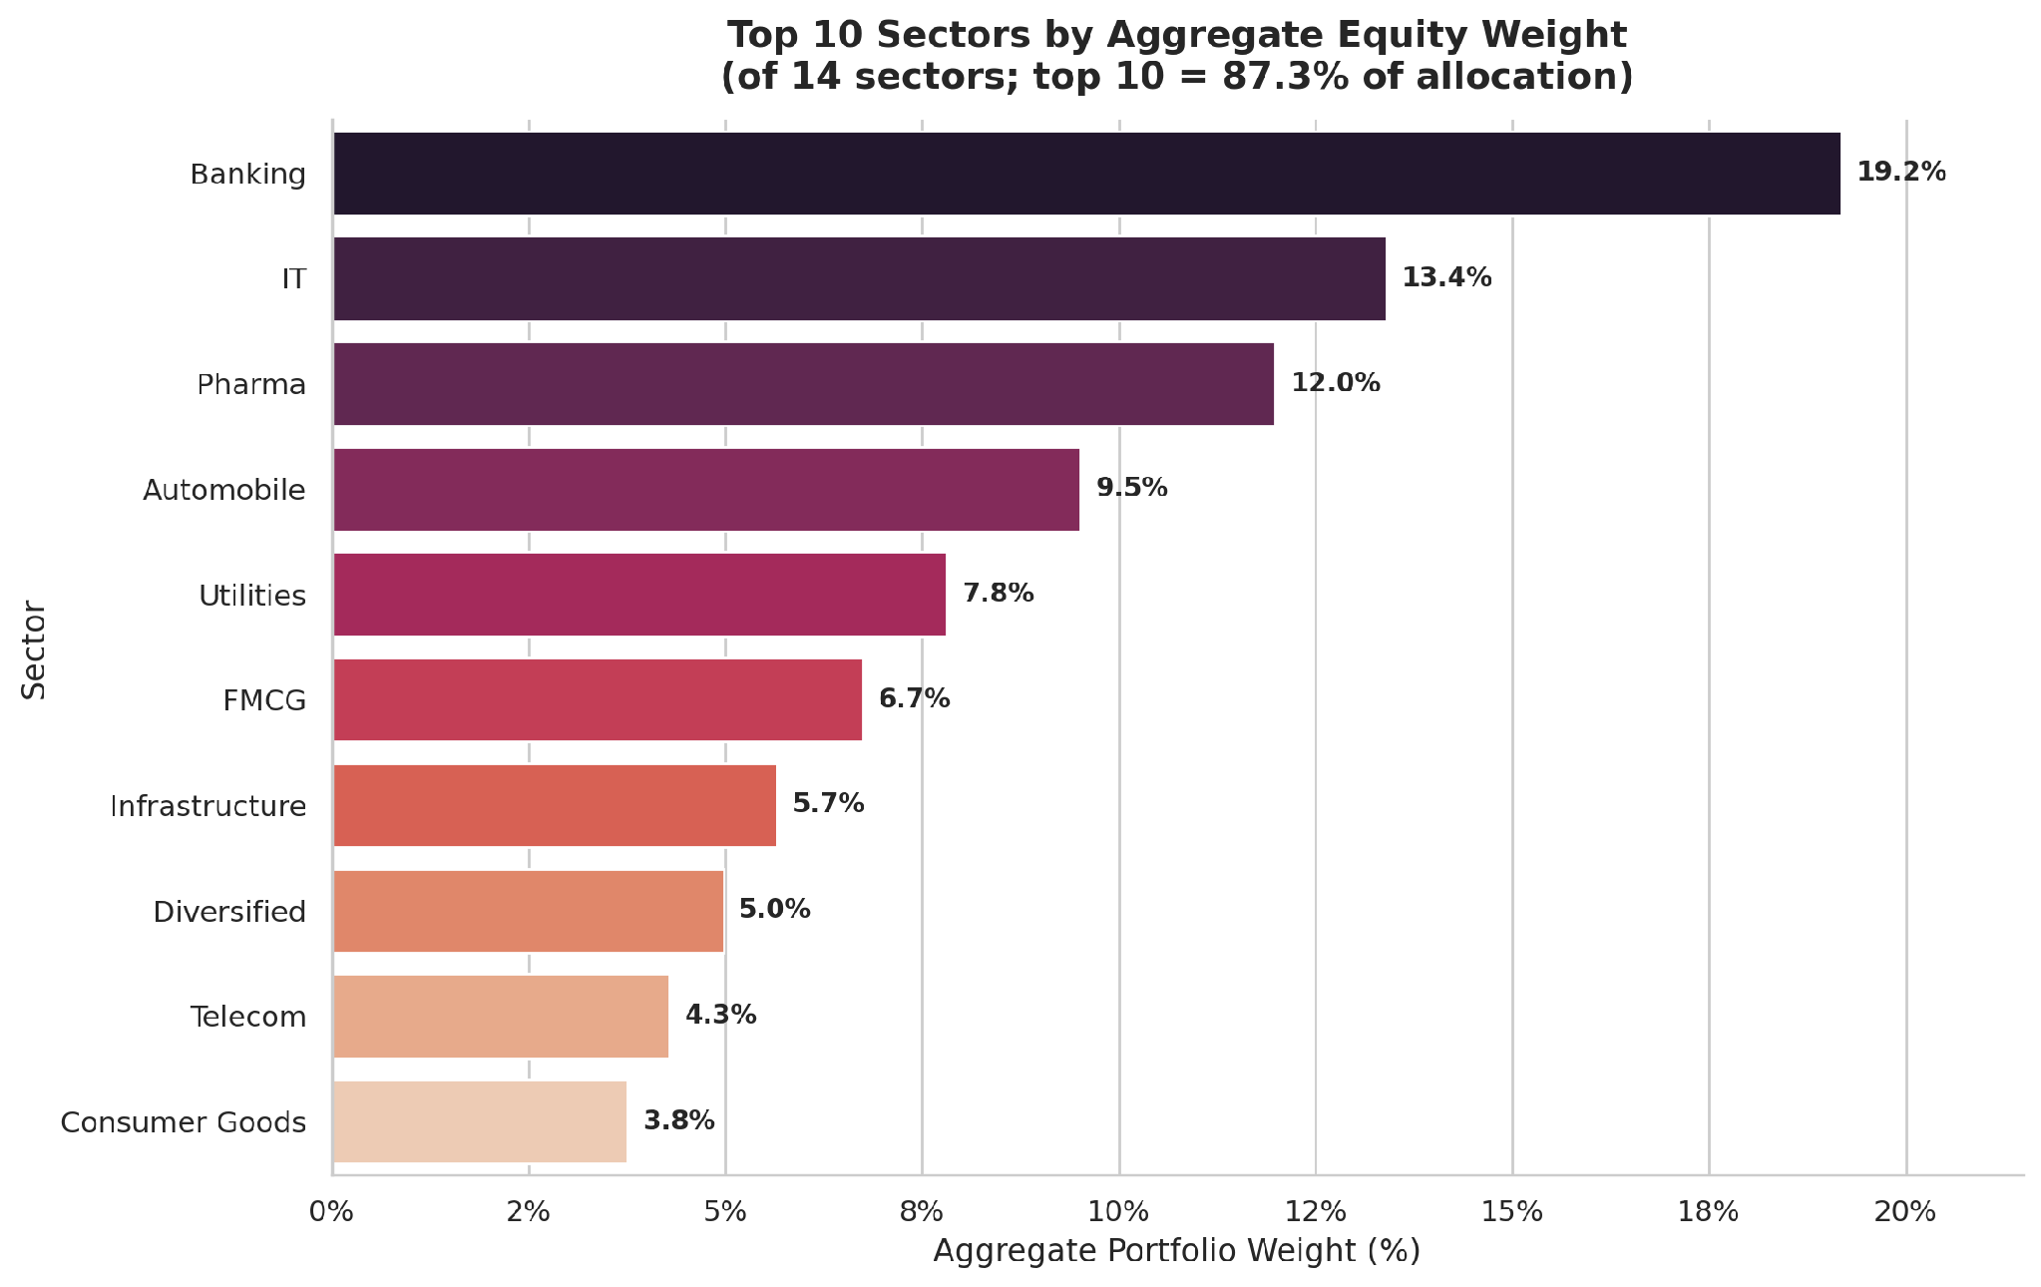
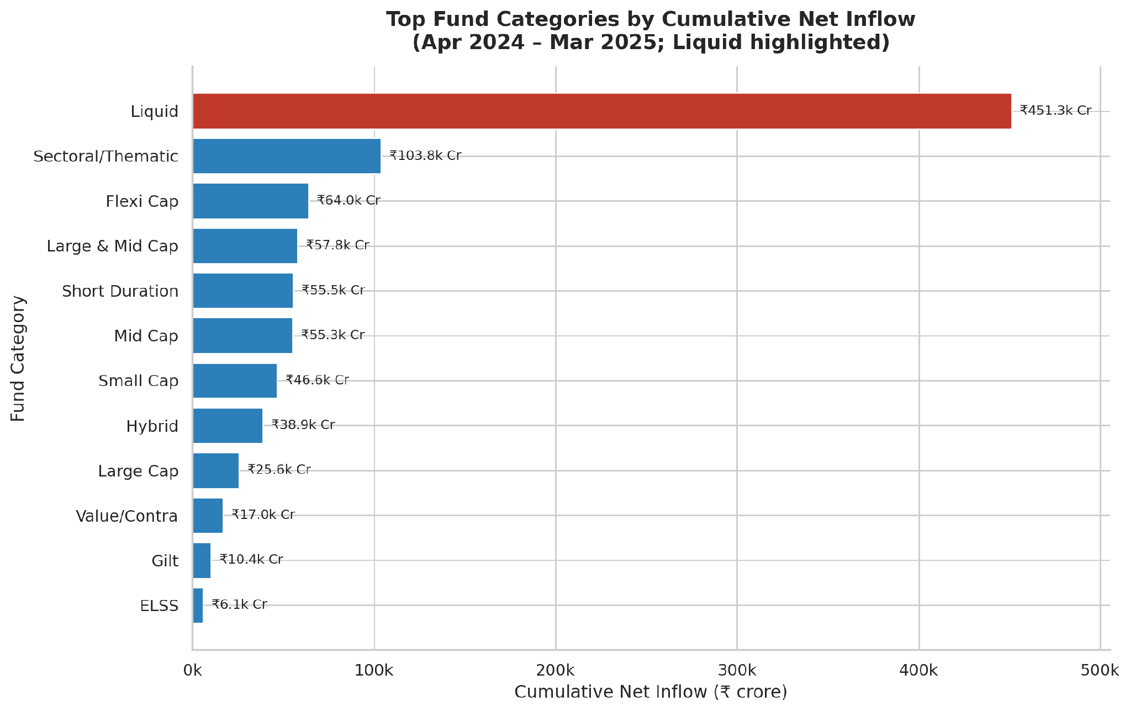
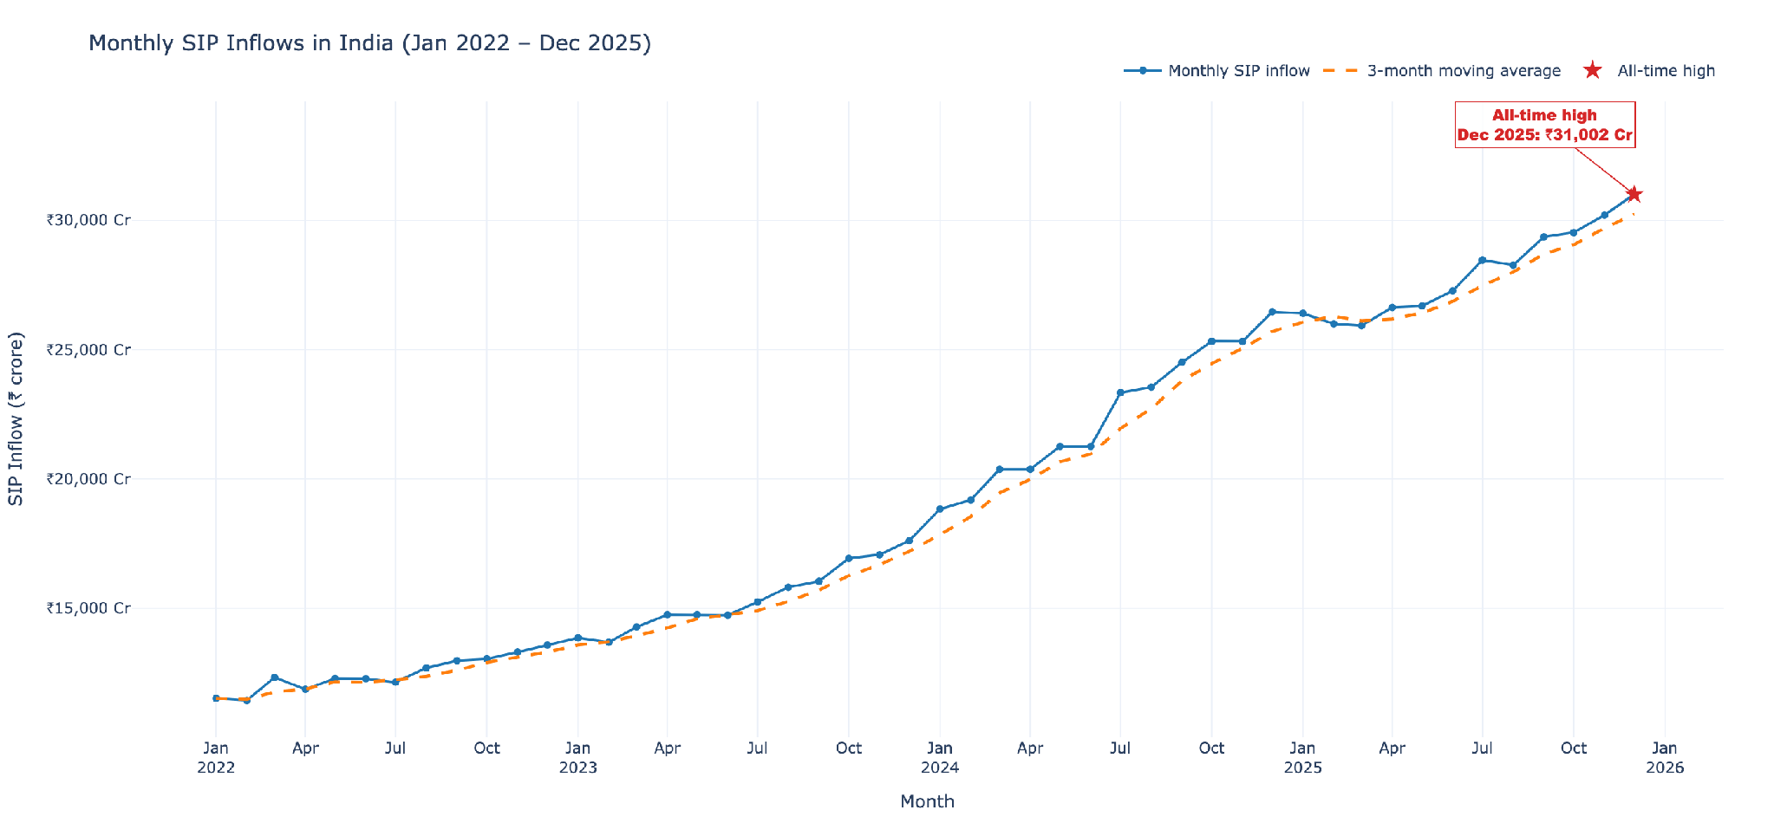
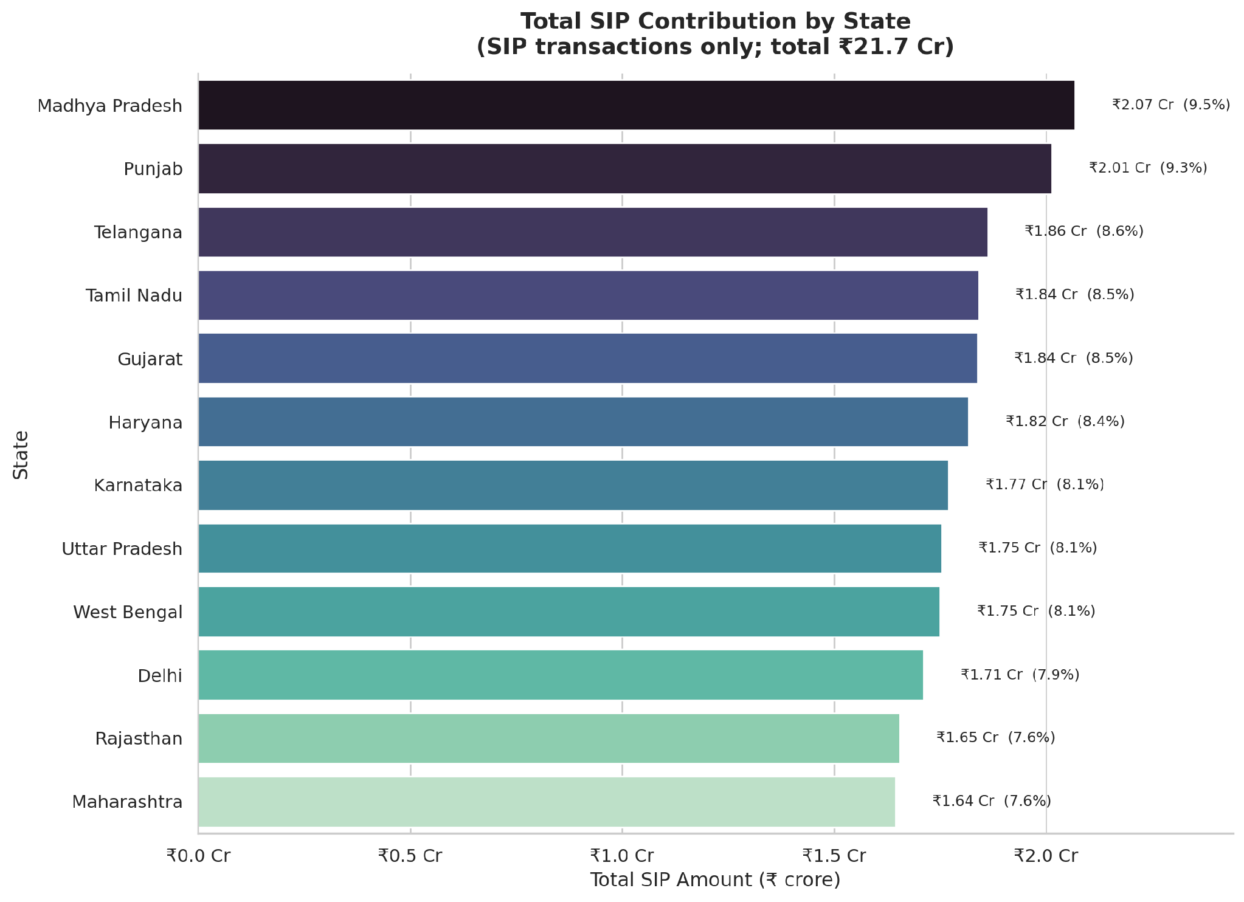
BEHAVIOUR & GEOGRAPHY
bluestock
EDA Highlights (cont.)
Mutual Fund Analytics
Sector / fund-house dominance
Category inflow trends
SIP behaviour — 60% of transactions
Geographic distribution — top states
Mutual Fund Analytics Platform · Internship Capstone
6 / 13
Notes:
SIPs are 60% of transactions; inflows led by Punjab, Madhya Pradesh, Tamil Nadu — equity-led, SIP-driven participation.

Slide 7
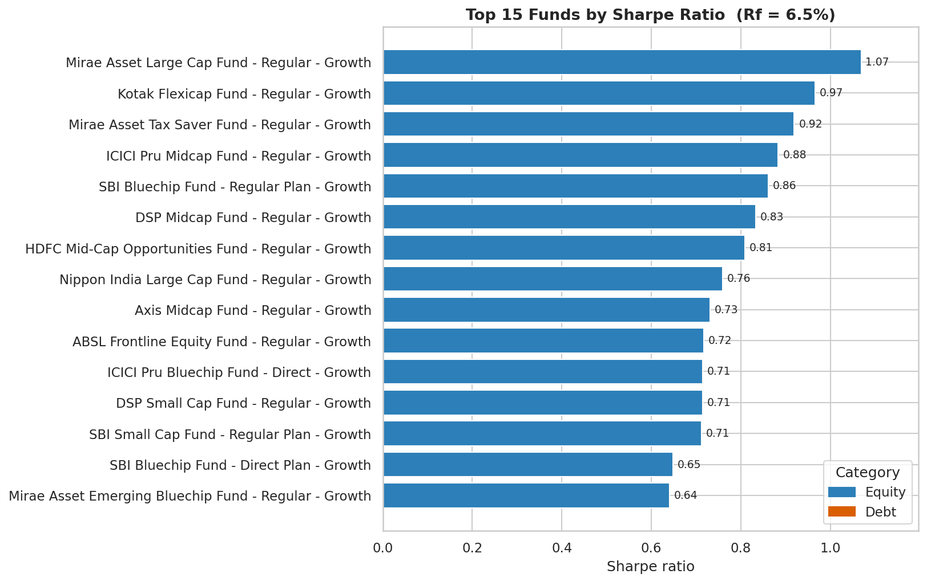
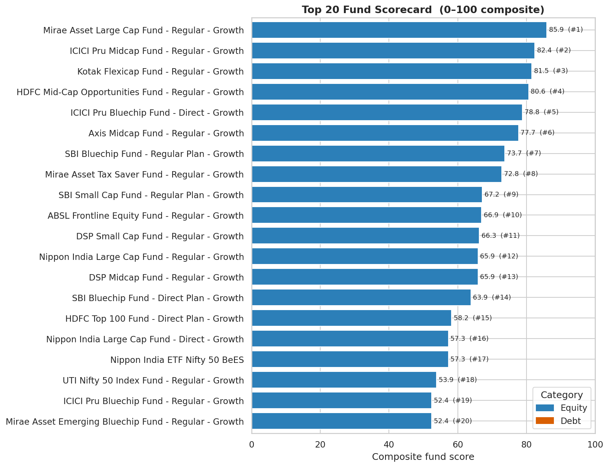
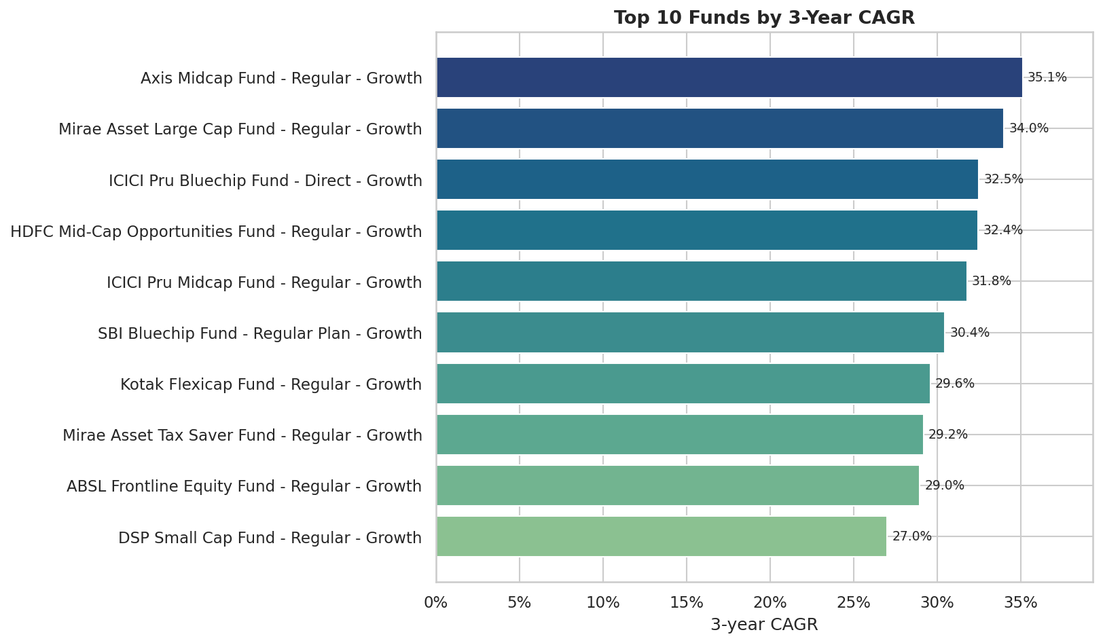
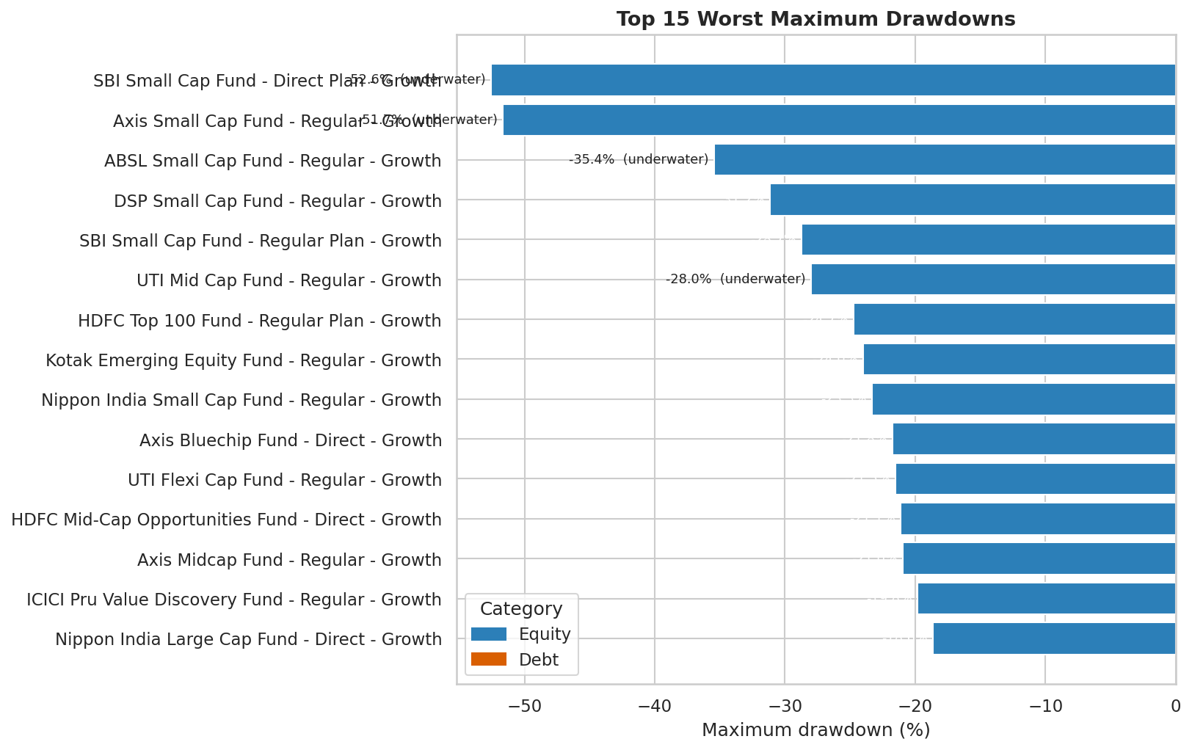
RISK-ADJUSTED RANKING
bluestock
Performance Metrics & Analytics
Mutual Fund Analytics
Sharpe leaders
Composite Fund Scorecard (0–100) — Mirae Large Cap #1 (85.9)
3-yr CAGR
Max drawdown
Mutual Fund Analytics Platform · Internship Capstone
7 / 13
Notes:
Six-factor framework rolled into a 0–100 composite scorecard. Mirae Asset Large Cap ranks #1 (85.9), leading Sharpe (1.07) and Sortino (1.49).

Slide 8
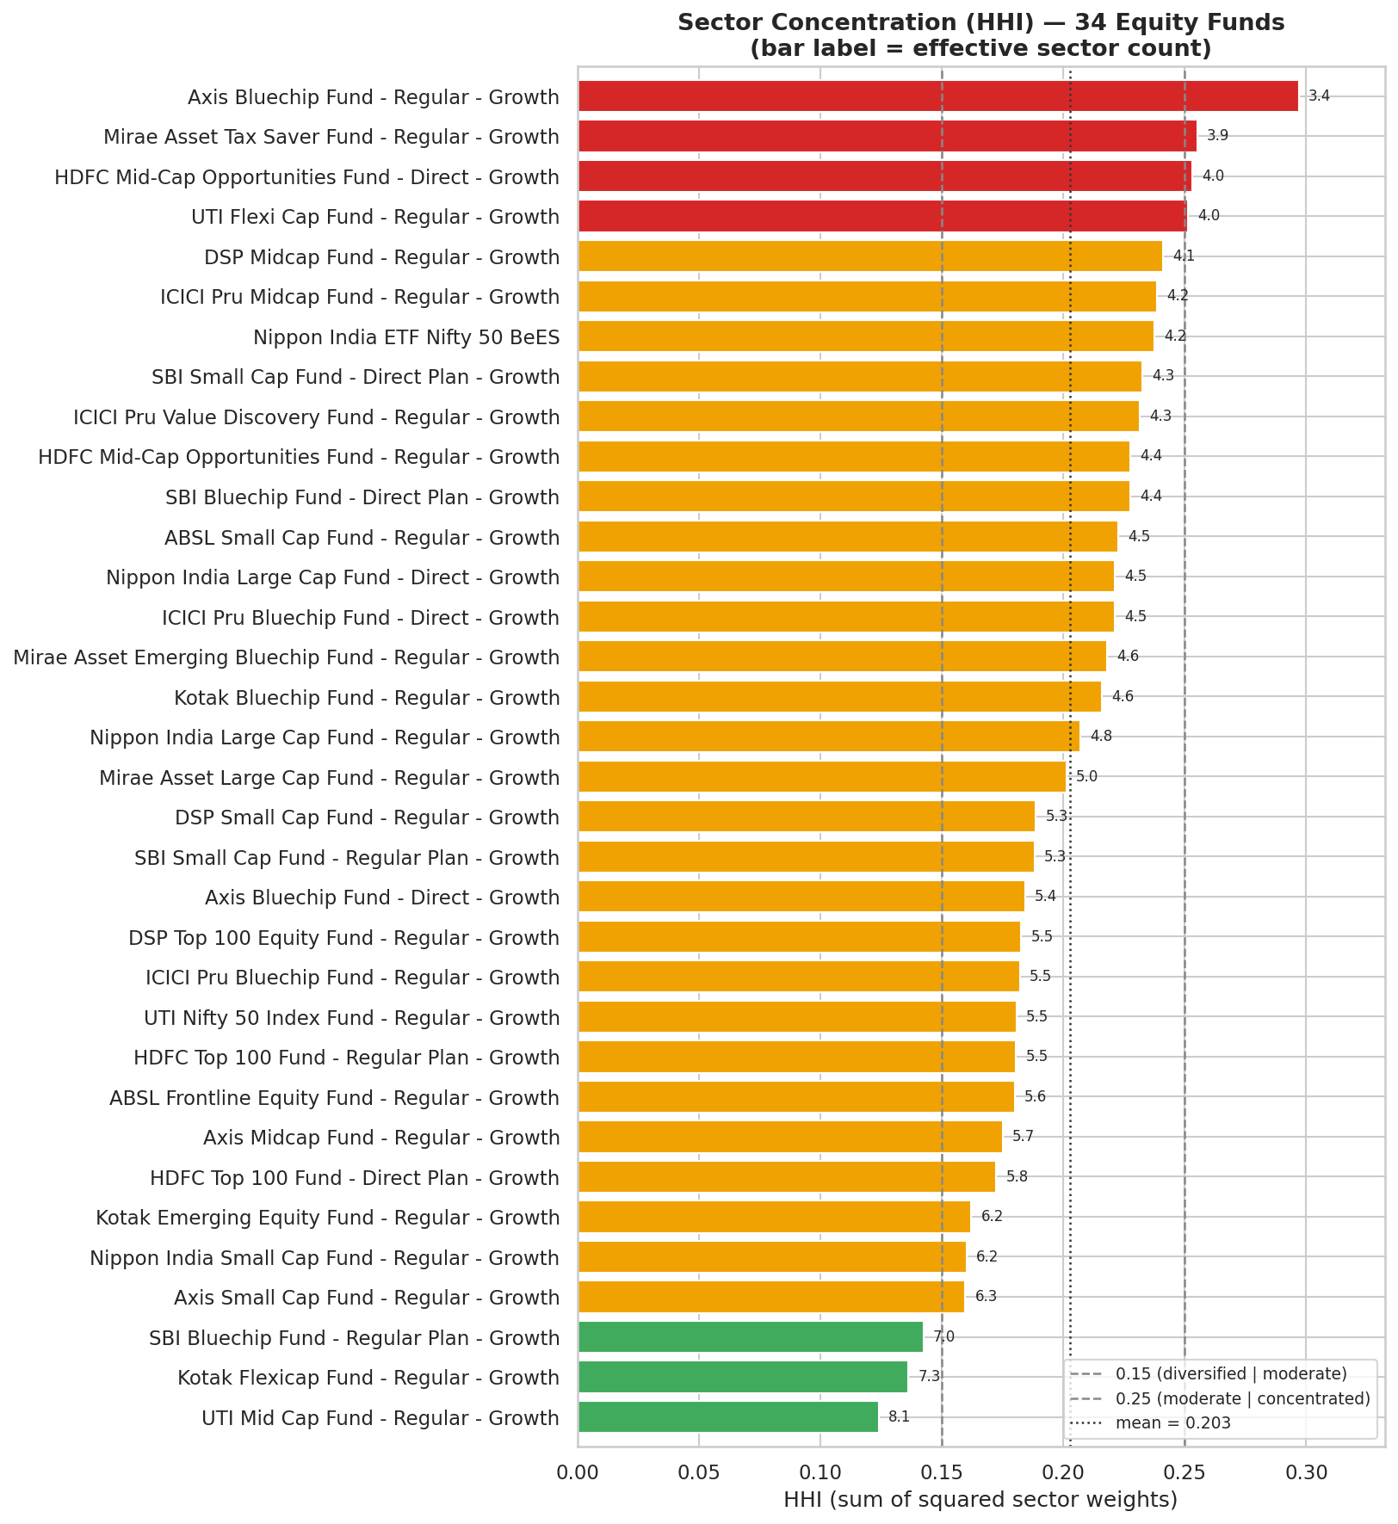
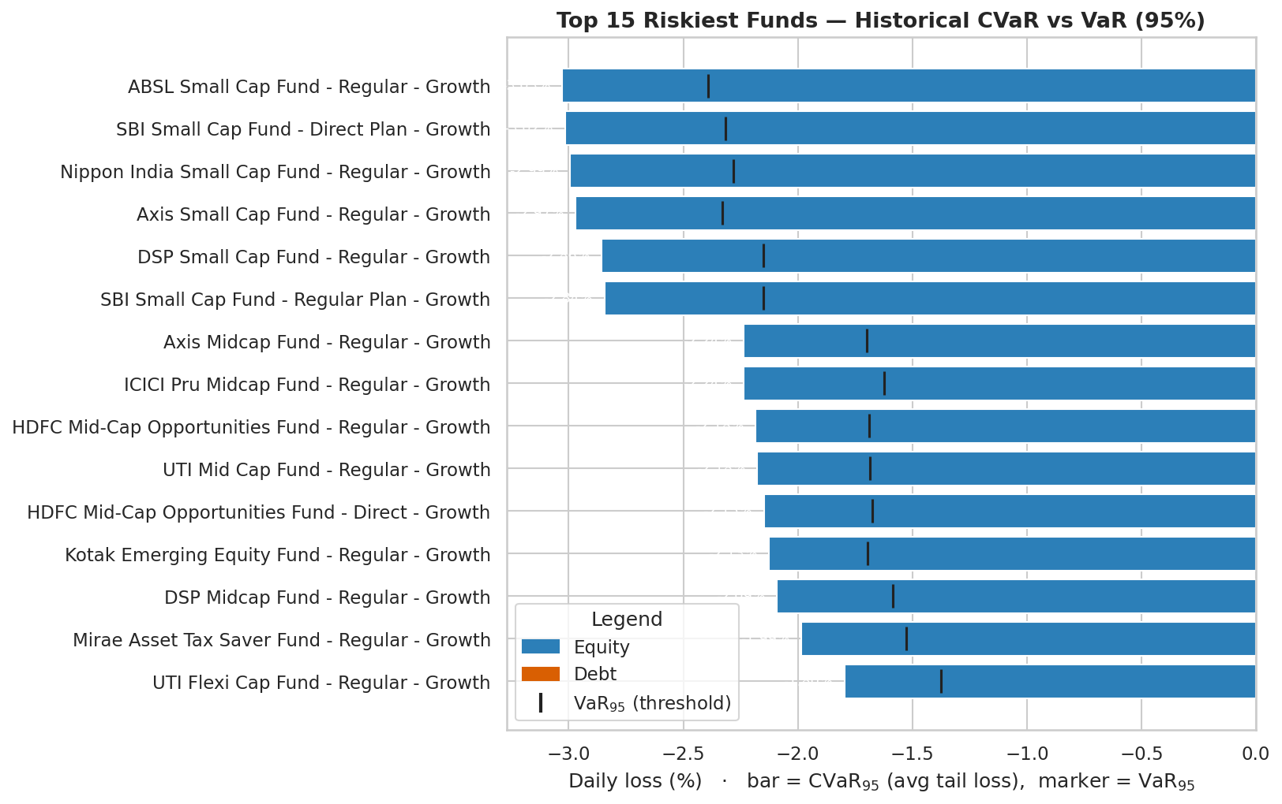
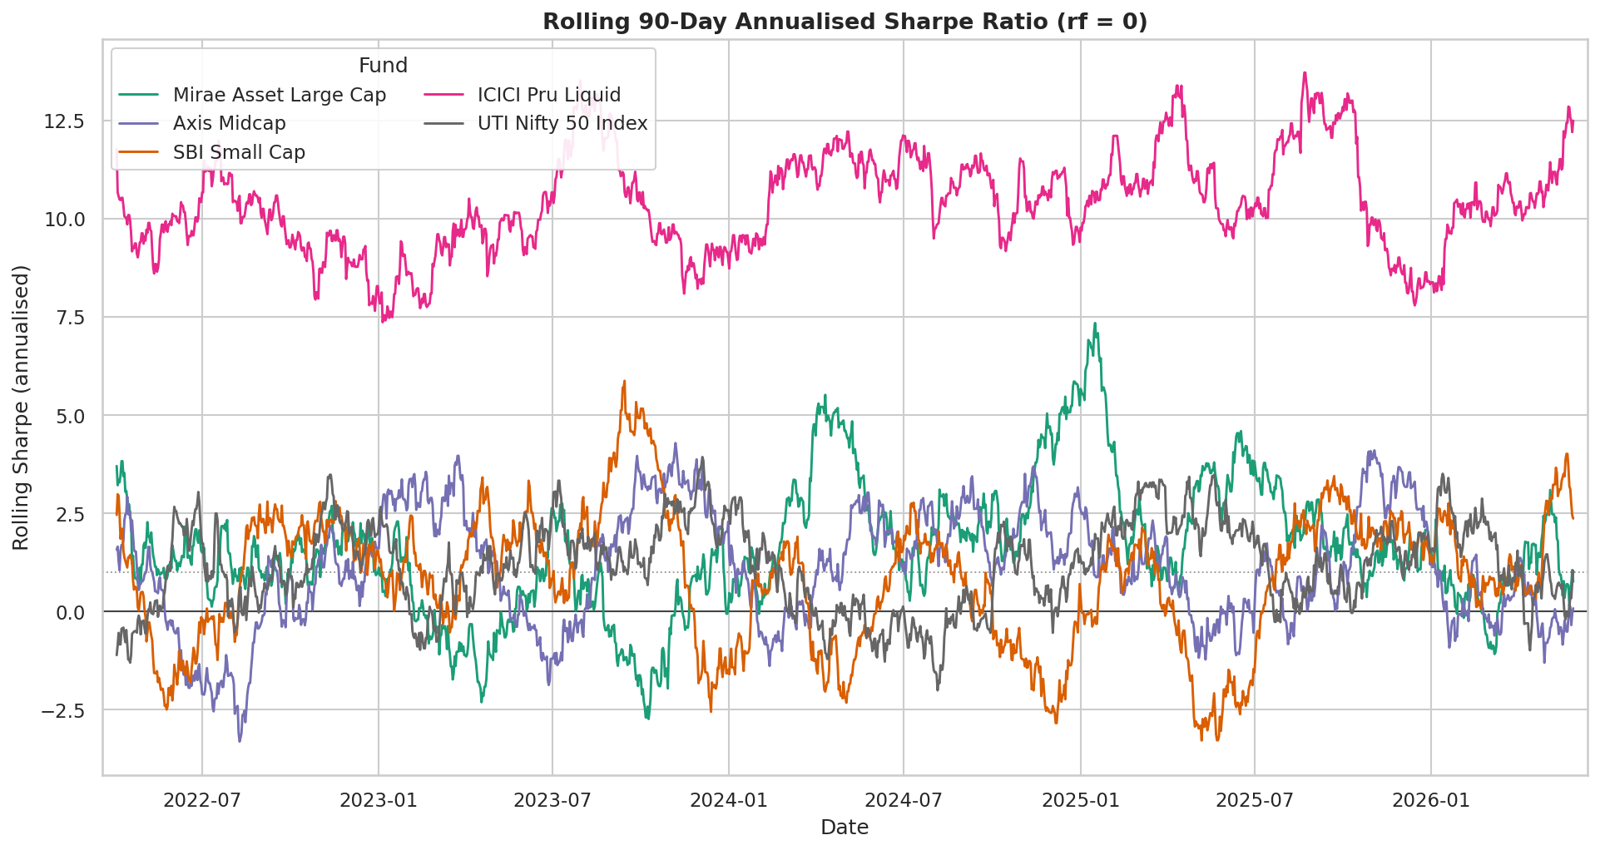
BEYOND RETURNS
bluestock
Advanced Analytics & Risk Analysis
Mutual Fund Analytics
VaR / CVaR — tail risk
Rolling Sharpe
Sector concentration (HHI)
~93×
30 / 1,362
UTI Mid Cap
Axis Bluechip
Tail-risk spread
SIP continuity
Most diversified
Most concentrated
CVaR max ÷ min
healthy vs total
8.1 eff. sectors
3.4 eff. sectors
Mutual Fund Analytics Platform · Internship Capstone
8 / 13
Notes:
Tail risk varies ~93×; SIP continuity is the red flag (30 of 1,362 healthy); UTI Mid Cap most diversified (8.1 sectors), Axis Bluechip most concentrated (3.4).

Slide 9
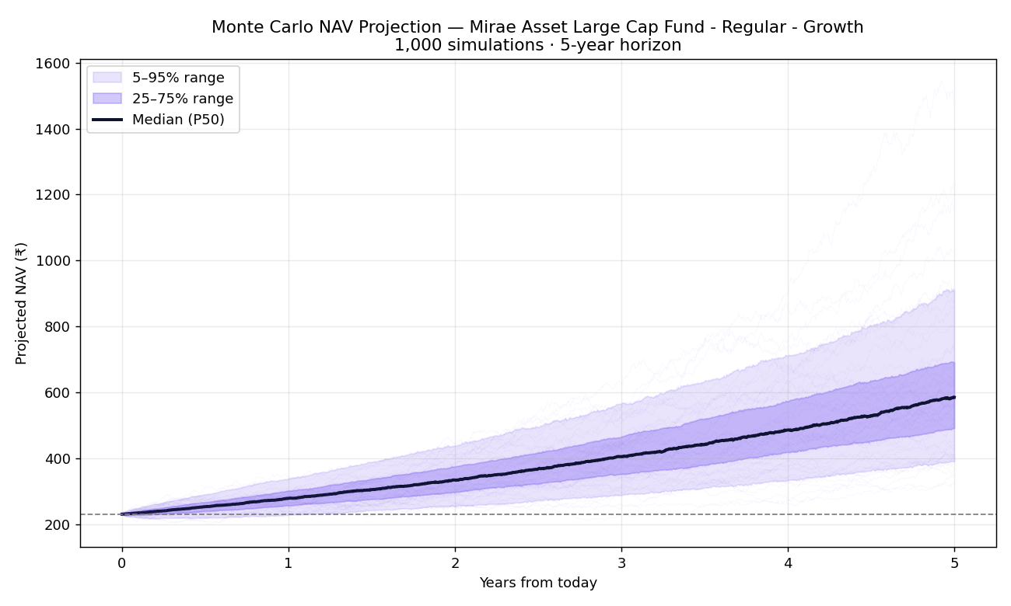
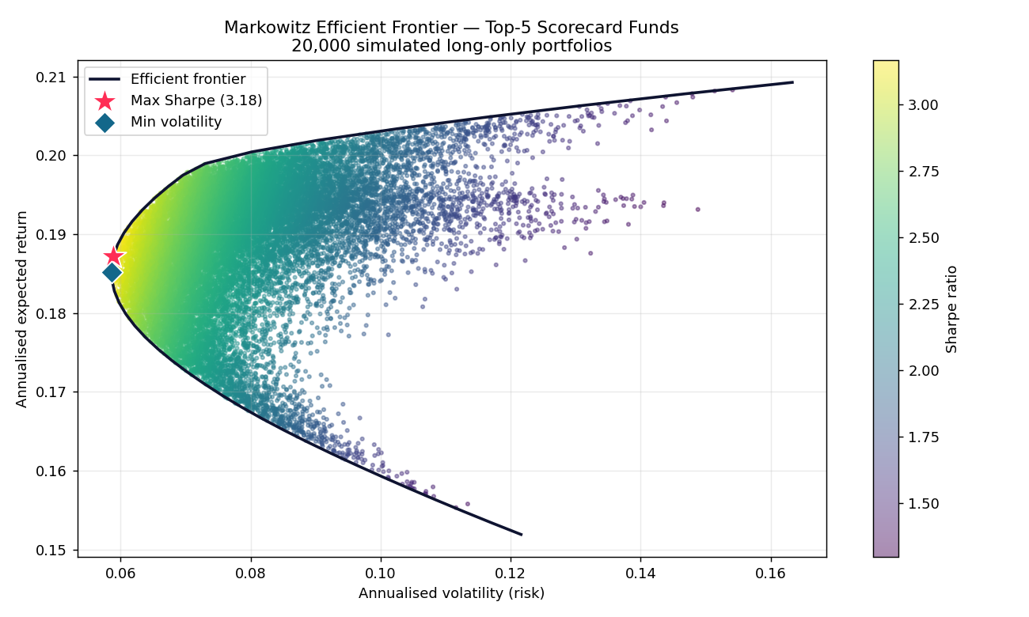
SIMULATION & OPTIMISATION
bluestock
Bonus Analytics — Forward-Looking
Mutual Fund Analytics
Monte Carlo — 5-yr NAV projection (1,000 paths, P5–P95 bands)
Markowitz Efficient Frontier — top-5 funds
Monte Carlo (Mirae Large Cap)
Max-Sharpe portfolio
₹230 → ₹585 median
18.7% ret · Sharpe 3.18*
+20.5% median CAGR · P5 ₹391 / P95 ₹909
Mirae 26% · ICICI Bluechip 22% · Kotak 21% (*synthetic)
Mutual Fund Analytics Platform · Internship Capstone
9 / 13
Notes:
Two forward-looking analyses. Monte Carlo projects the #1 fund's NAV 5 years out as a range of outcomes. The efficient frontier turns fund selection into portfolio construction. Note the synthetic-data caveat: near-zero correlation inflates Sharpe.

Slide 10
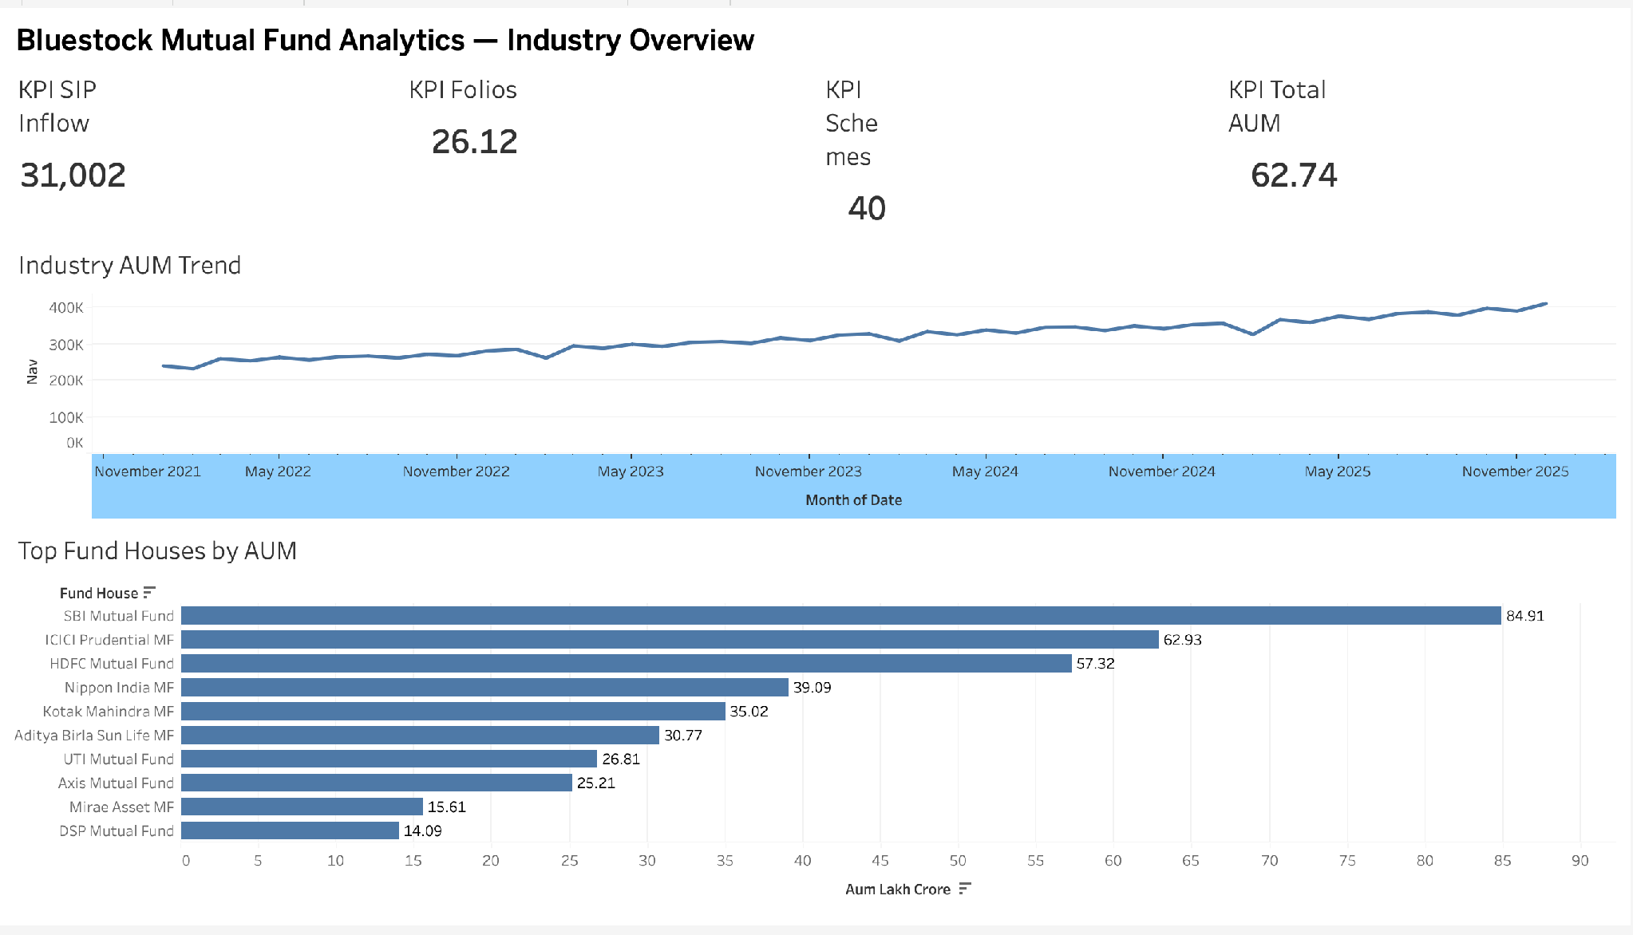
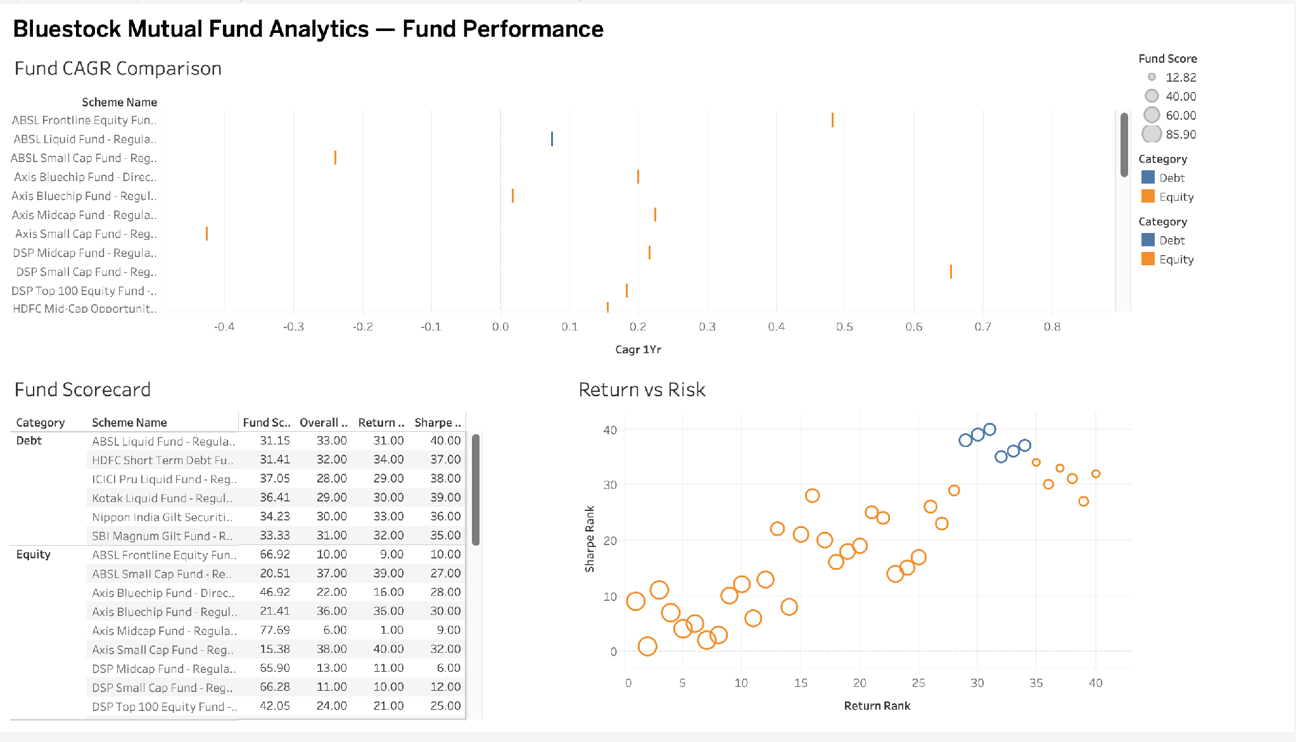
EXECUTIVE VIEW (1 OF 2)
bluestock
Dashboard Overview
Mutual Fund Analytics
Page 1 — Industry Overview: KPIs · AUM trends · fund houses
Page 2 — Fund Performance: scorecards · comparison
Mutual Fund Analytics Platform · Internship Capstone
10 / 13
Notes:
Pages 1–2: industry pulse and the fund league table — KPI cards, AUM trends, fund-house share, scorecards and performance comparison.

Slide 11
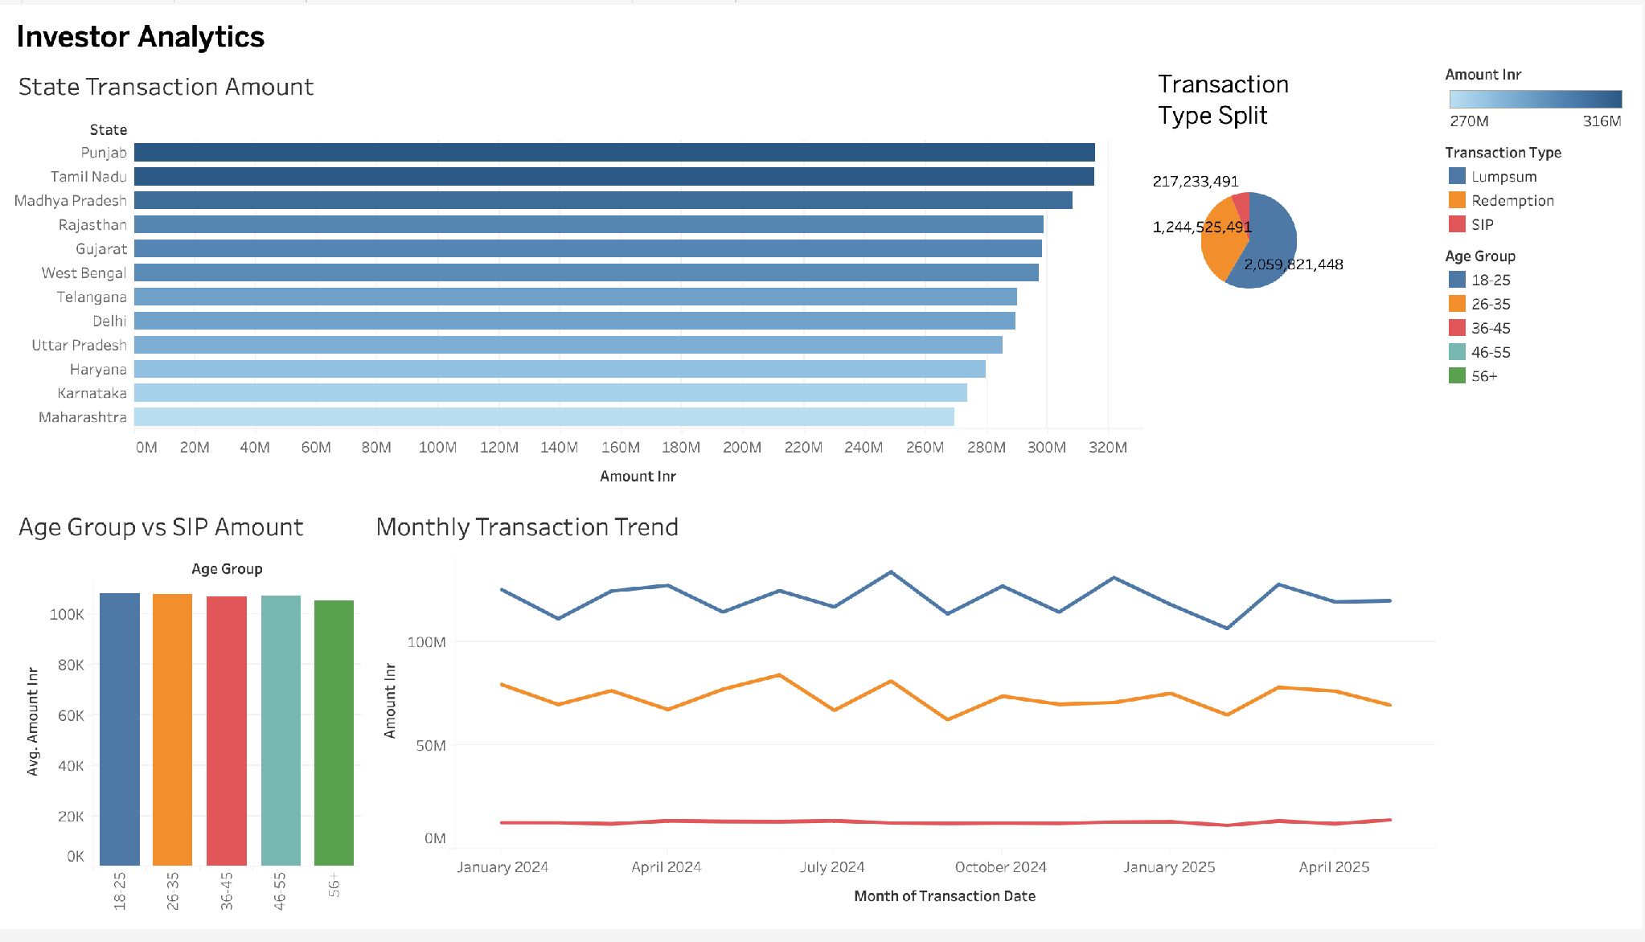
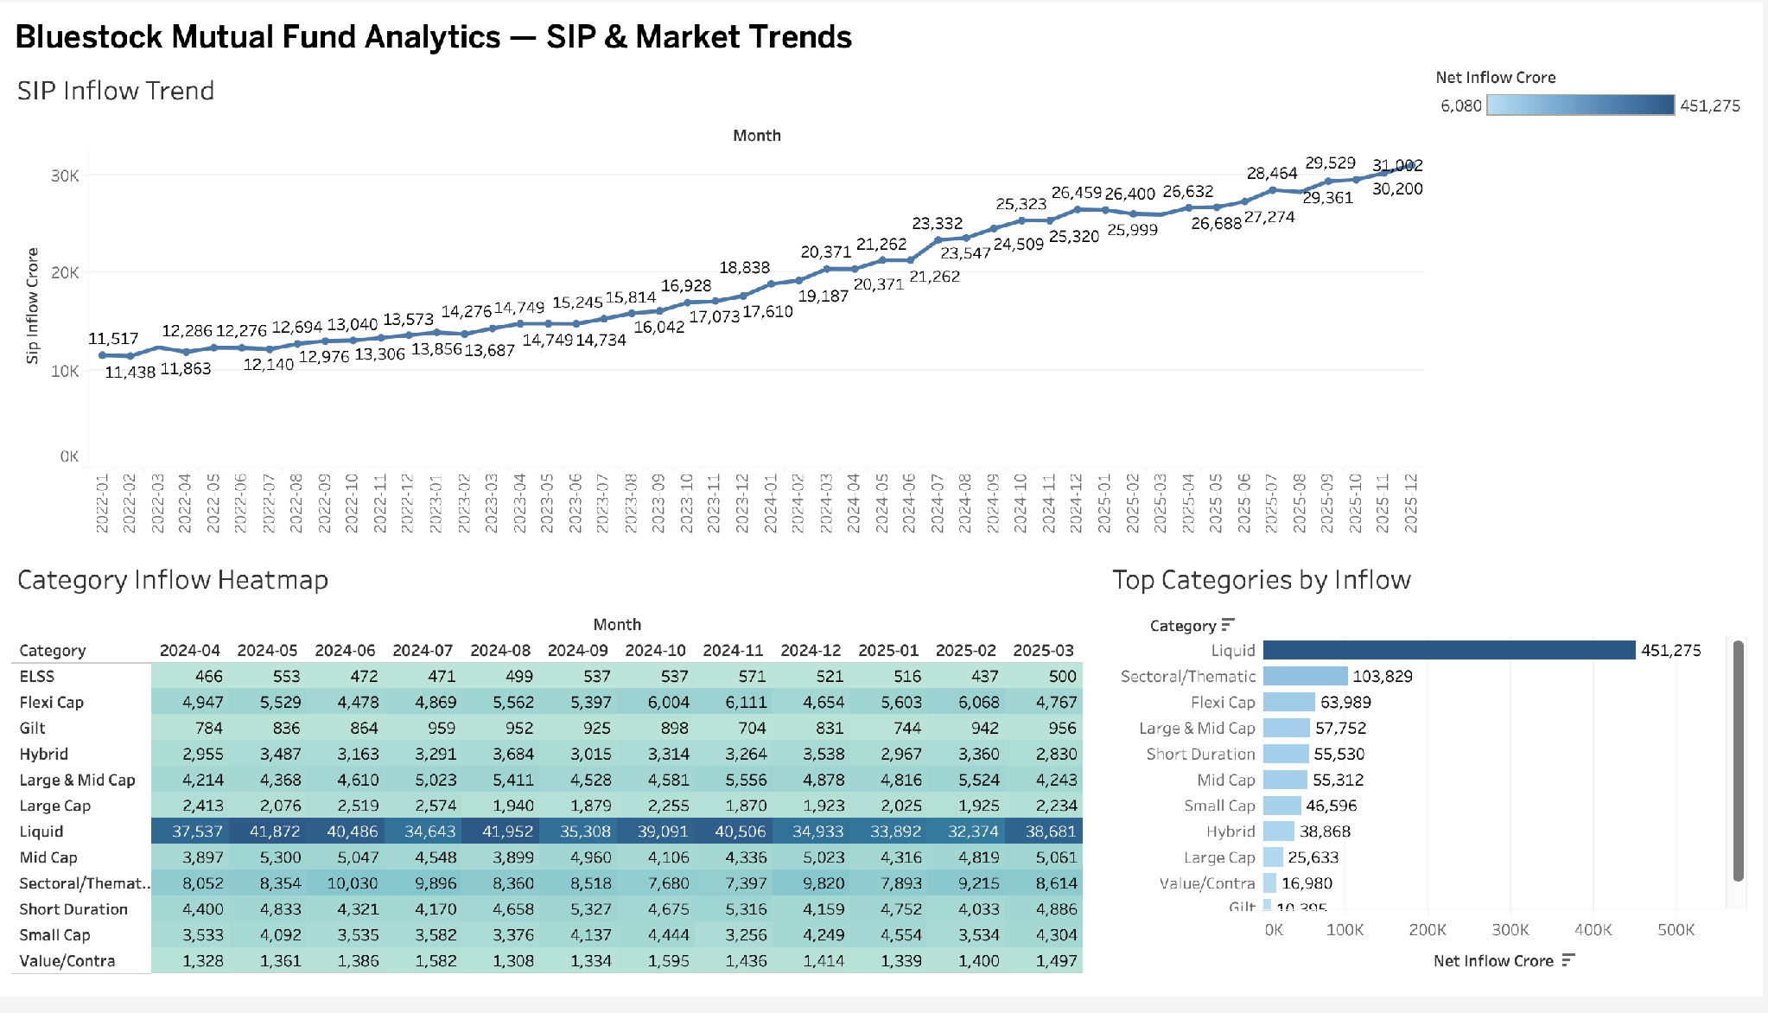
EXECUTIVE VIEW (2 OF 2)
bluestock
Dashboard Overview
Mutual Fund Analytics
Page 3 — Investor Analytics: behaviour · demographics
Page 4 — SIP & Market Trends: SIP growth · categories
Mutual Fund Analytics Platform · Internship Capstone
11 / 13
Notes:
Pages 3–4: the investor lens — demographics and transaction behaviour, SIP growth and category trends. No SQL needed for business users.

Slide 12
SO WHAT
bluestock
Key Findings & Business Impact
Mutual Fund Analytics
PERFORMANCE
RISK
INVESTOR BEHAVIOUR
Mirae Large Cap is the strongest risk-adjusted performer (85.9/100).
Equity funds carry far higher tail risk — ~93× spread, safest to riskiest.
SIP continuity challenge — only 30 of 1,362 investors 'healthy'.
FORWARD-LOOKING
RECOMMENDATIONS
DASHBOARD
Monte Carlo + efficient frontier add projection & optimisation.
Risk-profile engine implemented (Low / Moderate / High).
A single source of truth for decision-making across teams.
Mutual Fund Analytics Platform · Internship Capstone
12 / 13
Notes:
A clear performance winner, a quantified risk gradient, a retention problem to act on, forward-looking projections, a working recommender, and one dashboard as the source of truth.

Slide 13
Conclusion
✓
ETL Pipeline
✓
SQLite Database
✓
EDA
“Built an end-to-end analytics platform transforming raw mutual fund data into actionable investment insights.”
✓
Performance Analytics
Thank You
✓
Advanced Analytics
✓
Bonus Analytics (Monte Carlo · Frontier)
✓
Recommendation Engine
✓
Tableau Dashboard
Dheeraj Reddy Thumma · Data Analyst Intern · Bluestock · June 2026
Notes:
Wrap up: eight deliverables, fully built — including the bonus Monte Carlo and efficient-frontier work. The platform turns fragmented data into actionable insight. Happy to take questions.

