Slide 1
CSCE - 5222 Feature Engineering Increment-2 Feature Engineering on Facebook Dataset
Team Members:
Dheeraj Reddy Komandla (11526265)
Prem sai Vuppula (11528103)
Viveksen Naroju (11611662)
Sravan Boinapalli (11553755)

Slide 2
Objectives:
For our team to correctly build a Feature Engineering on Facebook dataset, several objectives must be accomplished. The project's process is represented by the objectives below..
Detail design of Features
Analysis
Implementation
Preliminary Results
Visualization & Evaluation of Results

Slide 3
Dataset Description:
We are use a dataset from the Kaggle library for this project. Facebook actually provided the dataset..
https://www.kaggle.com/competitions/FacebookRecruiting
The dataset is bidirectional graph dataset. There are two columns in the dataset: source node and destination node. Each row shows a connection from source to destination.
We are sure that the Instagram app is the rightful owner of this dataset. The link must be unidirectional because Facebook demands that we become friends. In the Instagram app, we frequently follow users and the reverse.
We assume that the Instagram program is the source of the data in this instance because we have a bidirectional dataset.

Slide 4
Detailed design of Features:
Extracting the features by using only columns is interesting and challenging problem. Since we are having the Instagram dataset, it is important to focus more on the followers and followees
The following are the features that we have so far extracted. All the features we collected provide us with valuable information about source and destination nodes.
1.Number of Source node Followers
2.Number of Destination node Followers
3.Number of Source node Followees
4.Number of Destination node Followees
5.Number of common Followers
6.Number of common Followees
7.Jaccard Similarity
8.Cosine Similarity
9.Is Followed Back
10.Shortest_path_length:
11.Page_rank:
12.Hits_Score:
13.Degree_centrality:
14.Out_degree_centrality:

Slide 5
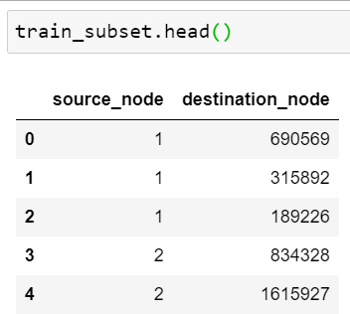
Analysis of Data:
In general, the dataset released by Facebook is very huge. It contains more than 9 million records in the dataset.
The screenshot represents the initial 5 rows of the sampled dataset

Slide 6
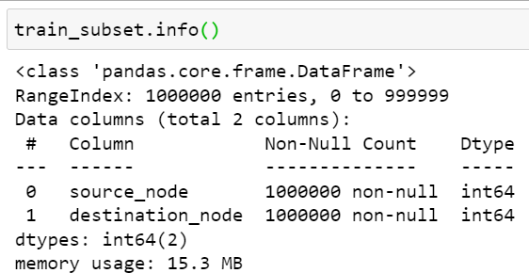
Analysis of Data:
The screenshot provides us the basic information like column name, count datatype etc.
we have tested if the dataset is having any null values.
we have also loaded the dataset into graph and printed number of nodes and number of edges.

Slide 7
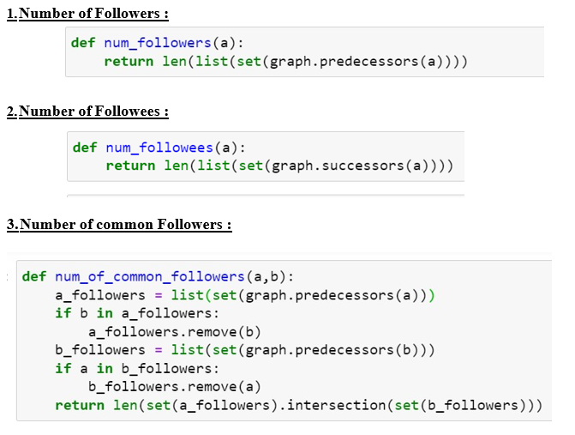
Implementation:
In this section we are pasting the screenshots of the code that we have used to create each feature.

Slide 8
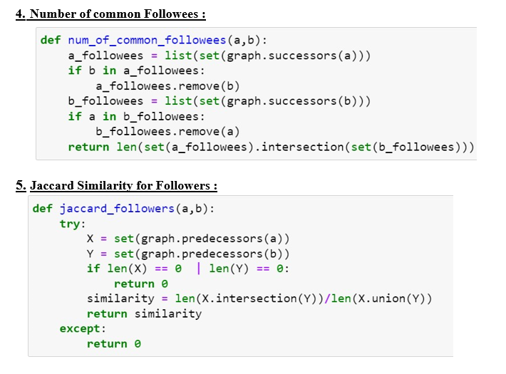

Slide 9
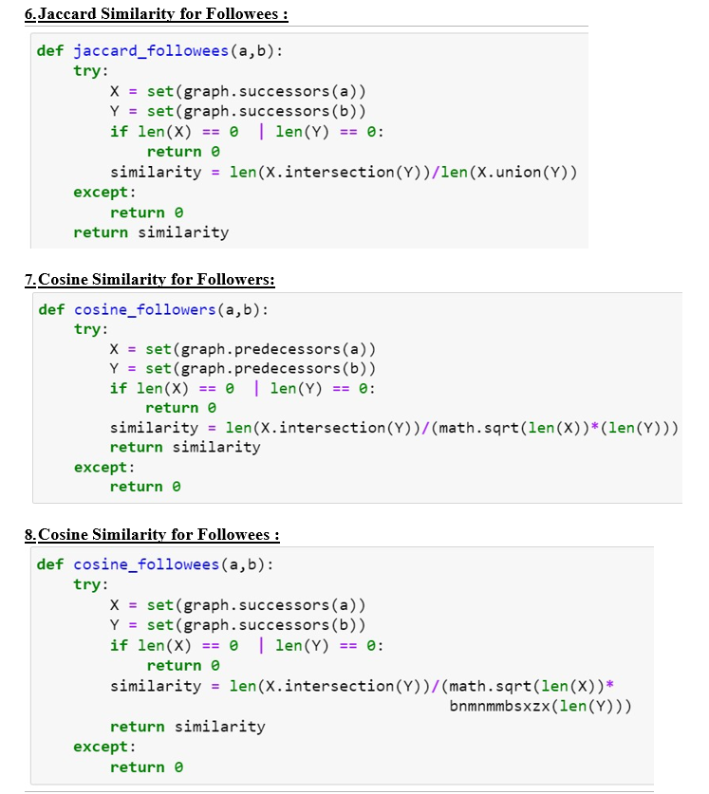

Slide 10
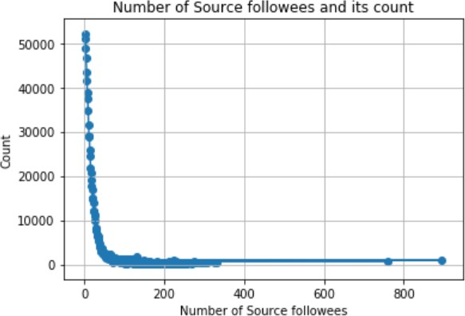
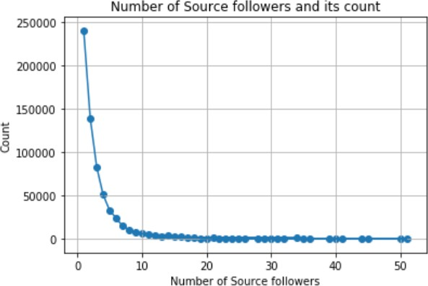
Preliminary Results:
For all the line charts, we have excluded the count of value 0 in order to make plot understandable by removing outlier.
Number of Source Followers :
Number of Source Followees :

Slide 11
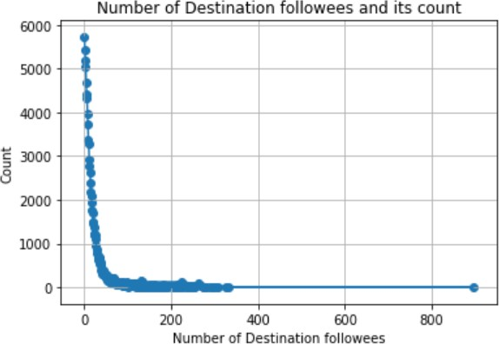
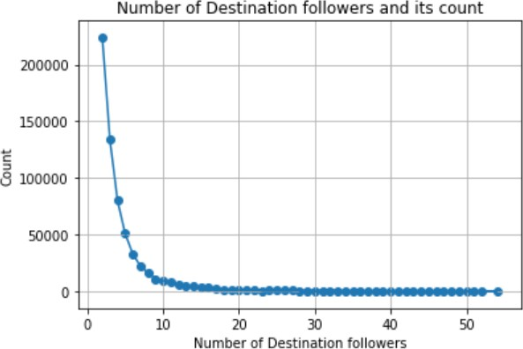
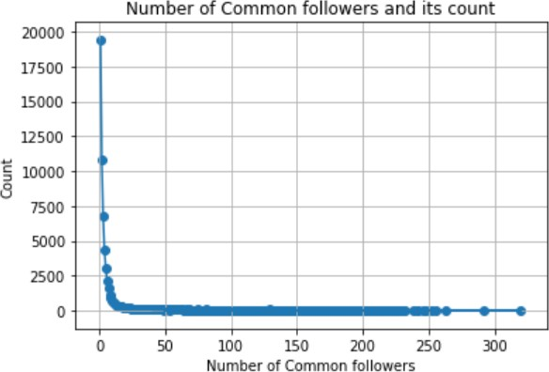
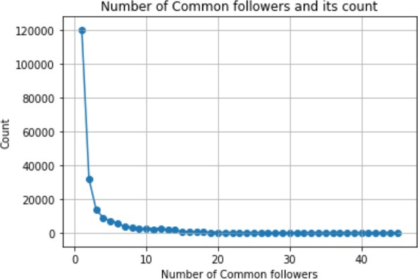
Number of Destination node Followers :
Number of Destination node Followees
Number of common Followers :
Number of common Followees

Slide 12
The Final Features are:
1. source_node
2. destination_node
3. num_of_source_followers
4. num_of_source_followees
5. num_of_destination_followers
6. num_of_destination_followees
7. num_of_common_followers
8. num_of_common_followees
9. jaccard_similarity_followers
10. jaccard_similarity_followees
11. cosine_similarity_followers
12. is_followed_back
13. shoterst_path_length
14. page_rank_source
15. page_rank_destination
16. hit_authorities_source
17. hit_authorities_destination
18. hit_hubs_source
19. hit_Hubs_destination
20. degree_centrality_source
21. degree_centrality_destination
22. outdegree_centrality_source
23. outdegree_centrality_destination
24. preferential_attachment_followers

Slide 13
Thank You

