Slide 1
CSCE - 5290 Natural Language Processing Increment-2 Text Emotion Detection
Team - 10:
Dheeraj Reddy Komandla (11526265)
Prem sai Vuppula (11528103)
Rahul Reddy Geereddy (11511846)
Sravan Boinapalli (11553755)

Slide 2
Objectives:
Our team has various goals that must be met to properly construct an emotion detection model. The following objectives depict the project's workflow.
Data Selection
Text Cleaning
Text Preprocessing
Text Vectorization
Modeling
Visualization & Evaluation of Results

Slide 3
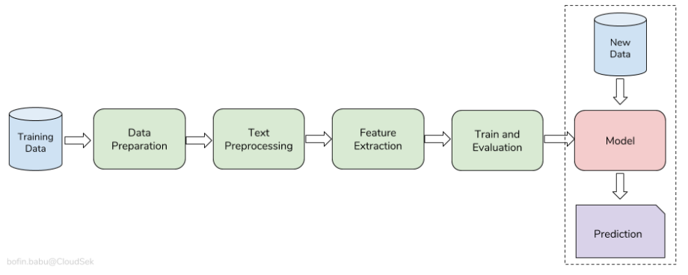






Model Workflow:

Slide 4
Dataset Description:
The dataset we are currently using in this project was obtained from the kaggle repository. Kaggle is a repository of a huge number of datasets that are freely available for use in practicing data science challenges.
https://www.kaggle.com/datasets/anjaneyatripathi/emotion-classification-nlp
We have two columns in the dataset to work with as we solve the Multi-Class text classification problem.
Text Column: This column contains the raw text. Our model should be able to take this text as input and predict the mood of the text.
Label: This column contains the class label for the relevant input text. The Label column has four different types of feelings. They are Fear, Anger, Joy, and Sadness.

Slide 5
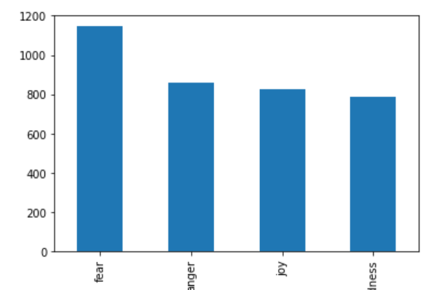
Graph model:
As we are analyzing our dataset, we observed the dataset is actually imbalanced. More often the imbalanced datasets are prone to biased predictions.
The screenshot represents the label column before balancing the dataset.

Slide 6
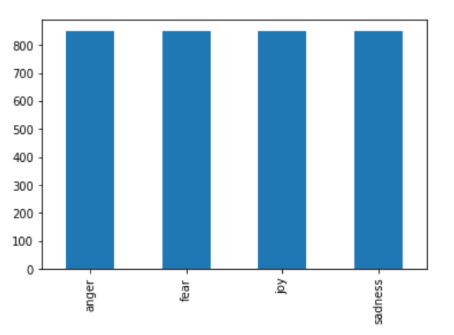
Graph model:
The screenshot represents the label column after balancing the dataset.
Trained dataset provides a balanced results which will be more promising compared to unbalanced data.

Slide 7
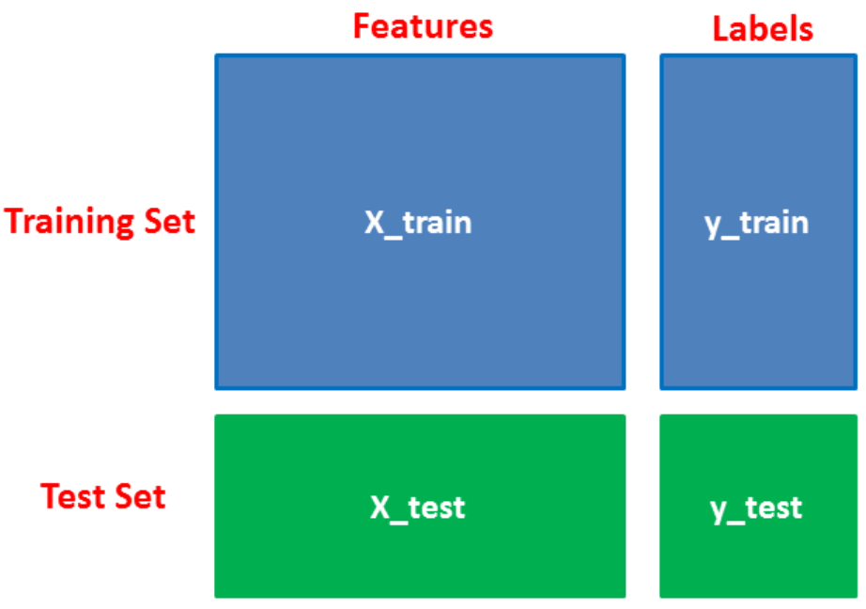
Futurized Vector

Slide 8
Features:
As discussed earlier we would like to spend some more time on picking the dataset, but in most of the text classification datasets, it contains 2 features.
Text: This feature mainly contains the raw text. This text represents the either review or statement for which we need to predict the emotion of the statement.
Label: This feature represents the class label of the given sentence. In most of the datasets we basically have 4 classes. They are:
Fear
Joy
Anger
Sadness

Slide 9
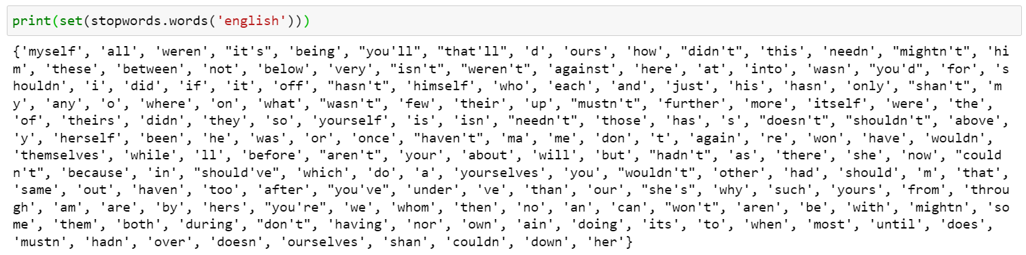
Analysis of Data:
While doing the research we came through an important text preprocessing practice called stopword removal. Stop-words are the set words which don’t add much value in a sentence. Examples of stop words in English are “a”, “the”, “is”, “are” and etc. Stop words are commonly used in Text Mining and Natural Language Processing (NLP) to eliminate words that are so commonly used that they carry very little useful information.
In the below screenshot, we have printed all the stop words that are removed in each text:

Slide 10
Implementation:
We have converted and used the current dataset as sentiment analysis. In the current dataset, we have joy, sadness, fear, and angry classes. In general, we know that all the joy texts are positive, and all the sadness texts are negative. Hence, we have removed the records which are being afraid and angry classes.
In the final filtered dataset, we have joy class labels as positive and sadness class labels as negative. The label id 1 represents the positive class and label id 2 represents the negative class. We have integrated the concepts of (sentiment analysis + classification) to achieve our outcome.
Next, we will be discussion how we implemented different models along with the accuracy report and confusion matrices.

Slide 11
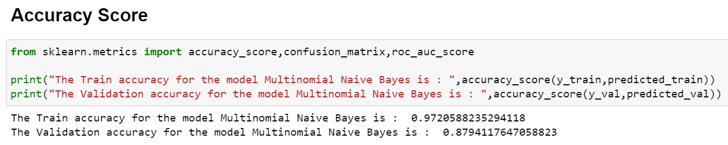
Multinomial Naive Bayes

Slide 12
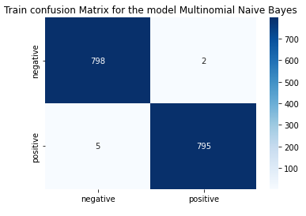
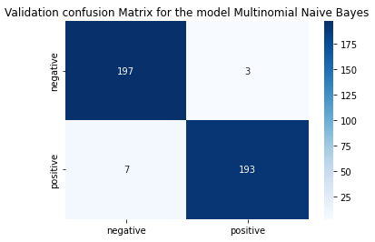
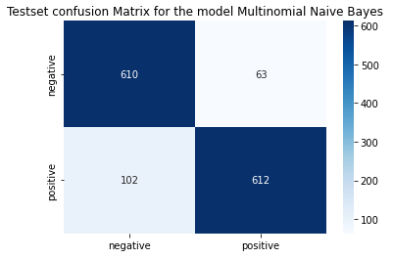

Slide 13
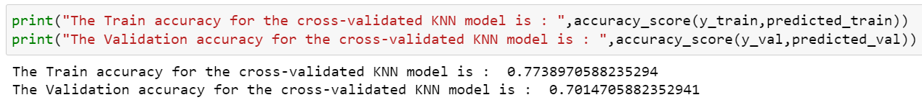
K-Nearest Neighbors with Cross Validation

Slide 14
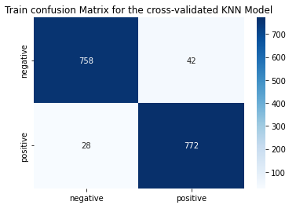
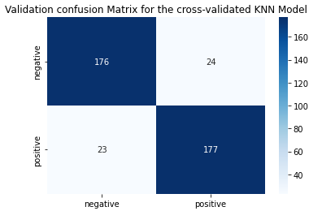
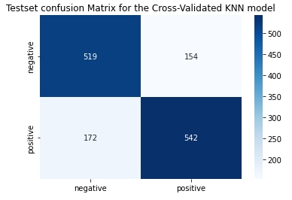

Slide 15
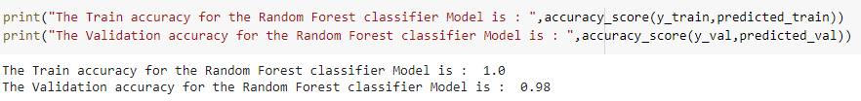
Random Forest

Slide 16
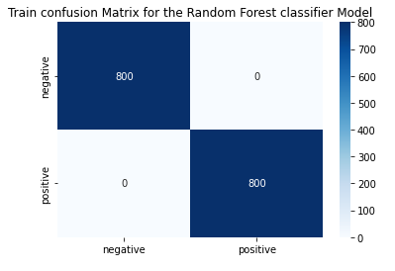
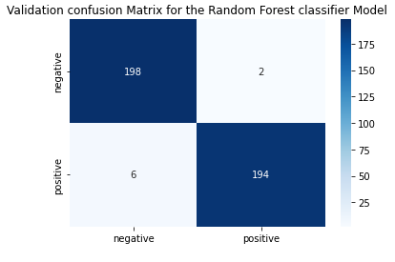
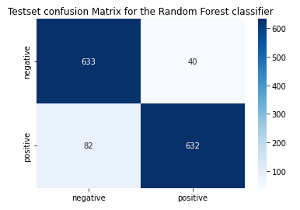

Slide 17
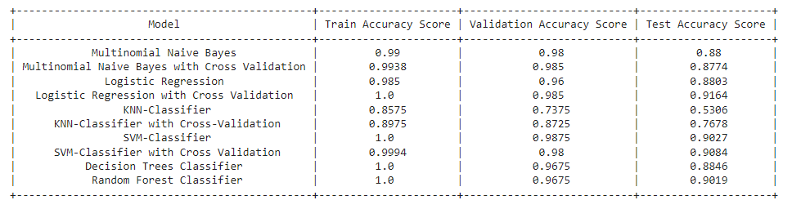
Accuracy Scores for Different models:
aaa
From above we can observe that Logistic Regression with Cross Validation model has the highest accuracy to detect the emotion of the text.
We have we have integrated the concepts of sentiment analysis and text classification in this project.

Slide 18
Thank You

