Slide 1
Investigating temperature variations of solar corona during Coronal Mass Ejections
Masters Thesis Presentation On
By
V DHEERAJ SHENOY
USN: 22MSRPH022
Guide
M N Sundar
Co-Guide
Dr. Tanmoy Samanta
Indian Institute of Astrophysics

Slide 2
Table of Contents
Abstract
Introduction
Methodology
Data Analysis
Result

Slide 3
Abstract

Slide 4
Introduction
Solar structure
Solar Corona
Filaments/Prominences
Flares
Coronal Mass Ejections (CMEs)
Stellar CMEs
Coronal Dimming
Differential Emission Measure

Slide 5
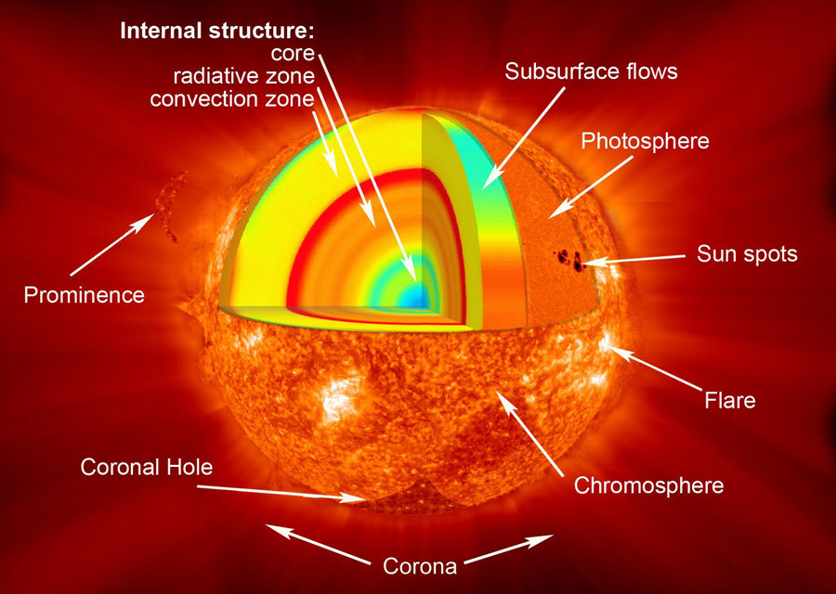
Solar structure
Divided into layers
Interior region
Visible surface
Atmosphere

Slide 6
Solar structure
Interior region
Core
Radiative zone
Convective zone
Visible surface (Photosphere)
Atmosphere (Chromosphere + Corona)

Slide 7
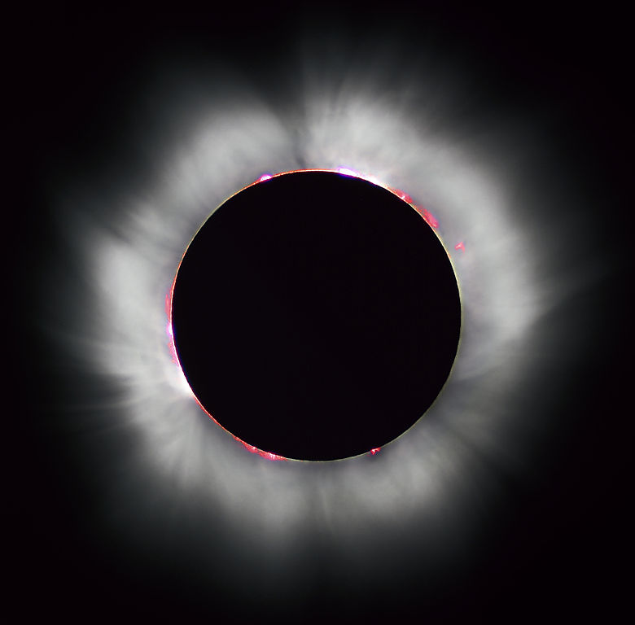
Solar Corona
The outermost layer of the Sun above the chromosphere.

