Slide 1

Predicting the Next Track in the Spotify App using ML
By Group 2

Slide 2
Project Proposal
INTRODUCTION:
Brief Literature Review: The growing importance of playlist curation on streaming platforms like Spotify has led to numerous studies exploring playlist creation, recommendation systems, and user preferences. Recent works focus on using deep learning, collaborative filtering, and sequence modeling to predict playlist continuation or recommend tracks. Existing approaches, like the one that emphasizes the challenges and opportunities in playlist-based music recommendation, particularly in addressing the cold start problem and improving playlist relevance, Reference Url
Relevance of the Research Questions in Today’s Scenario: Personalized music recommendations play a vital role in user engagement on streaming platforms. As more users rely on playlists to discover new music, understanding patterns within playlists and offering tailored recommendations is crucial. With playlist creation increasing, systems that automate or suggest music based on user preferences can enhance user satisfaction and platform engagement. Outcome: CNN was the best model as compared to other models with an AUC of 0.70.
Dataset:
https://www.aicrowd.com/challenges/spotify-million-playlist-dataset-challenge/dataset_files
Outcome variable(s): The sequence or continuation of tracks in a playlist. Sentiment of the user.
Key Variables of Interest: track_pos, track_artist_name, track_name, playlist_name, playlist_num_followers, playlist_num_tracks, playlist_modified_at
Unit of Analysis: Each track in the dataset represents a unit of analysis, with track-level details contributing to understanding playlist characteristics.
APPROACH
Data Storage: GitHub, Google Drive
Data Dimension: <1 million rows and 19 features
Data Visualizations: Univariate Analysis, Multivariate Analysis
Statistical Analysis: track metadata, summary statistics, correlation analysis
Feature Engineering: feature selection, feature extraction
Data Preprocessing & Embedding Models (Vectorization, etc): Text2vec/BERT, TF-IDF
Sequential Models: Recurrent Neural Network (RNN), Long Short-Term Memory (LSTM)
Collaborative Filtering: Logistic Regression, Naive Bayes Classification LLM (Optional): Llama and Open AI APIs
Outcome Variables: track_name, mean_sentiment
RESEARCH QUESTIONS:
1. Can we predict the next track in a playlist based on the current sequence of tracks?
2. How do mood-based playlists on Spotify reflect users’ emotional states and mental health trends?

Slide 3
Data Dictionary
Column Name | Description | Data Type | Example Value
track_pos | Position of the track in the playlist (zero-based) | int | 0
track_artist_name | Name of the primary artist of the track | string | 2Pac
track_track_uri | Spotify URI of the track | string | spotify:track:09EwNbGvUyu7BDEYG0cJro
track_artist_uri | Spotify URI of the primary artist | string | spotify:artist:1ZwdS5xdxEREPySFridCfh
track_track_name | Name of the track | string | Can't C Me
track_album_uri | Spotify URI of the album | string | spotify:album:4CzT5ueFBRpbILw34HQYxi
track_duration_ms | Duration of the track in milliseconds | int | 330760
track_album_name | Name of the album to which the track belongs | string | All Eyez On Me
playlist_pid | Playlist ID (unique identifier) | int | 302000
playlist_name | Name of the playlist | string | 90s HipHop
playlist_description | Description of the playlist (optional) | string or NoneType | NaN
playlist_modified_at | Timestamp (in seconds since epoch) when the playlist was last updated | int | 1471046400
playlist_num_artists | Total number of unique artists in the playlist | int | 27
playlist_num_albums | Total number of unique albums in the playlist | int | 33
playlist_num_tracks | Total number of tracks in the playlist | int | 38
playlist_num_followers | Number of followers of the playlist at the time of creation | int | 1
playlist_num_edits | Number of separate editing sessions for the playlist | int | 19
playlist_duration_ms | Total duration of all tracks in the playlist (in milliseconds) | int | 9965553
playlist_collaborative | Indicates whether the playlist is collaborative | boolean | FALSE

Slide 4
END-TO-END PROCESS FOR PREDICTING THE NEXT TRACK IN THE SPOTIFY APP
Problem Definition & Data Collection
Data Processing
Feature Engineering
Model Building & Evaluation
Deployment & Iteration
Extract lyrics using GeniusLyrics API
Partition data (40 DataFrames for parallel processing).
Preprocess text (clean lyrics, remove stopwords)
Define the problem (next-track prediction).
Collect spotify data of tracks from AIcrowd
Top 10 most weighted Bags of Words using TF-IDF calculation
Sentiment analysis (Sentiment Intensity Analyzer)
Train model (KNN, RNN, XGBOOST, BERT)
Evaluation process for Post Market Surveillance (PMS) data
Deploy model for predictions
Refine and retrain based on feedback

Slide 5
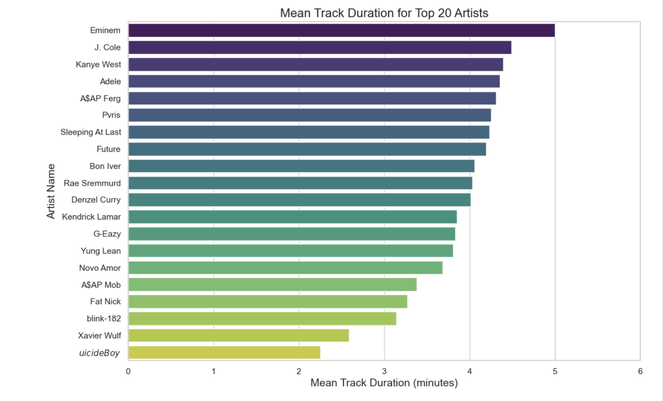
Exploratory Data Analysis (EDA)

Slide 6
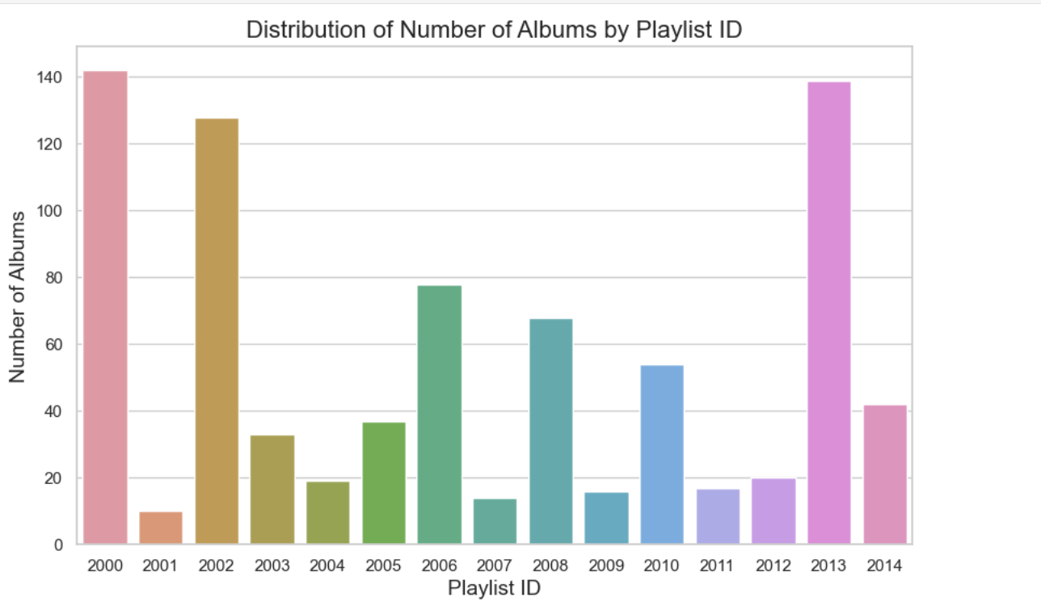

Slide 7
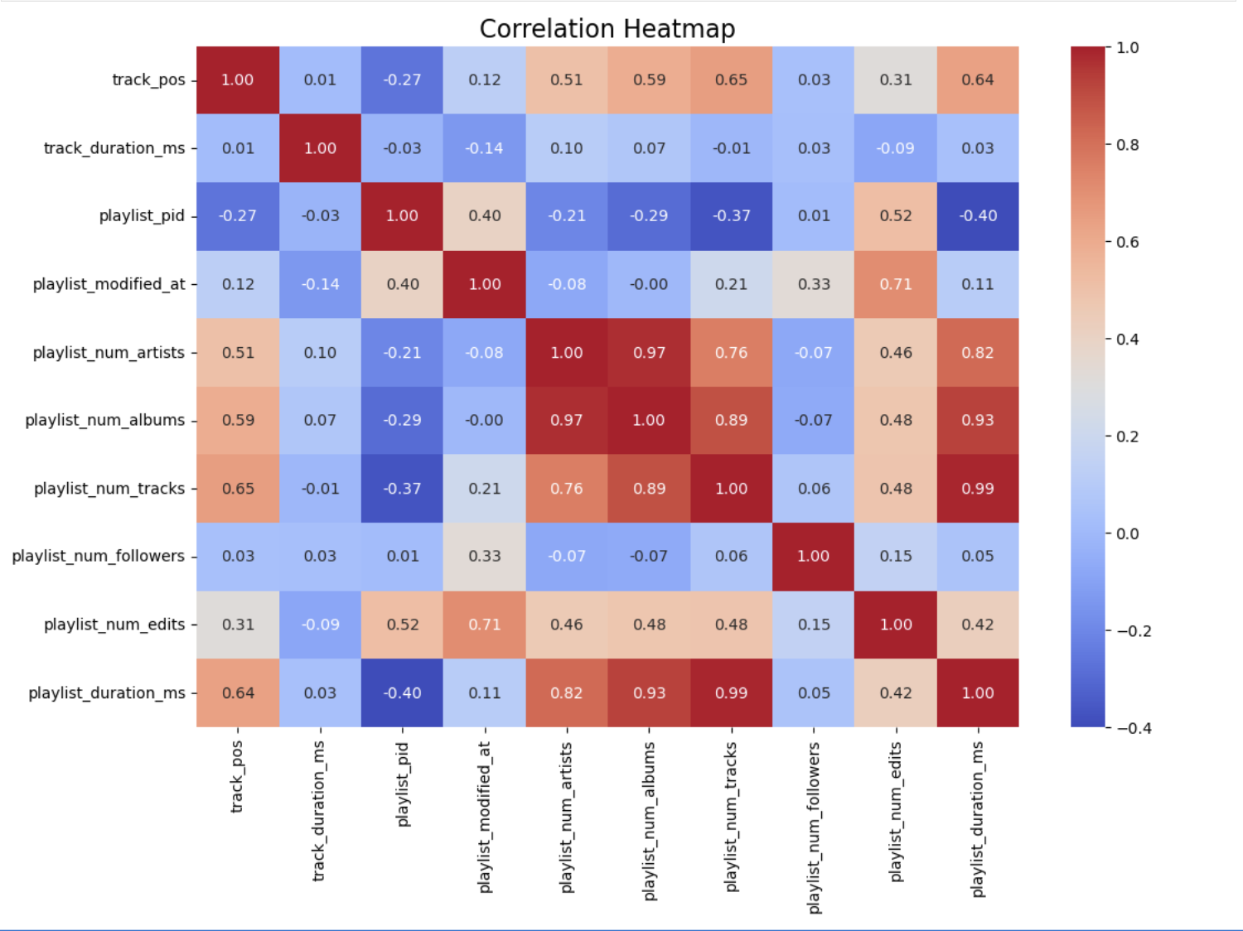

Slide 8
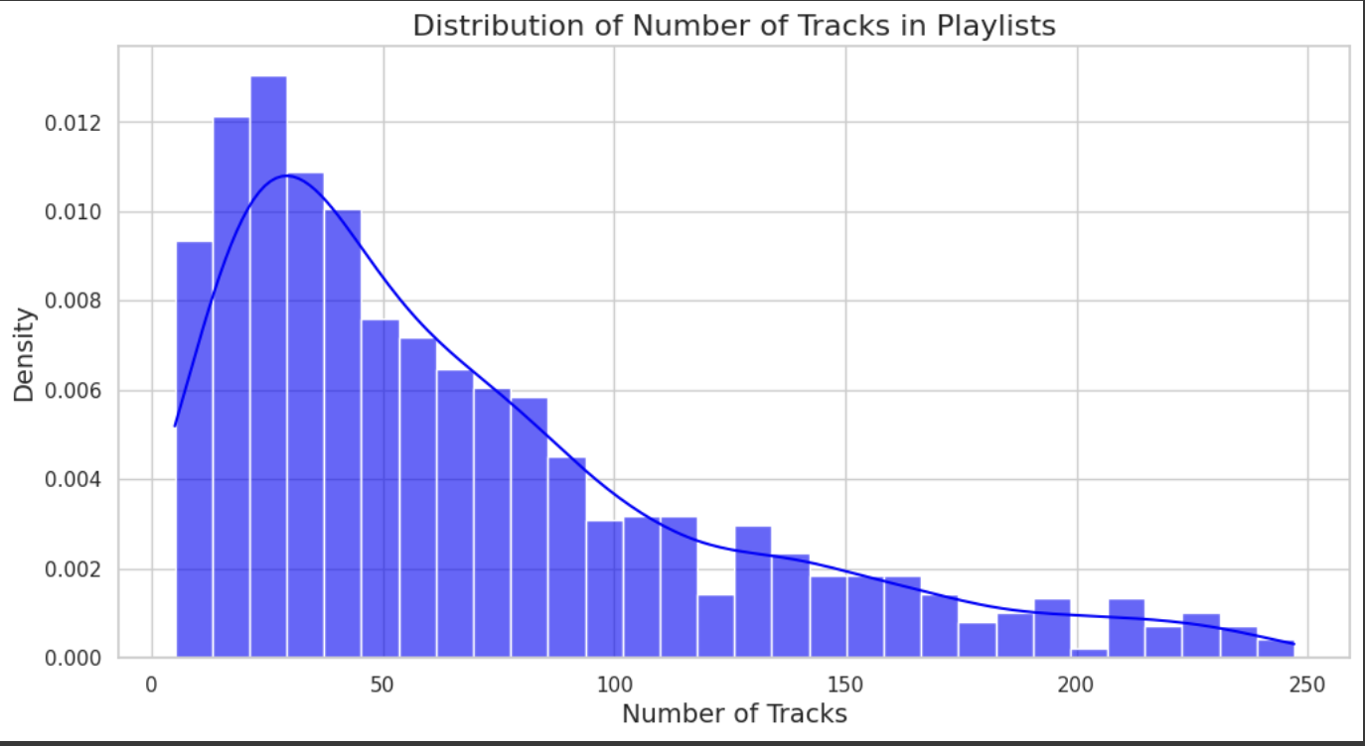
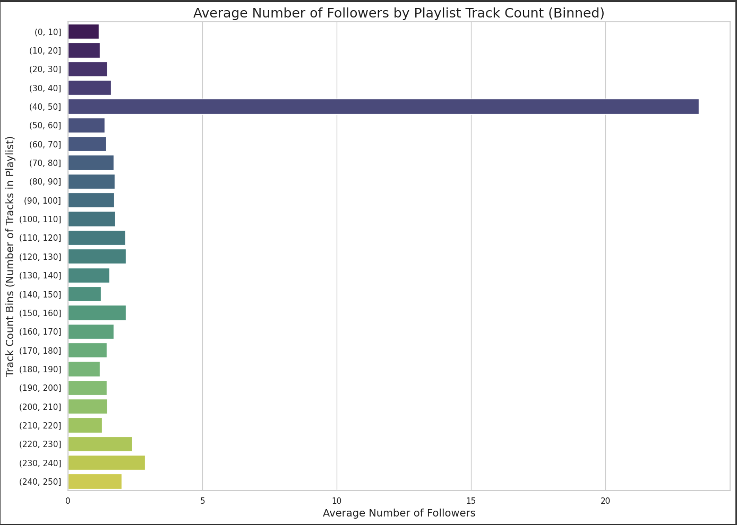
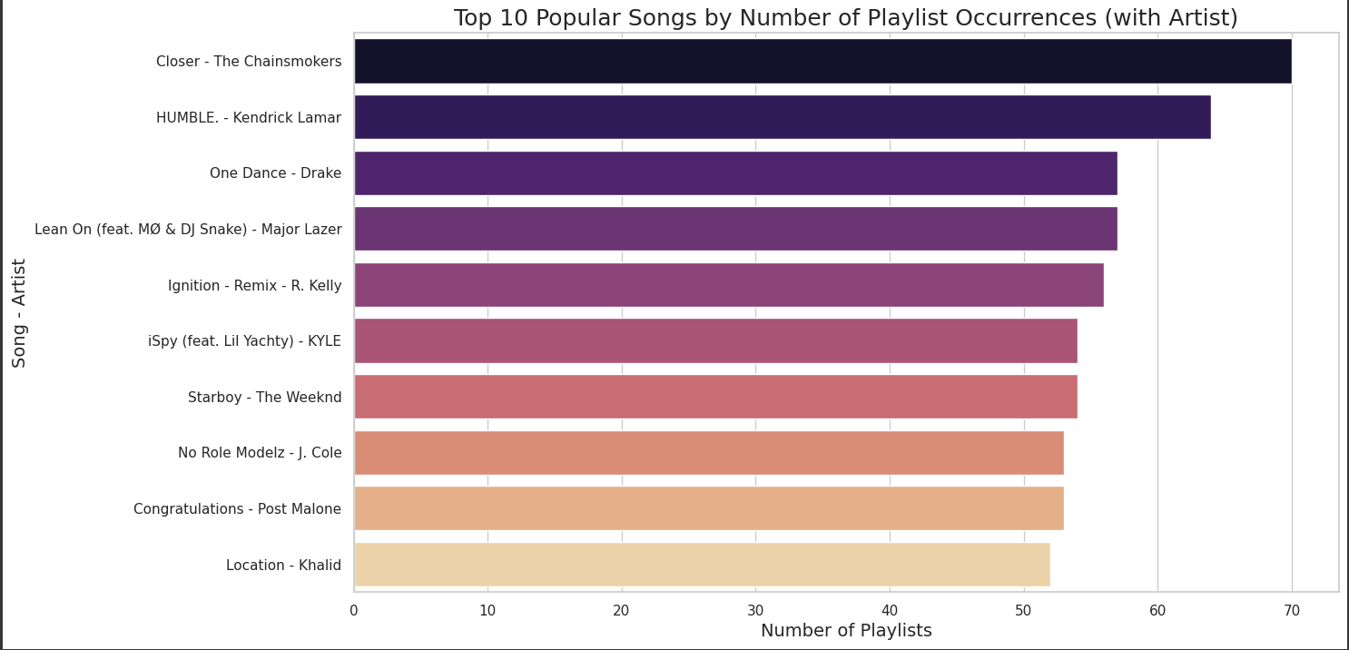
Building a Music Recommendation System to Predict the Next Track Using ML
Problem Statement: Predict the next track in a Spotify playlist based on the preceding tracks to enhance the user experience through personalized music recommendations.
In our context, the hypothesis implies that:
Track continuity: There are identifiable patterns in the sequences of tracks in playlists, influenced by factors like genre, tempo, and artist similarity.
User Intent: The arrangement of tracks conveys the user's desired flow or thematic direction, which can be inferred from the prior selections.
Model Predictability: A predictive model can learn these patterns and make accurate predictions about the next track in the playlist based solely on the sequence of previously played tracks.
1. cosine_similarity(T,Ij​)=∣∣T∣∣⋅∣∣Ij​∣∣(T⋅Ij​)​
2. NK​(T)=Top K(cosine_similarity(T,Ij​))
3. R(T)={Ij​∣Ij​∈NK​(T)}
4. R(T)={Ij​∣Ij​∈Top K(∣∣T∣∣⋅∣∣Ij​∣∣(T⋅Ij​)​)}
Link to Code:
https://colab.research.google.com/drive/1Q7UyVvwoluVJNY2j6FOnoanIGA24EJMr?authuser=1#scrollTo=bBAfCG06XTM2
#Insight from EDA 1:
Most playlists have 20-50 tracks
Peak is around 25-30 tracks
Few playlists exceed 150 tracks
#Insight from EDA 2:
40-50 tracks get most followers (~25)
Very short/long playlists get fewer followers (<5)
Follower count drops after 50 tracks
#Insight from EDA 3:
'Chainsmokers' "Closer" dominates with ~70 playlist appearances
The Hip-hop genre dominates the top 10 list
Tight spread between top/bottom (~15-20 playlist difference)

Slide 9
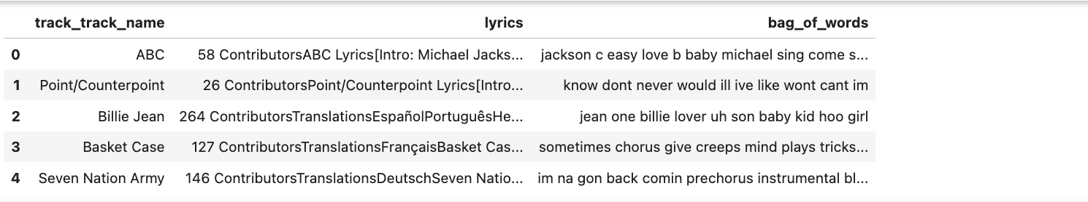
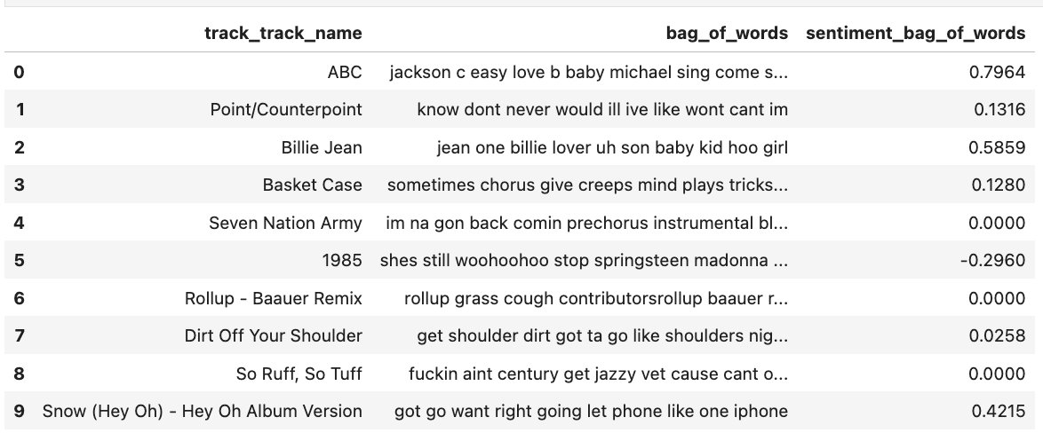
Step 1: Extracted most weighted 10 bag of words from the lyrics using TF-IDF
Step 2: Calculated Sentiment using Sentiment Intensity Analyzer Library

Slide 10
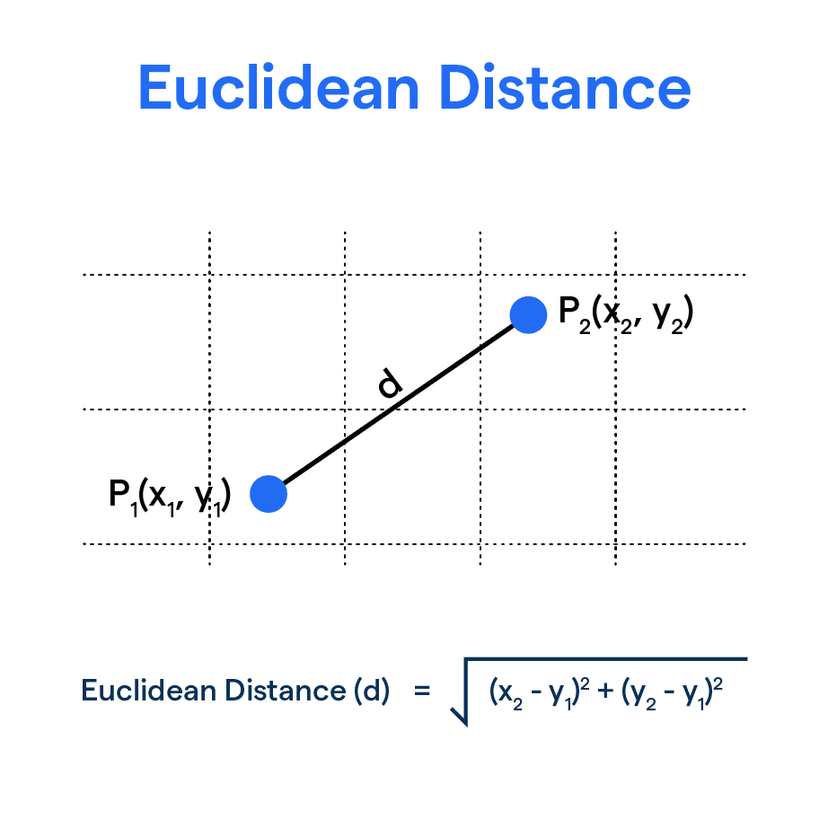
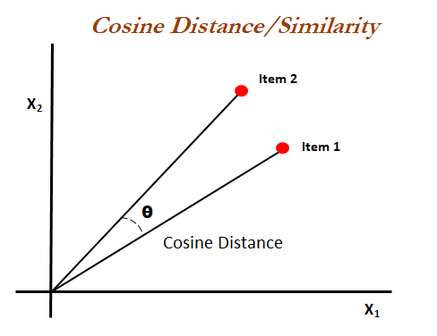
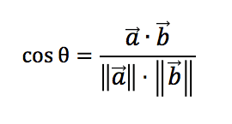
Model 1 : KNN
What is KNN?
KNN is a machine learning algorithm that makes predictions based on the similarity between data points.
In music recommendation, it suggests songs similar to a user’s preferences based on attributes like Playlist name, artist name, track name and etc
Why KNN for music recommendation?
Simple, intuitive, and effective for collaborative and content-based filtering.
Does not require complex training, making it suitable for real-time recommendations.
KNN model Colab link

Slide 11
KNN model flowchart
Label Encoding for categorical columns
Encode artist, albums and track names
Vector embedding
Vectorization of words
Update the weights
For artist name and playlist name for euclidean model.
Start
Testing the Model
Running some samples for both euclidean and cosine models
KNN Model building
Both on Euclidean and cosine- based
End

Slide 12
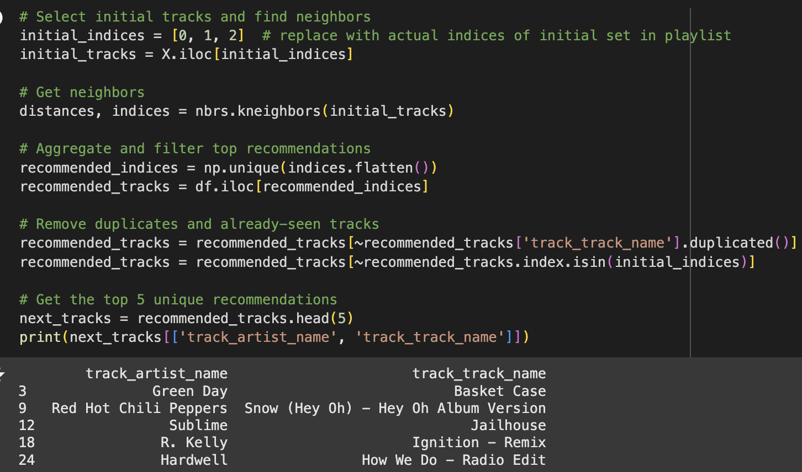
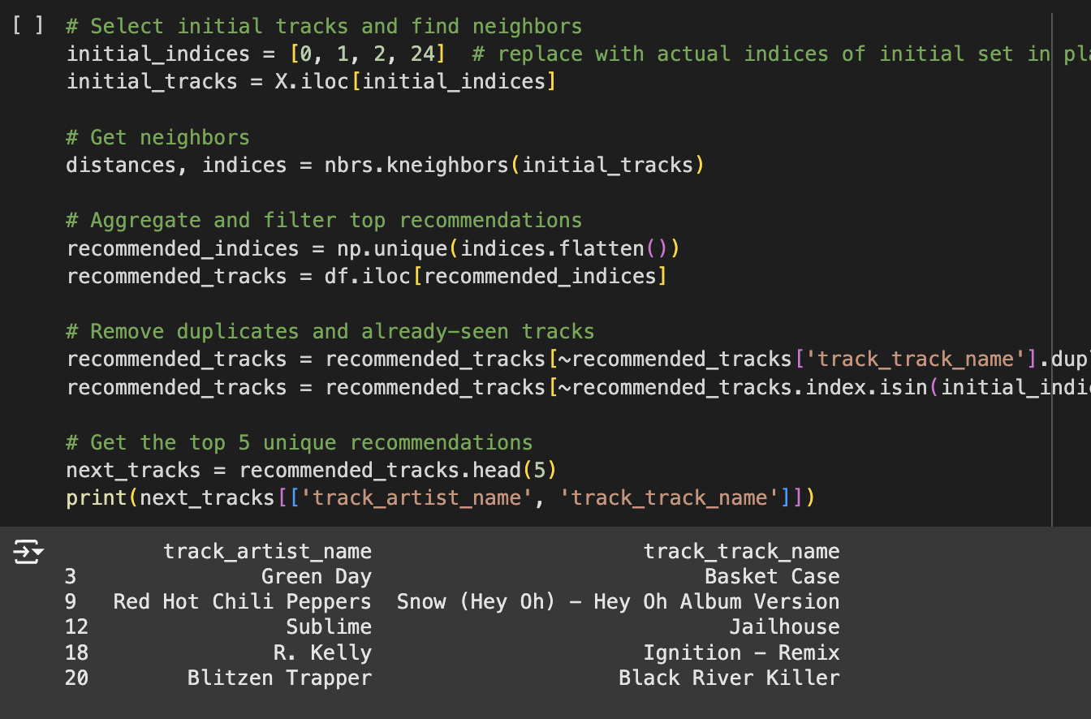
Output for KNN
Snapshot 1
Snapshot 2
Initially we pass tracks [0, 1, 2], then from the recommended list we add the 24th track, i.e., [0, 1, 2, 24]. We then receive an updated recommended list.

Slide 13
Model 2: BERT
What is BERT?
A transformer-based deep learning model developed by Google for Natural Language Processing (NLP).
stands for Bidirectional Encoder Representations from Transformers.
Processes text in both directions (left to right and right to left) to understand context.
Key Features:
Bidirectional: Captures full context of a word by looking at both preceding and succeeding words.
Fine-tunable: Can adapt to various NLP tasks like sentiment analysis, question answering, and recommendation systems.
Why use BERT?
Contextual Understanding:
BERT distinguishes tracks with similar words but different meanings, such as "Summer Girls" and "Summer Hits"
Handles complex language structures:
Captures relationships across long track/playlist names like "Throwback 90s Summer Hits".

Slide 14
Steps used to implement BERT:
Load Pre-trained BERT
Use the bert-base-uncased model and tokenizer from the Transformers library.
Example: "Summer Girls" → [CLS] Summer Girls [SEP].
K•Encode text with BERT
Convert track and playlist names into embeddings using BERT's [CLS] token for sentence-level representation.
Example: "Summer Girls" → [1.23, -0.45, ...]
Process the data in batches to handle memory constraints efficiently.
Calculate Similarity
Compute cosine similarity between the seed tracks' embeddings and all track embeddings.
Example: "Summer Girls" is 0.91 similar to "Party Girls".
Use the average similarity across all seed tracks for ranking.
Generate recommendations:
Rank tracks by similarity scores and exclude the seed tracks.
Select the top `N` recommendations based on similarity rankings.
Ensure Uniqueness:
Ensure all recommended tracks are unique and not duplicates of seed tracks or previous recommendations.

Slide 15
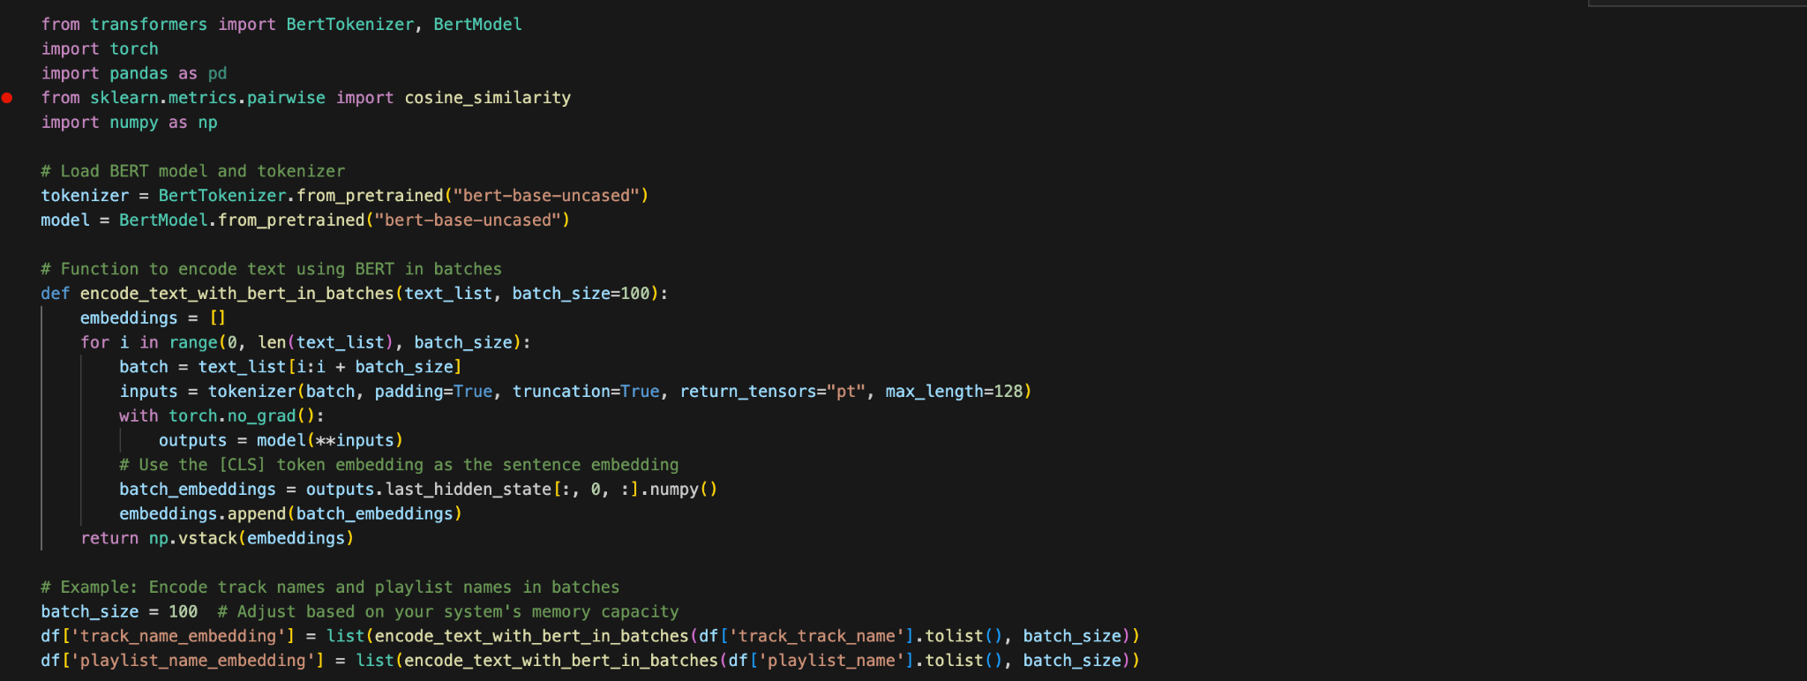
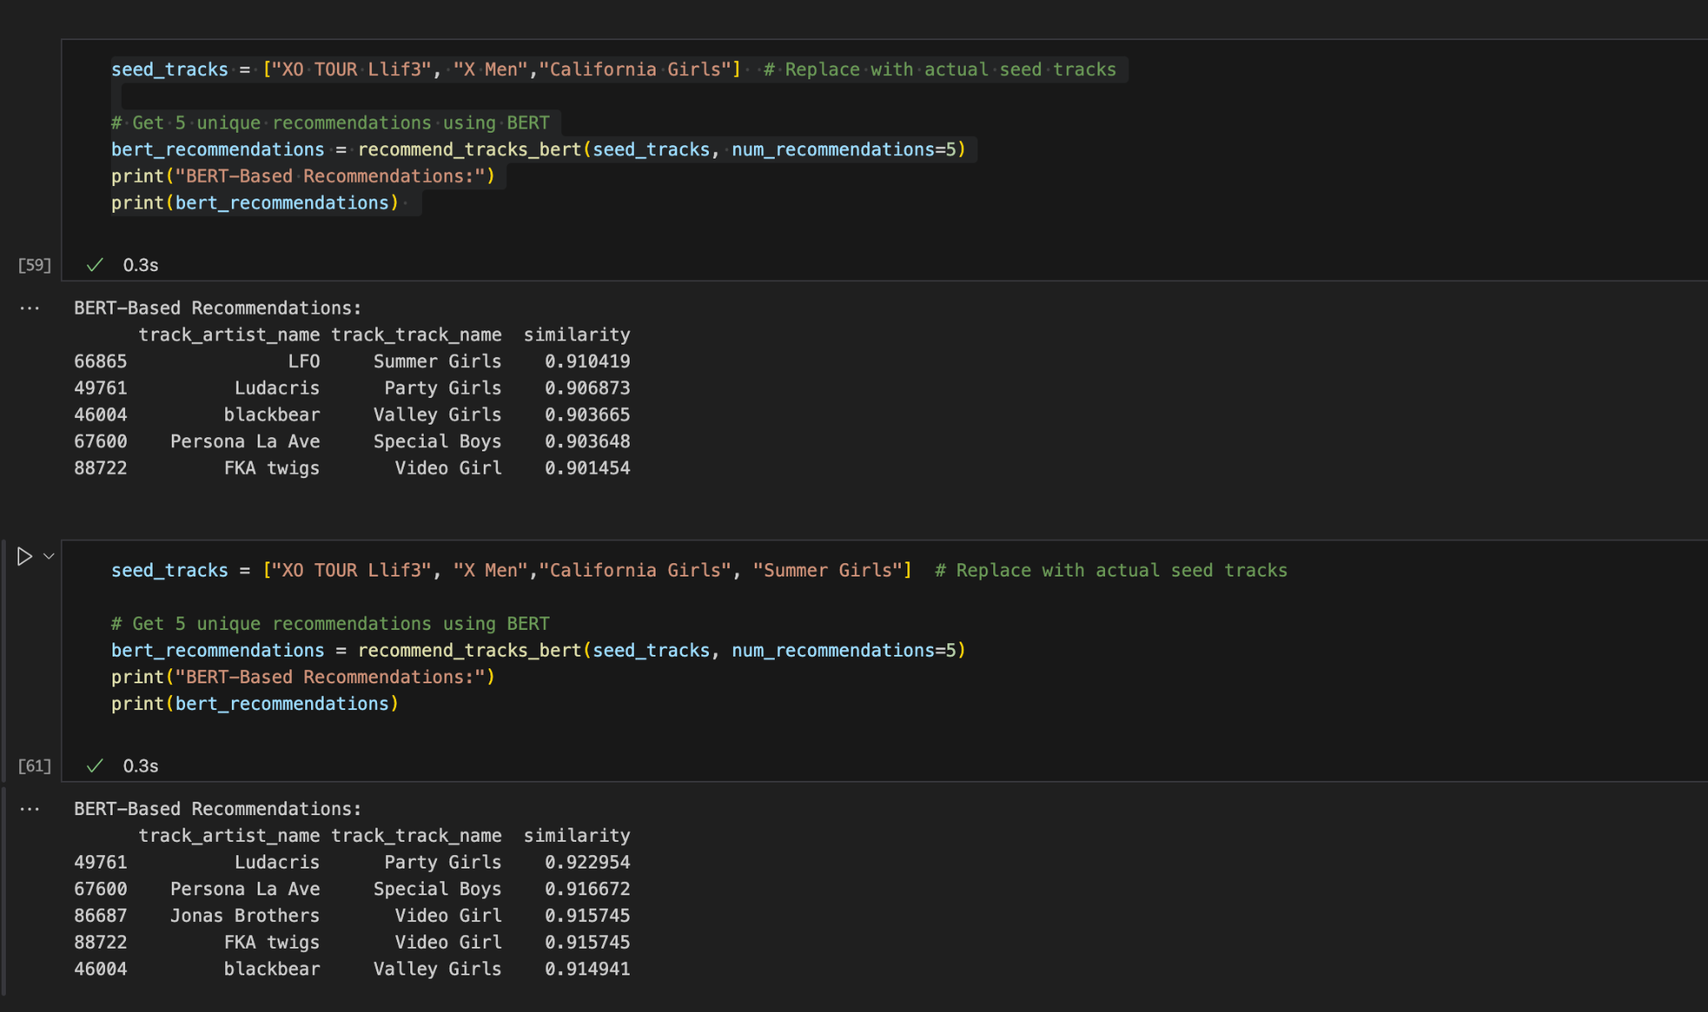
Code Walkthrough
Function encode_text_with_bert_in_batches Encodes text data (track and playlist names) into embeddings using BERT for similarity analysis.
It utilizes BertTokenizer and BertModel from Hugging Face Transformers.
For tokenization, it uses padding and truncation to standardize input length (max length = 128).
To run efficiently, adding batch size reduces the workload on CPU and GPU performance.
In Screenshot 2, the recommend_tracks_bert() function is called with the seed_tracks list and the number of recommendations desired (5) as arguments.
Using the output of the recommended song in the seed track in the next BOC (Block of Code), when calling the function again, it gives the next set of unique recommended tracks.

Slide 16
Model 3: XGBoost
XGBoost is a highly efficient, scalable, and powerful machine learning algorithm used for classification and regression tasks, known for its speed, accuracy, and ability to handle large datasets with regularization to prevent overfitting and improve generalization.
XGBoost: Leverages decision trees to identify patterns and predict track recommendations based on input features.
DistilBERT Embeddings (Only for Feature Engineering): Converts track names into semantic vectors that capture textual meaning.
XGBoost uses both DistilBERT embeddings + numerical features to predict the next track
Why is DistilBERT a better choice than Bag of Words for predicting the next track in a playlist?
DistilBERT can understand the semantic similarity between track names. For example, it can recognize that "Upbeat Party Anthem" and "Dance All Night" are related by their shared theme of energetic, danceable music, even if they don't contain identical words. Bag of Words would treat them as distinct, missing the deeper connection between the tracks.
For example, DistilBERT can recognize that tracks with similar themes or moods are likely to follow each other.
Bag of Words, however, treats each word independently, missing these contextual relationships and making it less effective for sequence-based tasks like predicting the next track.

Slide 17
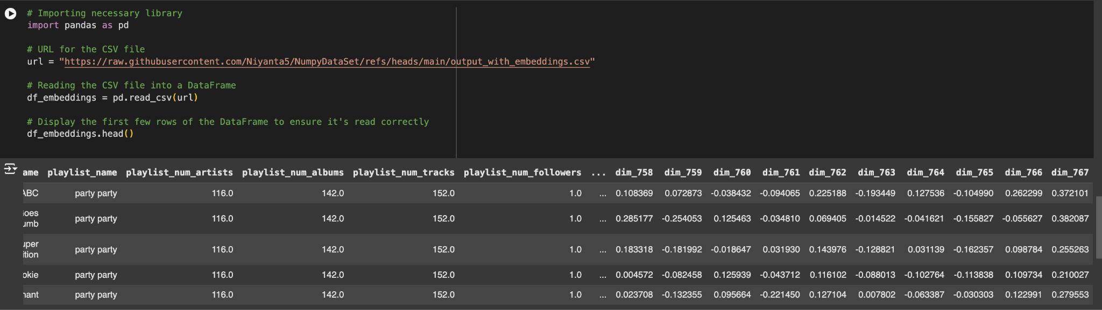
Embedding generation using DistilBERT
DistilBERT Setup: The DistilBERT model is initialized to convert track names into dense vector embeddings
For each track name, a batch of texts is tokenized, and the embeddings (semantic representations) are generated using the model’s output.
Embedding Integration: These embeddings, representing the semantic meaning of track names, are concatenated with other numerical features (like track duration, number of followers) and categorical features (encoded track/artist names).

Slide 18
XGBoost Model Preparation Flow
Label Encoding for categorical columns
Encode artist, albums and track names
Feature Engineering
Select Encoded features and add numerical features
Target Variable Handling
create dummy target
Start
Return Processed Data
X_scaled, y, df_processed
Scaling Numerical Features
Apply Standard Scaler to features
Ensure Binary Classification
Map target variable to binary ( 0 or 1)
End
TrackName | TrackDuration(seconds)) | PopularityScore | Embedding | IsNextTrack
Time to Party | 120 | 0.889 | [0.1, 0.3] | 1 (This track fits the sequence)
I’m so sad | 130 | 0.688 | [0.2, 0.4] | 0 (This track doesn't fit the sequence)

Slide 19
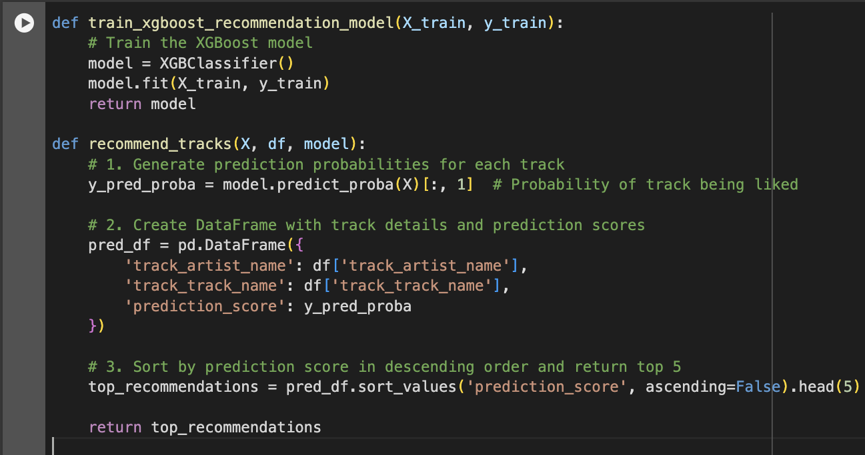
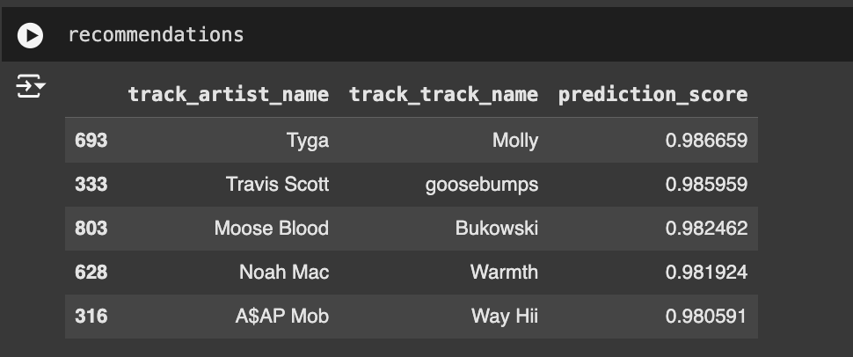
Code Walkthrough
Training the model: train_xgboost_recommendation_model(X_train, y_train) trains the XGBoost model using track features (X_train) and the binary target (y_train, indicating whether a track was liked or not).
Making predictions: model.predict_proba(X) generates probabilities for each track. [:, 1] extracts the probability that each track is liked (positive class).
Generating recommendation scores: The probabilities are stored in a DataFrame (pred_df) along with track details, specifically track_artist_name, track_track_name, and prediction_score.
Returning top recommendations: tracks are sorted by prediction_score in descending order. The top 5 tracks with the highest likelihood of being liked are returned as recommendations.

Slide 20
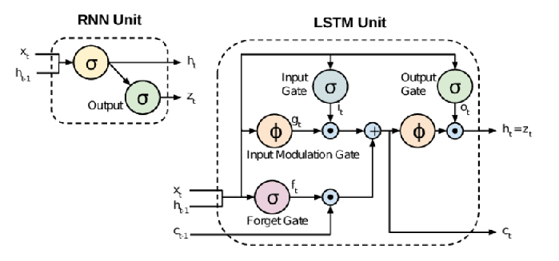
Model 4: Recurrent Neural Network using LSTM
What is RNN?
RNNs are specifically designed to handle sequential data like time-series, audio, text, and playlists where the order of data points matters.
RNNs have a "memory" that allows them to retain information about earlier inputs in the sequence.
How RNN is Useful here?
Predicting the next song in a playlist depends on the context of previous tracks.
Challenges with Standard RNN:
Vanishing Gradient Problem:
Difficulty in Remembering Long-Term Dependencies.
Solution: LSTM in RNN:
Memory Cells and Gates:
Ability to Handle Long Sequences:

Slide 21
RNN Model Flow:
Embedding Layer
Embed the sequence of tracks in N-Dimensional Vector
LSTM Layer
Learn from the vectors and output a single vector based on the learning.
Dense Layer
Assign weights to the output vector received from LSTM Layer.
Start
Final Output
Track with highest probability is selected.
Softmax
Convert the output vector into probability for all the tracks in the dataset.
End

Slide 22
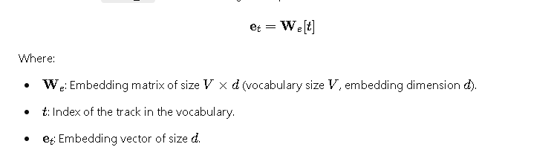
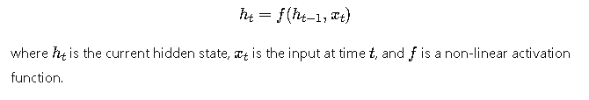
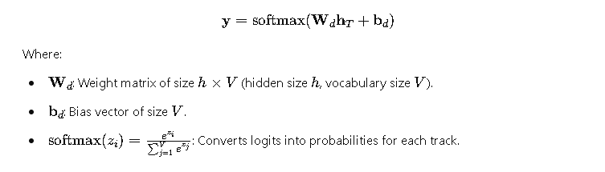
RNN Architecture
Input/Embedding Layer:
This layers is the first layer of the RNN model wherein the sequence of tracks would be vectorized in N-dimensional space based on embedding vector size.
2. LSTM Layer:
This layer learns vectors and update its "memory state" (called the cell state) and produces an intermediate output (called the hidden state).
This hidden state summarizes the information from the first track.
3. Dense Layer with Softmax:
The dense layer is essentially a classifier. It maps the LSTM's output vector into a probability distribution over all possible tracks (e.g., all track IDs in the dataset).
These raw values are then passed through a softmax function, which converts them into probabilities.
Then the track with the highest probability is selected as the output.

Slide 23
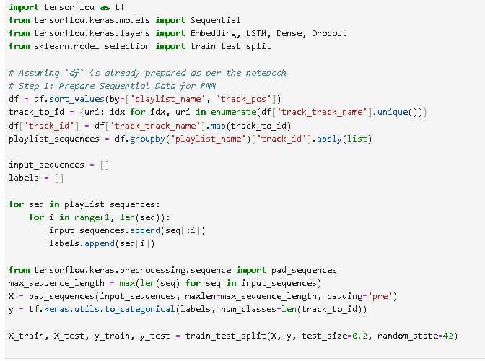
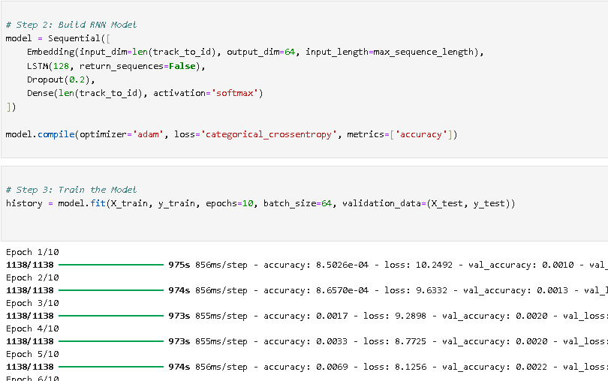
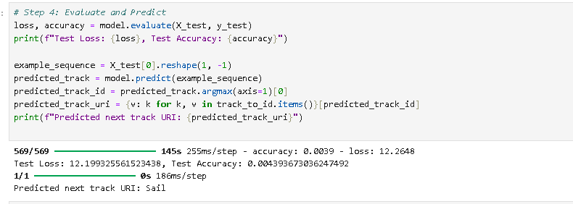
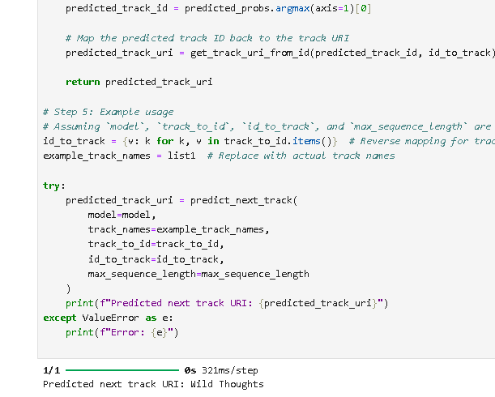
Code Walkthrough

Slide 24
RNN Model Results and Summary
The model performance metrics based on the labelled output would be low.
The sequence data is too heavy and it takes a lot of compute to train the model on this data. Therefore, the number of epochs should be higher. Due to resource constraints, this was a challenge in this model.
Regularisation and application of slow learning rates are a few methods that could be tried to improve the model performance.
This model can be useful for cases when all songs in a playlist are given as input and a new song track needs to be predicted based on the existing sequence.

Slide 25
Flow-chart for PMS data for model performance
Deployed model on app/web
Collect the sample survey from the users
Evaluate the metrics like Accuracy and Precision
A/B or A/B/C test if required
Our models are unsupervised, and therefore, their performance must be evaluated based on data collected through human interactions. Consequently, the performance of the model can be considered equivalent to the average psychological behavior of the population.

Slide 26
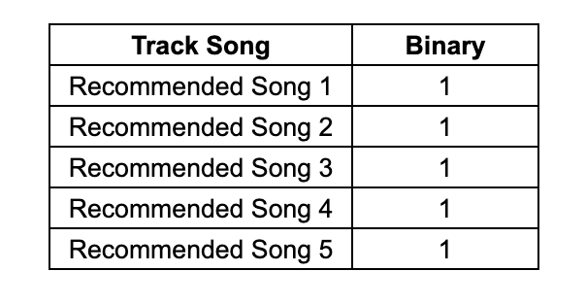
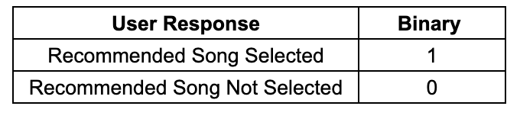
PMS Data Collection from survey
Data is collected from users through the model deployed on the web or app.
If a user selects a recommended song, the binary code will be 1.
If a user does not select a recommended song, the binary code will be 0.
This data is collected from various sources and compiled together.
Evaluation of metrics is carried out based on these data.

Slide 27
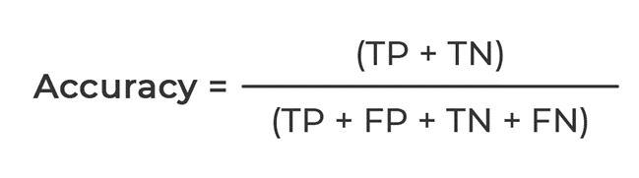
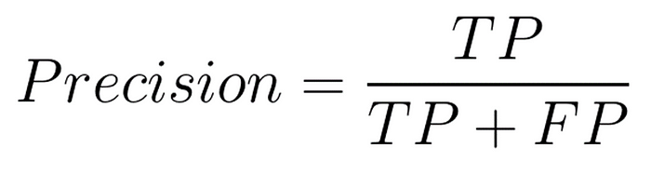
Important Metrics
Accuracy: Accuracy measures the proportion of correct predictions (both true positives and true negatives) made by a model out of the total number of predictions.
Precision: Precision measures the proportion of true positive predictions out of all positive predictions made by the model.
Why Precision?
Streaming Platforms:
For platforms like Netflix or Spotify, precision ensures that the movies, shows, or songs recommended align with the user’s viewing or listening history

Slide 28
Experimentation (A/B or A/B/C test)
Data from multiple models (PMS data) is collected, and A/B or A/B/C testing is performed.
A/B/C testing is conducted on various ML models to identify the best-performing model.
A/B testing can be carried out on two models simultaneously or used to compare the current model with the previous one.
The model that returns the highest value for business metrics is considered the final model.

Slide 29
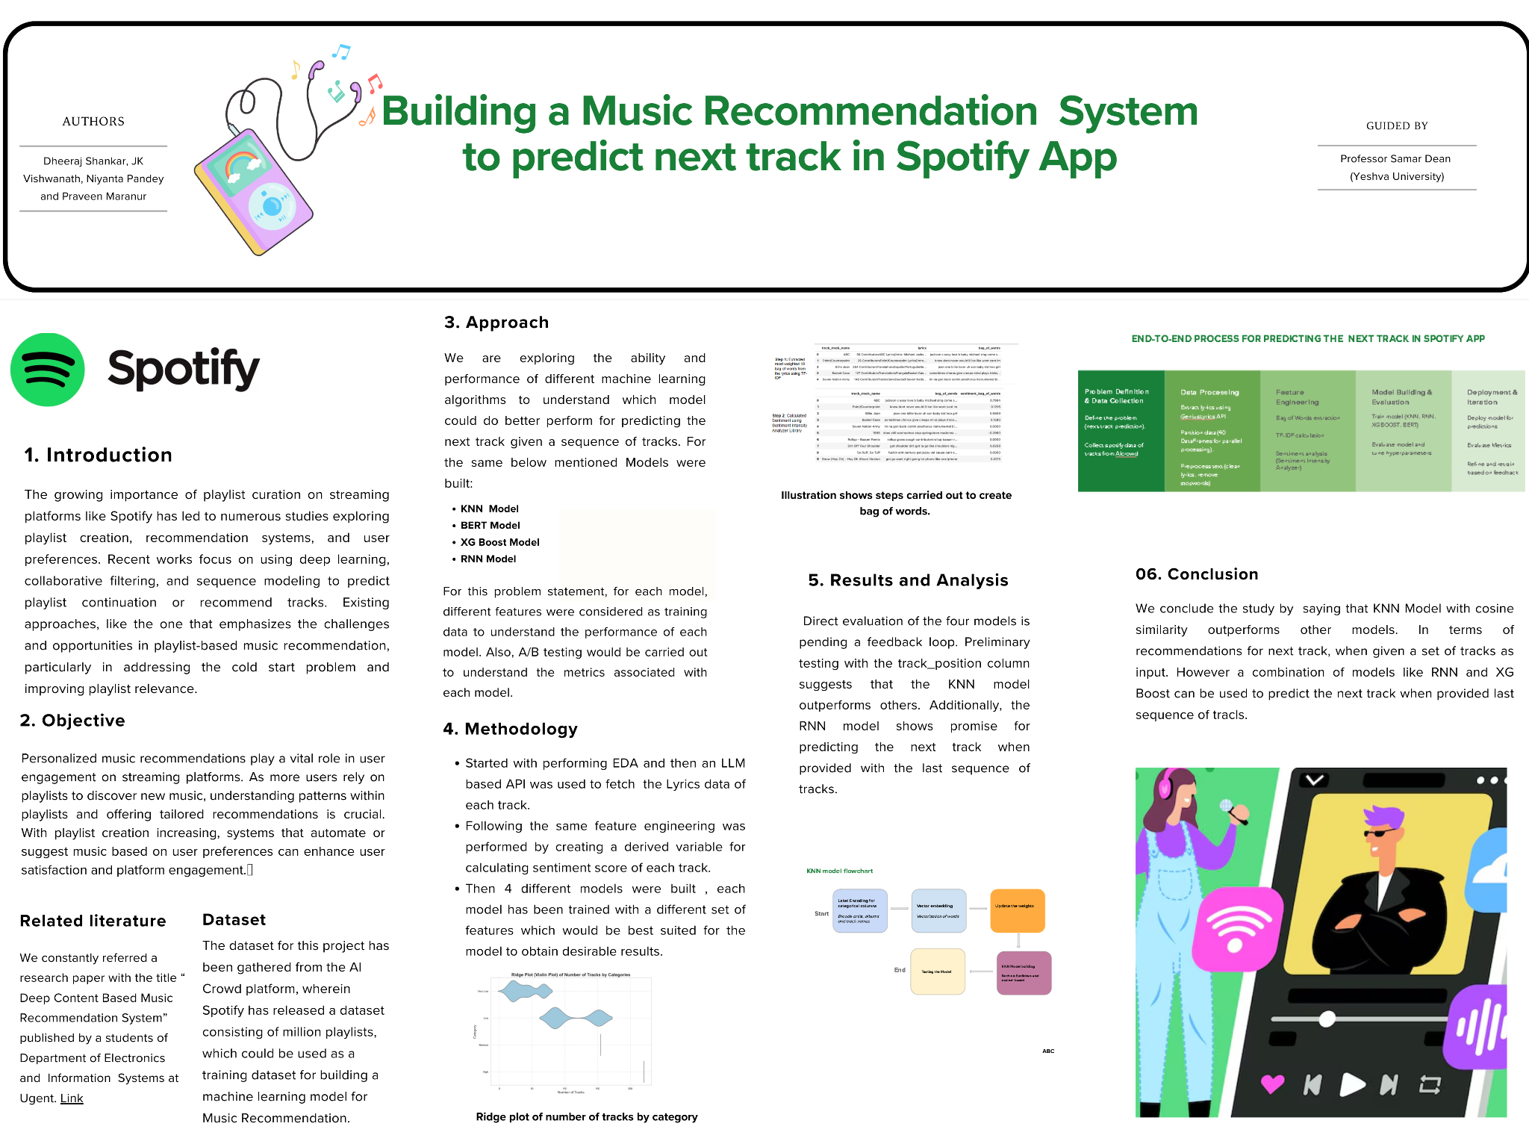

Slide 30
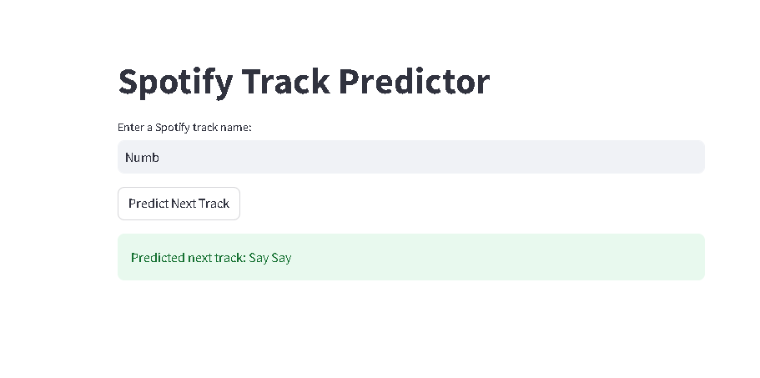
Streamlit Deployment Sample for Model
Link

Slide 31
THANK YOU :)

Slide 32
Appendix

Slide 33
