Slide 1

Computation Offloading in Dynamic Mobile Environment
Capstone Project Phase-2
6 credits
Project ID: W1

Slide 2



Team Composition
Gautham Bolar | PES1UG20EC044
C H Pranay | PES1UG20EC048
Dheemanth R Joshi | PES1UG20EC059
Guide: Dr. Vamsi Krishna (ECE)

Slide 3
Table of Contents
Sl No | Content | Slide number
1 | Introduction and Motivation | 3-5
2 | Literature Review | 6-10
3 | Problem Statement | 11
4 | Methodology | 12-25
5 | Simulation and Results | 26-37
6 | Conclusion and Future Work | 38
7 | Individual Contributions | 39
8 | Deliverables | 40
9 | References | 41
10 | Project Timeline | 42

Slide 4
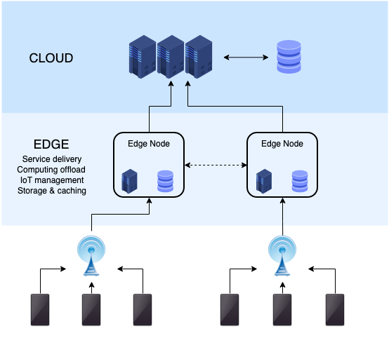
Introduction - Edge Computing
Edge Computing method introduces computing resources at the edge of the network.
This method reduces communication latency and local computing.
Minimizes load on the core network by computing data at the edge itself.

Slide 5



Motivation: Why Vehicular Edge Computing (VEC)?
Decentralized
Centralized
Reduces the Load on the Network
High load on the network
V/S
Routing Overhead implies high latency
Closer To the user
Low Latency
Far to the user
Applications of VEC include latency sensitive applications like AR/VR, Navigation and Vehicle Safety Applications

Slide 6
Delay Modeling in static environment
Edge servers and Caching schemes
Task scheduling and Bandwidth allocation
Multi Access Edge Computing
MDP Formulation
Literature Survey: Phase-1
Deep Reinforcement Learning
Federated Learning
Algorithms
MADRL, DDPG etc..
Vehicular Edge Computing
Bandwidth allocation schemes in dynamic environment
Road-Side Units (RSUs) and Service Migration Fundamentals
Delay Modeling in dynamic environment

Slide 7
Network Initiated Migration
Vehicle
Initiated Migration
Based on Vehicle attributes: Position, Velocity etc…
Communication Resource Allotment
Computing Resource Allotment
Service Migration
Based on Services Hosted
Resource Allocation
User Grouping
Literature Survey:
Phase-2

Slide 8
What is Service Migration?
VM
Initial Serving Edge Node
New Serving Edge Node
VM
VM
Service Migration is a scheme in which the Virtual Machine (VM) dedicated to a vehicle migrates from the source host edge node to another edge node through which serving latency is minimized. Service Migration decision is taken by the Agent based on mobility pattern of the vehicles.

Slide 9
Broad Classification of Literature: Vehicle Initiated Migration and Network Initiated Migration
Vehicle Initiated Migration
Network Initiated Migration
VM
VM
Agent
Agent

Slide 10
Research Gaps
Paper | Description | Research Gaps
[1] Q.Yuan et.al | Performed joint service migration and vehicle routing in a vehicular environment. Perform vehicle-initiated service migration using DRL to minimize service delay. | Computing and communications were not allocated adaptively. The service migration was jointly optimized with routing, therefore change in plans in route could imply significant fall in Quality of Service (QoS)
[2] W.Chen et.al | Performed network- initiated service migration using DRL in a small closed campus environment. | The users were assumed to be fixed in the environment. Users were pedestrians, which is a low- speed scenario.

Slide 11
Problem Statement
To develop a reinforcement learning (RL) method for optimal computing resource and bandwidth allocation for vehicular users. To provide network - initiated service migration for the vehicular users according to the mobility pattern.

Slide 12


Our Approach: Comparison with Literature on Resource Allocation and Service Migration methods
 | Bandwidth Resource Allocation | Compute Resource Allocation | User Grouping? | Vehicle Initiated Migration? | Network Initiated Migration?
[1] Q. Yuan et al
[2] W.Chen et al
Our Approach

Slide 13
System Description
Single Agent or Multi Agent Problem ? | Single agent problem
Who is the Agent ? | MEC server
Network Initiated Migration or Vehicle Initiated Migration? | Network Initiated Migration

Slide 14
Methodology
Modelling the Environment
Formulation on Markov Decision Process (MDP)
Designing DRL Model to solve the MDP
Result Analysis and Documentation
Modelling Grids
State Space Modelling of Vehicles, RSU and Server.
Reward Modelling for the designed MDP
Result Analysis
Vehicle Behavior Definition
Action Space Modelling (Service Migration Decision making)
DRL Algorithm to solve MDP
Documentation and Reporting
RSU Design
Server Modelling

Slide 15
Peripherals of the System Model
Vehicle
Road Side Unit (RSU)
MEC Server
Offloads Data to its hosted services
Moves in the environment with random velocities
Receives data from vehicles and transfers it to MEC server
Consists of Bandwidth Resource Blocks (BRBs)
Receives data from RSU.
Computes data through Compute Resource Blocks(CRBs)
Allocates CRBs, BRBs and takes service migration decision

Slide 16


System Model: Environment Overview
Services Hosted by MEC Server
Outgoing Services
Incoming Services
MEC Server (Agent)
Back Haul Link
Back Haul Link
Front
Haul
Link
Road
Side
Unit
(RSU)
MEC Server Coverage Area - 1
MEC Server Coverage Area - 2
MEC Server Coverage Area - 3
User Data

Slide 17



System Model: Markov Decision Process Overview
Agent
$$S_{t}$$
$$A_{t}$$
$$R_{t}$$
Environment

Slide 18
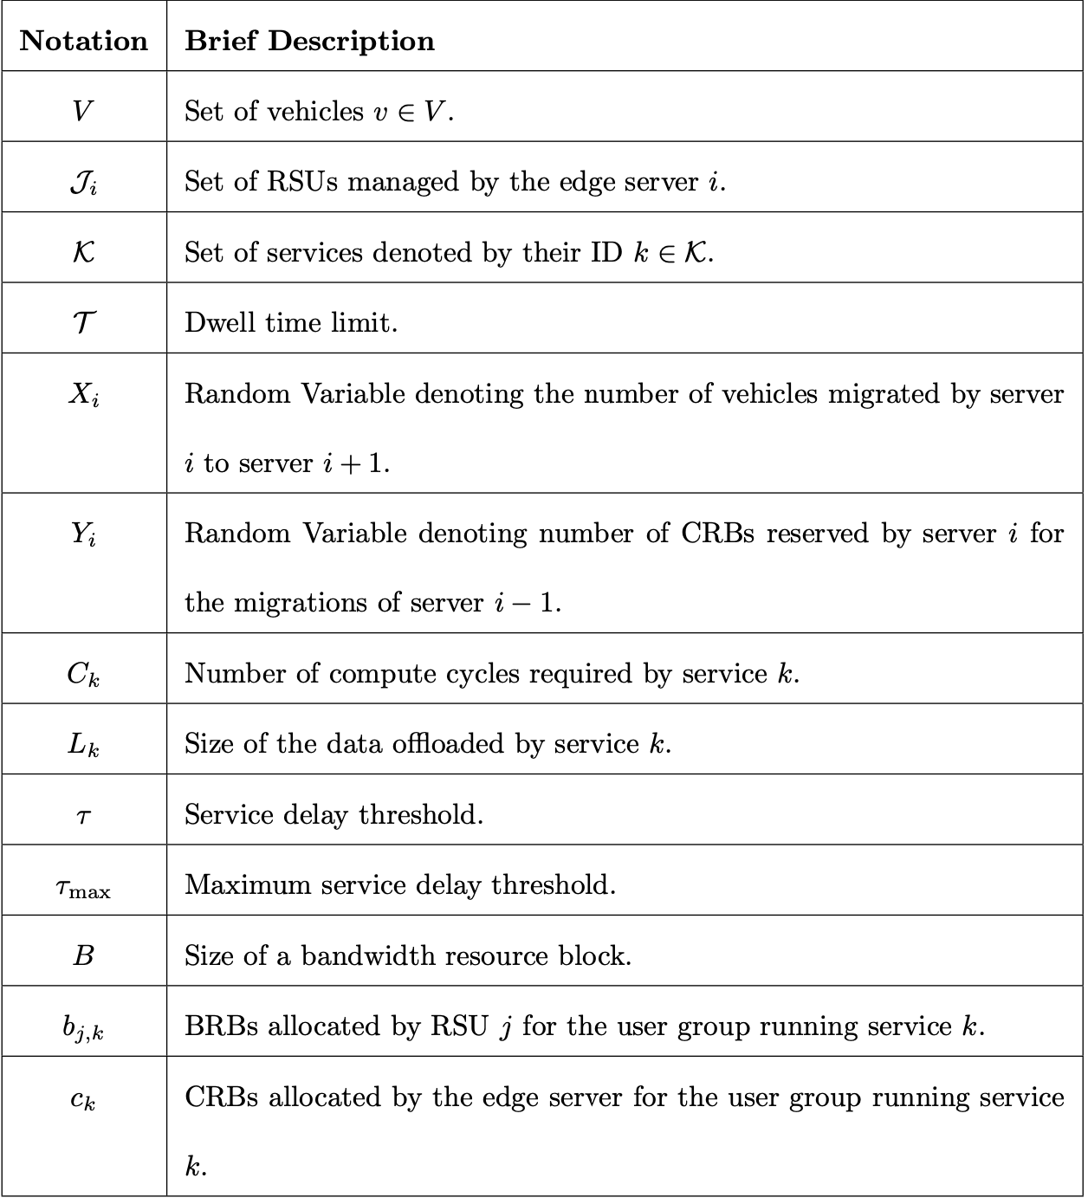
Formulation of Markov Decision Process: Notation Table

Slide 19




Formulation of Markov Decision Process
State Vector:
$$S_{t}=\left[\left\{V_{j,k,t} : ∀j, ∀k\right\}, W_{t},X_{i−1,t}, Y_{i+1, t}\right]$$
$$Where W_{t } is the number of vehicles remaining time less than under server i^{′}s coverage.$$
Action Vector:
$$A_{t}=\left[\left\{b_{j,k,t} : ∀j, ∀k\right\}, \left\{c_{k,t}:∀k\right\},y_{i,t}, x_{i,t}\right]$$
Note that the process does not have a state transition equation from which we sample the next state $S_{t+1}$ given $S_{t}, A_{t}$. Therefore, the MDP is termed as ”Model Free”

Slide 20
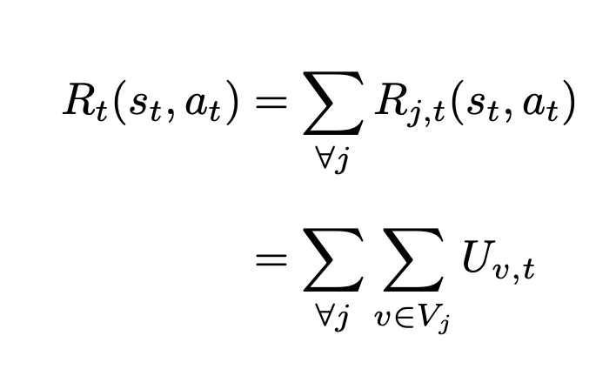
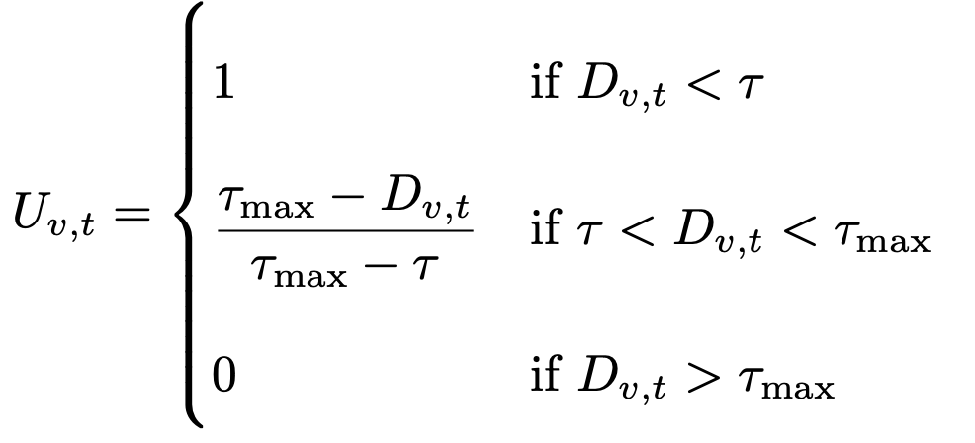
Formulation of MDP: Reward Modelling
(1)
(2)
Here, $U_{v,t}$ is termed the utility function which is defined below.
(3)

Slide 21
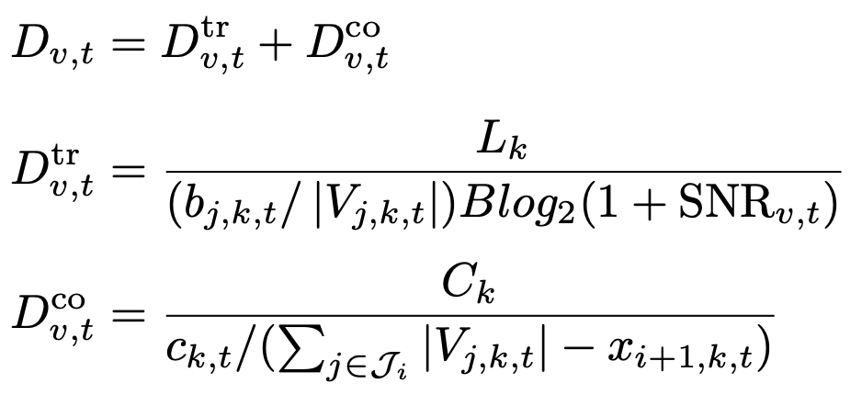
Formulation of MDP: Reward Modelling
$D_{v,t}$is the service delay encountered by vehicle $v$ at time $t$.
(4)
(5)
(6)
$D_{v,t}^{tr}$and $D_{v,t}^{co}$ are transmission and communication delays respectively. ${SNR}_{v}$ is the signal to noise ratio between the RSU and the vehicle.

Slide 22
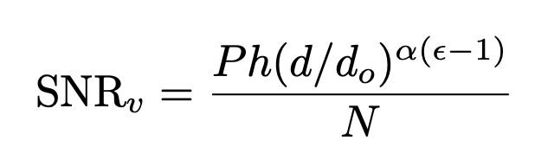
Formulation of MDP: Reward Modelling
(7)
Where P is the transmit power of the vehicle, h is the channel gain, d is the distance between the vehicle and RSU, do is a reference distance, α is the path-loss exponent, ε is the power control factor and N is the noise power.

Slide 23
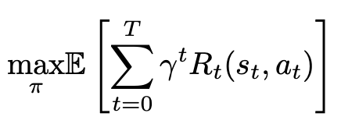
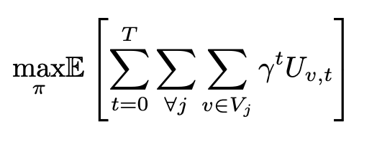

Formulation of MDP: Optimization Problem
To find the optimal policy $π^{∗}$, we formulate the following optimization problem
$$≡$$
(8)
Where $γ^{t}∈\left( 0 ,1 \right]$ is the discount factor to maintain convergence.
And $π$ is the policy followed by the agent.

Slide 24
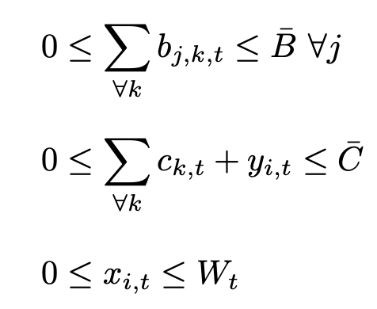
Formulation of MDP: Optimization Problem Constraints
(9)
(10)
(11)

Slide 25
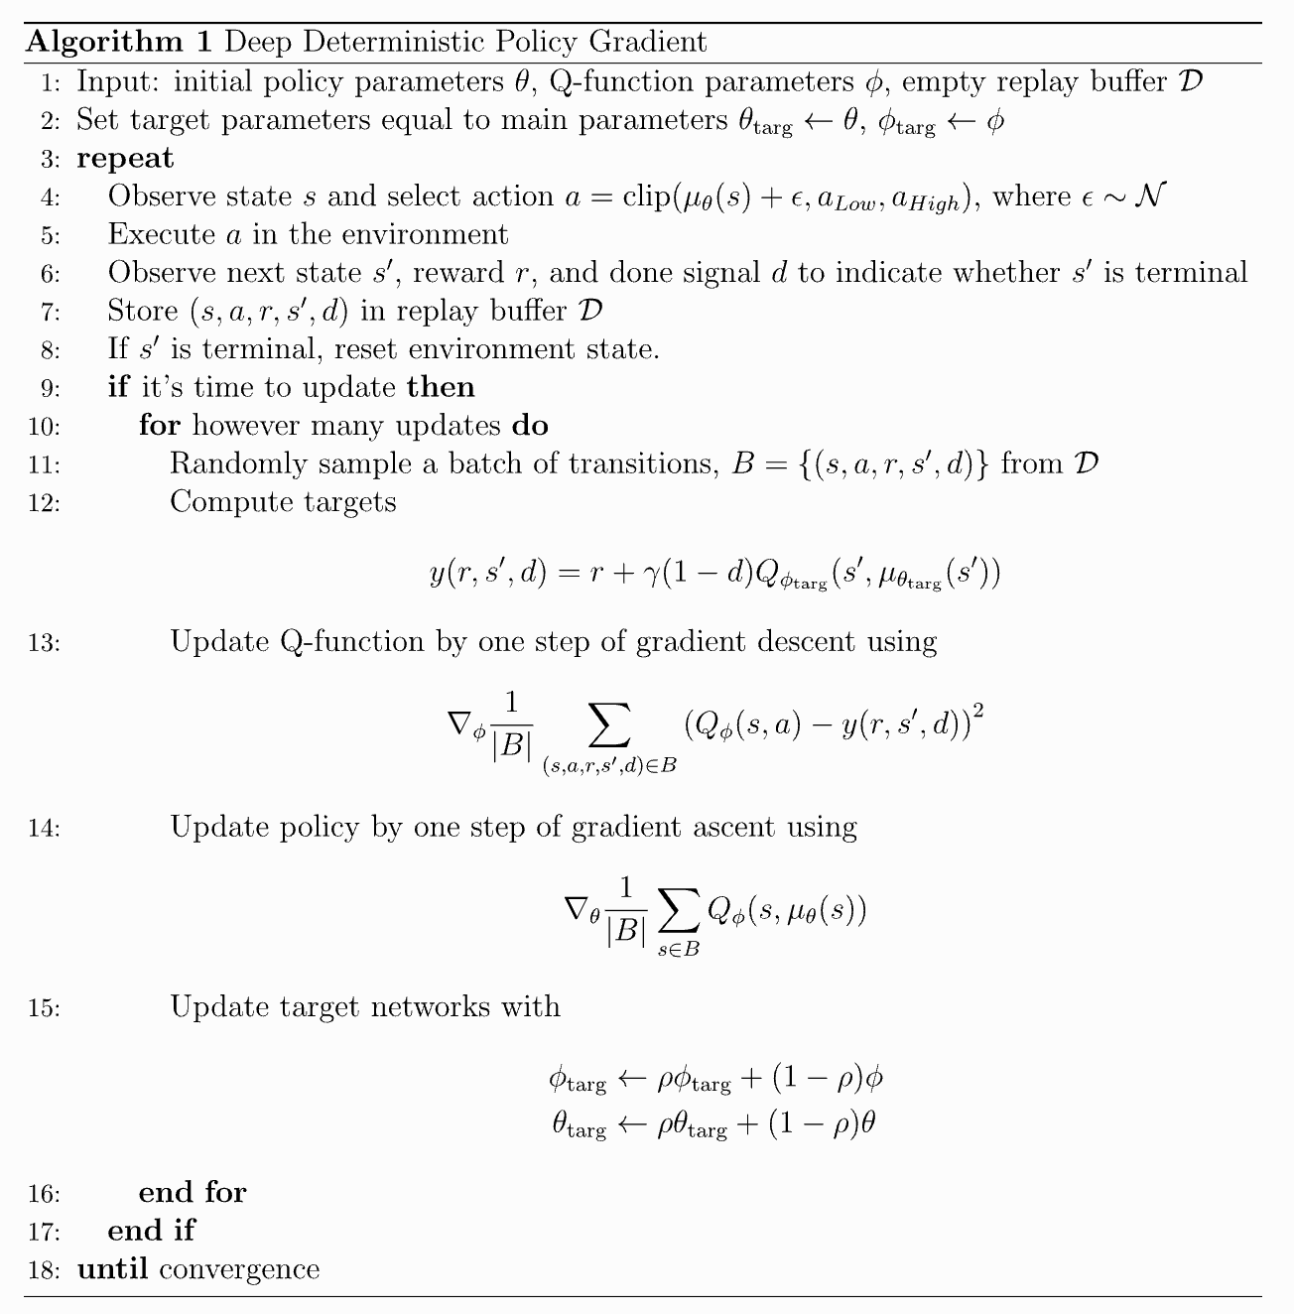
DRL to Solve the MDP: Deep Deterministic Policy Gradient Algorithm

Slide 26












Actor Critic Model- DDPG
$$S_{t}$$
$$a_{t}$$
Actor
Critic
$$∑$$
$$S_{t+1}$$
$$Q(S_{t},a_{t})$$
-
+
$$y=$$
$$R+ γQ^{′}(S_{t+1},a_{t+1})$$
$$Q^{′}(S_{t+1},a_{t+1})$$
$$+$$
$$S_{t+1}$$
$$a_{t+1}$$
Target Actor
Target Critic
$$S_{t+1}$$
$$R_{t}$$

Slide 27
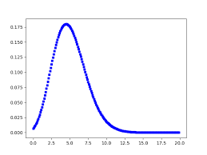
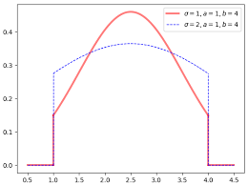
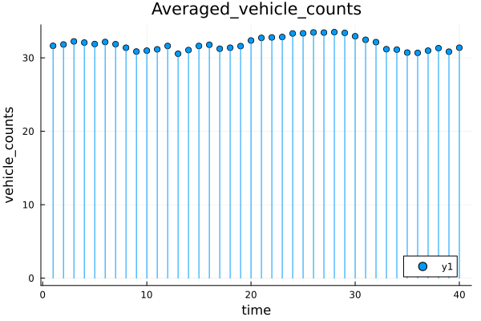
Simulation: Generation of Base Time Series
Injection Rate
Observe System Evolution for T slots
Generated State Info
Environment
Vehicle Velocity Distribution
Avg. Vehicle Count active in simulation

Slide 28


Simulation: creating multiple realizations with base time series using LHS [3]
LHS: Latin Hypercube Sampling
$$t=\hat{t}(1+n)$$
$$n\sim 𝓝(0,σ)$$

Slide 29
Simulation: Training DRL Model using DDPG
Behavioral Actor
Behavioral Critic
Desired Model for Deployment
Target Actor
Target Critic

Slide 30
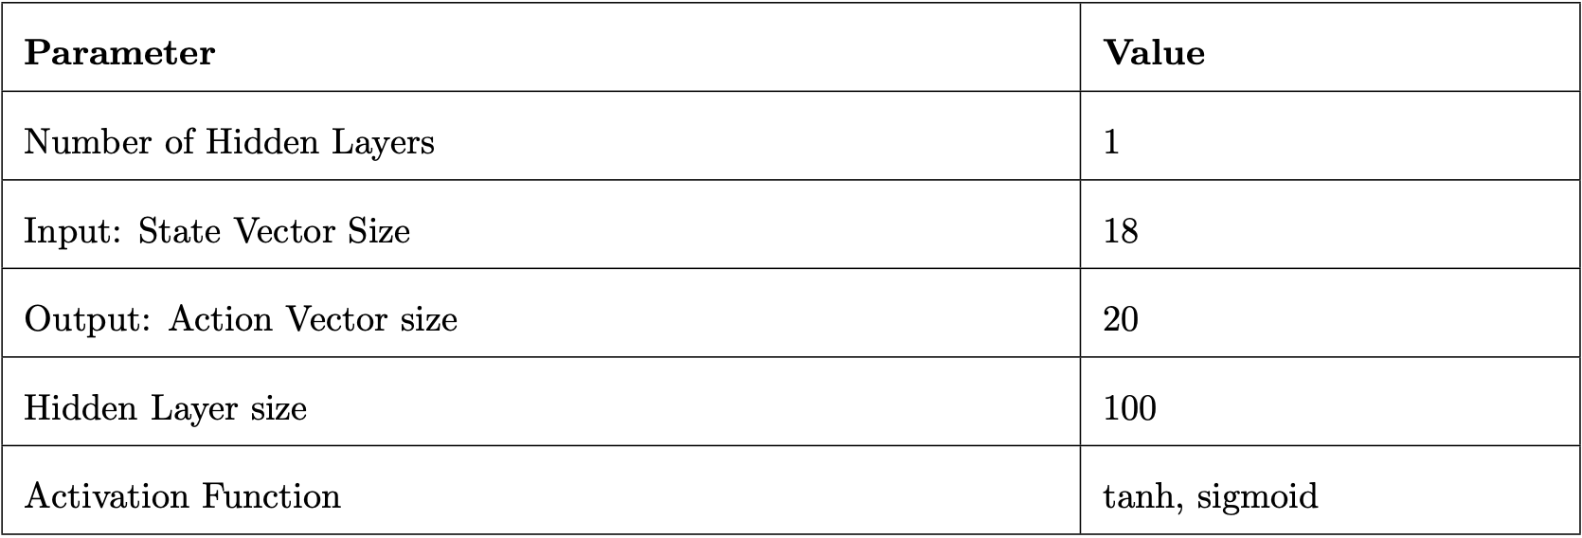
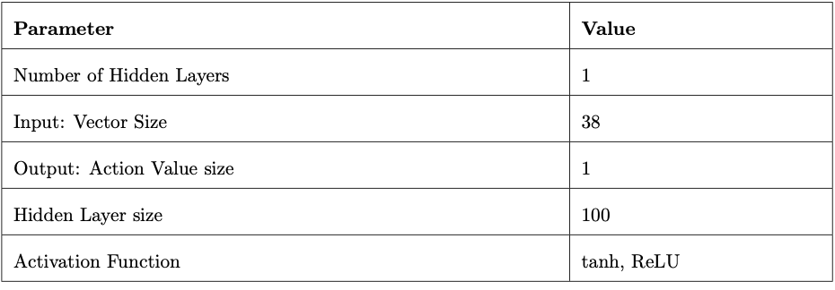
DDPG: Network Parameters
Actor Network
Critic Network

Slide 31




System Integrated With DRL Model
VM
VM
BRB: Bandwidth Resource Blocks (kHz)
$$S_{it}$$
$$S_{1t}$$
RSU1
CRB
CRB
CRB
CRB Allocation
CRB
CRB
CRB
Agent’s Resources
$$S_{2t}$$
Migration + Buffer Allocation
RSU2
BRB
BRB
BRB
BRB Allocation
BRB
BRB
BRB
$$S_{jt}$$
Trained DRL Model (Target Actor)
CRB: Compute Resource Blocks
(Cycles/sec)
RSU J

Slide 32
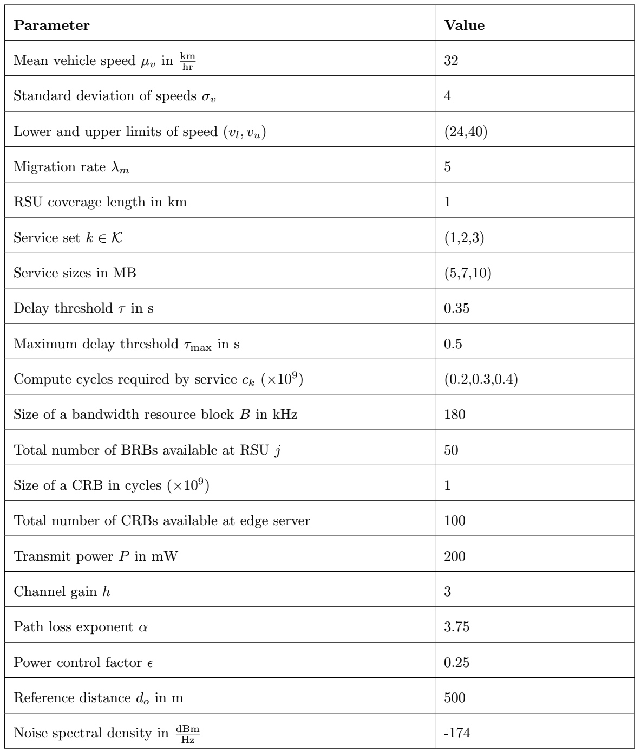
Simulation Parameters

Slide 33
Results: Return v/s Episode
From this graph, we can infer that the policy of the agent is improving at each successive episode which implies the DRL is converging to the Optimal Policy

Slide 34
Results: Performance of the agent

Slide 35
Reward Modeling: Biasing Model Behavior
Following performance metrics were obtained by using reward model eq.(1)

Slide 36
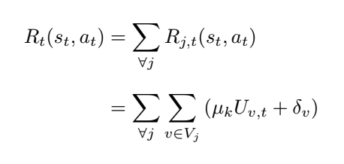
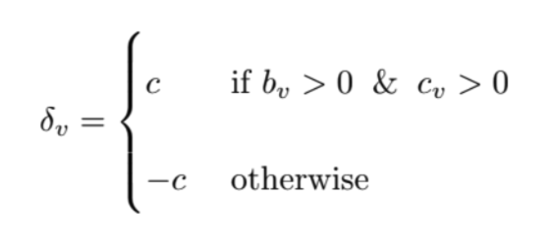
Reward Modeling: Biasing the Behavior
Now we consider the modified reward function given by eq (12)
(12)
(13)

Slide 37
Reward Modeling: Biased Results

Slide 38
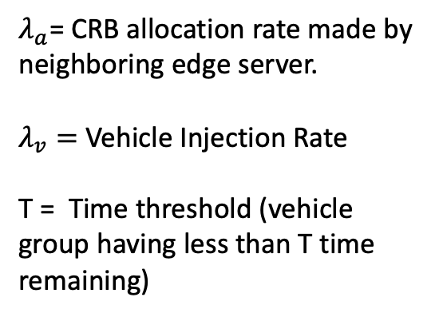
Results: Study on Migration
$λ_{a}$= CRB allocation rate made by neighboring edge server.
$λ_{v}=$Vehicle Injection Rate
T = Time threshold (vehicle group having less than T time remaining)

Slide 39
Conclusion and Future Work
Considered Service Migration and Resource allocation problem in vehicular edge networks.
We proposed a network - initiated user grouped service migration and allocation scheme and proved its efficiency in a mobile environment.
Formulated and solved a Markov Decision Process (MDP) using DDPG trained DRL Model.
Delivered comprehensive performance evaluation metrics to analyze the efficiency of the model.
We aim to extend this work by introducing multi-agent scenario with complex road networks.

Slide 40
Individual Contributions
Gautham Bolar | Role: Responsible for software design of the simulation platform. Also conducted research on DRL algorithms to improve system performance. Contribution: System Modeling, coding and algorithm study.
Chennamsetti Sai Pranay | Role: In-charge for literature survey on service migration. Provided clear ideas on implementation of service migration in this scenario. Was also responsible for content curation for the project Contribution: Literature review summary notes, System Modeling
Dheemanth Joshi | Role: Team Leader, Responsible and second in-charge for software simulations and paper implementations. Contributor to the content curation and report writing. Contribution: System Modeling, algorithm study, coding and main contributor for slides used in assessments.

Slide 41
Deliverables
Team ID: W1
Sl No | Submission | Status
1 | Project Report + Draft IEEE conference paper | To be done
2 | Project Poster | done
3 | Project Video | done
4 | Individual Contribution form | done
5 | Project Diary | done

Slide 42
References
[1] Q. Yuan, J. Li, H. Zhou, T. Lin, G. Luo and X. Shen, ”A Joint Service Migration and Mobility Optimization Approach for Vehicular Edge Computing,” in IEEE Transactions on Vehicular Technology, vol. 69, no. 8, pp. 9041-9052, Aug. 2020, doi: 10.1109/TVT.2020.2999617. (Base Paper)
[2] W. Chen et al., "MSM: Mobility-Aware Service Migration for Seamless Provision: A Data-Driven Approach," in IEEE Internet of Things Journal, vol. 10, no. 17, pp. 15690-15704, 1 Sept.1, 2023, doi: 10.1109/JIOT.2023.3265434..
[3] H. Heitsch and W. Romisch, "Generation of multivariate scenario trees to model stochasticity in power management," 2005 IEEE Russia Power Tech, St. Petersburg, Russia, 2005, pp. 1-7, doi: 10.1109/PTC.2005.4524696.

Slide 43
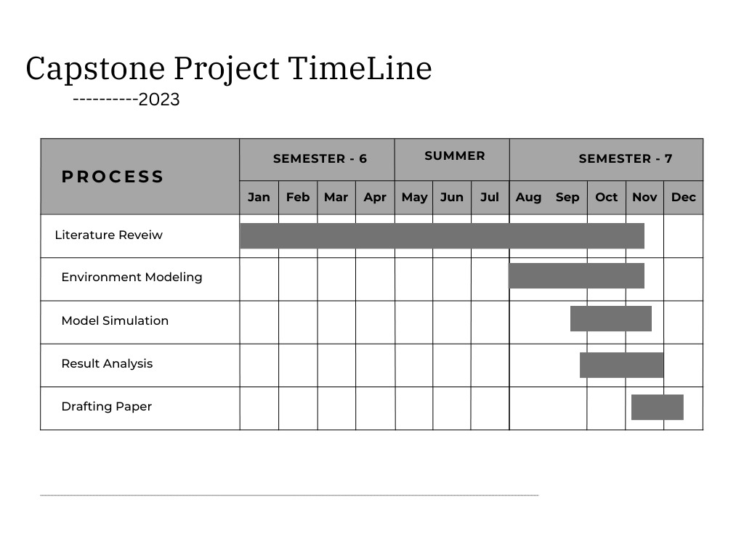

Slide 44
QNA
Thank You

