Slide 1

MOBY
Lincoln Stein
Cold Spring Harbor Laboratory

Slide 2








Getting Biological Data
What is out there?
Where do I find it?
How do I get it?

Slide 3
What Happens Now
GOOGLE
keyword
search
URLs
engage via HTTP

Slide 4
Issues with Current System
Keyword searching is a blunt tool.
HTTP/HTML not suitable for automation.
Services change without notice
GOOGLE
keyword
search
URLs
engage via HTTP

Slide 5
What we’d Like to Do
BioGOOGLE
Questions
Answers

Slide 6
What’s Been Done So Far
Interoperability on well-defined problem domains
  Exchangable flat files
  (Genome) DAS
  Gene DAS
  Protein DAS
Data Warehouses
  BioMART
  caBIO

Slide 7
The bioMOBY Project
2001 MOBY-DIC meeting (Model Organism Bring Your Own Database Interconnectivity Conference)
Two proposed architectures:
  MOBY Services – PI Mark Wilkinson
  Semantic MOBY – Pis Lincoln Stein & Damian Gessler

Slide 8
MOBY Services
MOBY Central
I’ve got a yeast Gbk
accession number and
want GO terms for the
corresponding protein.
What services operate
on accession #’s?
What services operate
on gene names?
GO Terms
Accession #
Gene name

Slide 9
MOBY-S Technology
XML ISA/HASA ontology of biological data types
Services register their call signature with MOBY Central using WSDL
Clients invoke services using SOAP
Perl API
In use by several projects
  PlaNET
  PlantsP

Slide 10
Semantic MOBY
HTTP GET
Provider
Graph
Subject
Object
type
type
type
type
operatesOn
hasMapping
mapsTo
“MOBY-
Google”
MyGOSearch
goTermURL
bnode1
bnode2
bnode3
bnode5
type
type
type
type
type
comment
Bag
GOSearch
GeneSymbol
goTerm
URL
Gene Ontology Annotation

Slide 11
Querying S-MOBY
HTTP
POST
“MOBY-Google”
Provider
Graph
Subject
Object
type
type
hasMapping
type
mapsTo
type
MyGOSearch
operatesOn
bnode1
bnode2
bnode3
goTermURL
bnode5
type
type
type
type
type
GOSearch
comment
Bag
goTerm
URL
Gene Ontology Annotation
GeneSymbol
URL1
URL2
URL3

Slide 12
Engaging a service
HTTP POST
Provider
Graph
Subject
Object
type
type
hasMapping
type
type
operatesOn
mapsTo
goTermURL
MyGOSearch
ACT1
GO:12345
http://...
bnode 1
bnode2
bnode3
bnode5
type
type
type
type
type
comment
Bag
GOSearch
GeneSymbol
goTerm
URL
Gene Ontology Annotation

Slide 13
S-MOBY & Semantic Web
  Graphs written using OWL DL
    OWL (Web Ontology Language) is W3C standard for semantic web.
    OWL DL (OWL Description Logic) adds constraints that enforce completeness and decidability on OWL.
  Based on RDF (Resource Description Framework)

Slide 14
RDF
Objects specified by unique URI
Predicates specified by unique URI
Relationships among objects via Statements (Subject, Predicate, Object)
Blank nodes represent information to be filled in by client or provider application

Slide 15
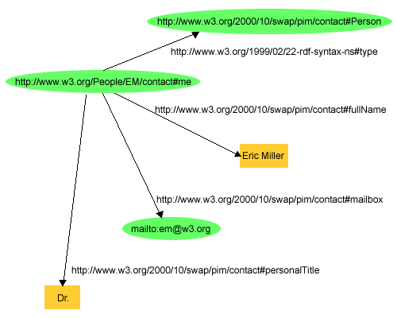
RDF Example

Slide 16
Canonical Graph
moby:Provider
moby:Graph
moby:Subject
moby:Object
rdf:
type
rdf:
type
rdf:
type
rdf:
type
moby:
operatesOn
moby:
hasMapping
moby:
mapsTo
Provider
URL
bnode1
bnode2
bnode3

Slide 17
Where We Are
MOBY-Google up and running
  Uses IBM’s JENA library for graph reasoning
Java API for creating graphs and engaging with clients.
Perl API pending
Snazzy user interface pending

Slide 18
Real Life Example – hapmap.org
Genotyping panel
 | Indiv1 | Indiv2 | Indiv3 | Indiv4 | Indiv5 | Indiv6
SNP1 | G/G | G/T | G/T | G/G | G/G | T/T
SNP2 | A/G | A/G | A/G | G/G | G/G | A/G
SNP3 | C/C | C/C | C/C | C/C | C/C | C/A
SNP4 | A/T | A/T | A/T | A/A | A/A | A/A
SNP5 | T/T | T/T | T/C | C/C | C/C | C/C
SNP6 | C/G | C/C | C/G | G/G | G/G | C/G
SNP
Set
Genotypes

Slide 19
Graph for Panel Query
moby:
Provider
moby:
Graph
moby:
Subject
rdf:
Bag
moby:
Object
rdf:type
rdf:type
rdf:type
rdf:type
rdf:type
cshl:
get-individuals
bnode 1
bnode 2
bnode 4
rdf:_1
bnode 5
rdf:type
moby:
hasMapping
moby:
operatesOn
moby:
mapsTo
rdf:type
rdf:type
cshlterms:
indivName
rdf:type
cshlterms:
panelName
cshlterms:
CSHLProvider
cshlterms:
Panel
bnode 3
cshlterms:
Individual
bnode 6

Slide 20
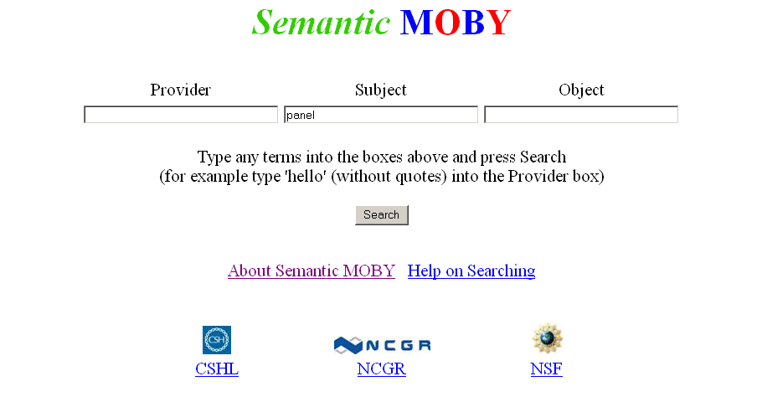
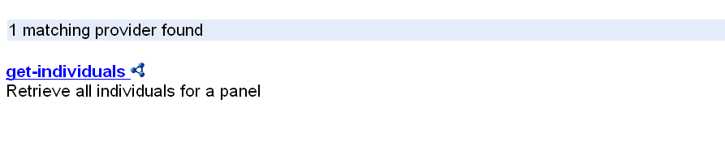
Searching the Repository

Slide 21
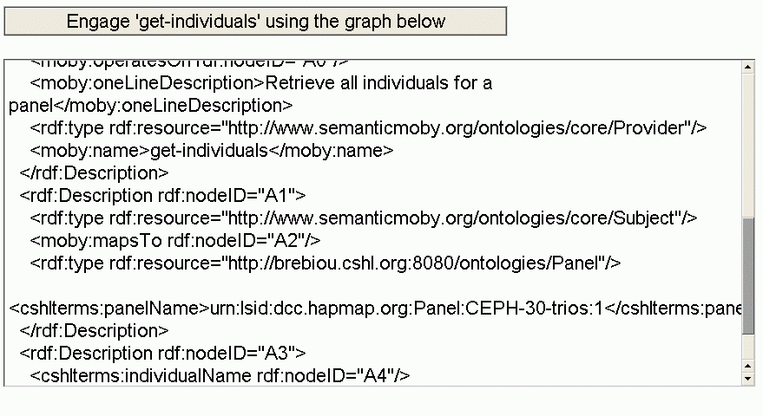
Engaging the Service

Slide 22
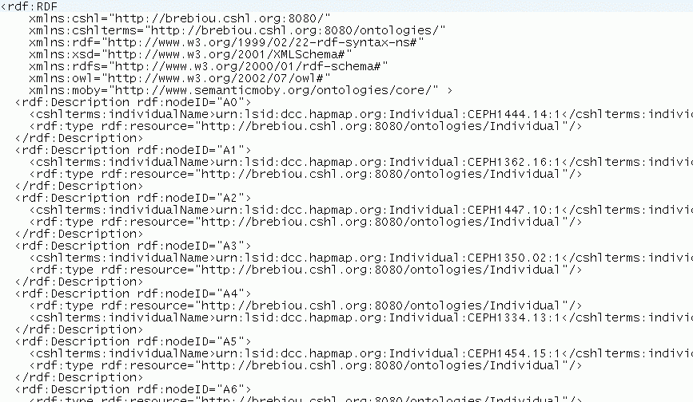
The Result

Slide 23
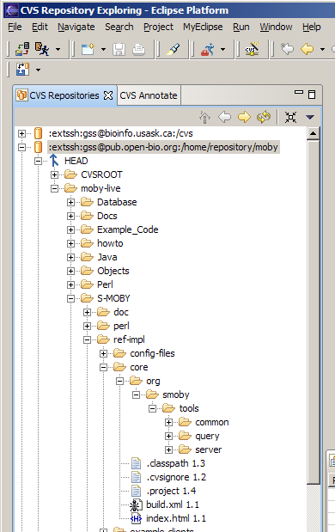
MOBY Software
MOBY (both versions) are open source and available from the CVS repository at www.biomoby.org.

Slide 24

Credits
CSHL
Lincoln Stein
Ardavan Kanani
Shuly Avraham
Fiona Cunningham
NCGR
Damian Gessler
Gary Schiltz
Andrew Farmer
University of BC
Mark Wilkinson

