Slide 1




The Cancer Biomedical Informatics Grid
From Village to City
Peter A. Covitz, Ph.D.
Director, Core Infrastructure
National Cancer Institute
Center for Bioinformatics

Slide 2
National Cancer Institute 2015 Goal
Relieve suffering and death due to cancer by the year 2015

Slide 3
Origins of caBIG
Need: Enable investigators and research teams to broadly combine and leverage their findings and expertise in order to meet NCI 2015 Goal.
Strategy: Create scalable, actively managed organization that will connect members of the NCI-supported cancer enterprise by building a biomedical informatics network

Slide 4
Scenario from Strategic Plan
A researcher involved in a phase II clinical trial of a new molecularly targeted therapeutic for brain tumors observes that cancers derived from one specific tissue progenitor appear to be strongly affected.
The trial has been generating proteomic and microarray data. The researcher would like to identify potential biochemical and signaling pathways that might be different between this cell type and other potential progenitors in cancer, deduce whether anything similar has been observed in other clinical trials involving agents known to affect these specific pathways, and identify any studies in model organisms involving tissues with similar pathway activity.

Slide 5
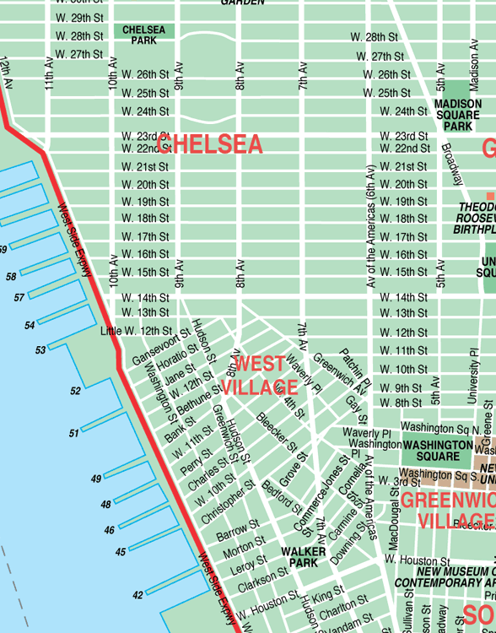
From Village to City

Slide 6
caBIG Principles
Open Source
  Publicly-funded development must yield openly distributable products.
Open Development
  Community-driven development aligns needs with development priorities
Open Access
  Data has value beyond original purpose for collection. Scientific method demands verification by peers. Obligation to share publicly-funded data products.
Federated
  Local control of deployments. No central “Ministry of Information.” Scalable.

Slide 7



Community Priorities
Database & Datasets
Imaging Tools & Databases
Integration
High Performance Computing
Pathways
Clinical Trial Management Systems
Licensing Issues
Laboratory Information Management Systems (LIMS)
Meeting
Microarray & Gene Expression Tools
Proteomics
Tissue
Banks
& Pathology
Remote/Bandwidth
Visualization & Front-End Tools
Statistical Data Analysis Tools
Vocabulary & Ontology Tools & Databases
Integrative Cancer Research
Meta-Project
Common Data Elements (CDE) & Architecture
Center Integration & Management
Tissue & Pathology Tools
Access to Data
Translational Research Tools
Distributed General Data Sharing & Analysis Tools
Staff Resources
Clinical Data Management Tools & Databases
0
5
10
15
20
25
30
35
Number of Needs Reported
Notes:
Three areas of critical need were identified based on this information and these facilitated the groupings of pilot project activities into three Workspaces:
(1) Clinical Trial Management Systems
(2) Integrative Cancer Research
(3) Tissue Banks and Pathology Tools

Slide 8
caBIG Organization Structure
caBIG Oversight
General Contractor
Clinical Trial Mgmt
Integrative Cancer Research
Tissue Banks & Pathology Tools
= Project
Working Group
Working Group
Working Group
Architecture
Vocabularies & Common Data Elements
Working Group
Working Group
Strategic Working Groups
Notes:
Workspace/Project Level Management – Workspace Managers, Project Managers
Each Workspace will be overseen by a Workspace Manager who will be responsible for overall budget, contracts and scheduling. Within a Workspace, individual project teams will be led by Project Managers, most of whom will be members of the Cancer Center community. Project Managers will be required to comply with management and reporting standards and processes according to agreed caBIG policy.
Intermediate Level Management – Master Contractor
A Master Contractor will be engaged to oversee the operational aspects of the caBIG pilot – including the activities of Workspaces and Working Groups. They will provide funding to Centers via subcontract mechanisms. Individual managers to oversee the operation of each Workspace will be appointed by the Master Contractor. The Master Contractor will be directly accountable to the caBIG oversight structure.
Governance Level Management – caBIG Oversight Board
The Oversight Board will be led by NCICB and NCI senior leadership and will provide strategic and programmatic guidance for the initiative as a whole, with the support and guidance of strategic level planning groups composed of members of the Cancer Center Community. The caBIG Oversight Board will be the final arbiter of all caBIG pilot activities and decisions and will follow processes and procedures consistent with government contract management standards.

Slide 9
Interoperability
Courtesy: Charlie Mead
in·ter·op·er·a·bil·i·ty
  ability of a system...to use the parts or equipment of another system
  Source: Merriam-Webster web site
interoperability
  ability of two or more systems or components to exchange information and to use the information that has been exchanged.
  Source: IEEE Standard Computer Dictionary: A Compilation of IEEE Standard Computer Glossaries, IEEE, 1990]
Syntactic
interoperability
Semantic
interoperability
Notes:
Our terms are Interoperability and Innovation. Lets start with some definitions.
Interoperability is a relatively new concept, centered on the idea that one system can use parts of another.
If you focus on computer interoperability, the IEEE definition includes two concepts.
Functional interoperability – the ability to exchange information – and semantic interoperability – the ability to use the information that has been exchanged.
As an aside, standards are frequently thought of as focusing primarily on functional interoperability, whereas the critical sine qua non for health care is semantic interoperability - if you don’t know exactly what the information you received means, having received it is useless, or worse, maybe even dangerous!

Slide 10
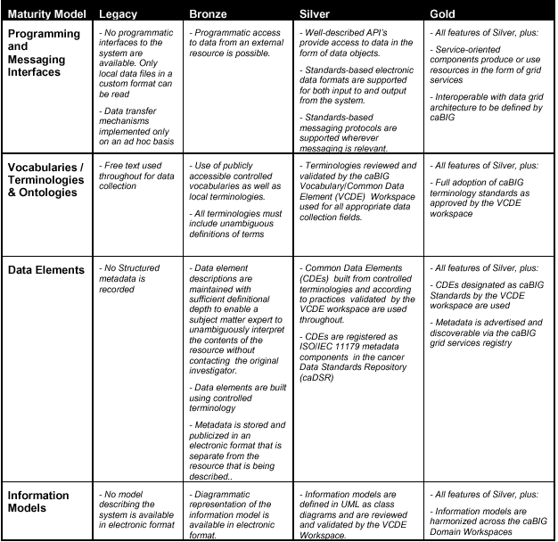
SYNTACTIC
SEMANTIC
SEMANTIC
caBIG Compatibility Guidelines
SEMANTIC

Slide 11
Model-Driven Architecture

Slide 12
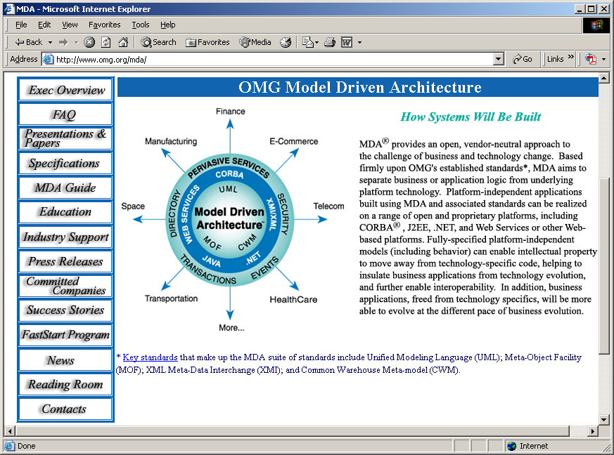

Slide 13
MDA Approach
Analyze the problem space and develop the artifacts for each scenario
  Use Cases
Use Unified Modeling Language (UML) to standardize model representations and artifacts. Design the system by developing artifacts based on the use cases
  Class Diagram – Information Model
  Sequence Diagram – Temporal Behavior
Use meta-model tools to generate the code

Slide 14
Limitations of MDA
Limited expressivity for semantics
No facility for runtime semantic metadata management

Slide 15
caCORE
MDA plus a whole lot more!

Slide 16




caCORE
Bioinformatics Objects
S
E
C
U
R
I
T
Y
Common Data Elements
Enterprise Vocabulary

Slide 17
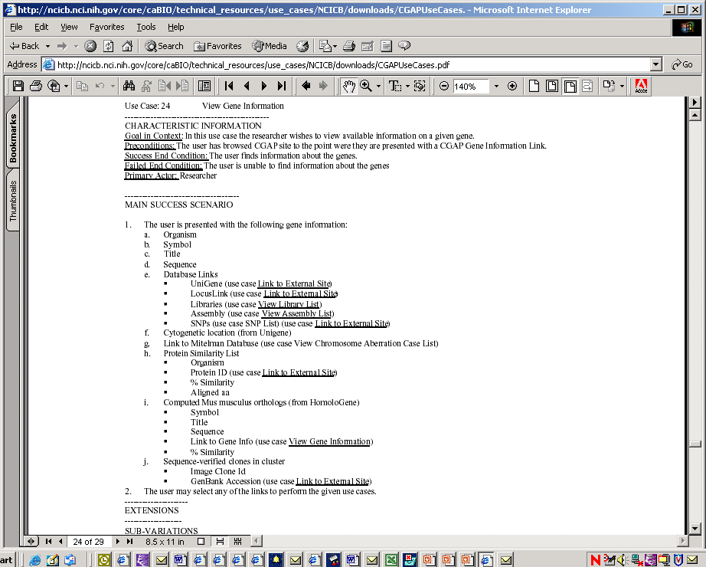
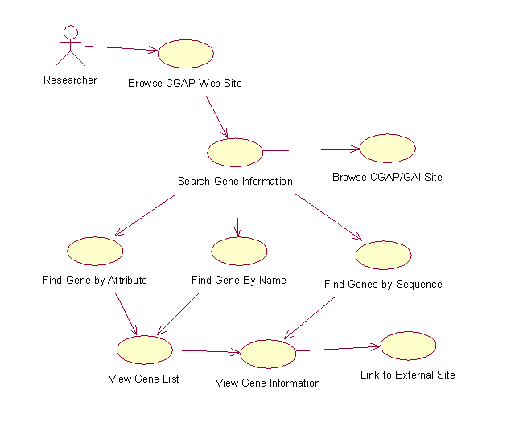
Use Cases
Description
Actors
Basic Course
Alternative Course

Slide 18
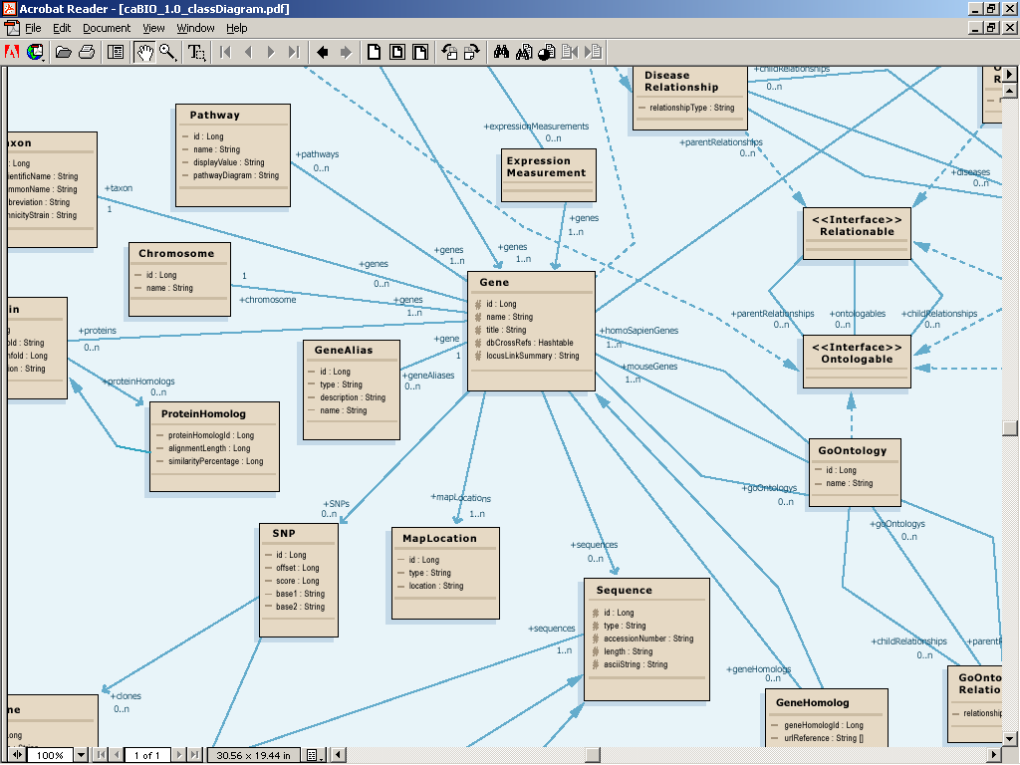
Bioinformatics Objects

Slide 19
Common Data Elements
What do all those data classes and attributes actually mean, anyway?
Data descriptors or “semantic metadata” required
Computable, commonly structured, reusable units of metadata are “Common Data Elements” or CDEs.
NCI uses the ISO/IEC 11179 standard for metadata structure and registration

Slide 20
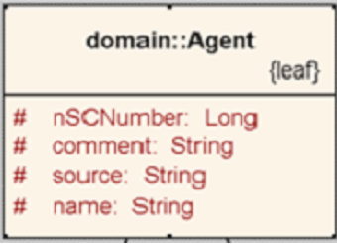
Semantic metadata example: Agent
<Agent>
  <name>Taxol</name>
  <nSCNumber>007</nSCNumber>
</Agent>

Slide 21
Why do you need metadata?
Class/ Attribute | NCI Metadata | CIA Metadata | Example Value
Agent | Chemical compound administered to a human being to treat a disease or condition, or prevent the onset of a disease or condition | A sworn intelligence agent; a spy
Agent nSCNumber | Identifier given to chemical compound by the US Food and Drug Administration (FDA) Nomenclature Standards Committee (NSC) | Identifier given to an intelligence agent by the National Security Council | 007
Agent name | Common name of chemical compound used as an agent | CIA code name given to intelligence agents | Taxol
Notes:
The segue from here is so how do we utilize this to provide semantic interoperability?

Slide 22
Cancer Data Standards Repository
ISO/IEC 11179 Registry for Common Data Elements – units of semantic metadata
Precise definitions of Classes, Attributes, Data Types, Permissible Values: Strong typing of data objects.
Tools:
  UML Loader: automatically register UML models as metadata components
  CDE Curation: Fine tune metadata and constrain permissible values with data standards
  Form Builder: Create standards-based data collection forms
  CDE Browser: search and export metadata components
Client for Enterprise Vocabulary: metadata constructed from ontology terms and concepts.

Slide 23
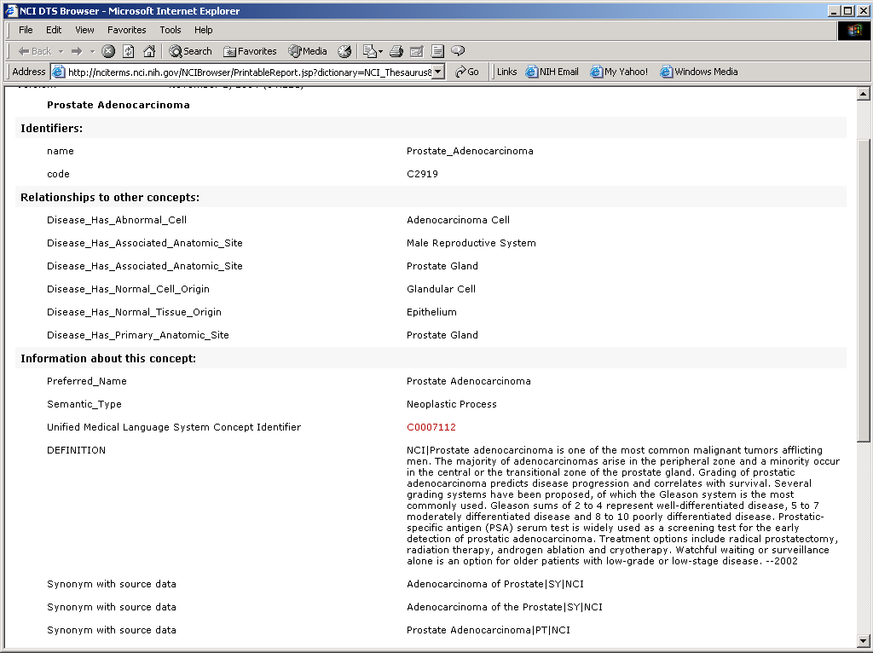
Enterprise Vocabulary
Description Logic Ontologies
Concept Code
Relationships
Preferred Name
Definition
Synonyms

Slide 24
Tying it all together: The caCORE semantic management framework
Ontology
Metadata ID Concept Codes
2223333 C1708
2223866 C1708:C41243
2223869 C1708:C25393
2223870 C1708:C25683
2223871 C1708:C42614
Bioinformatics Objects
Common Data Elements
Enterprise Vocabulary

Slide 25
Computable Interoperability
Agent
C1708
Drug
C1708
name
id
nSCNumber
C1708:C41243
NDCCode
CTEPName
approvalDate
FDAIndID
approver
IUPACName
fdaCode
C1708:C41243
My model
Your model

Slide 26
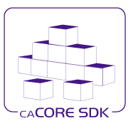
caCORE Software Development Kit

Slide 27
caCORE SDK Components
UML Modeling Tool (we use Enterprise Architect)
  Information domain model defines data classes, attributes and relationships
Semantic Connector (included in download)
  Annotates UML model with ontology concepts: bridges the world of databases to that of structured semantics
UML Loader (run by NCICB staff for now)
  Loads model into the caDSR metadata registry
  Model and associated semantics are available as metadata at runtime
Code Generator (included in download)
  UML model used as input into code generator
  Produces object-oriented middleware that instantiates model
  Object-relational mappings tie middleware to databases and other storage/retrieval systems.
  Programming interfaces provide access to system for application developers (Java APIs currently implemented; Web Services in upcoming release)

Slide 28
caCORE Architecture
Clients
Middleware
Data
HTTP Clients
A
P
I
Web Application Server
Biomedical
Data
Interfaces
Java
SOAP
XML
SOAP
Clients
A
P
I
Common
Data
Elements
Domain
Objects
[Gene, Disease, etc.]
Domain
Objects
[Gene, Disease, Agent,
etc.]
Data
Access
Objects
Perl
Clients
A
P
I
Enterprise
Vocabulary
Data Access
Objects
Java Applications
A
P
I

Slide 29
OTHER
TOOLKITS
OTHER caBIG
SERVICE
PROVIDERS
NCI
Cancer Center
Cancer Center
caGrid
Cancer Center
Cancer
Center
Cancer Center

Slide 30
caGrid Service-Oriented Architecture
Functions
Semantic Service
ID Resolution
Quality of Service
caCORE
Globus
Workflow
Security
Resource Management
Service Registry
Service
OGSA-DAI
GRAM
Globus
myProxy
Service Description
Globus Toolkit
Grid Communication Protocol
GSI
Transport
CAS
Mobius
Globus
OGSA Compliant - Service Oriented Architecture

Slide 31
caBIG Compatible
Software and Data Resources
caArray – Cancer microarray data management system
C3D – Clinical Trials data capture application
C3PR - Clinical trial participant registry tool
caWorkbench - Microarray analysis suite
caTIES - Automated free-text pathology data extraction tool
caTISSUE - Biospecimen database and tracking system
RProteomics - MALDI-TOF proteomics analysis tool
Gene Ontology Miner (GOMiner) - Tool for aggregate analysis of gene sets
HapMap - caBIG accessible map of haplotypes in human genome
Promoter Database
UniProt-PIR - Protein sequence and annotation database
Curated Cancer Pathways Data - Data sets generated from NCI 60 cell lines
Human-Mouse Anatomy Ontology
Nutritional Compound Ontology
Distance Weighted Discrimination - Microarray data analysis integrator
Cancer Molecular Pages Prototype - Cancer gene annotation with web-based visualization
Magellan - Tool for the analysis of heterogeneous data types (e.g., microarray)
Visual and Statistical Data Analyzer (VISDA) - Multivariate statistical visualization tool for the analysis of complex data
FunctionExpress - Tool for integrated analysis and visualization of Microarray data
Quantitative Pathway Analysis in Cancer (QPACA) - Pathway modeling and analysis tool
TrAPSS - Disease gene mutation discovery and analysis tool
Proteomics Laboratory Information Management System Prototype
SEED - Peer-to-Peer genome annotation tool
Pathways Tool Project - Pathway visualization tools
LexGrid – Ontology hosting software
*Note: Examples of upcoming 2006 Products and Data Sets

Slide 32

NCI
  Andrew von Eschenbach
  Anna Barker
  Wendy Patterson
  OC
  DCTD
  DCB
  DCP
  DCEG
  DCCPS
  CCR
Industry Partners
  SAIC
  BAH
  Oracle
  ScenPro
  Ekagra
  Apelon
  Terrapin Systems
  Panther Informatics
NCICB
  Ken Buetow
  Sue Dubman
  Leslie Derr
  Frank Hartel
  George Komatsoulis
  Avinash Shanbhag
  Denise Warzel
  Sherri De Coronado
  Dianne Reeves
  Gilberto Fragoso
  Jill Hadfield

Slide 33
caBIG Participant Community
9Star Research
Albert Einstein
Ardais
Argonne National Laboratory
Burnham Institute
California Institute of Technology-JPL
City of Hope
Clinical Trial Information Service (CTIS)
Cold Spring Harbor
Columbia University-Herbert Irving
Consumer Advocates in Research and Related Activities (CARRA)
Dartmouth-Norris Cotton
Data Works Development
Department of Veterans Affairs
Drexel University
Duke University
EMMES Corporation
First Genetic Trust
Food and Drug Administration
Fox Chase
Fred Hutchinson
GE Global Research Center
Georgetown University-Lombardi
IBM
Indiana University
Internet 2
Jackson Laboratory
Johns Hopkins-Sidney Kimmel
Lawrence Berkeley National Laboratory
Massachusetts Institute of Technology
Mayo Clinic
Memorial Sloan Kettering
Meyer L. Prentis-Karmanos
New York University
Northwestern University-Robert H. Lurie
Ohio State University-Arthur G. James/Richard Solove
Oregon Health and Science University
Roswell Park Cancer Institute
St Jude Children's Research Hospital
Thomas Jefferson University-Kimmel
Translational Genomics Research Institute
Tulane University School of Medicine
University of Alabama at Birmingham
University of Arizona
University of California Irvine-Chao Family
University of California, San Francisco
University of California-Davis
University of Chicago
University of Colorado
University of Hawaii
University of Iowa-Holden
University of Michigan
University of Minnesota
University of Nebraska
University of North Carolina-Lineberger
University of Pennsylvania-Abramson
University of Pittsburgh
University of South Florida-H. Lee Moffitt
University of Southern California-Norris
University of Vermont
University of Wisconsin
Vanderbilt University-Ingram
Velos
Virginia Commonwealth University-Massey
Virginia Tech
Wake Forest University
Washington University-Siteman
Wistar
Yale University

