Slide 1

Fraudulent Insurance Claim Detection
A Data-Driven Approach for Global Insure
Team Members: Booragadda Dheeraj, Aishwarya Dwivedi, Harshal Shrivas

Slide 2
Presentation Roadmap
1 2
3
Problem Statement & Business Objectives
Key Questions to Address
Data Overview & Preparation
4
Exploratory Data Analysis
5
Feature Engineering
6
Model Development & Selection
7
Model Validation
8
Answering Business Question
9
Conclusion
10
Recommendations & Next Steps

Slide 3

Problem Statement & Business Objective
Financial Losses
Insurance fraud costs the industry an estimated billions annually
Inefficient Detection
Manual inspections are slow and often too late.
Early Detection Goal
Predictive modeling aims to identify fraud early, Identify potentially fraudulent claims before payout.
Minimize Losses
Optimize claim handling and reduce financial impact.

Slide 4




Key Questions to Address
Historical Data Patterns?
How can past data reveal fraud trends?
Best Fraud Indicators?
Which features signal fraudulent behavior?
Predict New Claim Fraud?
Can we reliably predict fraud likelihood?
Actionable Insights?
What improves detection processes?

Slide 5
Data Overview & Preparation
Dataset Details
1000 rows, 40 columns from insurance_claims.csv.
Key Actions
Missing value handling, standardization, outlier removal.
Removed identifiers. Converted data types. Handled special characters.
70% training data.
30% validation data. Stratified sampling used.
Raw Data
Data Cleaning
1
2
4
3
Train & Test split
Feature selection

Slide 6
EDA: Key Insights
Our exploratory data analysis revealed several key patterns. Incident type, policy state, and insured occupation show varying fraud rates. These insights are crucial for effective fraud detection.
Class Distribution of Fraud
Fraud Rate by Incident Severity
Insured Hobbies & Fraud Rate
90%
75%
90%
75%
60.5%
76%
60%
50%
60%
30%
25%
25%
30%
10.7%
12.9%
6.7%
7.5%
0%
Legitimate Claims (N)
Fraudulent Claims (Y)
0%
Major Damage
Total Loss
Minor Damage
Trivial Damage
0%
Chess
Cross Fit
Golf
Original distribution showed significant class imbalance. Random Over Sampler was applied to training data. This balanced the training for better model performance.

Slide 7
EDA: Key Insights
Incident Severity
"Major Damage" incidents showed 60% fraud likelihood.
Insured Hobbies
Chess (90% fraud) and Cross-fit (76% fraud) were high.
Golf Hobby
Golf showed a low 7.5% fraud likelihood.
These findings highlight high-impact indicators. Ethical considerations are important for hobby-based profiling.

Slide 8
EDA: Key Insights
Lower Claim Amounts Fraudulent claims had lower average amounts.
Fewer Witnesses Correlation found between fewer witnesses and fraud.
Lower Deductibles Associated with higher fraud rates.
Newer Customers Showed higher fraud tendency.

Slide 9

Feature Engineering
Resampling
Achieved 50/50 class balance for
training.
New Features
Policy age, incident timing (month, day of week) added.
Preprocessing
Categorical encoding, numerical standardization applied.
Refinement
Grouped rare categories, removed redundant features.

Slide 10
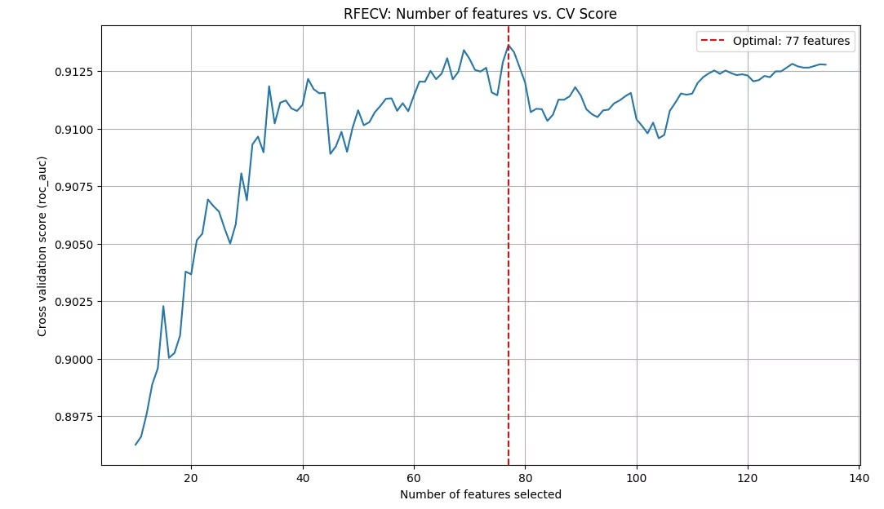
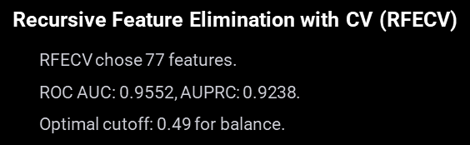
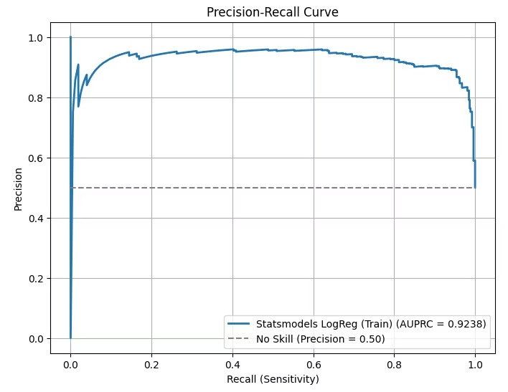
Model Development & Selection
We rigorously evaluated several models for optimal fraud detection. Each model was selected based on its performance metrics and suitability for our dataset.
Model 1 - Logistic Regression Development
Precision-Recall Curve At the optimal cutoff of 0.49, the model achieves:
Precision: 89%
Recall: 94%
AUPRC: 0.9238
This indicates strong ability to detect fraud while minimizing false positives."

Slide 11
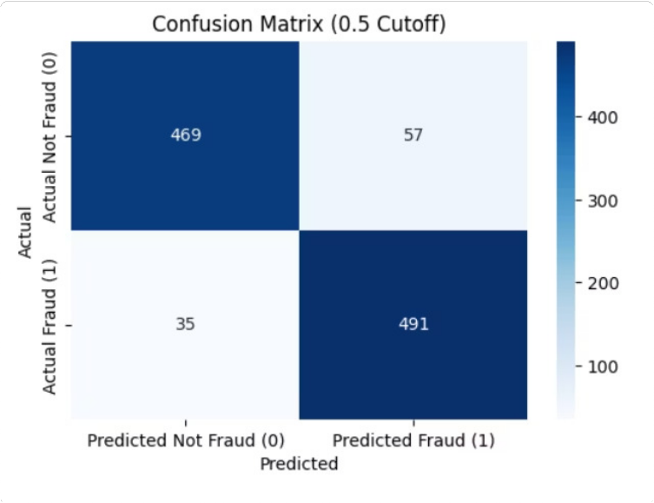
Logistic Regression 3 Training Performance
Results at 0.49 Cutoff
Accuracy: 91.54%
Recall (Fraud): 94.11%
Precision (Fraud): 89.51%
F1 Score: 0.9175
Specificity: 88.97%
High Fraud Recall
Detecting the most fraudulent claims
Balanced Precision
Minimizing false positives
Robust F1 Score
Demonstrating model reliability

Slide 12
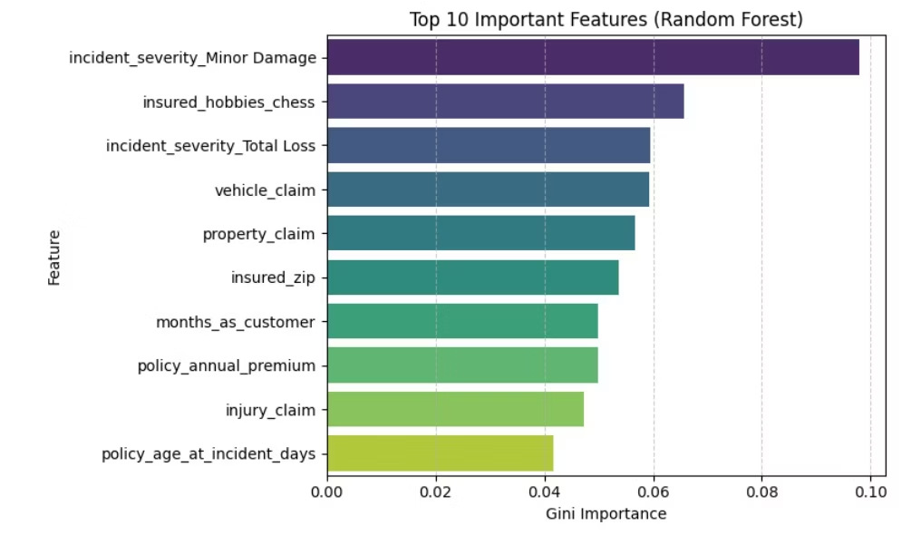
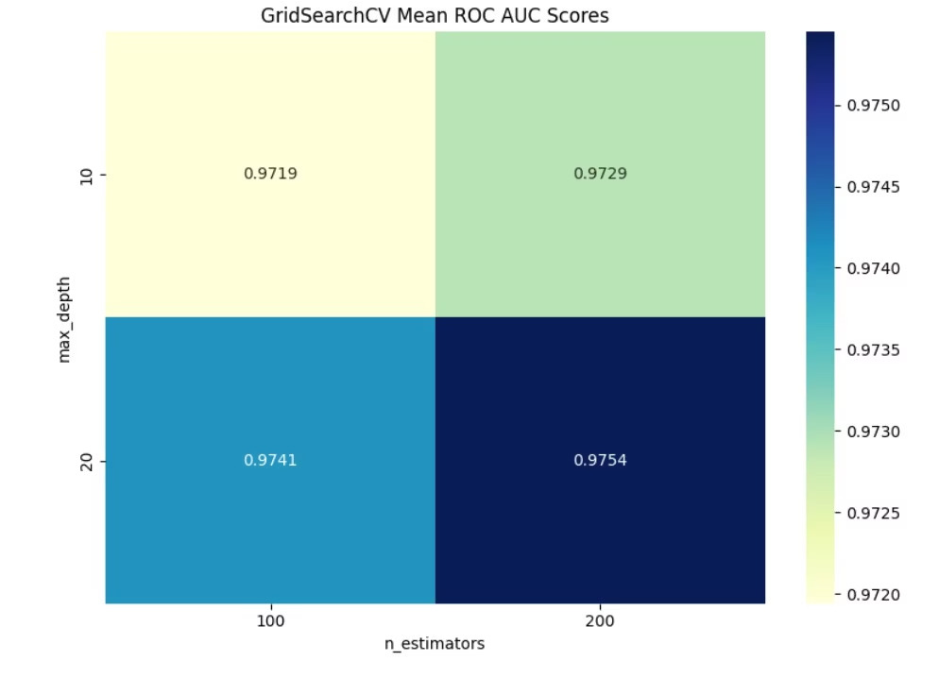
Model 2 3 Random Forest Development
Top 10 Important Features
Gini-based feature importance from Random Forest analysis.
Grid-Search CV ROC AUC Heatmap
Cross-validation results show optimal max_depth and n_estimators.
Modeling Approach | Training Performance | Cross-Validation Results | Hyperparameter Tuning
Initial Features: 134 Final Selected: Top 42 (Gini importance > 0.005) | Accuracy: 100% * Likely overfitting on training data | ROC AUC: 0.9835 F1 Macro: 0.9286 | Performed via GridSearchCV Best Parameters: max_depth = 20 n_estimators = 200 min_samples_split = 2

Slide 13
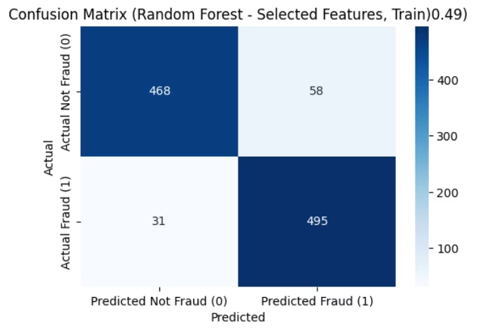
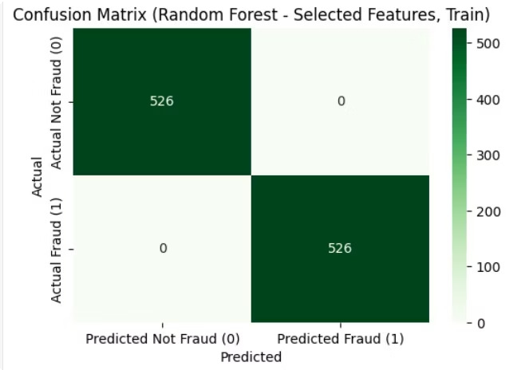
Model Validation 3 Head-to-Head Comparison
Confusion Matrix 3 Logistic Regression
Confusion Matrix 3 Random Forest
Accuracy: 82.00%
Accuracy: 76.67%
Recall (Fraud): 71.62%
Recall (Fraud): 37.84%
Precision (Fraud): 61.63%
Precision (Fraud): 53.85%
F1 Score (Fraud): 0.6625
F1 Score (Fraud): 0.4444
Specificity (Not Fraud): 85.40%
Specificity (Not Fraud): 89.38%
Logistic Regression outperforms Random Forest in fraud recall and overall detection performance.

Slide 14


Answering Business Questions
Detect Fraud?
EDA revealed clear patterns in severity, hobbies, and deductibles.
Fraud Features?
Severity, hobbies, claim amount, witnesses are key indicators.
Predict Reliability?
Logistic Regression recalled 72% of fraud on validation data.
Actionable Insights?
Claims prioritization possible based on predicted risk.
This project offers predictive power and strategic guidance for fraud claims handling.

Slide 15

Conclusions
Key Takeaways
Business Impact
Data-driven fraud detection outperforms manual inspection.
Logistic Regression is recommended for best generalization.
Achieved 71.62% fraud recall, 61.63% precision.
Identified critical risk indicators for operations.
Random Forest overfitted; unsuitable for production.
Early Fraud Identification
Detect fraud quickly.
Reduced Financial Losses
Minimize payouts.
Improved Claim Processing Efficiency
Streamline workflows.
Recommended Model: Logistic Regression @ 0.49 Cutoff

Slide 16

Recommendations & Next Steps
This roadmap outlines steps for deploying fraud detection at scale.
1 2
Deploy Model
Integrate the Logistic Regression model into existing claims workflows.
Monitor Performance
Track real-time model performance. Retrain periodically with new data.
3
Ensure Ethics
Review hobby-based features for bias. Apply regular fairness checks.
4
Enhance Capabilities
Improve data quality. Collect more fraud attributes. Explore advanced models.
5
Define Strategy
Establish risk-based prioritization. Align with decision-making teams.
This roadmap ensures a scalable, ethical, and business-aligned fraud detection system.

Slide 17

Thank You!
We are Open For Q&A
We appreciate your time and interest in our work. We are happy to discuss any aspect of this project.
Team:
Aishwarya Dwivedi
Booragadda Dheeraj Harshal Shrivas

