Slide 1

Smart start-up analyzer via prediction model for venture capitals
using ML and DL

Slide 2
Team members :
Mantej Singh Tuli - 1DS19CS086
Sree Chand R - 1DS19CS164
Shreyas G - 1DS19CS202
Dheemanth A N - 1DS19CS710
Under the Guidance of :
Prof. Anupama Girish
Assistant Professor, Dept of Computer Science and Engineering

Slide 3
CONTENTS
Introduction
literature Survey
Existing Problems
Proposed Solution
Advantages
Implementation
System Design
Challenges Faced
Conclusion

Slide 4

INTRODUCTION
START-UP ANALYZER
There are a variety of possible destinations for startups, but the two that are most coveted are either a successful acquisition from a larger company or an IPO. However, it is also conceivable for a business to acquire additional investment along the road or to sputter and collapse. Which makes it necessary to analyze a startup
thoroughly before investing in it's future.

Slide 5


WHY STARTUPS FAIL ?
The Small Business Administration (SBA) defines a "small" business as one with 500 employees or less workers.
According to startup owners, reasons for failure include money running out, being in the wrong market, a lack of research, bad partnerships, ineffective marketing, and not being an expert in the industry.

Slide 6
HOW INVESTORS INVEST CURRENTLY?
In traditional investment market where investors or Venture Capitalists (VCs) are interested in young and developing ideas, they have very less to latch onto in terms of company background and non-existent stock values before investing. Therefore, their only measure of assessment is the value of the idea and startup's current finances which are not a very good measure of check before investing in a
company. Currently investors invest in a lot of companies but only a handful pay-off. Though in no-way
we can make it always profitable but we try to increase that handful to a better number.

Slide 7

HOW TO MAKE INVESTING BETTER?
To solve issue discussed before and get another point-of- view for the VCs before investing we can use ML and DL models which predict based on different matrices, that will the startup be fruitful in the future or will it shut down leading to losses and gives a second perspective to the investor before making a critical decision of investing in a company.

Slide 8

PROPOSED SOLUTION
We propose "A machine learning model for startup selection and exit prediction" which is a full stack application that
helps in assessing startups on their feasibility based on their current track record and investments that it has pulled in over the duration, to give out probability of sustainability of a startup venture. So, that investors can make a better educated guess over their investments.
Considering all the drawbacks that exist in the current traditional investing system, our proposed solution seems to be promising tool to back-up investment decisions.

Slide 9

ADVANTAGES
OF THE PROPOSED SOLUTION
Investors gets an interactive tool which they can use to figure out rough probability of success.
Gives a second perspective to investment.
Less investments can result in equivalent profits as before. Number of companies and business can be analyzed at once. Accuracy of investments are improved.
A analytic view will reduce human error or on missing out on any critical information about a company.

Slide 10
IMPLEMENTATION
Training data :
Crunchbase data set for general business information: https://data.crunchbase.com/docs/daily-csv-export
USPTO for patents related to a company: https://ppubs.uspto.gov/pubwebapp/static/pages/landing.h tml
Primary input data sources :
User choosing a company or entering required data for analysis.

Slide 11
DEMONSTRATION OF DETAILS THROUGH A WEB APPLICATION
A client facing application for investors to analyze, audit and understand startups and their financials.
Powered by REST API + ML integrated web application. Intuitive UI with result and a conclusive factual opinion /suggestion for the investor to foresee the future of the company and analyze their next potential investment.

Slide 12
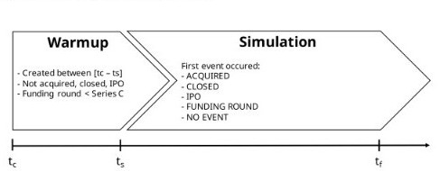
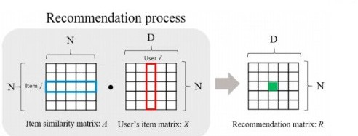
SOLUTION STRATEGY
A STARTUPS LIFE-CYCLE
HOW A RECOMMEDATION SYSTEM WORKS

Slide 13
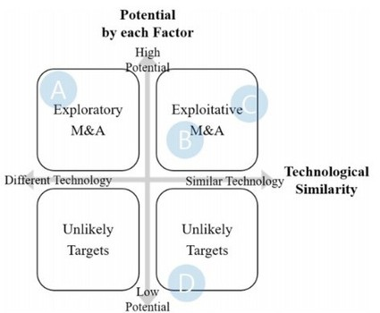
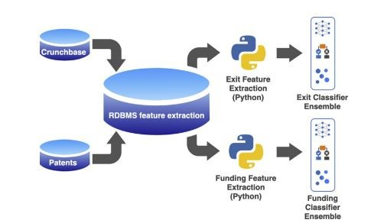
DECIDING FACTORS IN POTENTIALS OF A STARt-UP
SYSTEM DESIGN

Slide 14
CHALLENGES FACED
Key decisions can be impacted by the result of the model.
A major focus has to be spent on improving the accuracy of the result given by the model, as it might decide the future of investors as well as the company seeking funding and investments
Though results from AI are mostly bankable, external interference or other factors affect the company’s growth and position in the future.
Possibility of program bias in decision-making process.

Slide 15
CONCLUSION
The effective implementation of the proposed solution can achieve some objectives like :
To suggest to VCs (Venture Capitalists) the startups that yield good profit.
To cut off the time VCs take in analyzing the financial reports. Prediction of a company’s future in terms of a further funding round, IPO or an acquisition.
Ensure that a company with good fundamentals is not missed by an investor.
Investment in the right company with competitors in the same domain based on heuristics.

Slide 16
THANK YOU !

