Slide 1
PEV’s can save Drupley

Slide 2
Issues of Drupley
lack of space
low income
Low air/water quality

Slide 3
Description of technology
comprised of a motor, a controller, and a battery
control is done using gyroscope/accelerometer
very easy to control, just by leaning
completely open source

Slide 4
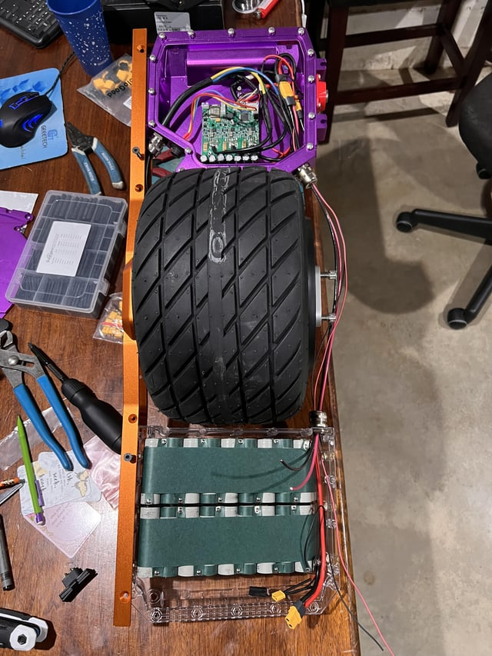
Inside a PEV

Slide 5
Reasons it will help Drupley
PEV’s take considerably less space to store and use
PEV’s are significantly cheaper than cars to buy and operate
PEV’s don’t have an exhaust and don’t put much demand on the power grid, significantly reducing greenhouse gasses

