Slide 1
Git
Drew Helgerson

Slide 2
What is Git/GitHub

Slide 3
What git is not
Git is not GitHub!
Git is not Dropbox!
Git is not any kind of web-service!

Slide 4
The Problem
Imagine you’re working on a group project with two others. You’re all editing a document together. One person, Alice, decides to rewrite a big section without telling the others. Later, when everyone combines their work, chaos erupts because Alice’s changes clash with the rest. If they had a system to work on their parts separately, like having their own drafts, it would avoid the mess.

Slide 5
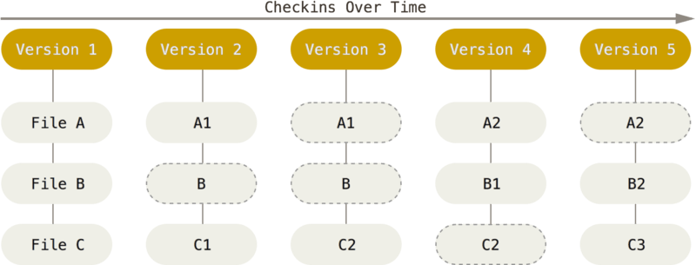
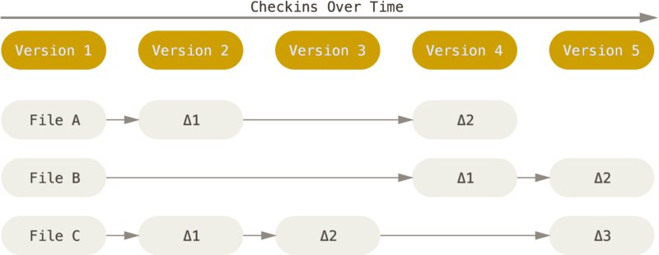
Solution
Change-based versioning (not git)
snapshot-based versioning (git)
image
image

Slide 6
Real Definition
git is a command-line, snapshot-based versioning tool - created by Linux Torvalds to manage massive open source projects. i.e. the Linux kernel - used widely across the globe, for personal and enterprise use

Slide 7
How do we use it

Slide 8
Cloning a Repo
git clone <repo>.git

Slide 9
Creating a Repo

Slide 10
Local
first create a local Repo - cd /path/to/project/dir - git init -b <branch-name> - add any files you don’t want to be kept track of to .gitignore - git stage . - git commit

Slide 11
Remote
now push your Repo to a remote - Create a Repo on your desired remote(GitHub) - git add remote origin <remote repo>.git - now to sync your local repo with the remote repo do: git pull && git push

Slide 12
Commits
the backbone of git
creates a snapshot in time of your project and hashes it for computation
after any meaningful change, you should ‘commit’ your changes

Slide 13
Branches
many people working on a project
issues arise when everybody has their hands on a single file
changes more than a few lines of code should be done in branches
as simple as git switch -c <branch-name>
make your changes

Slide 14
Merges
when your ready, merge your changes into the main branch with git switch main && git merge <branch-name>
all changes to the branch will be reflected in main

Slide 15
Fork/PR
not everybody can edit your repo
anybody can copy it
pull requests are the official way to ask a project maintainer to pull your changes into their project. usually they’ll review your changes and either accept the pull, offer suggestions you should change before they pull, or deny it altogether.

Slide 16
Fork cont.
to contribute to someone else’s project there are a few steps:
‘fork’ the repo: usually a ‘fork’ button at the top of a repo’s page
run git clone <forked-repo>
make your changes & git commit && git push
submit a ‘pull request’

Slide 17
Practical Examples

Slide 18
Stashing
we all make mistakes
what if we’ve made changes somewhere we don’t want to
just git stash

Slide 19
Stashing cont.
this will tuck away your changes where you can retrieve them later and restore your active tree to it’s previous state
e.g. you made changes to the wrong branch
git stash
git switch <correct-branch>
git stash pop

Slide 20
Collaboration

Slide 21
Oh crap
you deleted a file in your tree and your IDE doesn’t have it anywhere in it’s history
just git checkout <last-commit-with-file> <file>
the file has returned to it’s last commit’ed state
this is why it’s important to commit after each meaningful change

Slide 22
Upstream Changes
your working on a fork of a project
the upstream project has made changes
you can’t submit a PR unless your fork includes those changes
the GitHub Web-UI provides a way to do this
there’s an easier way:
git remote add <upstream-url>.git
git fetch upstream
git rebase upstream

Slide 23
Tagged Commits
you’re working on a project that people regularly install and depend on
you want to keep your repository current with your changes, but these changes may not be stable
you could use a different branch, but this isn’t very transparent to the users nor is it best practice
enter tagged commits

Slide 24
Tagged Commits cont.5
any commit that you designate can be tagged.
this is useful for showing your users which commit to use e.g. “release version”
tags can be made at commit time with git commmit -m "<your-tag-here>" or afterwards with git tag -a "<your-tag>" <commit-hash>
now when your users setup your project, then can rest assured that the major version tagged commit “should” be stable

