Slide 1
Installing ArchLinux

Slide 2
Preconceptions
arch is hard
no, arch requires reading
arch will always break
no, arch is as stable as you make it
I reinstalled arch 3 times in the last month
you’re the sysadmin of your system. you’ll get better.

Slide 3
Steps to do anything in arch:
what do you want to do?
how would a nerd do it?
read the wiki
READ THE WIKI
devise a plan for what you want to do based on its contents
DON’T BLINDLY PASTE WIKI COMMANDS

Slide 4
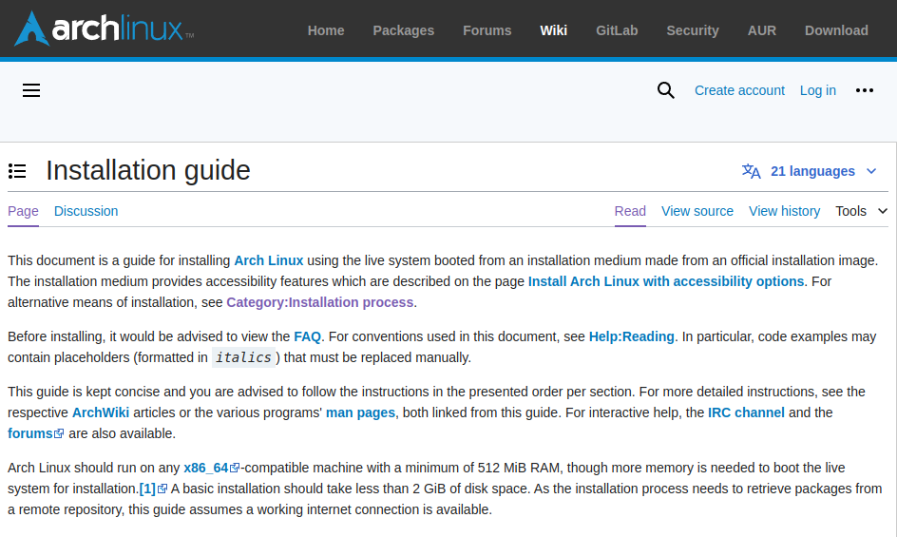
How to use the Wiki
the wiki is a tree
if you don’t traverse the tree, you won’t find what you want

Slide 5
Preparation
examining hardware
choosing a disk layout
ext/xfs
“bUt wHaT aBoUt ZFS!?!
what about zfs’ baby brother
choosing a boot toolchain

Slide 6
Choosing an environment
FULL DE’s
gnome
kde
cinnamon
BYO DE’s
xfce
lxqt
TWM’s
i3
sway
hyprland

Slide 7
Preparation cont.
Security considerations
secure boot
encryption
boot toolchain considerations

Slide 8
Installation

Slide 9
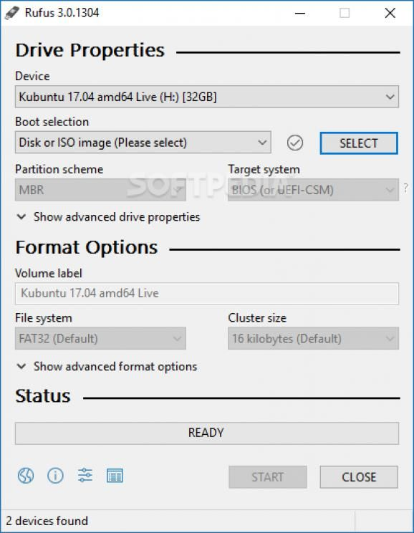
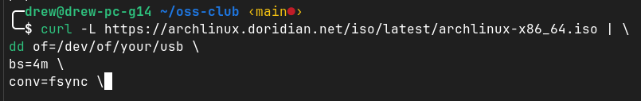
Obtain/create installation media
on macOS and linux: use curl and dd
on windows: use rufus

Slide 10
boot
plug in your usb and power on
usually pressing f2, f11, f12, of del will get you into the boot picker or the bios. From there, choose your usb

Slide 11
Networking
if using wifi, use iwctl to connect
ping 1.1.1.1 for ip
ping google.com for dns

Slide 12
time, date, locale, keeb, etc
defaults to american qwerty, utc time, american english

Slide 13
setup disks
DON’T LISTEN TO THE PARTITIONING SCHEME
refer to the wiki article for your chosen disk layout

Slide 14
mount your disks
start with $ mount /path/to/root/fs /mnt
continue filling out the tree
don’t forget to mount your EFI partition at /mnt/efi

Slide 15
package installation
choose kernel: linux,linux-lts,zen, etc.
are headers/dkms required
out of tree packages e.g.zfs
editor e.g. vim,nano,nvim,micro,eMaCs
DON’T FORGET NETWORKING e.g. networknanager
genfstab

Slide 16
Boot toolchain
differs per method.
very important

Slide 17
Post-Installation

Slide 18
what we have
kernel
coreutils
init system
userspace
that’s it

Slide 19
what we don’t
sudo
users
most applications
Desktop Environment
AUR

Slide 20
what now?

Slide 21
make users
add a user
install sudo
add user to sudoers somehow
other required groups
# useradd -m -G wheel myuser
# pacman -S sudo
# visudo
# usermod -G other groups myuser

Slide 22
install a DE
graphics drivers
base DE package
audio
gui apps

Slide 23
Security
Secure boot

Slide 24
Ricing
the term
Hyprland
themes

