Slide 1
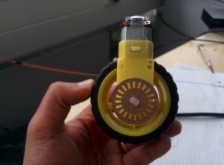
Ultrasound sensors, Index = 0
Ultrasound sensors, Index = 1
Contacts are inside. Solder cables to the motors first then fix to the car
RightFront Motor
compass
Gyro
Motors are on the bottom side
Speed
Enc
Speed
Enc
LeftFront Motor
Motor
Motor
Ultrasound sensors, Index = 2
H-Bridge
H-Bridge
RightRear
Motor
Motor
Speed
Enc
Motor
LeftRear Motor
Speed
Enc
CC3000
Level 0, top view

