Slide 1

Anomaly Detection-Based on oversampling Principal Component Analysis
Batch No: A-02 Project Guide:
M. Dhenuka Datta (164G1A0521) Ms. Karamala. Hema Latha M.Tech.,
B. Divya Bharathi (164G1A0523) Assistant Professor`
G. Kaleem (164G1A0534)
P. Chakrapani (164G1A0517)
Srinivasa Ramanujan Institute of Technology
Department of Computer Science & Engineering

Slide 2
Flow chart
START
INPUT DATA
CLEANING
EXTRACTION
PRINCIPAL COMPONENT ANALYSIS

Slide 3
OVERSAMPLING
UPDATE PRINCIPAL COMPONENTS
ANOMALY DETECTION
STOP

Slide 4
Data Flow Diagram (LEVEL – 0)
OSPCA
ANOMALY DETECTION
DATA SET

Slide 5
Data Flow Diagram (LEVEL – 1)
DATA EXTRACTION
PCA
DATA SET
UPDATED
PRINCIPAL
COMPONENTS
CLEANING
OVER
SAMPLING
ANOMALY DETECTION

Slide 6
Use case Diagram
Input data
Data set
Cleaning
Data extraction
Detector
Users
Principal Component Analysis
Updated Principal
components
Over Sampling
Anamoly Detection

Slide 7
Activity Diagram
Input Data
Cleaning
Data
Extraction
Principal Component Analysis

Slide 8
Over Sampling
Update principal components
Anamoly Detection

Slide 9
SEQUENCE DIAGRAM
EVENT DETECTION
USERS
Input Data
Cleaning
Data Extraction
Principal Component Analysis
Over Sampling
Updating Principal Component

Slide 10
IMPLEMENTATION
Modules :-
Cleaning Data
Detecting Outliers

Slide 11
Module-1 (Cleaning Data)
A set of data instances in the original data set is taken as input. This data may be contaminated by noise or incorrect data .
So the cleaning is done using Over-Sampling Principal Component Analysis (osPCA) method.
And then the score of outlierness is calculated and the smallest value is taken as the threshold value.

Slide 12
Module-2 (Detecting Outlier)
In this module we detect the outlierness of the user input.
When the user gives the input to the system, the system calculate the score value for the new input.
The new score value is compared with the threshold value which is calculated in previous module.
If the score value of the new data instance is above the threshold value, then that input data is identified as an outlier. Otherwise it is considered as a normal data instance, and the PCA value of that particular data instance is updated accordingly.

Slide 13
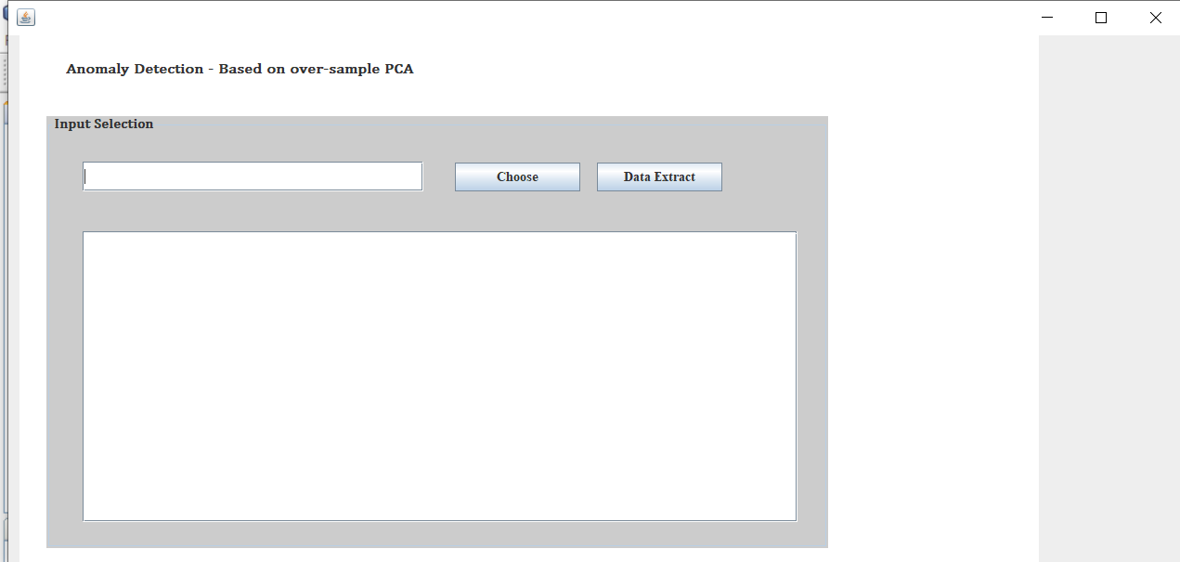

Slide 14
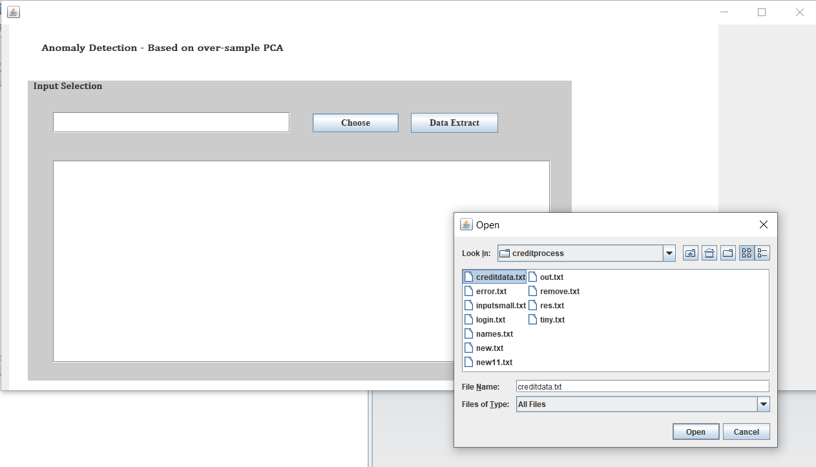

Slide 15
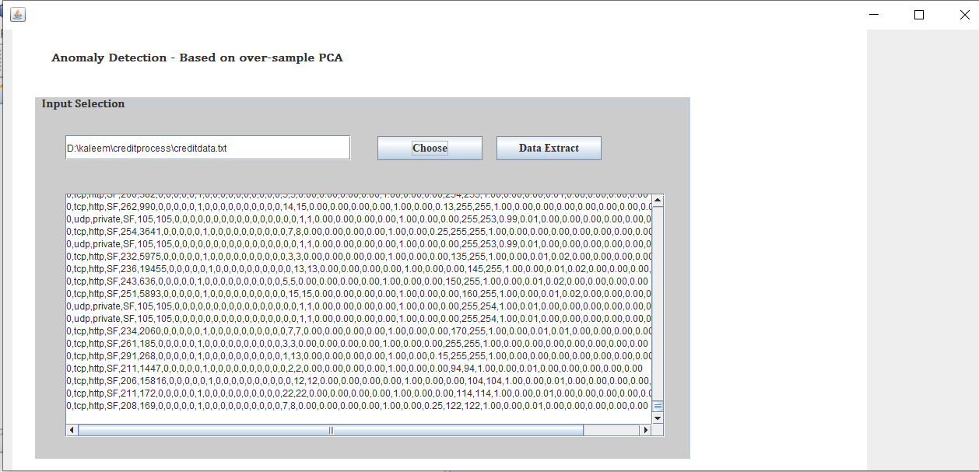

Slide 16
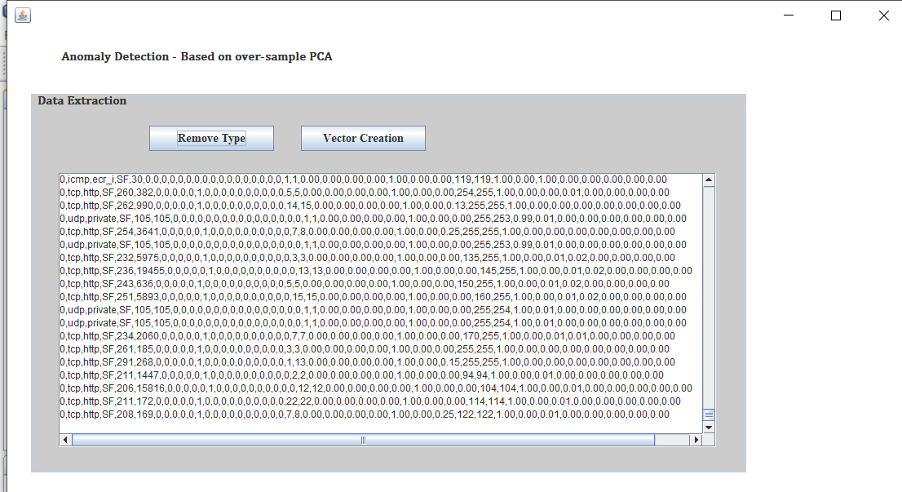

Slide 17
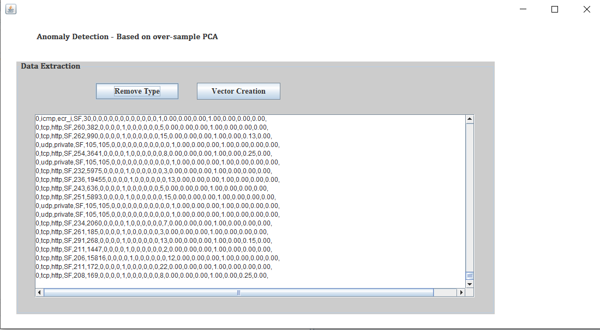

Slide 18
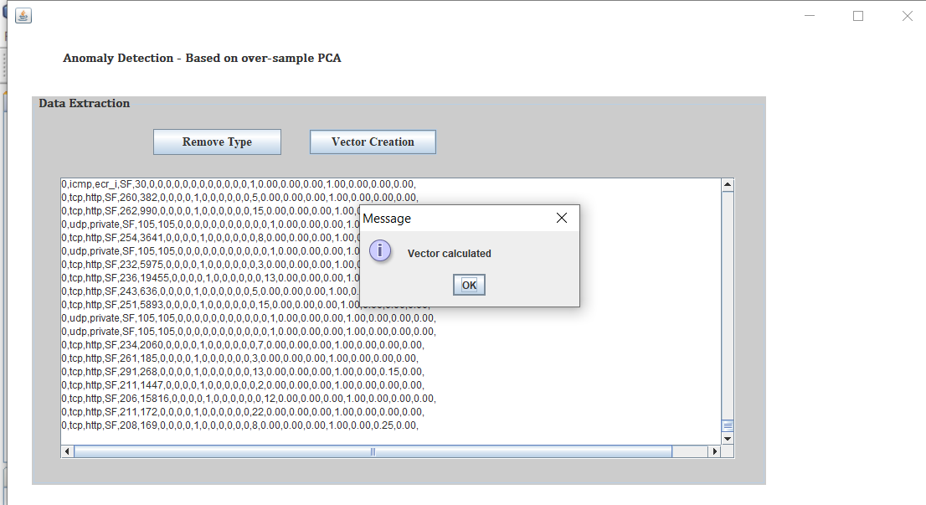

Slide 19
QUERIES POSTED IN REVIEW 2
Asked to change literature survey paper.

Slide 20
Thank you
Queries
?

