Slide 1

Anomaly Detection-Based on oversampling PCA
Batch No: A-02 Project Guide:
M. Dhenuka Datta (164G1A0521) Ms.Karamala.Hema Latha M.Tech.,
B. Divya Bharathi (164G1A0523) Assistant Professor`
G. Kaleem (164G1A0534)
P. Chakrapani (164G1A0517)
Srinivasa Ramanujan Institute of Technology
Department of Computer Science & Engineering

Slide 2
Abstract
Anomaly detection is the process of identifying unexpected items or events in data sets.
It is often applied on unlabeled data which is known as unsupervised anomaly detection.
In data mining , anomalies are referred to as outliers , noise , deviations and exceptions.
It is used in real-world applications which includes intrusion detection systems.

Slide 3
Existing System
In existing system , the process of detecting anomalies is done in batch mode by using traditional techniques .
Principal Component Analysis is a well known unsupervised dimension reduction method which cannot be applied to real-world large-scale applications.
Disadvantages of existing system are:
It requires high computational cost and high memory requirements.
Cannot be applied to large-scale problems.

Slide 4
Literature Survey
F. Angiulli, S. Basta, and C. Pizzuti, “Distance-based detection and prediction of outliers,” IEEE Transactions on Knowledge and Data Engineering, vol. 18, no. 2, pp. 145–160, 2006.
Notes:
A distance-based outlier detection method finds the top outliers in an unlabeled data set and provides a subset called outlier detection solving set,
which is used to predict the outliers.

Slide 5
Literature Survey
W. Jin, A.K.H. Tung, J. Han, and W. Wang, “Ranking Outliers Using Symmetric Neighbourhood Relationship,” Proc. Pacific-Asia Conf. Knowledge Discovery and Data Mining, 2006.
Notes:
Ranking Outliers Using Symmetric Neighbourhood Relationship (Density-Based anomaly detection technique )
Density-based outlier detection method investigates the density of an object and that of its neighbors.
Here, an object is identified as an outlier if its density is relatively much lower than that of its neighbors.

Slide 6
Proposed system
We are using online over-sampling Principal Component Analysis (osPCA) in order to overcome the above problems.
An updating technique is used which allows us to calculate the approximated eigenvector without performing eigen analysis .
Advantages of proposed system:
No need to store covariance matrix.
Reduces computational cost and memory requirements.
Notes:
Updating technique – A technique used to calculate the eigen vector .
Oversampling – It duplicates the target instance n times, and will compute score of outlierness. If the score is above some predefined threshold then it is considered that instance as an outlier .

Slide 7
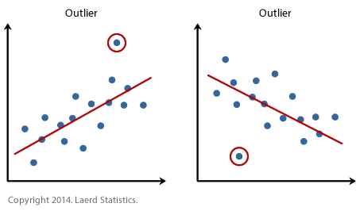
Graph

Slide 8
Problem Statement
Most of the anomaly detection methods are implemented in batch mode ,and cannot be easily applied to large-scale problems which in turn require more computational and memory requirements.
To solve these problems, we are using an online oversampling principal component analysis (osPCA) algorithm ,which aims at detecting the presence of outliers from a large amount of data via an online updating technique.

Slide 9
Planning
Week 1 : Software Installation and Requirements
Week 2 : Analysis and Design
Week 3 : Implementation
Week 4 : Testing
Week 5 : Documentation and Verification

Slide 10
Procedure
START
READ
DATASET
CONTAMINATED DATA
NO
NORMAL DATA
YES
CLEANING
Notes:
Two phases:
1.Data cleaning
2.Online detection

Slide 11
EXTRACTION
OSPCA
UPDATED PC
ANOMALY DETECTION
REFINED DATA
STOP

Slide 12
Thank you
Queries
?

