Slide 1

Anomaly Detection-Based on oversampling Principal Component Analysis
Batch No: A-02 Project Guide:
M. Dhenuka Datta (164G1A0521) Ms. Karamala. Hema Latha M.Tech.,
B. Divya Bharathi (164G1A0523) Assistant Professor`
G. Kaleem (164G1A0534)
P. Chakrapani (164G1A0517)
Srinivasa Ramanujan Institute of Technology
Department of Computer Science & Engineering

Slide 2
Flow chart
START
INPUT DATA
CLEANING
EXTRACTION
PRINCIPAL COMPONENT ANALYSIS

Slide 3
OVERSAMPLING
UPDATE PRINCIPAL COMPONENTS
ANOMALY DETECTION
STOP

Slide 4
Data Flow Diagram (LEVEL – 0)
OSPCA
ANOMALY DETECTION
DATA SET

Slide 5
Data Flow Diagram (LEVEL – 1)
DATA EXTRACTION
PCA
DATA SET
UPDATED
PRINCIPAL
COMPONENTS
CLEANING
OVER
SAMPLING
ANOMALY DETECTION

Slide 6
Use case Diagram
Input data
Data set
Cleaning
Data extraction
Detector
Users
Principal Component Analysis
Updated Principal
components
Over Sampling
Anamoly Detection

Slide 7
IMPLEMENTATION
Modules :-
Cleaning Data
Detecting Outliers

Slide 8
Module-1 (Cleaning Data)
A set of data instances in the original data set is taken as input. This data may be contaminated by noise or incorrect data .
So the cleaning is done using Over-Sampling Principal Component Analysis (osPCA) method.
And then the score of outlierness is calculated and the smallest value is taken as the threshold value.

Slide 9
Module-2 (Detecting Outlier)
In this module we detect the outlierness of the user input.
When the user gives the input to the system, the system calculate the score value for the new input.
The new score value is compared with the threshold value which is calculated in previous module.
If the score value of the new data instance is above the threshold value, then that input data is identified as an outlier. Otherwise it is considered as a normal data instance, and the PCA value of that particular data instance is updated accordingly.

Slide 10
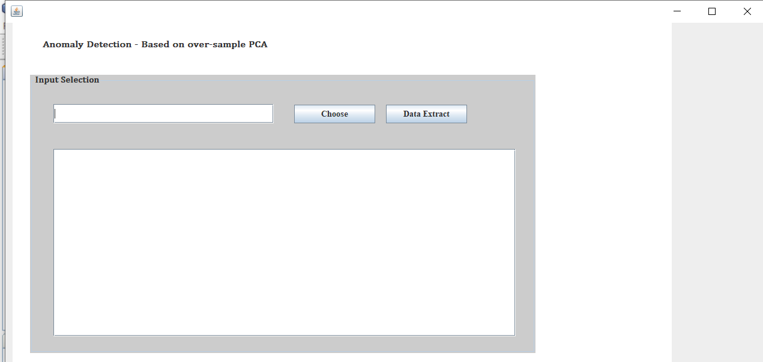
Screenshots

Slide 11
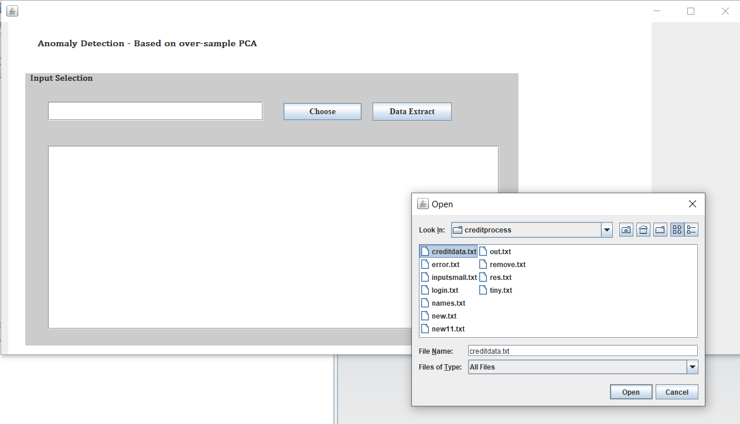

Slide 12
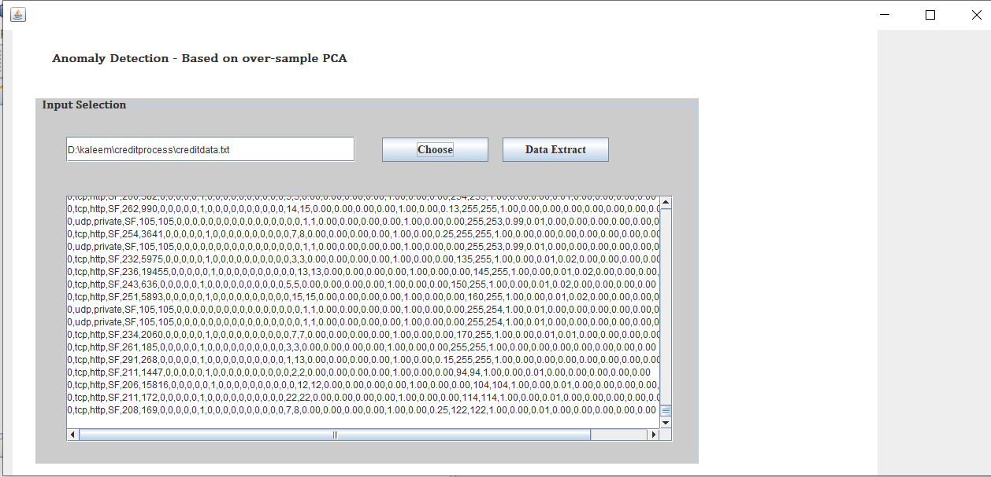

Slide 13
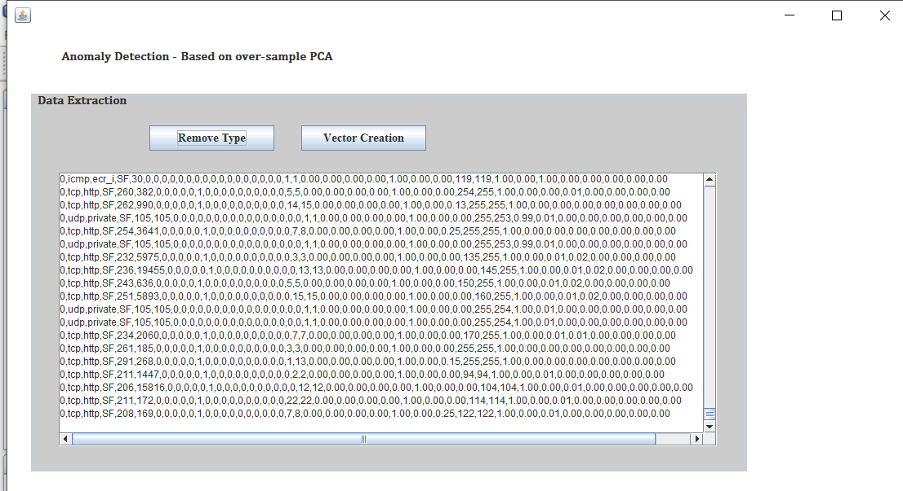

Slide 14
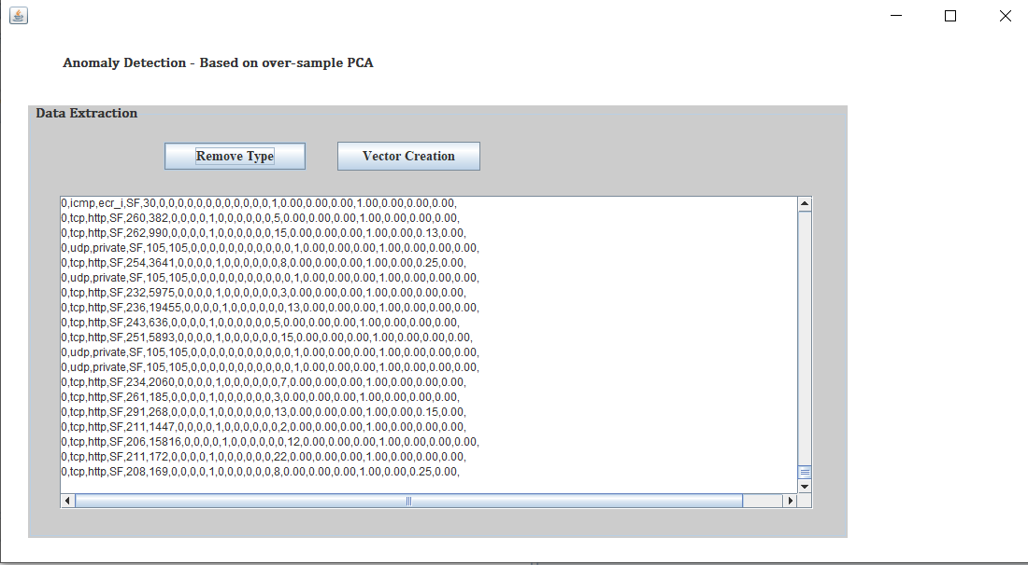

Slide 15
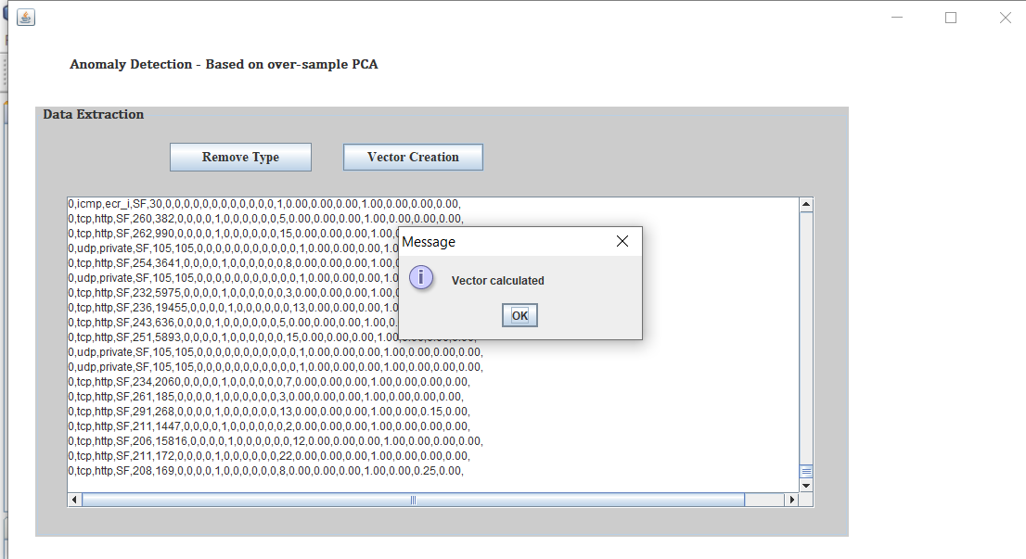

Slide 16
QUERIES POSTED IN REVIEW 2
Asked to change literature survey paper.

Slide 17
Thank you
Queries
?

