Slide 1
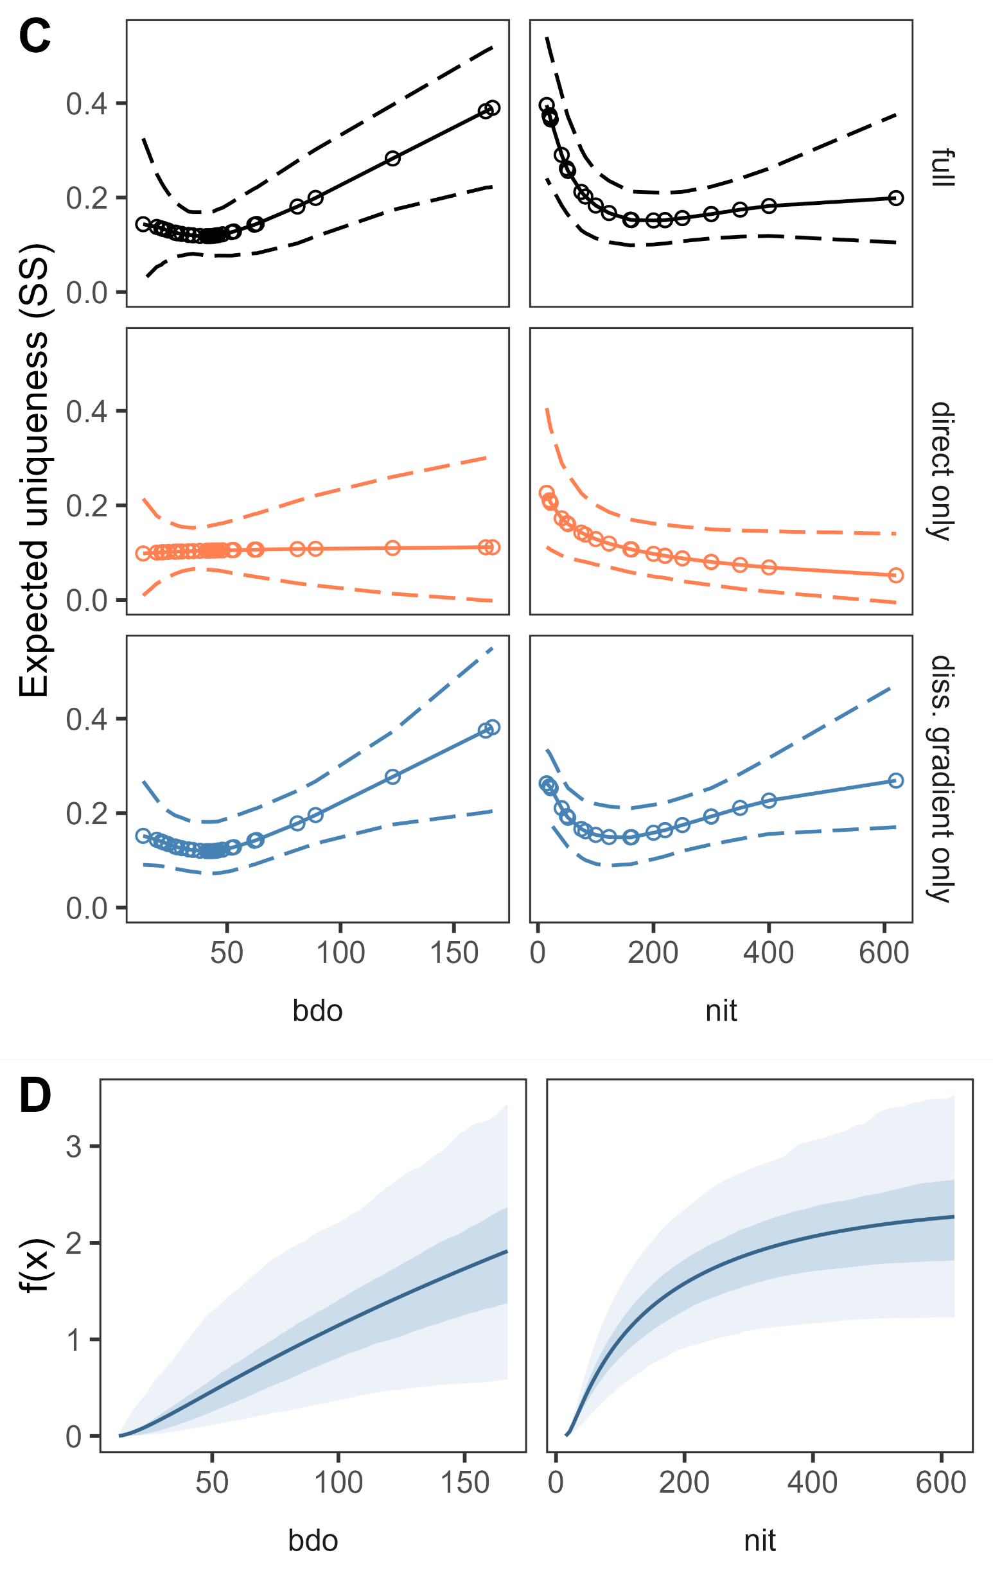


A
gdmm(
Y = com,
X = env,
diss_formula =~s(log(nit))+s(log(bdo)),
uniq_formula =~log(nit)+log(bdo),
method = 'bray’,
binary = TRUE,
family = 'binomial’,
link = 'logit’,
mono = TRUE,
bboot = TRUE)
Pseudo-P = 0.454
Pseudo-P = 0.008**
$λ_{bdo}$= 0.018
$λ_{nit}$= - 0.274
predict(
model,
new_X = newdata_X,
new_W = newdata_W,
component = 'uniqueness')
diss_gradient(model)
B

