Slide 1

SMART INDIA HACKATHON 2024
Problem Statement ID - 1741
Problem Statement Title - Centralized application-context aware firewall
Theme - Blockchain & Cybersecurity
PS Category - Software
Team ID - Nil
Team Name - GLAD BITS

Slide 2
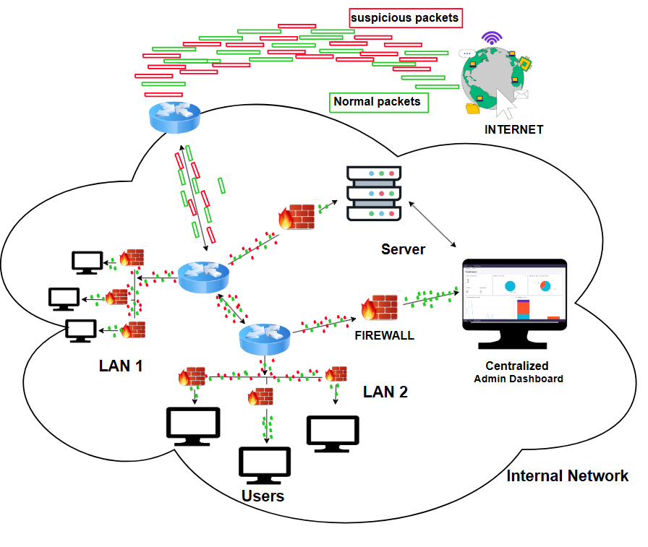
IDEA TITLE
IDEA TITLE - Centralized application-context aware firewall
Proposed Solution:
The system monitor each applications and website requests/response and controls whether to allow or block that traffic based on set rules.
Each application running on the endpoint will have its own set of firewall policies.
The agent will collect detailed logs of network usage and capture information such as the destination IPs, domains, protocols and reports this to a central server.
A web-based console allows administrators to manage all devices and apps from one place, setting and updating rules as needed
Primarily designed for Windows and extend compatibility with linux Systems,
Integrate AI/ML algorithms to analyze network traffic, automatically detect anomalies, and generate real-time alerts, enhancing network security by preemptively addressing potential threats.
Innovation and uniqueness of the solution
The solution stands out by integrating a hybrid anomaly detection model with Z-Score method & Autoencoders. This fusion boosts detection accuracy for complex threats, while its adaptive learning capability allows the system to evolve with emerging patterns, ensuring robust and responsive security.

Slide 3
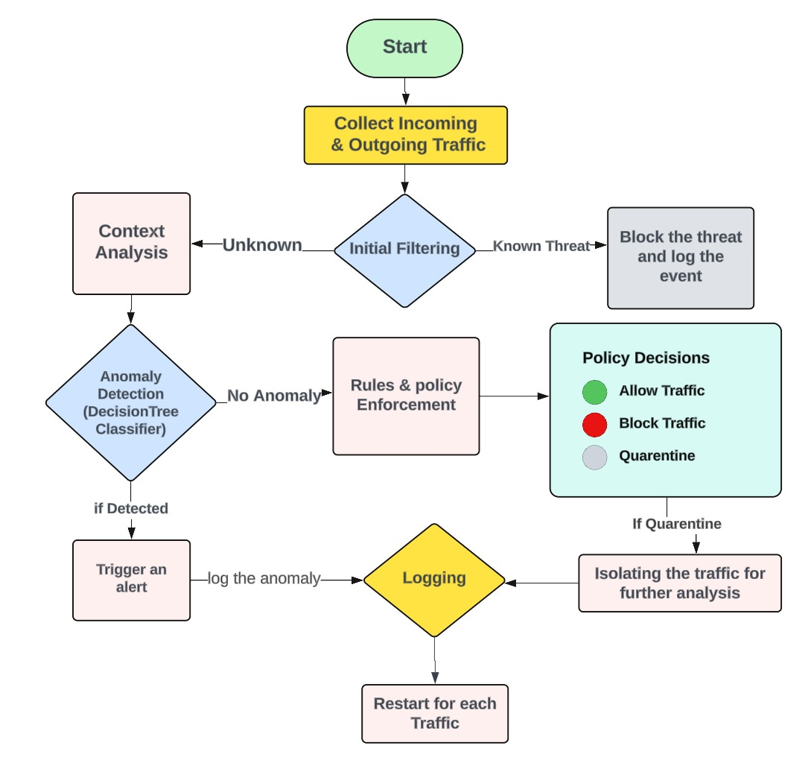
TECHNICAL APPROACH
Technologies to be used
Iptables/nftables: For implementing firewall rules and managing network traffic
Suricata: integrated for deep packet inspection.
Scapy: Packet sniffing, Network testing, Port scanning.
Z-score Method : Identifies anomalies based on mean.
Autoencoder : Detects anomalies based on the reconstruction error.
Programming languages:​
Python
PostgreSQL
REACT JS
Node.js
Express.js

Slide 4
FEASIBILITY AND VISIBILITY
Analysis of the feasibility of the idea.
Customizable Policy Enforcement.
Compatibility with existing network infrastructure.
Advanced Techniques: ML for Real-time threat detection and contextual analysis.
Integration: Compatibility with existing network infrastructure.
Scalability: Handling large volumes of data and varying traffic loads.
Data Handling: Real-time processing & Monitering with Centralized application.
Potential challenges and risks​
The system might slow down devices.​
Making it work well on different systems could be tricky. ​
Strategies for overcoming these challenges​
Processing algorithms to minimize CPU and memory usage. (asynchronous processing, multi-threading)
Hybrid algorithm used here for better accuracy

Slide 5
IMPACT AND BENEFITS
Potential impact on the target audience.
Enhanced Security: Helps cybersecurity teams to protect against threats by controlling, which applications can access the network traffic.
Centralized application: to monitor all the user real time network activities.
Quick Threat Response: Real-time alerts allow for fast action against suspicious activities.
Better Compliance: Keeps detailed records and controls, helping organizations follow security rules and requirements.
Simplified Management: Centralizes policy deployment and enforcement, reducing complexity and effort.
Broad Compatibility: Works on both Windows and Linux, making it suitable for different environments.
Benefits of the solution:
IT Admins: Easier management with a central console.
Organizations: Enhanced security and compliance.
End-Users: Reduce disruptions from unauthorized access.
Flexibility: Works with both Windows and Linux systems.
security Teams: Better control and quicker response to threats.

Slide 6
REFERENCES AND RESEARCH
CONTEXTAWAREFIREWALL: https://medium.com/@prabhu_b/context-aware-firewall-in-nsx-6-4-4763707fa415#
DASHBOARD: https://docs.servicenow.com/bundle/washingtondc-it-operations-management/page/product/discovery/concept/firewall-admin-workspace-dashboard.html
DATASET: https://www.kaggle.com/datasets?search=firewall
AUTOENCODER: https://www.geeksforgeeks.org/auto-encoders/
Z-SCORE: https://corporatefinanceinstitute.com/resources/commercial-lending/altmans-z-score-model/

Slide 7

Thank You

