Slide 1
Predictive Modeling for Attorney Involvement in Claims

Slide 2
Problem Statement
Insurance companies face significant legal expenses when claimants involve attorneys in the claims process. Legal involvement can lead to increased settlement amounts, prolonged claim resolution times, and higher administrative costs. Identifying claims that are more likely to involve attorneys in advance can help insurers optimize their processes, allocate resources efficiently, and potentially reduce unnecessary legal expenditures.
This project aims to develop a predictive model that determines whether an attorney will be involved in a claim based on various claim-related factors. By leveraging machine learning, the model will analyze key attributes such as CLMINSUR, accident severity, policy type, LOSS, and claim approval status to make accurate predictions.

Slide 3
Dataset Overview
Total Entries: 1,340 rows
Total Features: 13 columns
Key Features:
CASENUM (Integer) – Unique identifier for each case.
ATTORNEY (Binary: 0 or 1) – Indicates if an attorney was involved (1 = Yes, 0 = No).
CLMSEX (Categorical: 0 or 1) – Gender of the claimant (1 = Male, 0 = Female).
CLMINSUR (Binary: 0 or 1) – Whether the claimant was insured at the time of the accident.
SEATBELT (Binary: 0 or 1) – Whether the claimant was wearing a seatbelt during the accident.
CLMAGE (Integer) – Age of the claimant.
LOSS (Float) – The financial loss associated with the claim.
Accident Severity (Categorical: Minor, Moderate, Severe) – Severity of the accident based on damage or injuries.
Claim Amount Requested (Float) – The initial amount requested by the claimant.
Claim Approval Status (Binary: 0 or 1) – Whether the claim was approved (1 = Yes, 0 = No).
Settlement Amount (Float) – The final amount paid after settlement.
Policy Type (Categorical: Comprehensive, Third-Party) – Type of insurance policy held.
Driving Record (Categorical: Clean, Minor Offenses, Major Offenses) – Claimant’s history of traffic violations.

Slide 4
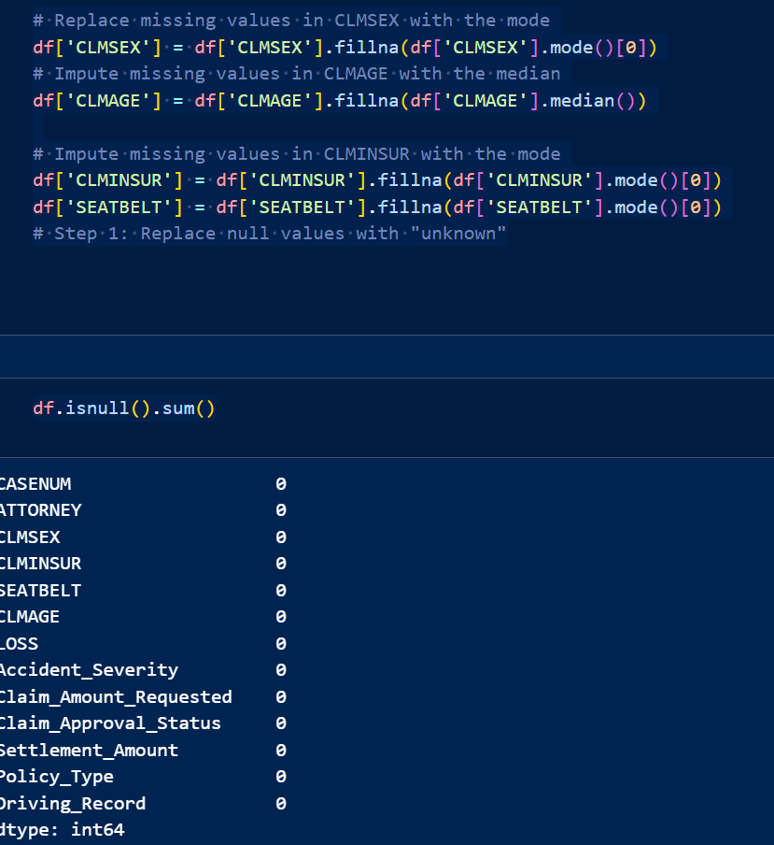
Exploratory Data Analysis
Handling Missing Values
🔹 Missing Values Count:
CLMSEX → 12 missing values
CLMINSUR → 41 missing values
SEATBELT → 48 missing values
CLMAGE → 189 missing values
🔹 Imputation Strategy:
CLMSEX, CLMINSUR, SEATBELT → Filled
with mode.
CLMAGE → Filled with median to
handle skewness.

Slide 5
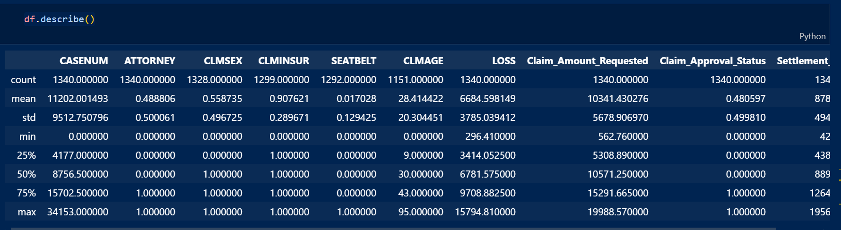
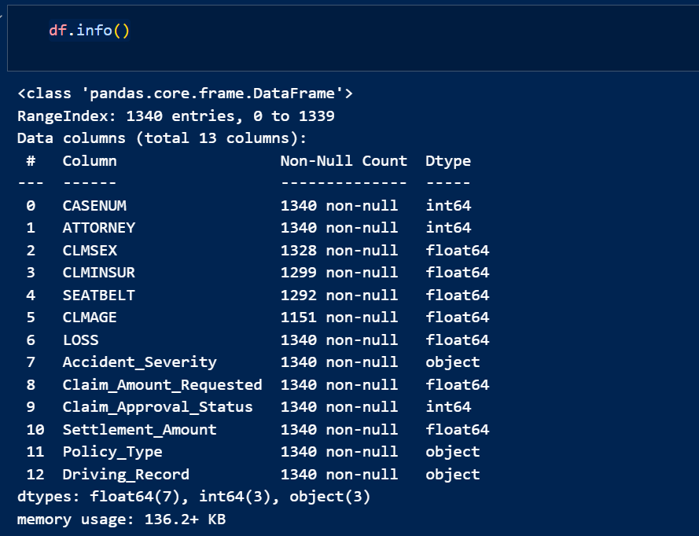

Slide 6
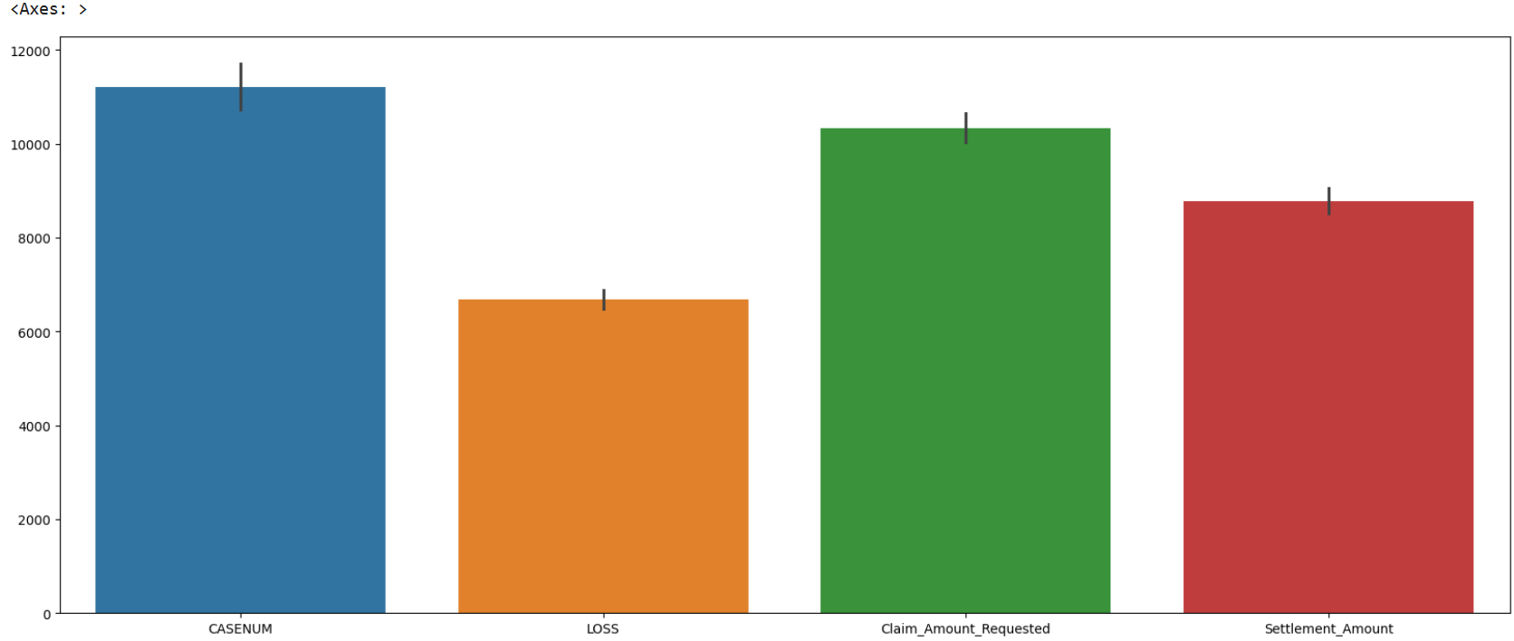
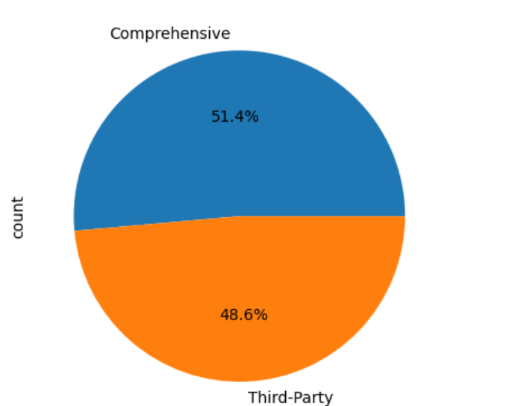
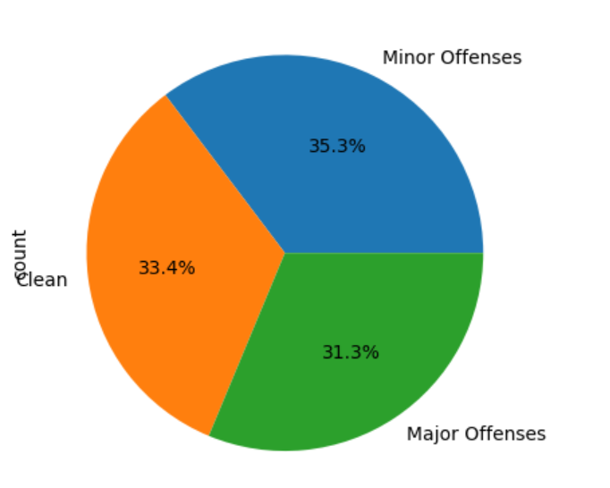
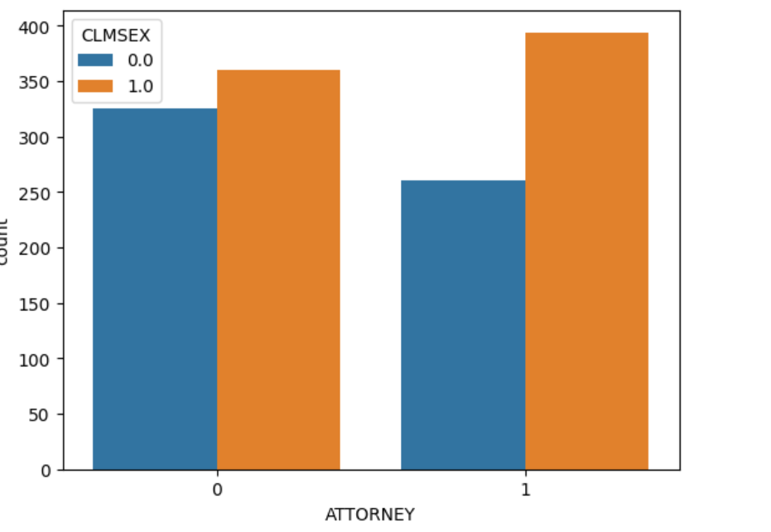
Data Visualization
Bar Plot Analysis pie chart

Slide 7
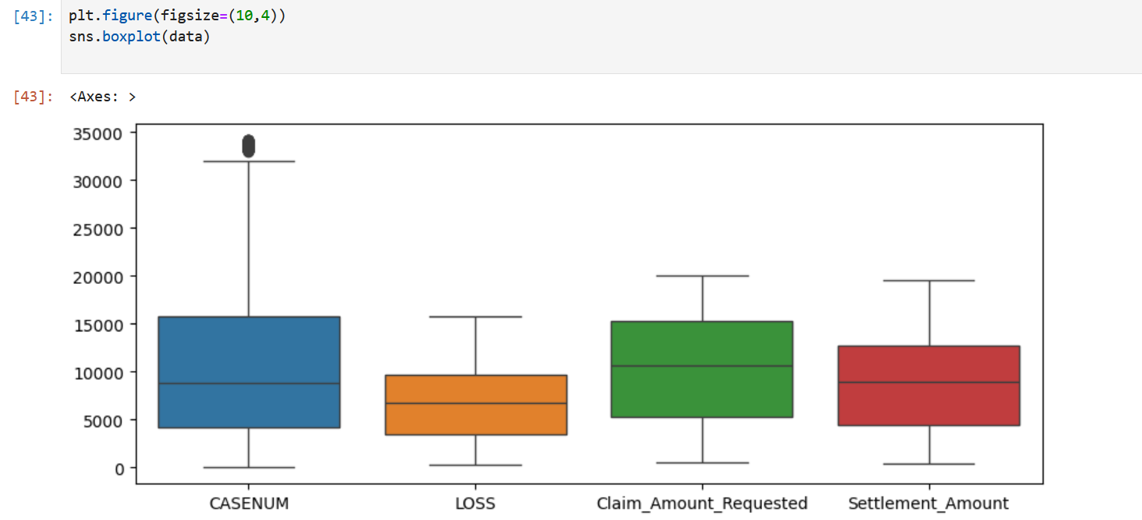
Data Visualization
CASENUM has extreme outliers → Should be removed.
- LOSS, Claim Amount Requested, and Settlement Amount are right-skewed.
- High-value claims exist but are rare.
- Settlement Amount is usually lower than Claim Amount Requested.

Slide 8
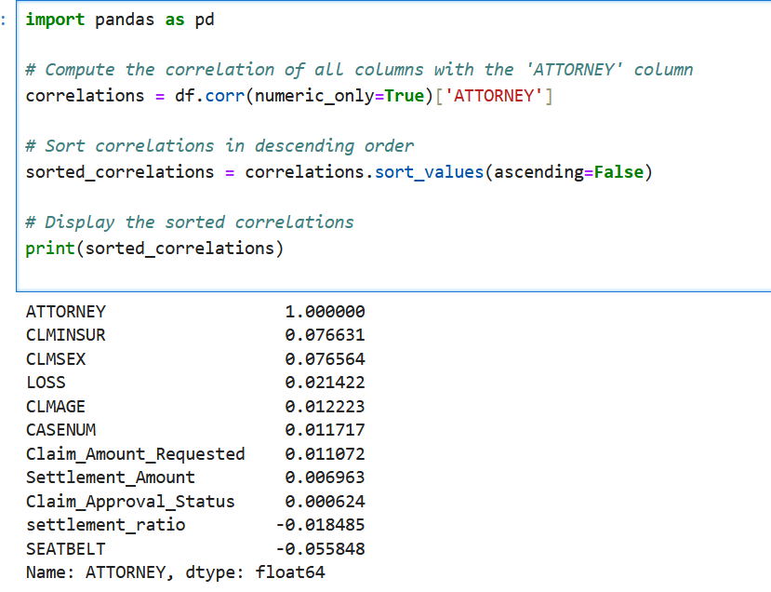
Feature Engineering & Selection
Calculated correlation of all features with ATTORNEY.
High correlation
features indicate strong relationships with the target.
Low correlation features might not contribute significantly to predictions.

Slide 9
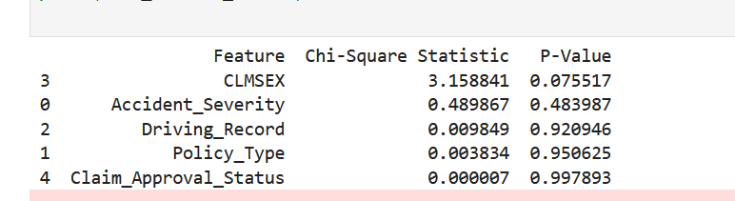
Feature Engineering & Selection
Chi-Square Test evaluates feature importance based on statistical significance.
Features ranked by p-value to identify the most relevant predictors.
Top Selected Features:
Accident Severity, Policy Type, Driving Record, Claim Approval Status.

Slide 10
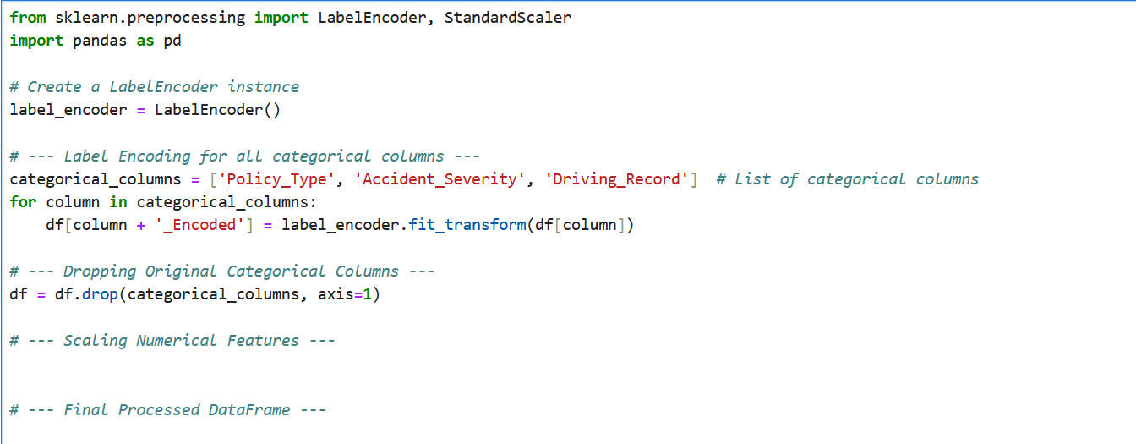
Feature Engineering & Selection
Label Encoding for categorical features
Accident Severity, Policy Type, Driving Record, CLMSEX, Claim Approval Status.
Converts categorical values into numerical form for model compatibility.

Slide 11
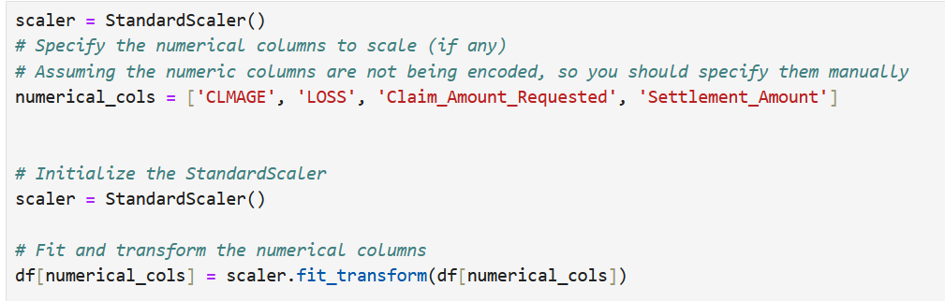
Feature Engineering & Selection
Dropped original categorical columns after encoding.
Standardized numerical features (CLMAGE, LOSS, Claim Amount Requested, Settlement Amount).
Helps improve model performance and ensures balanced feature impact.

Slide 12
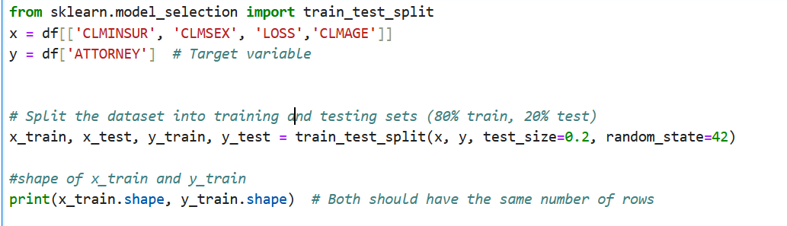
Model Selection & Training
Train-Test Split
Features (X): CLMINSUR, CLMSEX, LOSS, CLMAGE.
Target (y): ATTORNEY (1 = Yes, 0 = No)
Dataset split: 80% training, 20% testing.

Slide 13
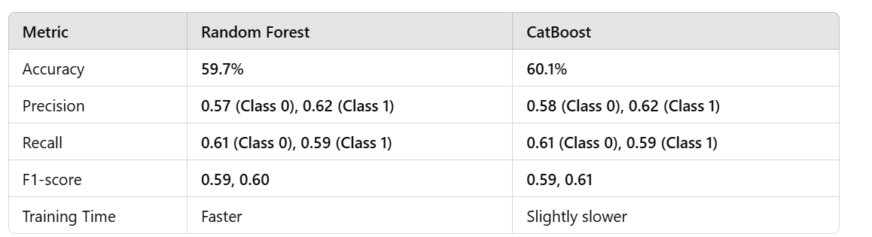
Model Selection & Training
CatBoost is a gradient boosting algorithm designed to handle categorical features efficiently.
It improves model performance by reducing overfitting and handling class imbalance.
Random Forest is an ensemble learning method that uses multiple decision trees.
It reduces overfitting and improves accuracy by averaging multiple tree predictions.

Slide 14
Results & Evaluation
Random Forest Classifier
- Accuracy: 59.7%
- Precision: 57% (Class 0), 62% (Class 1)
- Recall: 61% (Class 0), 59% (Class 1)
- F1-score: 59% (Class 0), 60% (Class 1)
CatBoost Classifier
- Accuracy: 60.1%
- Precision: 58% (Class 0), 62% (Class 1)
- Recall: 61% (Class 0), 59% (Class 1)
- F1-score: 59% (Class 0), 61% (Class 1)
Additional Analysis
- Confusion Matrix evaluated for classification errors.
- Feature Importance analysis conducted to determine key predictors.

Slide 15
Deployment Strategy
We created an interactive web app using Streamlit to allow users to input claim details and get predictions.
Key components of the Streamlit app (app.py):
User Inputs:
Number inputs for Insurance Claim Amount, Loss, Age
Dropdown for Gender (Male/Female)
Preprocessing:
Converts categorical variables (e.g., Gender) into numerical format.
Prediction Display:
Model outputs either "Attorney Involved" or "No Attorney Involved".
Feature Importance Visualization:
Users can see which factors influence predictions the most.

Slide 16
Deployment Strategy
Vizualisation.py
Objective: Explore patterns & relationships in the insurance claims dataset.
Tools Used: Streamlit , Seaborn, Matplotlib for interactive visualizations.
Key Features & Visualizations
Single Attribute Analysis
Histogram & Boxplot → Show distribution & outliers for numeric attributes.
Countplot → Displays the frequency of categorical attributes
Relationship Analysis
Scatterplot → Examines correlation between two selected attributes.
Heatmap → Highlights correlations between numerical features.
Pairplot → Shows relationships among multiple numerical attributes.

Slide 17
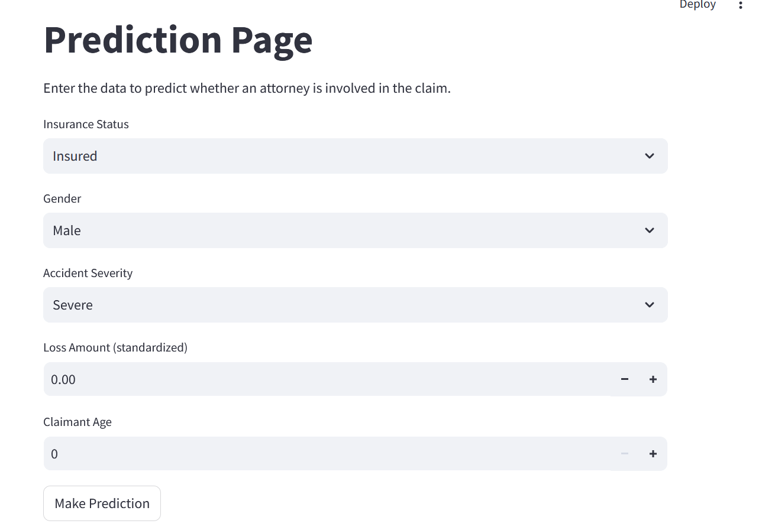

Slide 18
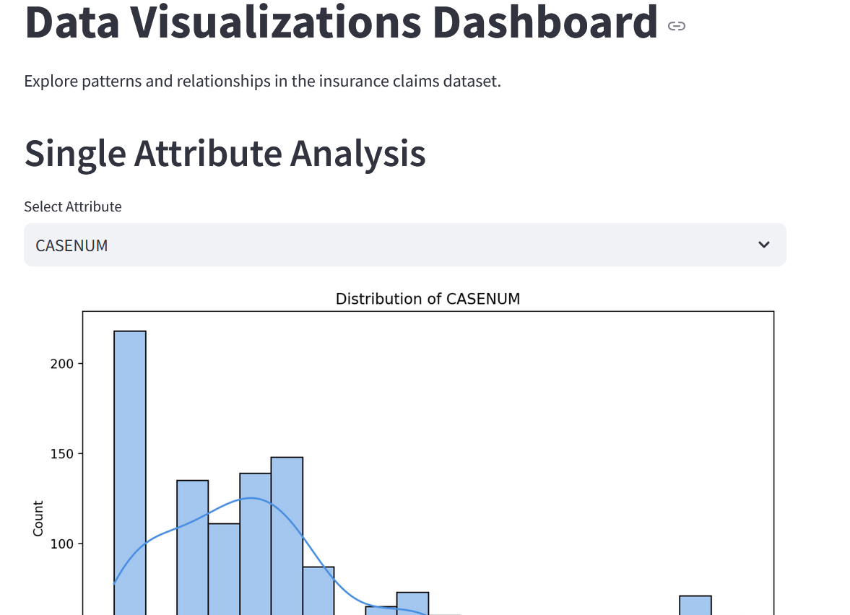
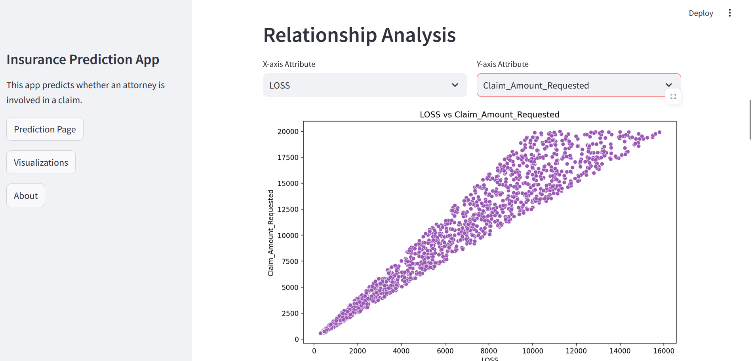
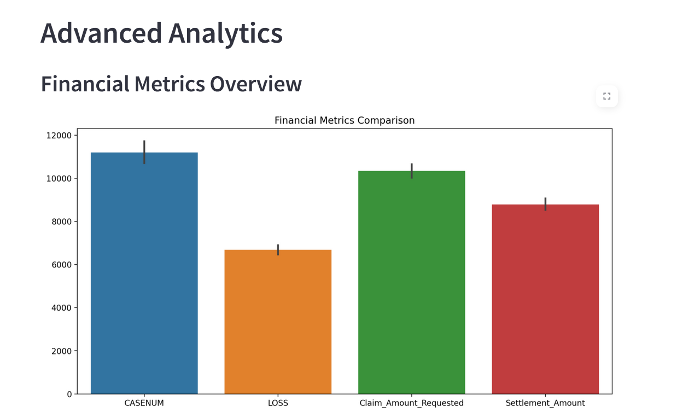
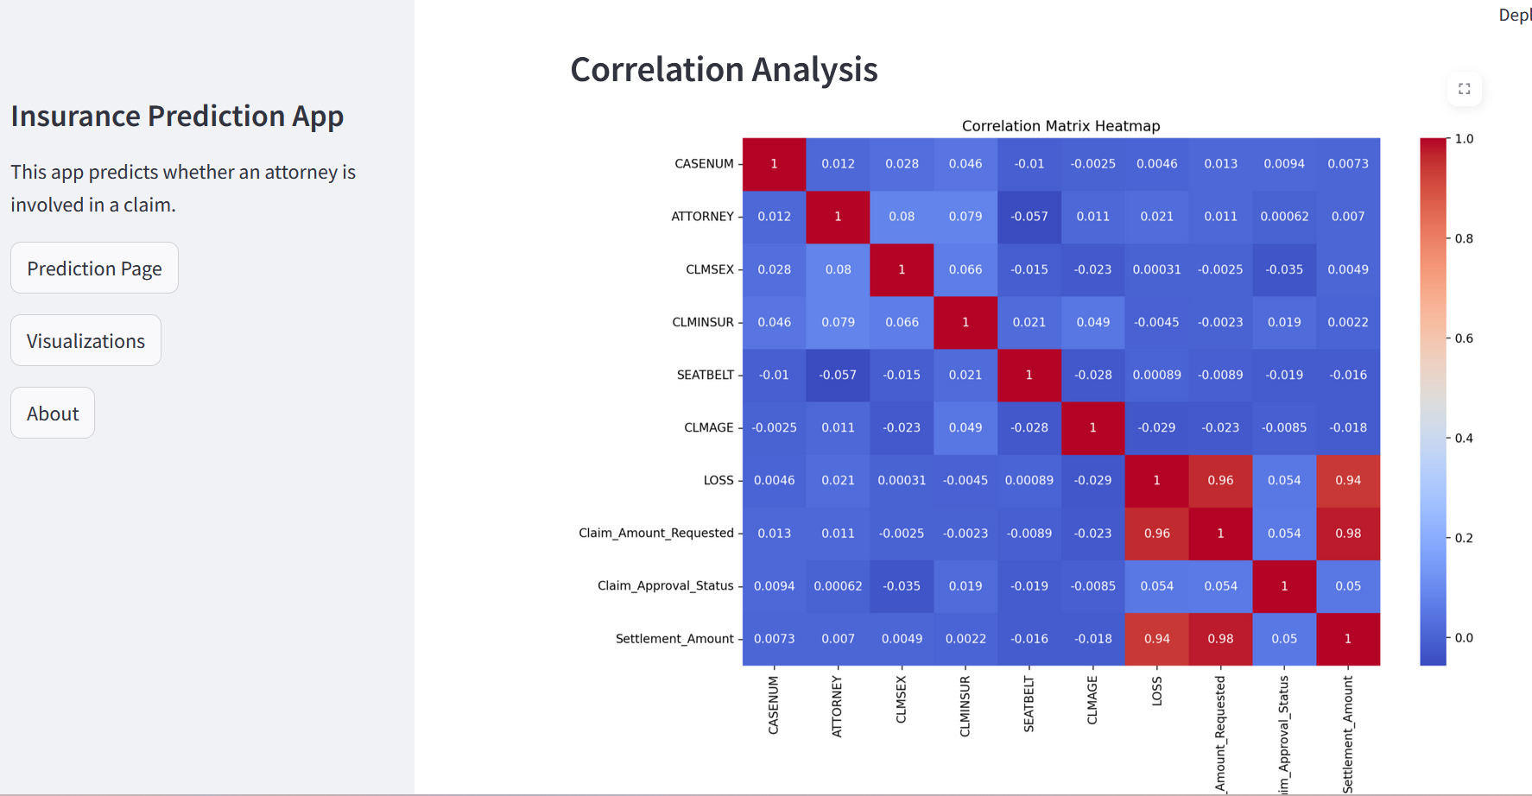

Slide 19
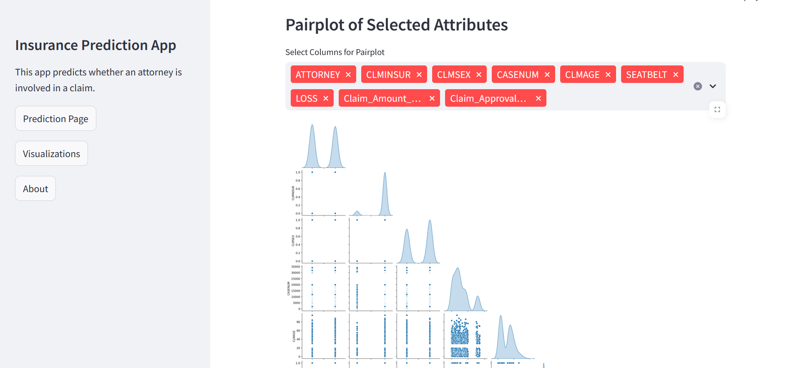

Slide 20
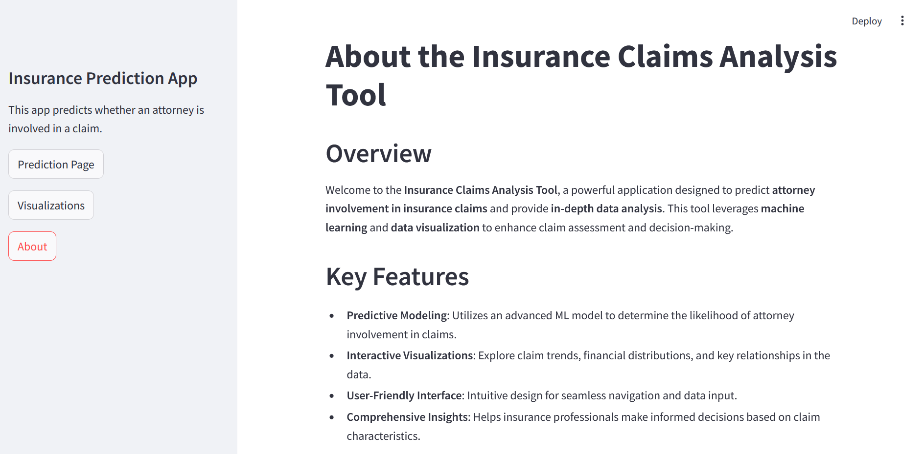

Slide 21
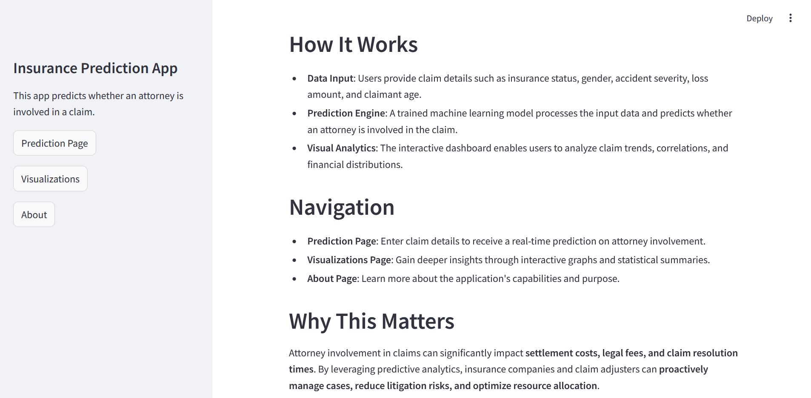

Slide 22
Thank You
By
Dhevesh Arun
Swathi Mamilla
E.Abdur Rahman Anas
MOHAMMED SHYJIL
Ms. Teena Suresh Bokde
Sadu Gopi Krishna
Mrunal Girdhar Patil

