Slide 1
Sentiment Analysis
The W5H

Slide 2
Background – When & Who
Sentiment Analysis is a field within the Natural Language Processing, which started in 1950’s
Alan Turing published a book called “Intelligence” in 1950
Today we use the Turing test to determine intelligence of a machine
(See the youtube video regarding Google’s Duplex assistant AI)
In the 80’s it was based on rule setting (aka labelling) but later on using statistical / probabilistic decisions models (think algorithms)
Other and more complex types & style of ML evolved in NLP
E.g. Deep neural network, reinforced learning, deep learning, etc.

Slide 3
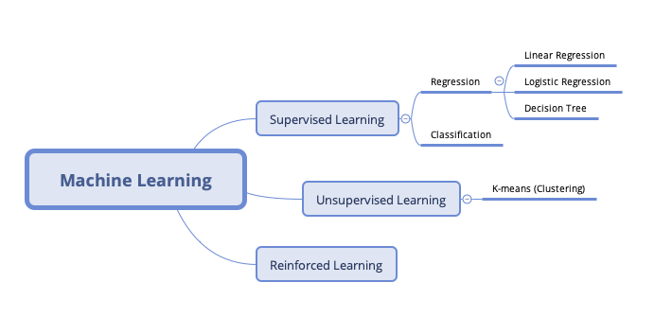
Different branches of Machine Learning

Slide 4
What is Sentiment Analysis?
It is known as opinion mining
The application of ”Easy NLP” or Natural Language Processing via text analysis (can be speech), computational linguistic and biometrics
There’s also “Hard NLP” – Hidden Markov Model & Recursive Neural Network
NLP is a branch of Machine Learning of AI where big data (structured data) is used to teach machine to understand human languages.
Math is universal but language is ambiguous
For example:
e.g. I got grilled on the test – different interpretation
1) I failed the test
2) I got cooked on the test
Machines cannot understand the context and there are multiple interpretation.
Notes:
Context and meaning of the phrase, text, etc.

Slide 5
What is Sentiment Analysis? (continuing)
Two main theme in sentiment analysis are: regression and classification
Regression – can be linear, logistic, or decision tree that trains the ML model by reiterating recursively and mapping out the target closer to a certain category (requires continuous input)
Classification tries to predict a category, e.g. image of a digit, or even image of a hotdog (think Silicon Valley show), and handwriting (from A to Z)
They eventually get transformed by deep learning
Natural occurring data types include text, images, age, binary classification (yes/no)

Slide 6
Why is Sentiment Analysis is important?
To gauge a person’s emotion and feelings
To quantify sentiment based on a text, speech, or even emoticons measured in polarity score
Ranges from -1 to +1.
Data mined and analyzed from sentiments can be used to determine an outcome or result, e.g. election polling
Results can be used to prescribe a certain action or nothing at all

Slide 7
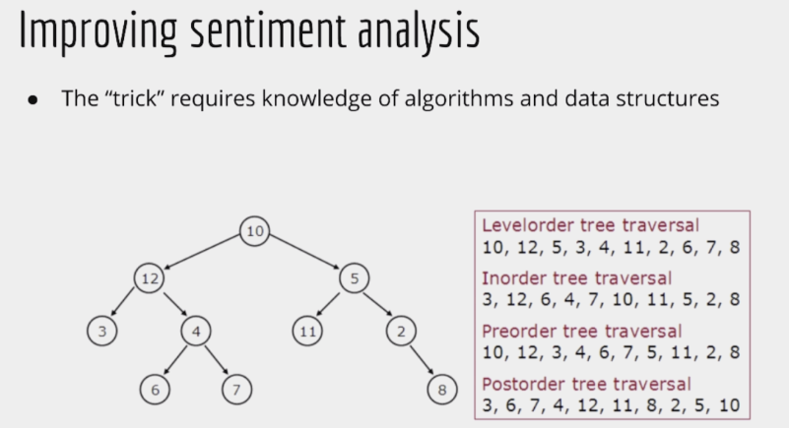
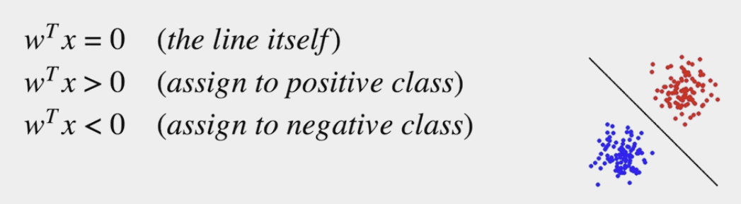
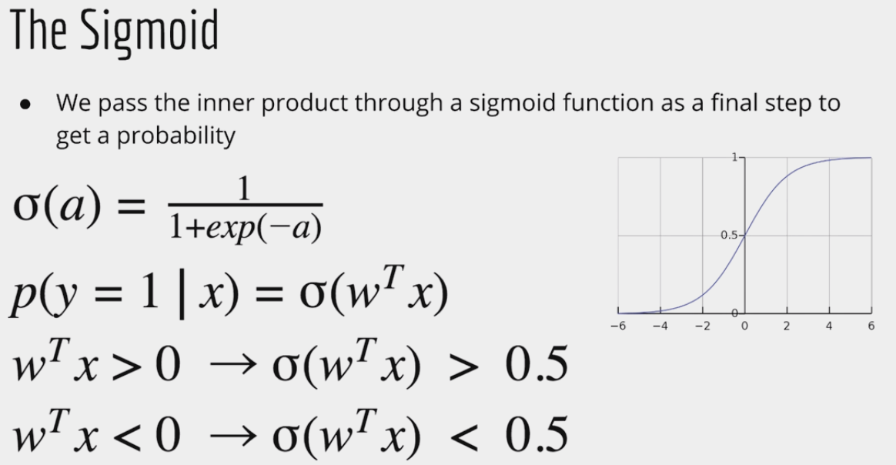
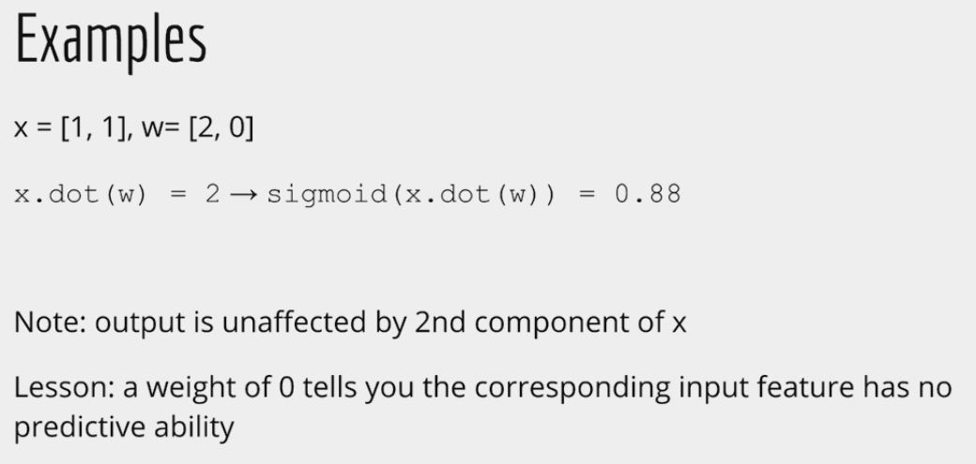
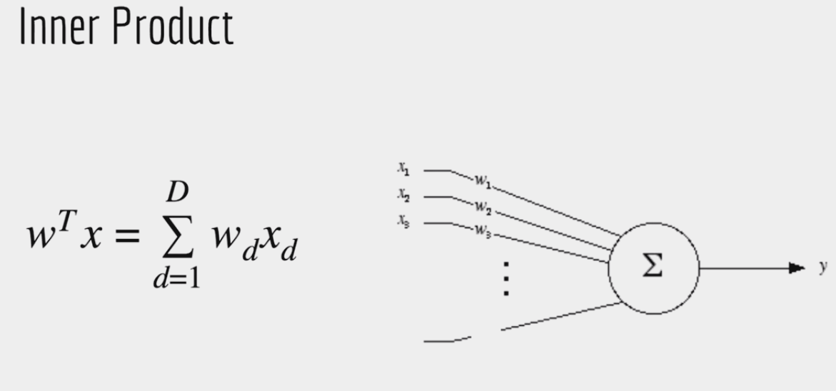
How does it work?
There’s a lot math involved, i.e. field of statistics and algorithm
Does involve linear or logistic regression, word to vector, decisions trees

Slide 8
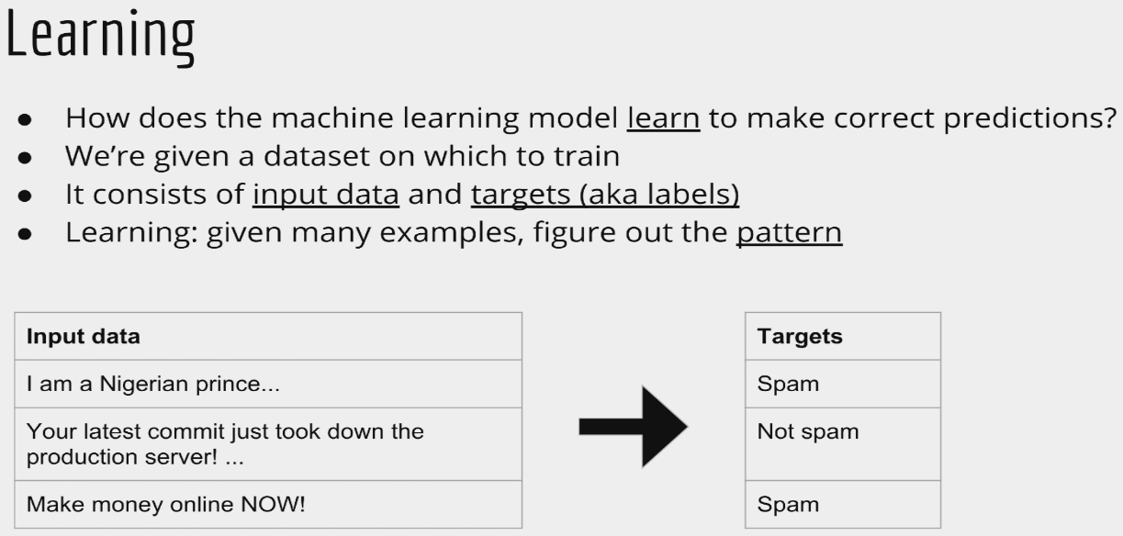
How does it work? (continuing…)
There are two common techniques & part of the NLP family:
Parts of Speech Tagging (PoST)
Grammatical tagging of adjacent words (clause), e.g. SVO
Named-Entity Recognition (NER)
Locate & classify named entities, e.g. person, location, organization, names, etc.
Learn via inputs from datasets
Demo Time
POST / NER

Slide 9
Libraries & languages for NLP
Libraries
Scikit-Learn
NLTK
Spacy
VaderSentiment
Tensorflow
Keras
PyTorch
Programming Languages
Python
R
Scala
Java
C++
C#
JavaScript

Slide 10
Some drawbacks of sentiment analysis
Predictive analysis is not very useful unless there is a prescriptive action or actionable step (extra steps are required)
Accuracy score of sentiment polarity (negative, neutral, positive) can be skewed or not accurate yet, due to limited datasets
Weighted matrix:
Lower the category, the higher the accuracy score
Higher the category, lower the accuracy score but more interpretable
Trade-offs between accuracy score and interpretability
To improve sentiment analysis, we need to learn RNN & HMM

Slide 11
Demonstration of Electronics Review & GoT Season 8 Finale
Electronic Review demo using Jupyter Notebook, panda, scikit / NTLK
Game of Thrones S8 demo via Spacy, VaderSentiment, Bokeh, pandas
Datasets are scraped off of Amazon and IMDB using Scrapy & BeautifulSoup
C# .NET port of VaderSentiment → VaderSharp

Slide 12
Where can this be applied to Methodify?
This can be useful on the open-ended questions where users enter their thoughts and feedbacks
Provides realtime updates on overall compound scoring
Allows the qualitative answers to be quantifiable
Can be sold as an enhanced feature for future versions of Methodify

