Slide 1




Group Meeting – January 19, 2011
Preparing a Scientific
Manuscript for Publication
Matt Teeter
The University of Western Ontario – London, Canada
Modified from a presentation by David Holdsworth

Slide 2
Outline
Motivation
What is a scientific manuscript?
Strategies for organizing, writing
Tips for successful publications
Authorship

Slide 3
Motivation
Why make the effort?
  If your science is worth doing, it is worth describing well
  If your work is not written up and published, the scientific impact is nearly zero
  Pride in your accomplishment
  Professional advancement

Slide 4
What is a scientific manuscript?
A compelling story, which describes a rigorous study
Addresses a particular question or objective
Provides a complete description of how the work was done
Results are presented clearly and concisely, with appropriate analyses
Implications of the results are made clear in the discussion

Slide 5
Strategies for success
Know the purpose of the study, and the study design!
Hypothesis-driven or observational
A manuscript may:
  Answer a question (hypothesis driven)
  Describe the development of a new tool or technique
  Remedy some identifiable deficiency
  Be an observational study
  Be a review article

Slide 6
Strategies for success
Be sure of the validity of your study design at the outset!
  Is the methodology sound?
  Can you describe your methodology clearly? (preferably, in advance…)
  Is the study original?
  Do you have sufficiently large samples?
  Will you test your hypothesis?

Slide 7
Strategies for success
Choose a target journal, running title, and author list as early as possible!
  Your paper should be written in the specific style of the most appropriate journal
  You must narrow the scope of your study to something that can be described in 3000 to 4000 words
  You should select the potential co-authors at the beginning, so that they can assist you (and to avoid future conflicts)
Notes:
Journal selection based on:
Where similar works have been published
Journal impact factor
Availability (listed in PubMed)

Slide 8
Tips for writing
Follow the detailed instructions to authors for your journal
Instructions will include details on:
  Length of article, number of figures, tables
  Format and number for references
  General format, sections, headings
  Technical details related to figures, fonts
  Details related to author responsibilities
  Details related to required ethics reviews

Slide 9
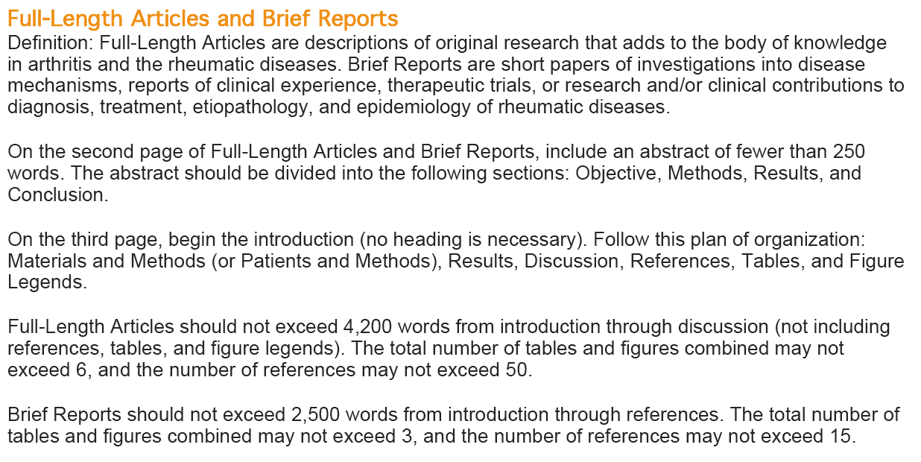
Tips for writing
Authors instructions from Arthritis and Rheumatism

Slide 10
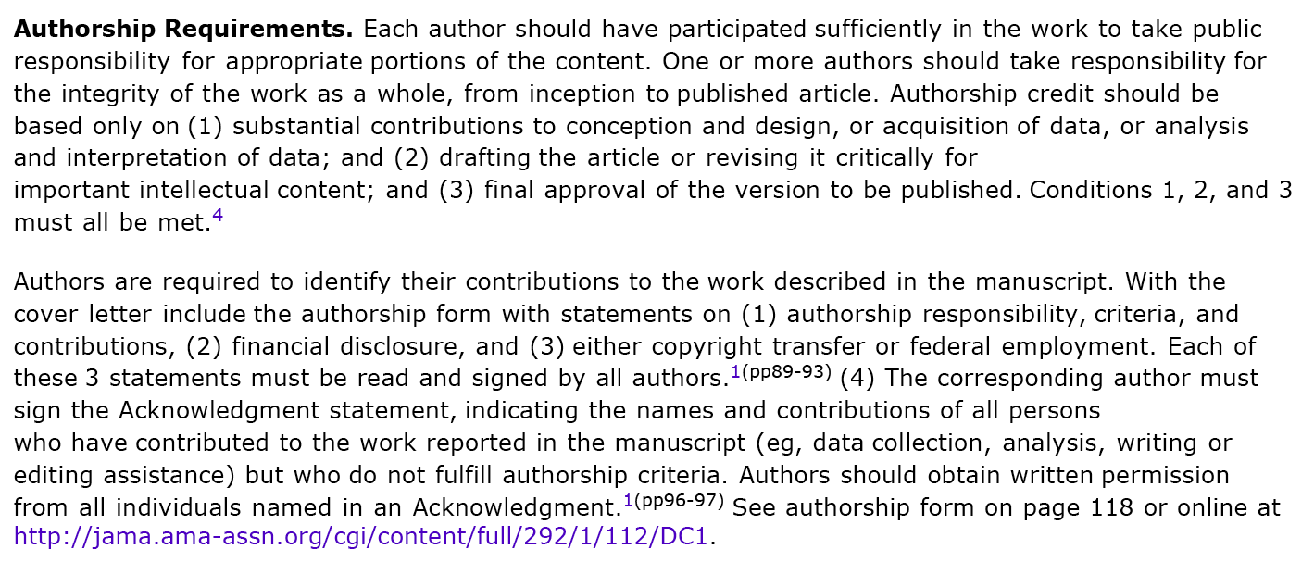
Tips for writing
Authorship requirements from JAMA

Slide 11
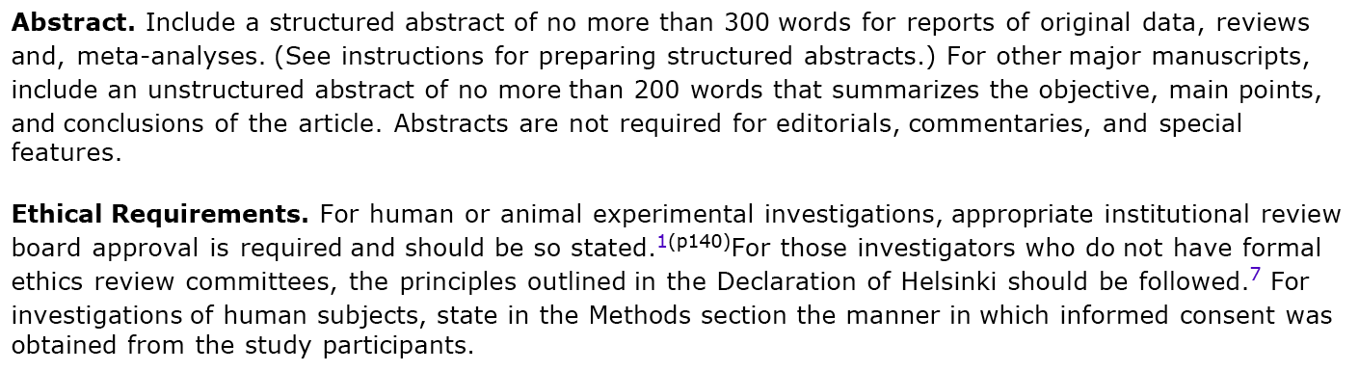
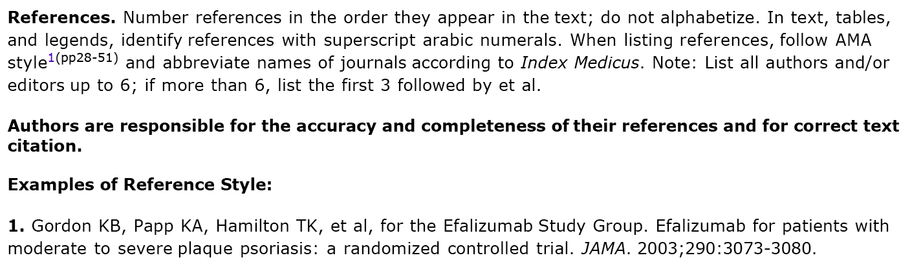
Tips for writing
Author’s instructions from JAMA

Slide 12
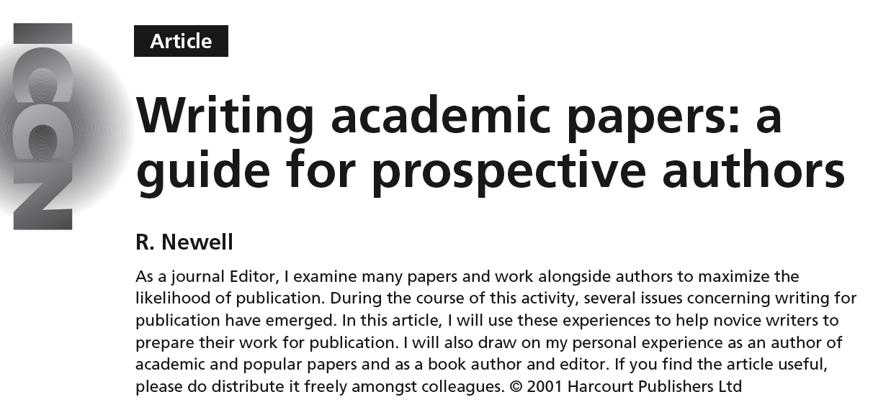
Tips for writing
Intensive and Critical Care Nursing 17:110-116 (2001)
take advantage of previous authors’ experience

Slide 13
Tips for writing
Start with a draft outline of each section
Use bullets, summarize each paragraph
Expand point into a complete paragraph
Aim to have each paragraph follow logically from the previous
Include some indication of the motivation for your actions
Limit the number of iterations
Notes:
In outline stage, write as thoughts come to you. If you feel one point is too tricky to tackle, move to the next and come back to it later. Write notes about what to cite, don’t have to search for the full reference right away.
Keep a plan in your head about what the paper is saying, how it will flow. Don’t have to write in order. Think about key results and message, fill in sections to justify that.
Think about limitations of your study and how you can write the paper to acknowledge yet limit the impact of those limitations.

Slide 14
Summary
Know what question you are asking
Decide on the target audience (journal)
Confirm all co-authors at an early stage
Obtain and follow specific journal instructions
Prepare a complete bullet-point outline first
A manuscript should tell a concise story, with a clear message

Slide 15
Authorship
Authorship is becoming an increasingly challenging point in manuscript prep
Need to identify authors and their roles early in the process
Be prepared to justify each author’s role to a journal
Journals may limit the number of authors

Slide 16
Authorship best practices
Try to work with people you know well
Figure it out early
Make sure all co-authors see drafts
Get documentation of their approval to submit the manuscript
Never forge their signature
Follow journal directions

Slide 17
Authorship scenario #1
Coauthor involved with study design, multiple revisions of drafts
Manuscript submitted and rejected at 2 journals, under review at a 3rd
Coauthor emails other authors suggesting he didn’t make a large enough contribution and wants his name removed from the paper

Slide 18
Authorship scenario #2
Journal willing to accept manuscript, but wants to remove authors
Manuscript has 7 authors, journal only allows 5
Journal requires justification for all authors, editor doesn’t believe the authors made significant enough contributions

Slide 19
Authorship scenario #3
Colleague at another institution proposes collaborative study
Suggests authorship of himself, 3 clinicians at his institution, and our PI
No indication clinicians will have any role, ignores contributions of other local faculty and grad students

Slide 20
Appendix: Planning a paper
stages involved in manuscript preparation

Slide 21
1) Concept
generation of initial idea for investigation
  overt planning with supervisor
  serendipitous idea

Slide 22
2) Literature search
check for related previous work in Medline, Pubmed
  be sure to search broadly enough to capture pertinent papers
  search titles, abstract as well as MESH headings

Slide 23
3) Pilot experiment
perform preliminary experiments to determine viability of study
  small sample size
  often performed without dedicated apparatus
  not intended to test hypothesis, simply proof of principle

Slide 24
4) Manuscript outline
decide on hypothesis, objective, scope of study
also decide running title, author list, target journal
include major headings and “bullet point” summaries of each paragraph

Slide 25
5) Experiments
build the required equipment (or create the required software) and perform the complete study
collect enough data to test your hypothesis
  be careful here; resist the temptation to collect a lot of additional data ‘for fun”

Slide 26
6) Analyze data
perform all post-processing, statistical analysis, plot graphs
  be careful in choosing the correct statistical tests
  most studies can be completed with a small range of statistical tests: t-test, paired t-test, ANOVA, repeated-measures ANOVA, linear regression
  try to analyze your data as you go along; don’t leave it all until the last patient has been studied!

Slide 27
7) Prepare figures
complete all figures, including schematics, graphs and images
do not depend on Word and Excel!
  use Photoshop for images
  use graphics program (e.g Canvas) for line drawings and schematics
  use graph plotting software (e.g. Prism, Sigmaplot) for graphs
remember, it is very difficult to write a manuscript unless the figures are available

Slide 28
8) Manuscript text
expand the bullet-point draft “skeleton” to complete paragraphs
avoid unnecessary material; be concise!
be sure to follow detailed instructions provided by the target journal
proofread carefully
  try to have another student, colleague or friend review it

Slide 29
9) Co-author review
all co-authors must read, edit, and approve your manuscript
  many journals require all co-authors to sign a copyright agreement

Slide 30
10) Submission
likely to be completely electronic
journals may specify type of document (Word) and format for figures (tiff)
  after submission, you can expect to wait 1-4 months before receiving reviews

Slide 31
11) Respond to reviews
if you are fortunate, your paper will be accepted with minor (or major) revisions requested
  always respond to revision requests (i.e. don’t give up)
  don’t be confrontational; try to make as many changes as possible
  you may be required to shorten manuscript

Slide 32
12) Final publication
if your revisions are satisfactory, your manuscript will be turned over to a publisher for editing, typesetting
you will receive “proofs” of the manuscript for review, after a few months
  you must respond quickly (days) to a request to review proofs
  be sure to check formulae, units, figure captions

Slide 33
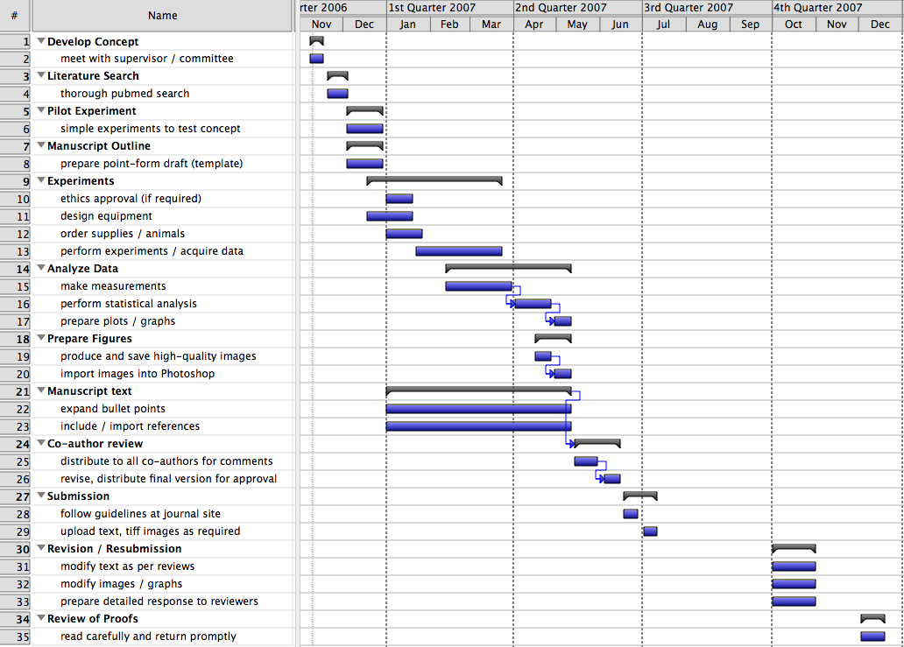
13) Summary of time-line

