Slide 1

Historical events and conceptual change in 18th century England
A case study of the Act of Union (1707)
Joseph Flanagan, Wen Guo, Sonja Korkiakoski, Syed Mahmood, Tanja Säily, Olli O. Silvennoinen, Jukka Suomela

Slide 2
Our research question
Did the Act of Union change the way people talked about Scotland and the British Isles (and, presumably, thought about Scotland and the British Isles)?

Slide 3
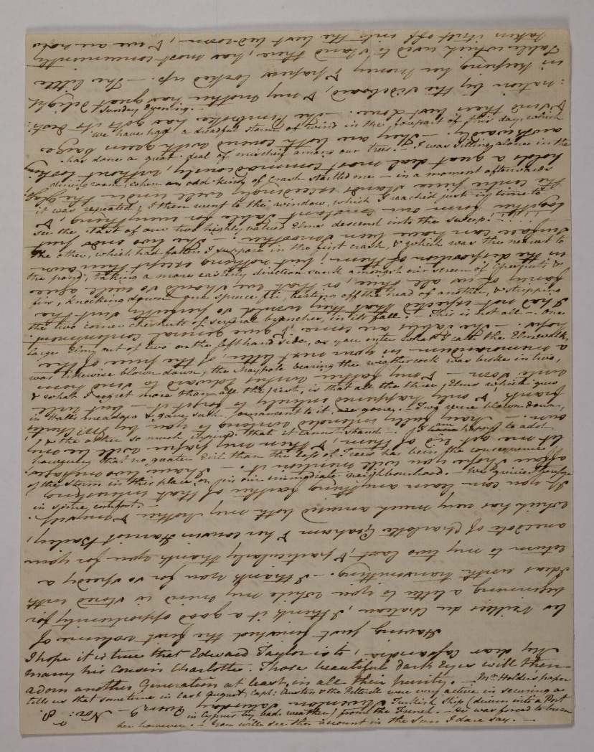
Corpus of Early English Correspondence (CEEC)
Letters from 1400—1800, c. 4 million words
Our research is based on the years 1680—1800
2,216,119 words
4,945 letters
315 writers
Letters selected from printed editions, aimed at sociolinguistic studies
Metadata (gender, social rank, domicile…)
Coverage

Slide 4
Data
Subset of letters that specifically mentioned Scotland

Slide 5
Initial problem
How to find letters that mention Scotland from 4,945 letters?

Slide 6
Challenges with the data
Cleaning up the data so that one can use standard tools to study it
Robustness against outliers

Slide 7
Computational techniques
Count the number of letters (not e.g. the number of words) — single outlier letter is harmless
Calculate how much the results would change if we excluded any single sender or any single letter collection, and show this in the plots, too

Slide 8
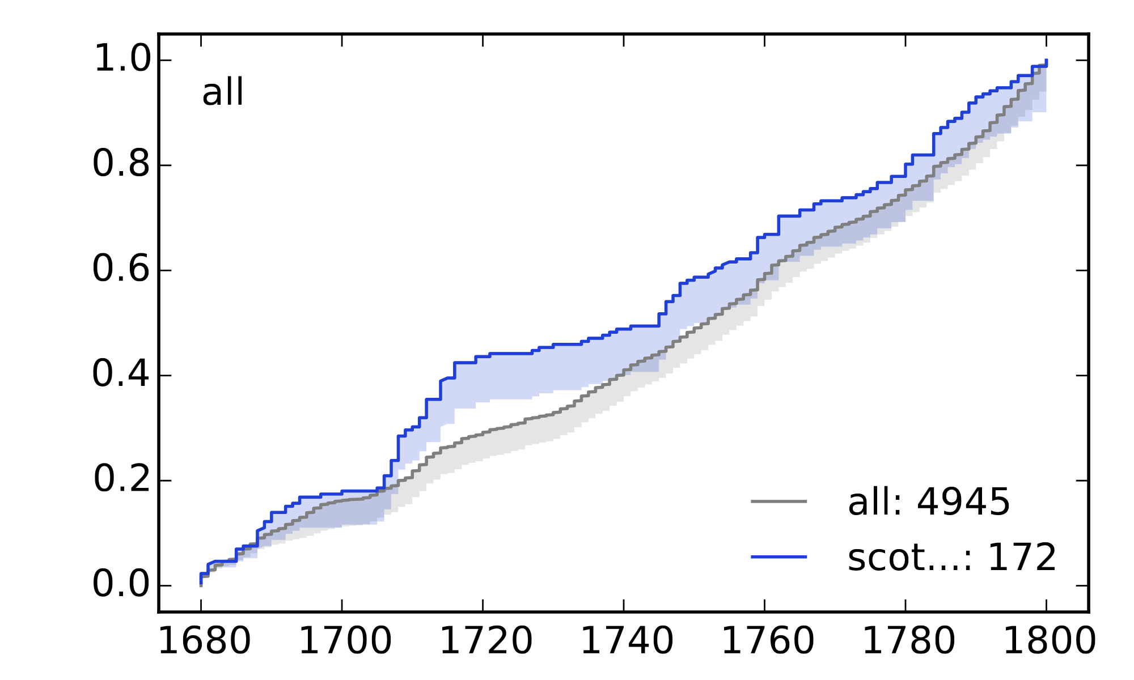
All letters that contain the word Scotland/Scottish/Scot…

Slide 9
Scotland in 1700—1719 vs. 1720—1739 (letters)

Slide 10
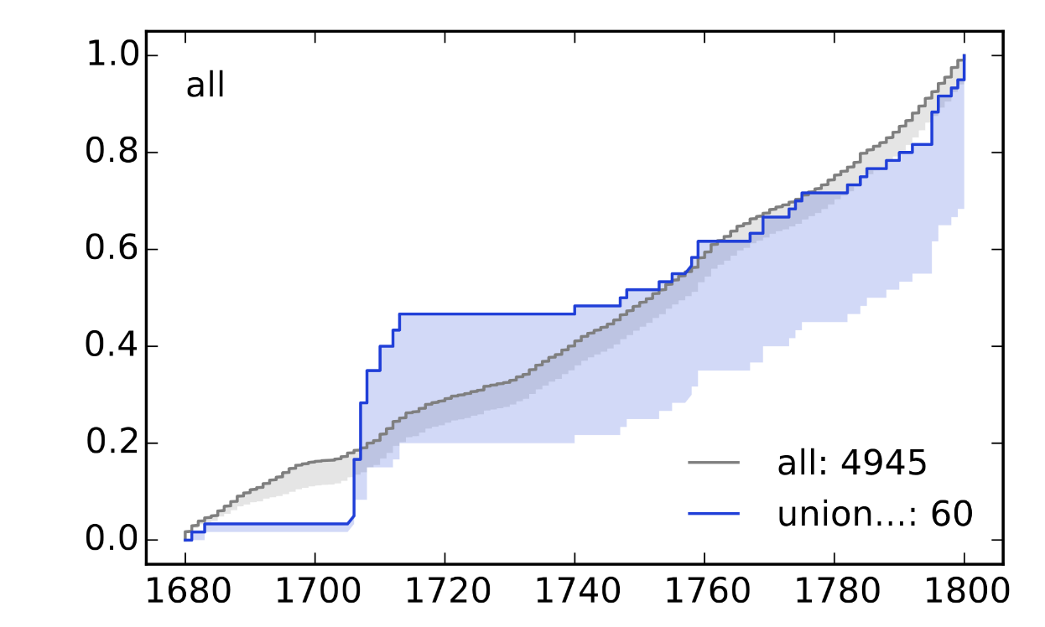
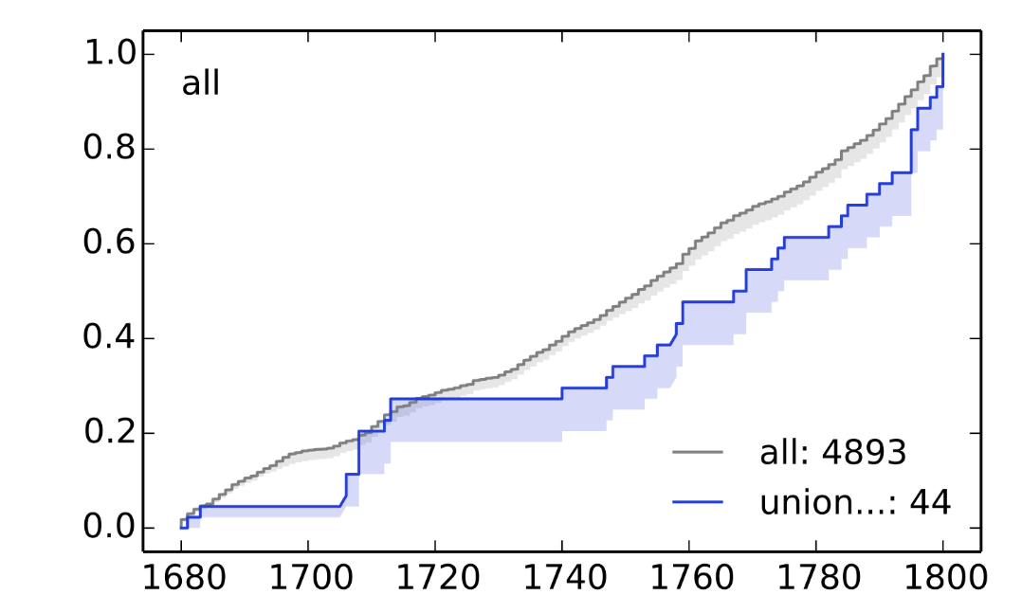
Close reading of selected letters
Close reading of 32 letters sent between 1680-1800
Keywords ”England” and ”Scotland
Neutral references to both countries
Interesting example: Daniel Defoe and Act of Union

Slide 11
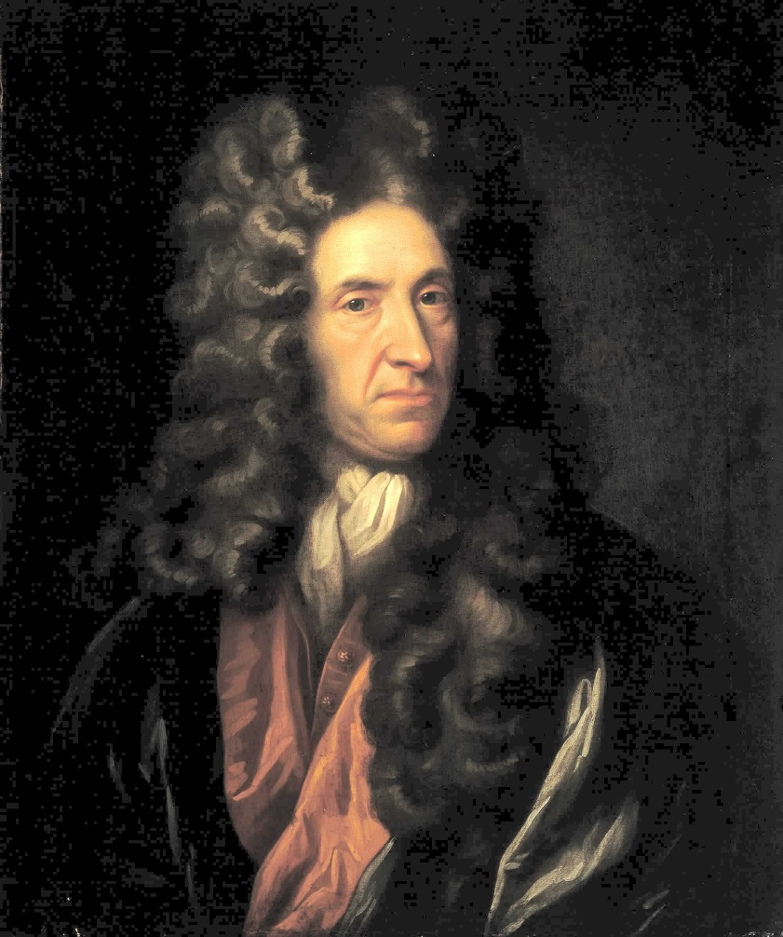
Daniel Defoe, in a letter to Robert Harley, 24 October 1706
I had not been Long There but I heard a Great Noise and looking Out Saw a Terrible Multitude Come up the High street with A Drum at the head of Them shouting and swearing and Cryeing Out all scotland would stand together, No Union, No Union, English Dogs, and the like.

Slide 12
Avenues for future research
Construct a corpus specifically focused on Scotland
More advanced search techniques than searching for Scot*
More advanced statistical techniques
Other historical events?

Slide 13
Shiny app
https://jflanagan.shinyapps.io/shiny/

