Slide 1
18th-century letters
In the Corpora of Early English Correspondence (CEEC)
Tanja Säily, VARIENG

Slide 2
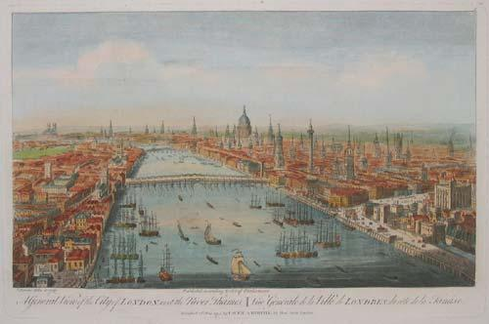
18th-century England
Long 18th century: Glorious Revolution, 1688
James II (Catholic) → William III (Dutch Protestant) & Mary II
Later Anne, then Georgian era (George I–IV, Hanoverian)
Crucial division in society: gentry vs. non-gentry
Blurred lines: wealthy merchants, sons of great manufacturers
Education more widely available than before, still stratified
Universities for high-ranking men only, women educated at home
Language codified & standardised (grammars, etc.)

Slide 3
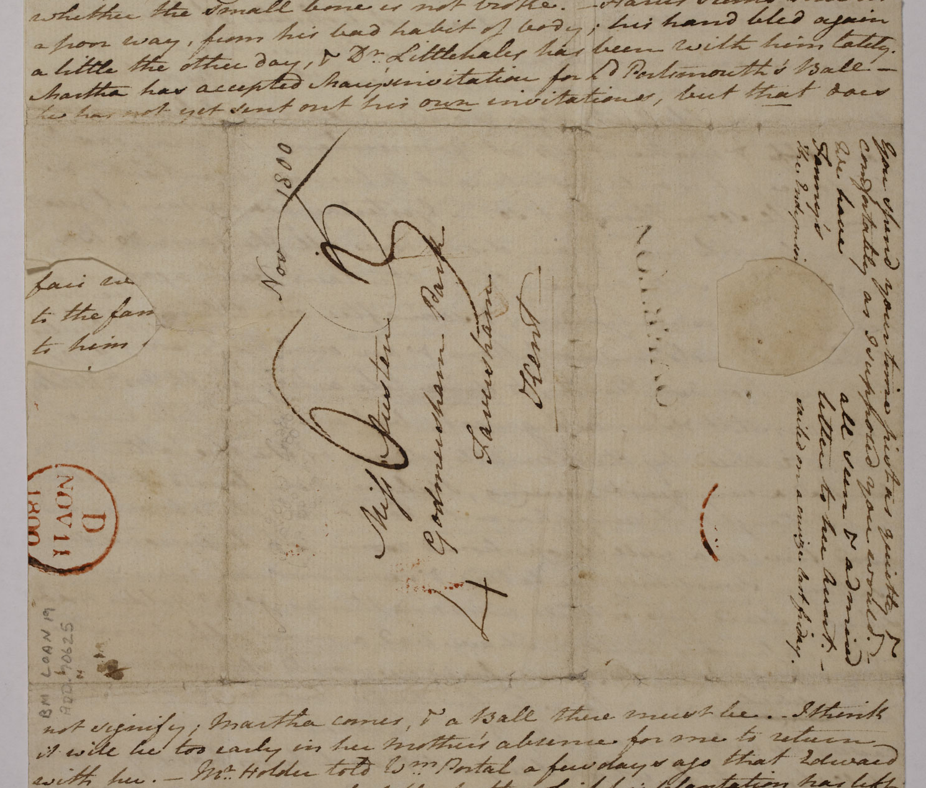
Personal letters as data
Identifiable writer & recipient
Communication across distance & time
“Speech-like”, can be used to study language change
Specific form
Opening & closing formulae
Dates, endorsements for carrier
Functions
Communication of information
Maintaining social relations
© British Library

Slide 4
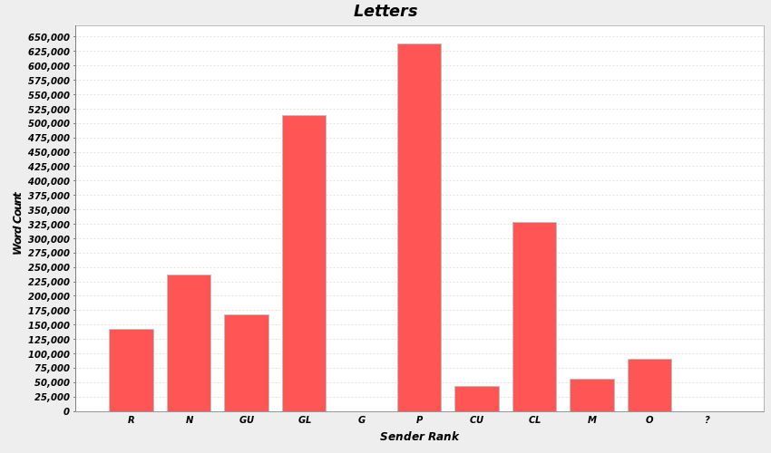
CEEC, 1680–1800
Based on printed editions
Letters selected & digitised by team at VARIENG
Compiled for historical sociolinguistics → extensive metadata on correspondents & letters
2,216,119 words; 4,945 letters; 315 writers

Slide 5
Metadata: Person
PersonCode: JCLIFT
Last Name: Clift
First Name: John
Sex: M
Lifespan: 1759–1819
Place of Birth: O
Region: O
County: CON
Migration Code: N/A
Migration Notes: Born at Glynn, near Cardinham, Cornwall; Burcombe Mill, Bodmin; Pencarrow, Cornwall –1819
Rank: O
Social Mobility: N
Title/Occupation: Steward
Education Code: A
Education Notes: Apprenticed to carpentry and building; no record of formal education; perhaps some elementary schooling
Father’s Rank: O
Father: Robert Clift (1720–1784), a miller
Notes: John was apprenticed to carpentry and building, and became a general foreman or steward for the Molesworths at Pencarrow
(Career, Link to DNB: N/A)

Slide 6
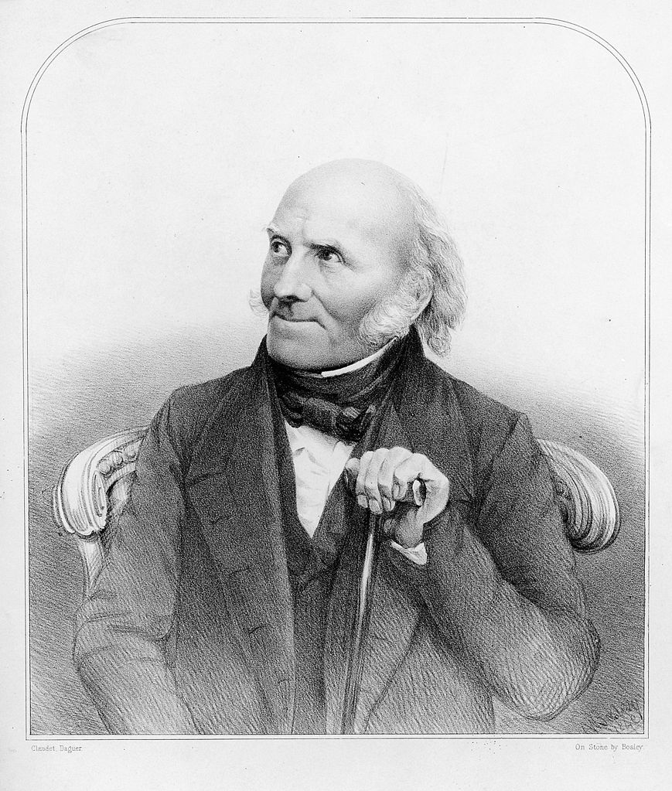
Metadata: Letter
LetterID: CLIFT_055
Date: 8 January 1798
Place: Pencarrow
Sender’s ID: JCLIFT
Last Name: Clift
First Name: John
Sender’s Rank: O
Sender’s Status: non-gentry; general foreman/steward
Source: The Clift Family Correspondence 1792–1846. Ed. by Frances Austin. Centre for English Cultural Tradition & Language. The University of Sheffield. 1991.
Page Number: 168
Words: 590
Content Type: family matters
Authenticity: A
Recipient’s ID: WCLIFT
Last Name: Clift
First Name: William
Recipient’s Rank: P
Recipient’s Status: professional; conservator of the Hunterian Museum
RelCode: FN
Relationship: brothers
Address Formula: Y
Closing Formula: Y
© Wellcome Library

Slide 7
EXAMPLE: has vs. hath (Nevalainen, forthcoming)
Our Tommy has had a grievous Cof and feavor, yr sister Frank has dun more for him then I could have thought …
(Sir Thomas Browne to his daughter Mrs. Lyttelton, 6 June 1681; Browne, p. 194)
Cousin peggy Bate is married to a Soldier and is sent abroad she hath had a Child and hath been home with her parents for some time …
(John Clift to his brother William Clift, 8 January 1798; Clift, p. 168)

Slide 8
Standardised-spelling version
Before (original):
Dear Brother this Comes with my Cind Love to you hoping it will find you in Good health as this Leves me at Preasent I bless the All Mighty for it Dear Brother I receved your welcom Letter a Goodfriday an I am happy to hear that there is some hopes of an alteration wich I hope will be for youre betterment
(Elizabeth Clift to her brother William Clift, 16 April 1796; Clift, p. 130)
After automatic standardisation:
Dear Brother this Comes with my Kind Love to you hoping it will find you in Good health as this Leves me at Present I bless the All Mighty for it Dear Brother I received your welcome Letter a Goodfriday an I am happy to hear that there is some hopes of an alteration which I hope will be for your betterment

Slide 9
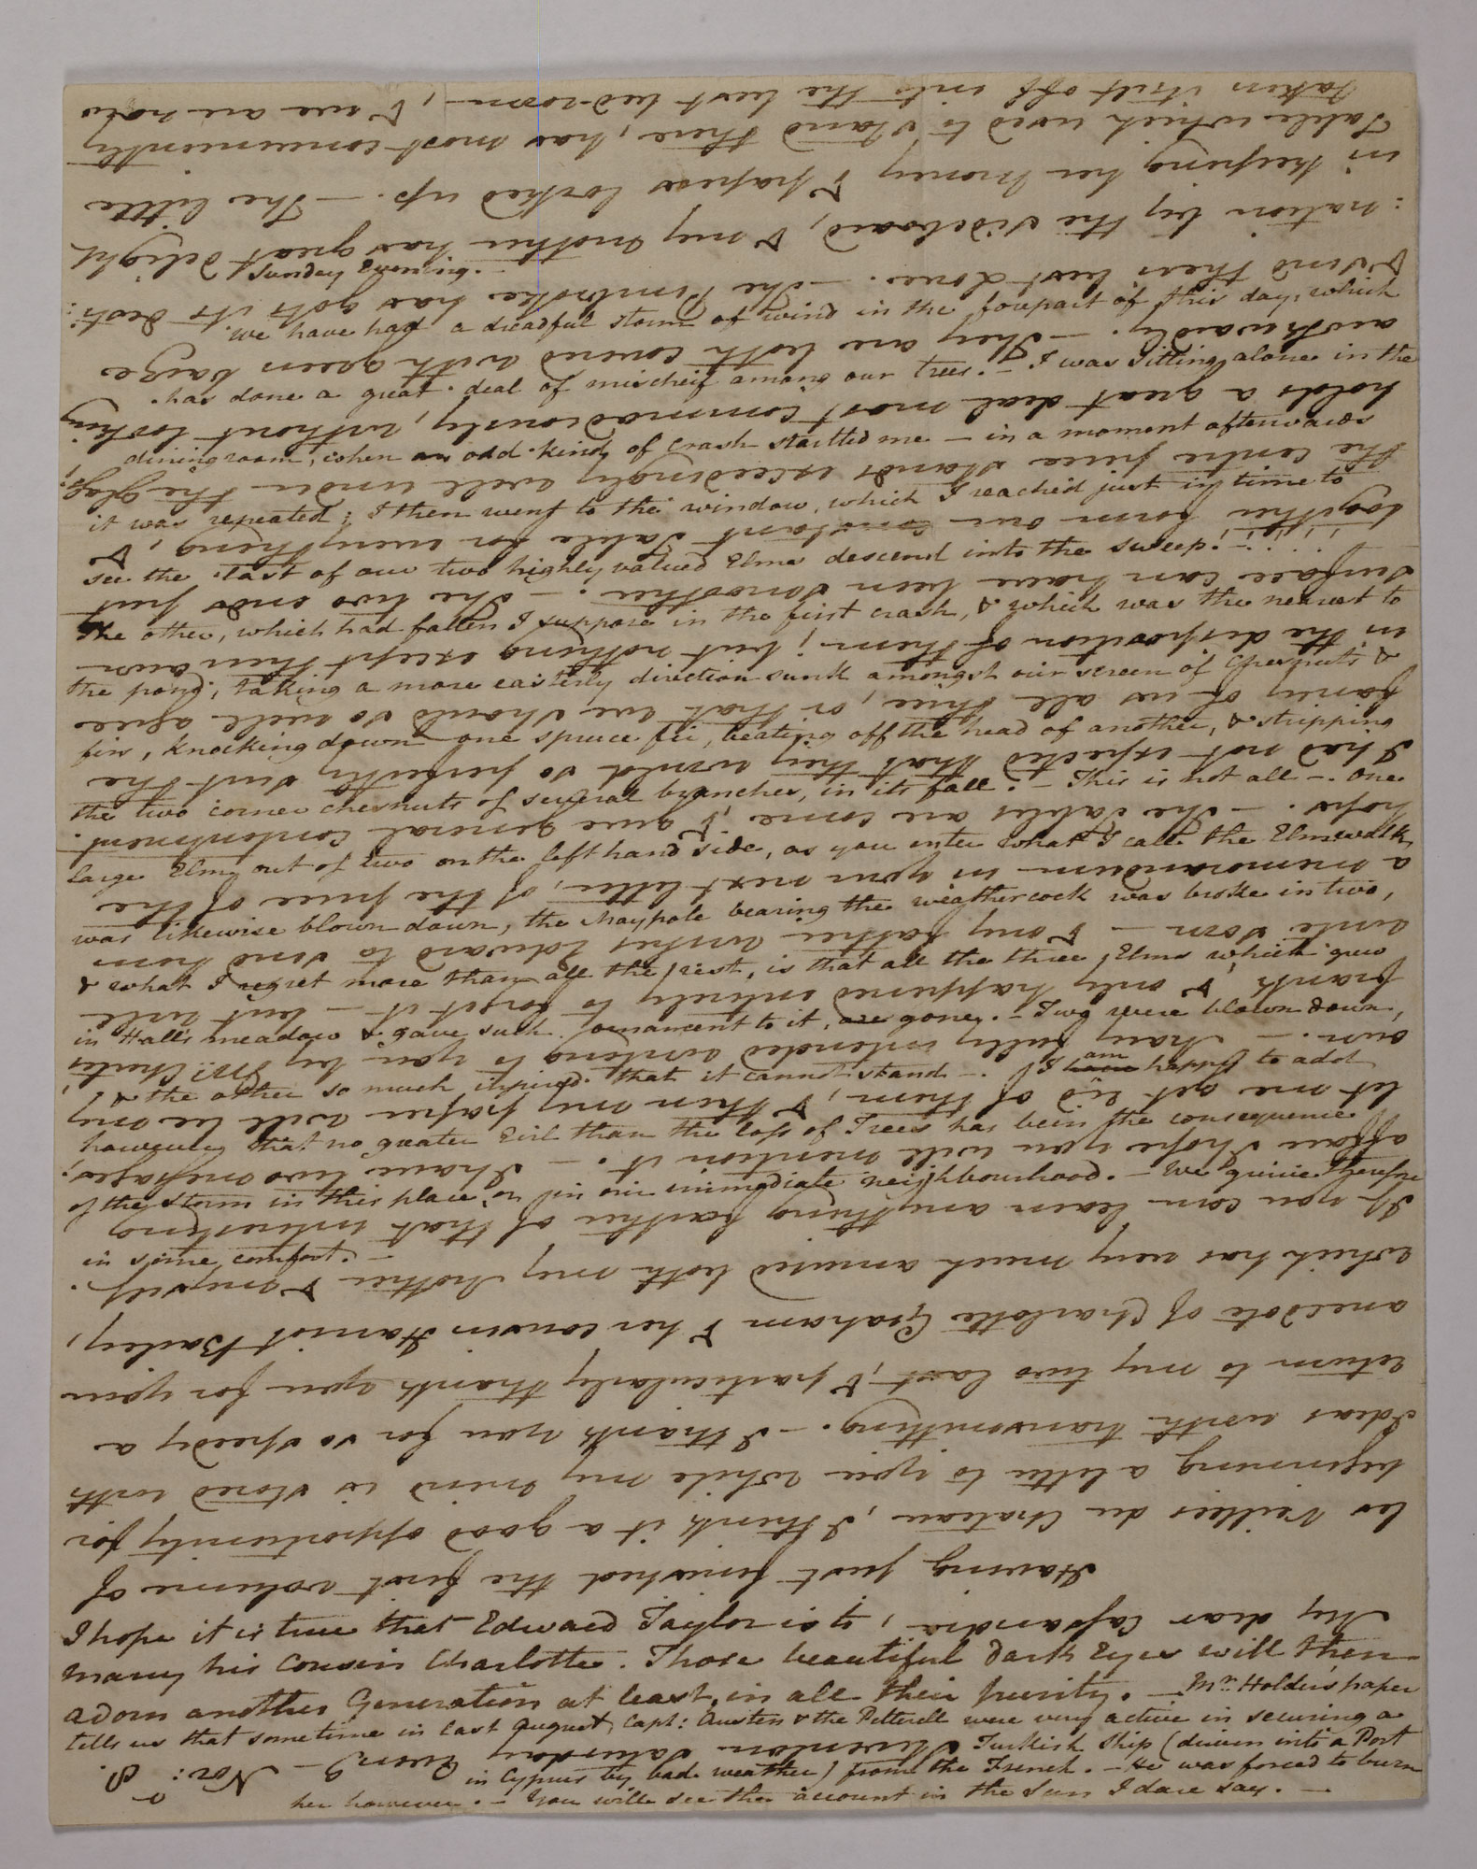
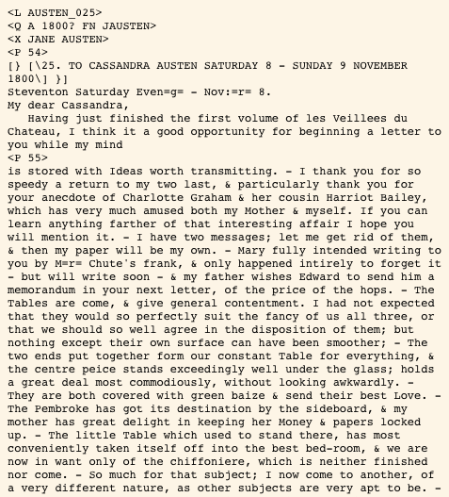
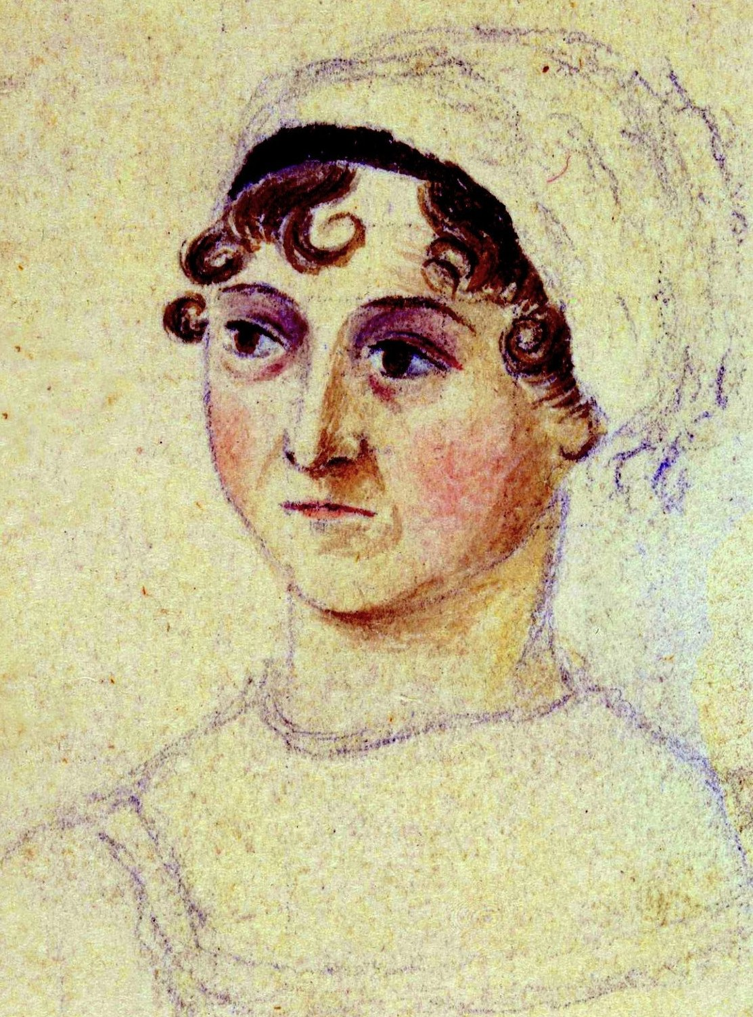
CONCLUSION
CEEC: Compiled for the study of language change in its social contexts but could be used for other purposes as well (e.g. history, culture, literature)
2.2 million words of authentic 18th-century communication representing a wide social spectrum and a variety of topics
Complete CEEC: 5 million words, 1400–1800
Extensive metadata gives a comprehensive picture of the correspondents and their letters
helsinki.fi/varieng/CoRD/corpora/CEEC/

