Slide 1
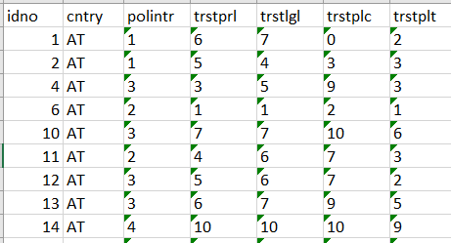
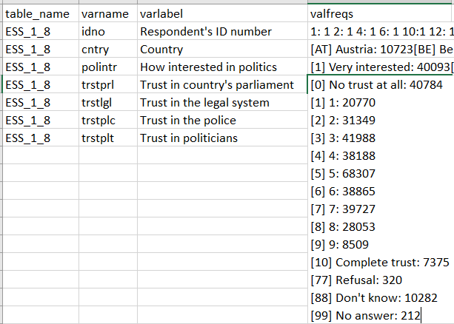
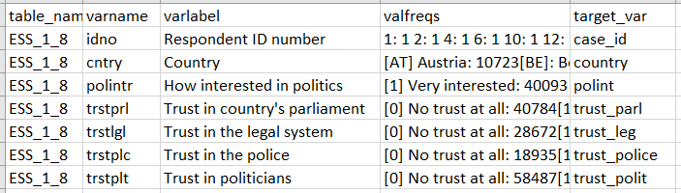
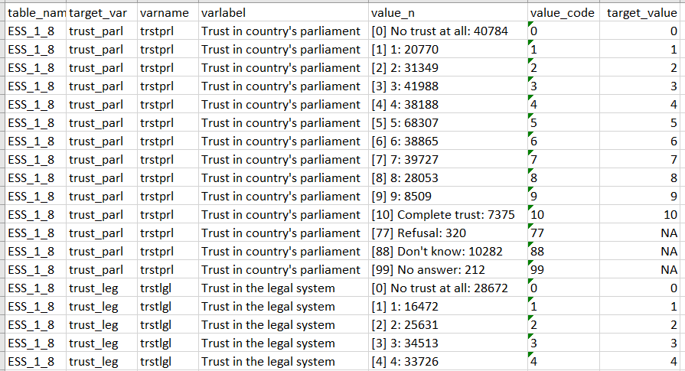
1. Data in the data file
Variables
2a. Codebook
2b. Codebook with variable mapping
3. Crosswalk of the source-to-target values mapping
Harmonization:
mapping of
source values
into
target values

Slide 2
