Slide 1
The Top 7 Ethical Dilemmas reported by IT in 2016
Mostly captured from the following 2 discussions:
https://medium.freecodecamp.com/the-code-im-still-ashamed-of-e4c021dff55e#.l94l11o96 http://www.iflscience.com/technology/programmers-are-having-a-huge-discussion-about-the-unethical-and-illegal-things-theyve-been-asked-to-do/all/

Slide 2
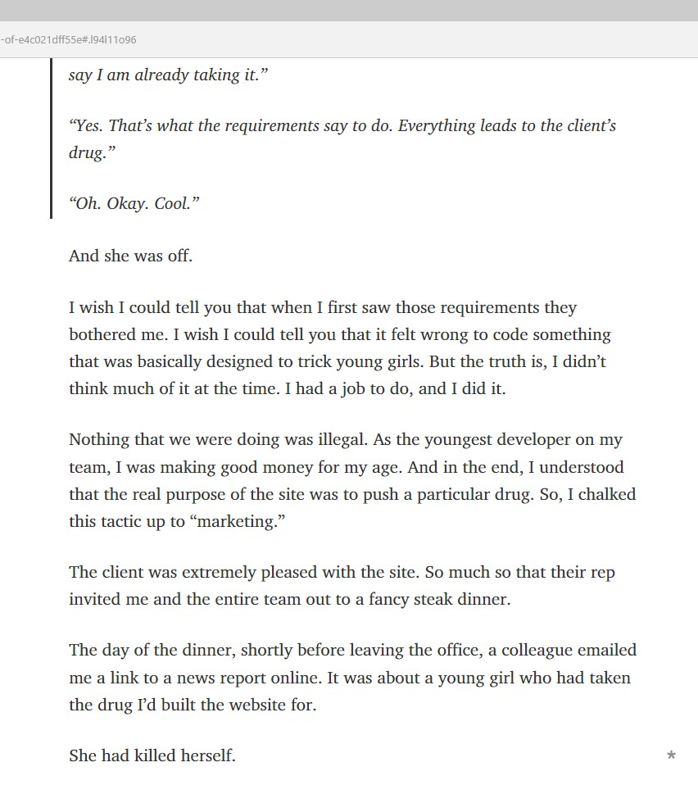
1. Girl kills herself taking drug that website recommened
The clients’ requirements asked that the website always recommend their drug (unless you were allergic or already taking it).
The programmer that built the website just followed instructions. But Bill Sourour blogged that this is “the code I’m still ashamed of”.
If you want to think about this one some more, see my post:
Who tells you what to do?
http://www.itworldcanada.com/blog/who-tells-you-what-to-do/375646

Slide 3
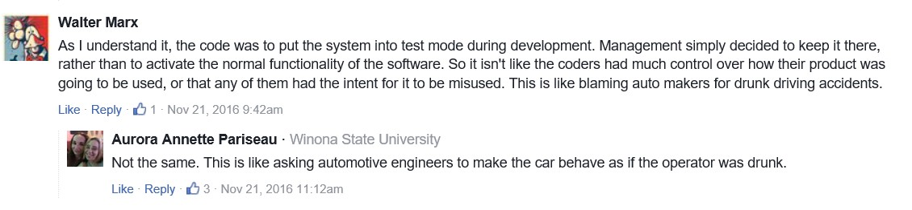
2. VW emissions cheating scandal Code changed the engine tuning when there was a test going on. It gave false results for emissions tests.
Discussions / comments above may be about VW.
If you want to see more VW discussion, see my blog:
VW Software puts all IT under suspicion
http://www.itworldcanada.com/blog/vw-software-puts-all-it-under-suspicion/377398

Slide 4
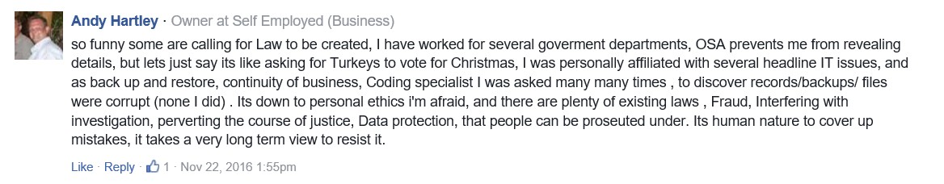
3. Asked to lose files needed in investigation As part of headline IT issues the backups were needed to find out what happened. Andy was asked to say those files were corrupt/ unavailable.
If you want to think about the responsibilities of our data custodians some more, see my blog:
Are you hoarding data?
http://www.itworldcanada.com/blog/are-you-hoarding-data/97516

Slide 5
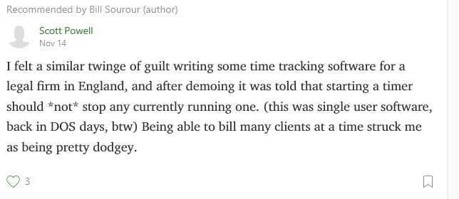
y
Legal firm bills 2 clients for same elapsed time
Scott was asked to make the time tracking software allow the lawyer to keep the timer running.
If you feel a “twinge of gulit” you have an ethical dilemma. Check out my blog for what to do:
How to handle an ethical dilemma
http://www.itworldcanada.com/blog/how-to-handle-an-ethical-dilemma/95000

Slide 6
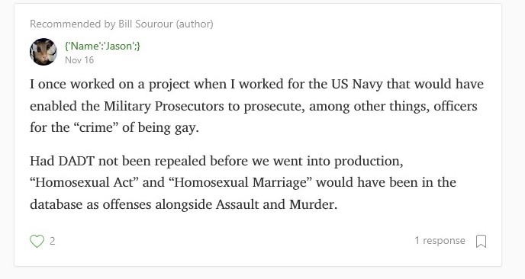
5. Database lists crime of being gay Coder was glad rules were repealed before production date.
I blogged about how IT must not discriminate. With the unlikely title of:
How Sci Fi teaches ethics
http://www.itworldcanada.com/blog/how-sci-fi-teaches-it-ethics/99799

Slide 7
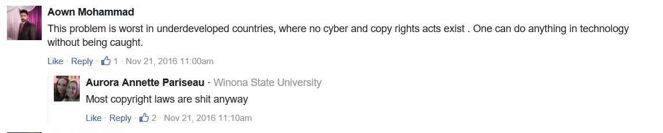
6. Underdeveloped countries’ copyright The law does not always enforce fairness.
If you want more thoughts about copyright, read my blog:
Songvids and copyright
http://www.itworldcanada.com/blog/songvids-and-copyright/96089

Slide 8
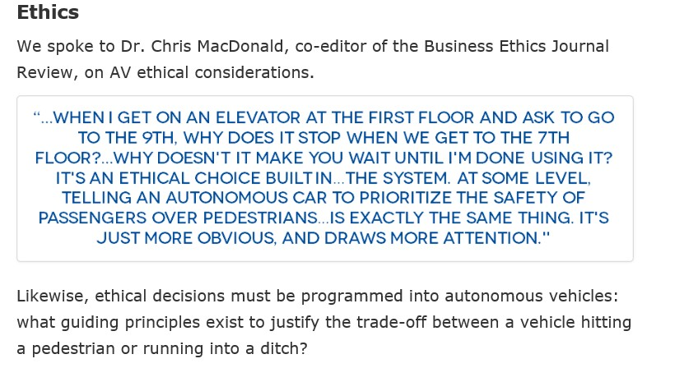
7. Ryerson Students predict ethics problems with Autonomous Vehicles (AV)
As part of a contest the students submitted a paper that included ethical considerations. Should the passengers or the pedestrians be the priority?
I am very encouraged by the awareness of this new generation. See their whole paper titled “A bump in the road” at:
http://www.itbusiness.ca/blog/a-bump-in-the-road-can-autonomous-vehicles-do-more-harm-than-good/83634

