Slide 1
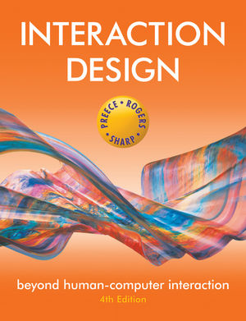
Chapter 1
WHAT IS INTERACTION DESIGN?

Slide 2
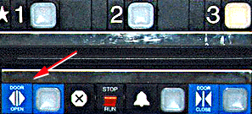
Bad designs
Elevator controls and labels on the bottom row all look the same, so it is easy to push a label by mistake instead of a control button
People do not make same mistake for the labels and buttons on the top row. Why not?
www.baddesigns.com

Slide 3
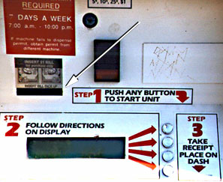
Why is this vending machine so bad?
Need to push button first to activate reader
Normally insert bill first before making selection
Contravenes well known convention
www.baddesigns.com
3

Slide 4
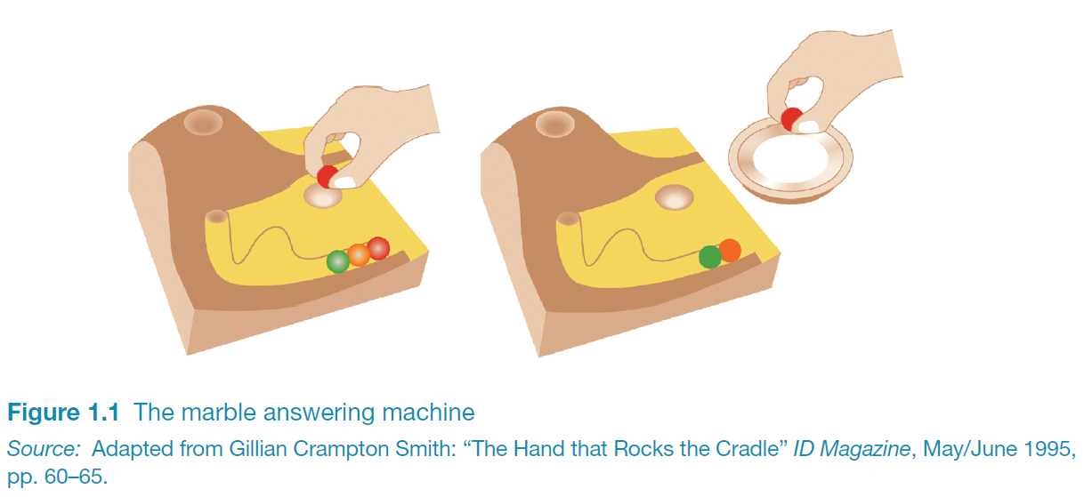
Good design
Marble answering machine (Bishop, 1995)
Based on how everyday objects behave
Easy, intuitive and a pleasure to use
Only requires one-step actions to perform core tasks
4

Slide 5
Good and bad design
Why is the TiVo remote so much better designed than standard remote controls?
Peanut shaped to fit in hand
Logical layout and color-coded, distinctive buttons
Easy to locate buttons
See:
http://gizmodo.com/5017972/story-of-a-peanut-the-tivo-remotes-untold-past-present-and-future
5

Slide 6
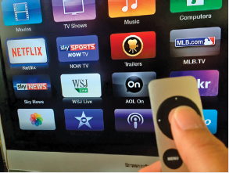
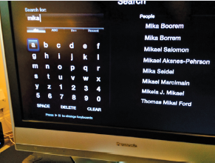
Dilemma
Which is the best way to interact with a smart TV?
Standard remote device?
Apple slimline remote control?
Minnum’s new keyboard?
http://minuum.com

Slide 7
What to design
Need to take into account:
Who the users are
What activities are being carried out
Where the interaction is taking place
Need to optimize the interactions users have with a product:
So that they match the users’ activities and needs

Slide 8
Understanding users’ needs
Need to take into account what people are good and bad at
Consider what might help people in the way they currently do things
Think through what might provide quality user experiences
Listen to what people want and get them involved
Use tried and tested user-centered methods

Slide 9
What is interaction design?
“Designing interactive products to support the way people communicate and interact in their everyday and working lives.”
Preece, Sharp and Rogers (2015)
“The design of spaces for human communication and interaction.”
Winograd (1997)

Slide 10
Goals of interaction design
Develop usable products
Usability means easy to learn, effective to use and provide an enjoyable experience
Involve users in the design process

Slide 11
Which kind of design?
Number of other terms used emphasizing what is being designed, e.g.
user interface design, software design, user-centered design, product design, web design, experience design (UX)
Interaction design is the umbrella term covering all of these aspects
fundamental to all disciplines, fields, and approaches concerned with researching and designing computer-based systems for people

Slide 12
HCI and interaction design

Slide 13
Relationship between ID, HCI and other fields
Academic disciplines contributing to ID:
Psychology
Social Sciences
Computing Sciences
Engineering
Ergonomics
Informatics

Slide 14
Relationship between ID, HCI and other fields
Design practices contributing to ID:
Graphic design
Product design
Artist-design
Industrial design
Film industry

Slide 15
Relationship between ID, HCI and other fields
Interdisciplinary fields that ‘do’ interaction design:
HCI
Ubiquitous Computing
Human Factors
Cognitive Engineering
Cognitive Ergonomics
Computer Supported Co-operative Work
Information Systems

Slide 16
Working in multidisciplinary teams
Many people from different backgrounds involved
Different perspectives and ways of seeing and talking about things
Benefits
more ideas and designs generated
Disadvantages
difficult to communicate and progress forward the designs being create

Slide 17
Interaction design in business
Increasing number of ID consultancies, examples of well known ones include:
Nielsen Norman Group: “help companies enter the age of the consumer, designing human-centered products and services”
Cooper: “From research and product to goal-related design”
Swim: “provides a wide range of design services, in each case targeted to address the product development needs at hand”
IDEO: “creates products, services and environments for companies pioneering new ways to provide value to their customers”

Slide 18
What do professionals do in the ID business?
interaction designers - people involved in the design of all the interactive aspects of a product
usability engineers - people who focus on evaluating products, using usability methods and principles
web designers - people who develop and create the visual design of websites, such as layouts
information architects - people who come up with ideas of how to plan and structure interactive products
user experience designers (UX) - people who do all the above but who may also carry out field studies to inform the design of products

Slide 19
The User Experience
How a product behaves and is used by people in the real world
the way people feel about it and their pleasure and satisfaction when using it, looking at it, holding it, and opening or closing it
“every product that is used by someone has a user experience: newspapers, ketchup bottles, reclining armchairs, cardigan sweaters.” (Garrett, 2010)
“all aspects of the end-user's interaction with the company, its services, and its products. (Nielsen and Norman, 2014)
Cannot design a user experience, only design for a user experience

Slide 20
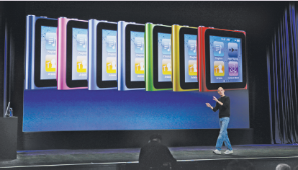

Why was the iPod user experience such a success?
Quality user experience from the start
Simple, elegant, distinct brand, pleasurable, must have fashion item, catchy names, cool, etc.

Slide 21
What is involved in the process of interaction design
Establishing requirements
Developing alternatives
Prototyping
Evaluating

Slide 22
Core characteristics of interaction design
Users should be involved through the development of the project
Specific usability and user experience goals need to be identified, clearly documented and agreed at the beginning of the project
Iteration is needed through the core activities

Slide 23
Why go to this length?
Help designers:
understand how to design interactive products that fit with what people want, need and may desire
appreciate that one size does not fit all
e.g., teenagers are very different to grown-ups
identify any incorrect assumptions they may have about particular user groups
e.g., not all old people want or need big fonts
be aware of both people’s sensitivities and their capabilities

Slide 24
Are cultural differences important?
5/21/2015 versus 21/5/2015?
Which should be used for international services and online forms?
Why is it that certain products, like the iPod, are universally accepted by people from all parts of the world whereas websites are reacted to differently by people from different cultures?

Slide 25
Accessibility
Degree to which a product is usable and accessible by as many people as possible
Focus on disability:
Have a mental or physical impairment
This has an adverse affect on their everyday lives
It is long term

Slide 26

Anna, IKEA online sales agent
Designed to be different for UK and US customers
What are the differences and which is which?
What should Anna’s appearance be like for other countries, like India, South Africa, or China?

Slide 27
Usability goals
Effective to use
Efficient to use
Safe to use
Have good utility
Easy to learn
Easy to remember how to use

Slide 28
User experience goals
Desirable aspects
satisfying helpful fun
enjoyable motivating provocative
engaging challenging surprising
pleasurable enhancing sociability rewarding
exciting supporting creativity emotionally fulfilling
entertaining cognitively stimulating
Undesirable aspects
boring unpleasant
frustrating patronizing
making one feel guilty making one feel stupid
annoying cutesy
childish gimmicky

Slide 29
Usability and user experience goals
Selecting terms to convey a person’s feelings, emotions, etc., can help designers understand the multifaceted nature of the user experience
How do usability goals differ from user experience goals?
Are there trade-offs between the two kinds of goals?
e.g. can a product be both fun and safe?
How easy is it to measure usability versus user experience goals?

Slide 30
Design principles
Generalizable abstractions for thinking about different aspects of design
The do’s and don'ts of interaction design
What to provide and what not to provide at the interface
Derived from a mix of theory-based knowledge, experience and common-sense

Slide 31

Visibility
• This is a control panel for an elevator
• How does it work?
• Push a button for the floor you want?
• Nothing happens. Push any other button? Still nothing. What do you need to do?
It is not visible as to what to do!
www.baddesigns.com

Slide 32
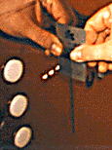
Visibility
…you need to insert your room card in the slot by the buttons to get the elevator to work!
How would you make this action more visible?
• make the card reader more obvious
• provide an auditory message, that says what to do (which language?)
• provide a big label next to the card reader that flashes when someone enters
• make relevant parts visible
• make what has to be done obvious
www.baddesigns.com

Slide 33

What do I do if I am wearing black?
Invisible automatic controls can make it more difficult to use

Slide 34
Feedback
Sending information back to the user about what has been done
Includes sound, highlighting, animation and combinations of these
e.g. when screen button clicked on provides sound or red highlight feedback:
“ccclichhk”

Slide 35
Constraints
Restricting the possible actions that can be performed
Helps prevent user from selecting incorrect options
Physical objects can be designed to constrain things
e.g. only one way you can insert a key into a lock

Slide 36
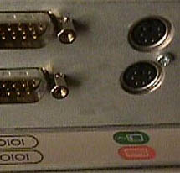
Logical or ambiguous design?
Where do you plug the mouse?
Where do you plug the keyboard?
top or bottom connector?
Do the color coded icons help?
www.baddesigns.com
36

Slide 37


How to design them more logically
(i) A provides direct adjacent mapping between icon and connector
(ii) B provides color coding to associate the connectors with the labels
www.baddesigns.com
www.baddesigns.com
37

Slide 38
Consistency
Design interfaces to have similar operations and use similar elements for similar tasks
For example:
always use ctrl key plus first initial of the command for an operation – ctrl+C, ctrl+S, ctrl+O
Main benefit is consistent interfaces are easier to learn and use

Slide 39
When consistency breaks down
What happens if there is more than one command starting with the same letter?
e.g. save, spelling, select, style
Have to find other initials or combinations of keys, thereby breaking the consistency rule
e.g. ctrl+S, ctrl+Sp, ctrl+shift+L
Increases learning burden on user, making them more prone to errors

Slide 40
Internal and external consistency
Internal consistency refers to designing operations to behave the same within an application
Difficult to achieve with complex interfaces
External consistency refers to designing operations, interfaces, etc., to be the same across applications and devices
Very rarely the case, based on different designer’s preference

Slide 41
Keypad numbers layout
A case of external inconsistency
(a) phones, remote controls
(b) calculators, computer keypads
1
2
3
7
8
9
4
5
6
4
5
6
7
8
9
1
2
3
0
0

Slide 42
Affordances: to give a clue
Refers to an attribute of an object that allows people to know how to use it
e.g. a mouse button invites pushing, a door handle affords pulling
Norman (1988) used the term to discuss the design of everyday objects
Since has been much popularised in interaction design to discuss how to design interface objects
e.g. scrollbars to afford moving up and down, icons to afford clicking on

Slide 43
What does ‘affordance’ have to offer interaction design?
Interfaces are virtual and do not have affordances like physical objects
Norman argues it does not make sense to talk about interfaces in terms of ‘real’ affordances
Instead interfaces are better conceptualized as ‘perceived’ affordances
Learned conventions of arbitrary mappings between action and effect at the interface
Some mappings are better than others

Slide 44
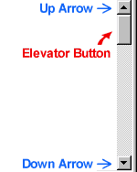


Activity
Virtual affordances
How do the following screen objects afford?
What if you were a novice user?
Would you know what to do with them?

Slide 45
Key points
Interaction design is concerned with designing interactive products to support the way people communicate and interact in their everyday and working lives
It is concerned with how to create quality user experiences
It requires taking into account a number of interdependent factors, including context of use, type of activities, cultural differences, and user groups
It is multidisciplinary, involving many inputs from wide-reaching disciplines and fields

