Slide 1
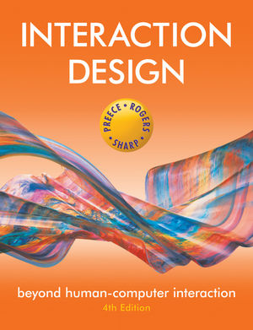
Chapter 6 INTERFACES

Slide 2
Overview
Interface types
highlight the main design and research issues for each of the different interfaces
Consider which interface is best for a given application or activity
Notes:
2

Slide 3
1. Command-based
Commands such as abbreviations (e.g. ls) typed in at the prompt to which the system responds (e.g. listing current files)
Some are hard wired at keyboard, others can be assigned to keys
Efficient, precise, and fast
Large overhead to learning set of commands
Notes:
3

Slide 4
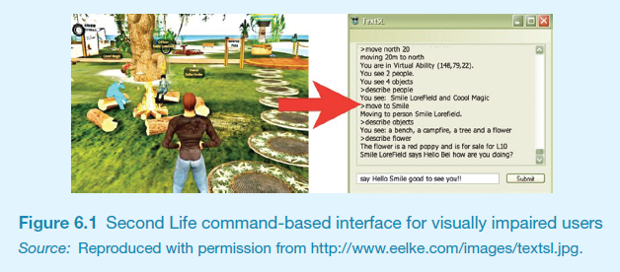
Second Life command-based interface for visually impaired users

Slide 5
Research and design issues
Form, name types and structure are key research questions
Consistency is most important design principle
e.g. always use first letter of command
Command interfaces popular for web scripting
Notes:
5

Slide 6
2. WIMP and GUI
Xerox Star first WIMP -> rise to GUIs
Windows
could be scrolled, stretched, overlapped, opened, closed, and moved around the screen using the mouse
Icons
represented applications, objects, commands, and tools that were opened when clicked on
Menus
offering lists of options that could be scrolled through and selected
Pointing device
a mouse controlling the cursor as a point of entry to the windows, menus, and icons on the screen
Notes:
6

Slide 7
GUIs
Same basic building blocks as WIMPs but more varied
Color, 3D, sound, animation,
Many types of menus, icons, windows
New graphical elements, e.g.
toolbars, docks, rollovers
Challenge now is to design GUIs that are best suited for tablet, smartphone and smartwatch interfaces
Notes:
7

Slide 8
Windows
Windows were invented to overcome physical constraints of a computer display
enable more information to be viewed and tasks to be performed
Scroll bars within windows also enable more information to be viewed
Multiple windows can make it difficult to find desired one
listing, iconising, shrinking are techniques that help
Notes:
8

Slide 9
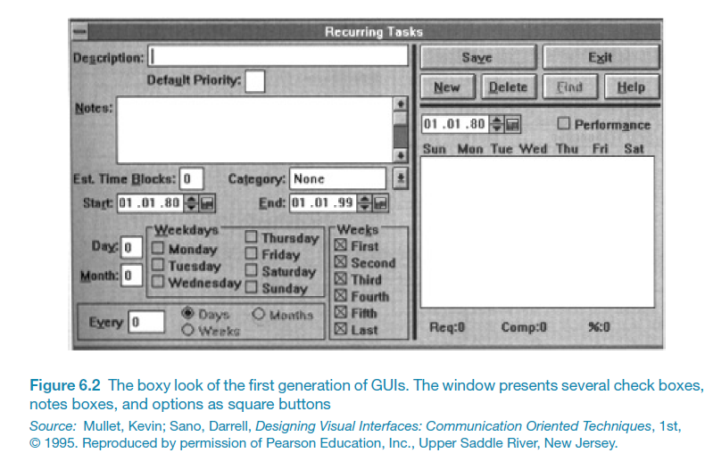

Slide 10
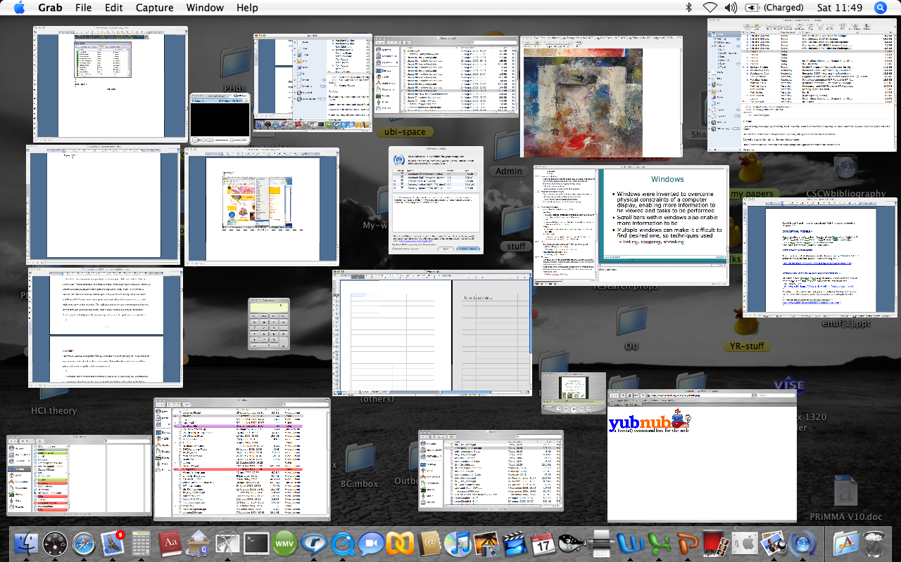
Apple’s shrinking windows
Notes:
10

Slide 11
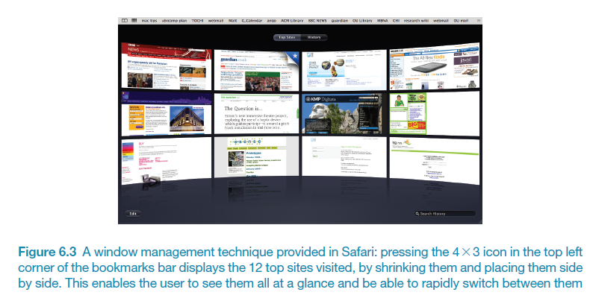
Safari panorama window view

Slide 12
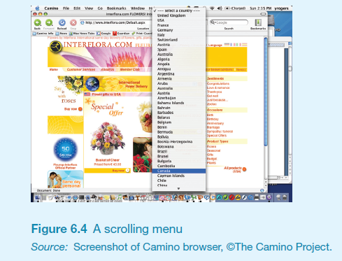
Selecting a country from a scrolling window
Notes:
12

Slide 13
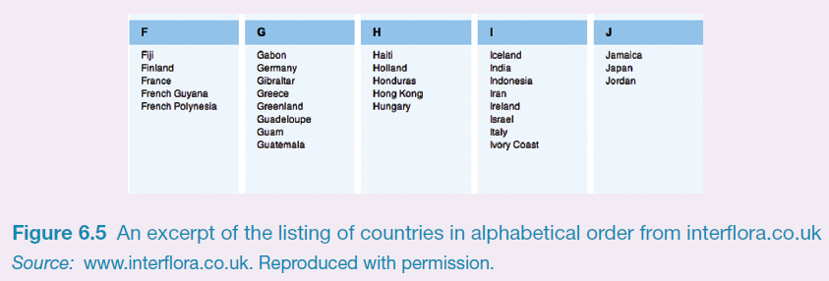
Is this method any better?
Notes:
13

Slide 14
Research and design issues
Window management
enables users to move fluidly between different windows (and monitors)
How to switch attention between windows without getting distracted
Design principles of spacing, grouping, and simplicity should be used
Notes:
14

Slide 15
Menus
A number of menu interface styles
flat lists, drop-down, pop-up, contextual, and expanding ones, e.g., scrolling and cascading
Flat menus
good at displaying a small number of options at the same time and where the size of the display is small, e.g. iPods
but have to nest the lists of options within each other, requiring several steps to get to the list with the desired option
moving through previous screens can be tedious
Notes:
15

Slide 16
Expanding menus
Enables more options to be shown on a single screen than is possible with a single flat menu
More flexible navigation, allowing for selection of options to be done in the same window
Most popular are cascading ones
primary, secondary and even tertiary menus
downside is that they require precise mouse control
can result in overshooting or selecting wrong options
Notes:
16

Slide 17
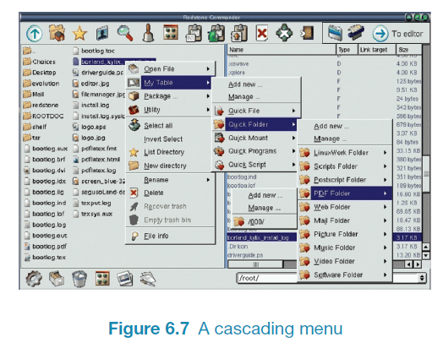
Cascading menu
Notes:
17

Slide 18
Contextual menus
Provide access to often-used commands that make sense in the context of a current task
Appear when the user presses the Control key while clicking on an interface element
e.g., clicking on a photo in a website together with holding down the Control key results in options ‘open it in a new window,’ ‘save it,’ or ‘copy it’
Helps overcome some of the navigation problems associated with cascading menus
Notes:
18

Slide 19
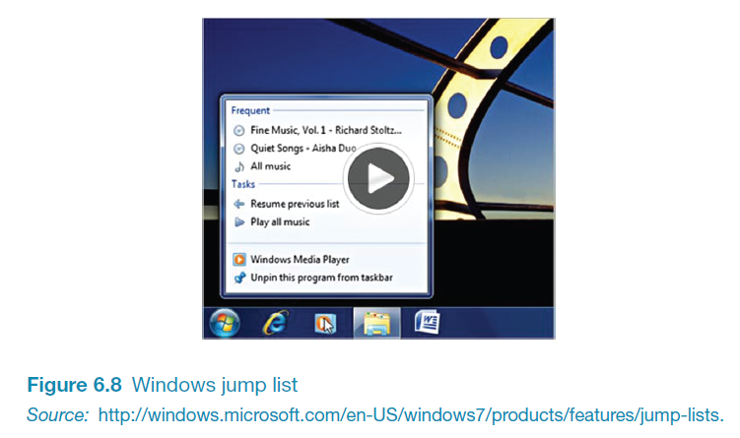
Windows Jump List Menu

Slide 20
Research and design issues
What are best names/labels/phrases to use?
Placement in list is critical
Quit and save need to be far apart
Choice of menu to use determined by application and type of system
flat menus are best for displaying a small number of options at one time
expanding menus are good for showing a large number of options
Notes:
20

Slide 21
Icon design
Icons are assumed to be easier to learn and remember than commands
Can be designed to be compact and variably positioned on a screen
Now pervasive in every interface
e.g. represent desktop objects, tools (e.g. paintbrush), applications (e.g. web browser), and operations (e.g. cut, paste, next, accept, change)
Notes:
21

Slide 22
Icons
Since the Xerox Star days icons have changed in their look and feel:
black and white -> color, shadowing, photorealistic images, 3D rendering, and animation
Many designed to be very detailed and animated making them both visually attractive and informative
GUIs now highly inviting, emotionally appealing, and feel alive
Notes:
22

Slide 23
Icon forms
The mapping between the representation and underlying referent can be:
similar (e.g., a picture of a file to represent the object file)
analogical (e.g., a picture of a pair of scissors to represent ‘cut)
arbitrary (e.g., the use of an X to represent ‘delete’)
Most effective icons are similar ones
Many operations are actions making it more difficult to represent them
use a combination of objects and symbols that capture the salient part of an action
Notes:
23

Slide 24
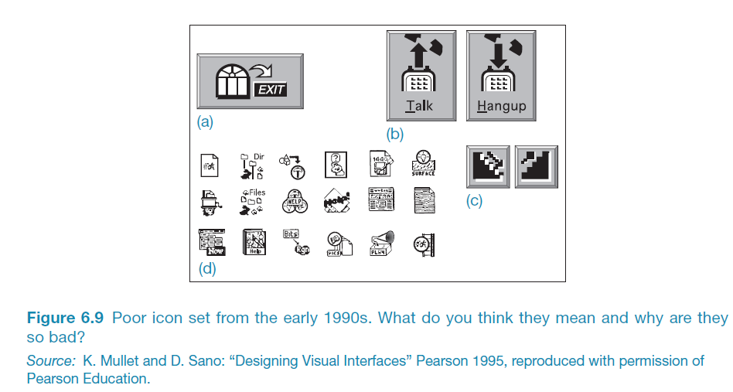
Early icons
Notes:
24

Slide 25
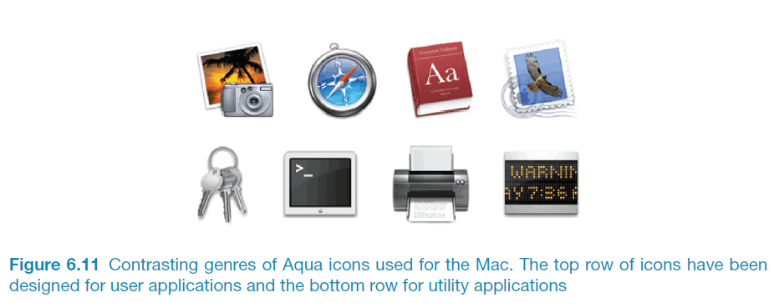
Newer icons
Notes:
25

Slide 26
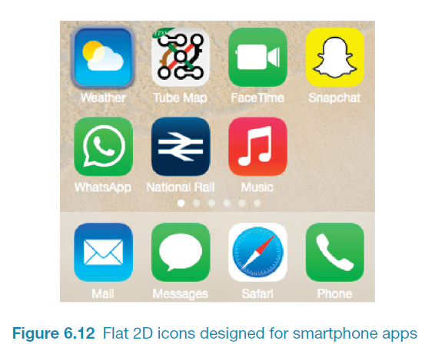
Simple flat 2D icons
Notes:
26

Slide 27
Activity
Sketch simple icons to represent the following operations to appear on a digital camera screen:
Turn image 90 degrees sideways
Auto-enhance the image
Fix red-eye
Crop the image
Show them to someone else and see if they can understand what each represents
Notes:
27

Slide 28
Basic edit icons on iPhone
Which is which?
Are they easy to understand
Are they distinguishable?
What representation forms are used?
How do yours compare?
Notes:
28
Add new figure 6.13

Slide 29
Research and design issues
There is a wealth of resources now so do not have to draw or invent new icons from scratch
guidelines, style guides, icon builders, libraries
Text labels can be used alongside icons to help identification for small icon sets
For large icon sets (e.g. photo editing or word processing) use rollovers
Notes:
29

Slide 30
3. Multimedia
Combines different media within a single interface with various forms of interactivity
graphics, text, video, sound, and animations
Users click on links in an image or text -> another part of the program -> an animation or a video clip is played ->can return to where they were or move on to another place
Notes:
30

Slide 31
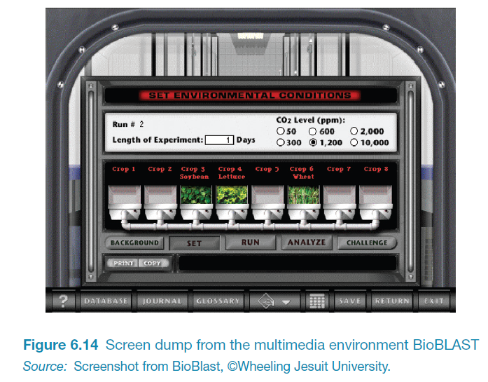
BioBlast Multimedia Learning Environment
Notes:
31

Slide 32
Pros and cons
Facilitates rapid access to multiple representations of information
Can provide better ways of presenting information than can any media alone
Can enable easier learning, better understanding, more engagement, and more pleasure
Can encourage users to explore different parts of a game or story
Tendency to play video clips and animations, while skimming through accompanying text or diagrams
Notes:
32

Slide 33
Research and design issues
How to design multimedia to help users explore, keep track of, and integrate the multiple representations
provide hands-on interactivities and simulations that the user has to complete to solve a task
Use ‘dynalinking,’ where information depicted in one window explicitly changes in relation to what happens in another (Scaife and Rogers, 1996).
Several guidelines that recommend how to combine multiple media for different kinds of task
Notes:
33

Slide 34
4. Virtual reality
Computer-generated graphical simulations providing:
“the illusion of participation in a synthetic environment rather than external observation of such an environment” (Gigante, 1993)
Provide new kinds of experience, enabling users to interact with objects and navigate in 3D space
Create highly engaging user experiences
Notes:
34

Slide 35
Pros and cons
Can have a higher level of fidelity with objects they represent compared to multimedia
Induces a sense of presence where someone is totally engrossed by the experience
“a state of consciousness, the (psychological) sense of being in the virtual environment” (Slater and Wilbur, 1999)
Provides different viewpoints: 1st and 3rd person
Head-mounted displays are uncomfortable to wear, and can cause motion sickness and disorientation
Notes:
35

Slide 36
Research and design issues
Much research on how to design safe and realistic VRs to facilitate training
e.g. flying simulators
help people overcome phobias (e.g. spiders, talking in public)
Design issues
how best to navigate through them (e.g. first versus third person)
how to control interactions and movements (e.g. use of head and body movements)
how best to interact with information (e.g. use of keypads, pointing, joystick buttons);
level of realism to aim for to engender a sense of presence
Notes:
36

Slide 37
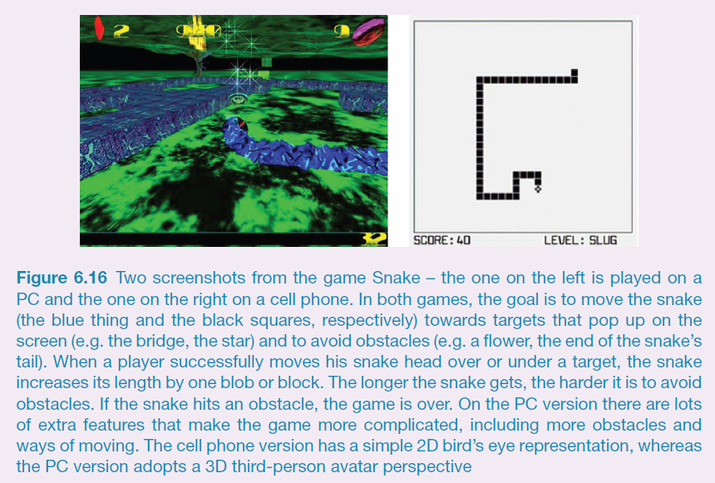
Which is the most engaging game of Snake?
Notes:
37
Realism versus abstraction?
One of the challenges facing interaction designers is whether to use realism or abstraction when designing an interface. This means designing objects either to (i) give the illusion of behaving and looking like real-world counterparts or (ii) appear as abstractions of the objects being represented. This concern is particularly relevant when implementing conceptual models that are deliberately based on an analogy with some aspect of the real world. For example, is it preferable to design a desktop to look like a real desktop, a virtual house to look like a real house, or a virtual terrain to look like a real terrain? Or, alternatively, is it more effective to design representations as simple abstract renditions, depicting only a few salient features?
One of the main benefits of using realism at the interface is that it can enable people to feel more comfortable when first learning an application. The rationale behind this is that such representations can readily tap into people’s understanding of the physical world. Hence, realistic interfaces can help users initially understand the underlying conceptual model. In contrast, overly schematic and abstract representations can appear to be too computer-like and may be off-putting to the newcomer. The advantage of more abstract interfaces, however, is that they can be more efficient to use. Furthermore, the more experienced users become, the more they may find comfortable interfaces no longer to their liking. A dilemma facing designers, therefore, is deciding between creating interfaces to make novice users feel comfortable (but more experienced users less comfortable) and designing interfaces to be effective for more experienced users (but maybe harder to learn by novices).

Slide 38
5. Information visualization and dashboards
Computer-generated interactive graphics of complex data
Amplify human cognition, enabling users to see patterns, trends, and anomalies in the visualization (Card et al, 1999)
Aim is to enhance discovery, decision-making, and explanation of phenomena
Techniques include:
3D interactive maps that can be zoomed in and out of and which present data via webs, trees, clusters, scatterplot diagrams, and interconnected nodes

Slide 39
Dashboards
Show screenshots of data updated over periods of time - to be read at a glance
Usually not interactive - slices of data that depict current state of a system or process
Need to provide digestible and legible information for users
design its spatial layout so intuitive to read when first looking at it
should also direct a user’s attention to anomalies or unexpected deviations

Slide 40
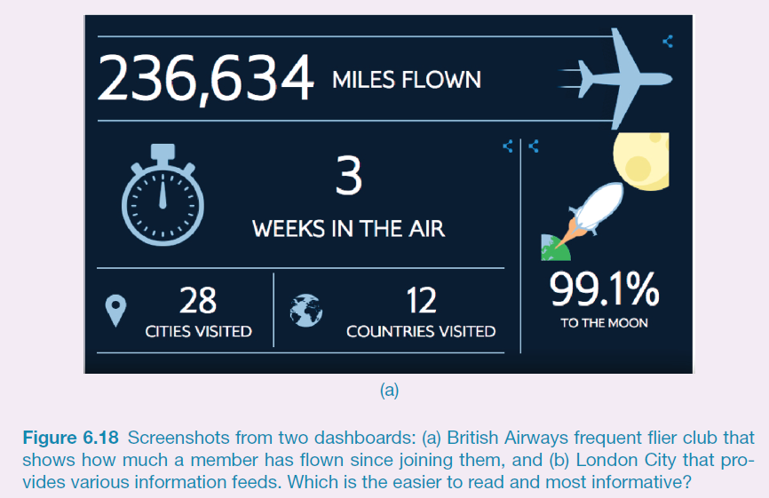
Which dashboard is best?

Slide 41
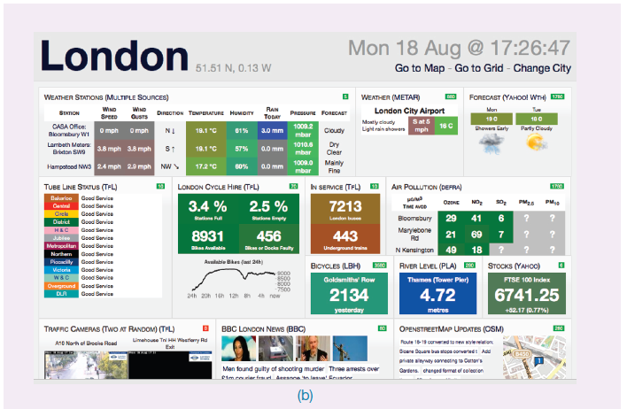

Which dashboard is best?

Slide 42
Research and design issues
Whether to use animation and/or interactivity
What form of coding to use, e.g. color or text labels
Whether to use a 2D or 3D representational format
What forms of navigation, e.g. zooming or panning,
What kinds and how much additional information to provide, e.g. rollovers or tables of text
What navigational metaphor to use

Slide 43
6. Web
Early websites were largely text-based, providing hyperlinks
Concern was with how best to structure information to enable users to navigate and access it easily and quickly
Nowadays, more emphasis on making pages distinctive, striking, and pleasurable
Need to think of how to design information for multi-platforms - keyboard or touch?
e.g. smartphones, tablets, PCs
Notes:
43

Slide 44
Usability versus attractive?
Vanilla or multi-flavor design?
Ease of finding something versus aesthetic and enjoyable experience
Web designers are:
“thinking great literature”
Users read the web like a:
“billboard going by at 60 miles an hour” (Krug, 2000)
Need to determine how to brand a web page to catch and keep ‘eyeballs’
Notes:
44

Slide 45
In your face ads
Web advertising is often intrusive and pervasive
Flashing, aggressive, persistent, annoying
Often need to be ‘actioned’ to get rid of
What is the alternative?
Notes:
Web advertising has become pervasive and invasive. Advertisers realized how effective flashing and animated ads were for promoting their products, taking inspiration from the animated neon light adverts used in city centers, such as London’s Piccadilly Circus. But since the banner ads (the 728 x 90 pixel ads that were placed at the top of web pages) emerged in the 90s, they have become even more cunning and aggressive in their tactics. In addition to designing even flashier banner ads, more intrusive kinds of web ads have begun to appear on our screens. Short movies and garish cartoon animations – often with sound – now pop up in floating windows that zoom into view or tagged on at the front end of a online newspaper or magazine news videoclip. Moreover, this new breed of in-your-face web ads often requires the user to either sit and wait till it ends or find a checkbox to close the window down. This can be really annoying to have to do especially when multiple ad windows open up. Sites that provide free services, such as Facebook, YouTube and Gmail, have also become populated with web ads. Many people choose to ignore them or simply put up with them. However, as advertisers get even more aggressive in their tactics there will be a point where that will become harder to do. The problem is advertisers pay significant revenues to online companies to have their adverts placed on their websites entitling them to say where, what and how they should appear
45

Slide 46
Research and design issues
Need to consider how best to design, present, and structure information and system behavior
But also content and navigation are central
Veen’s (2001) design principles
(1)Where am I?
(2)Where can I go?
(3) What’s here?
Notes:
46

Slide 47
Activity
Look at the Nike.com website
What kind of website is it?
How does it contravene the design principles outlined by Veen?
Does it matter?
What kind of user experience is it providing for?
What was your experience of engaging with it?
Notes:
47

Slide 48
7. Consumer electronics and appliances
Everyday devices in home, public place, or car
e.g. washing machines, remotes, photocopiers, printers and navigation systems)
And personal devices
e.g. MP3 player, digital clock and digital camera
Used for short periods
e.g. putting the washing on, watching a program, buying a ticket, changing the time, taking a snapshot
Need to be usable with minimal, if any, learning

Slide 49
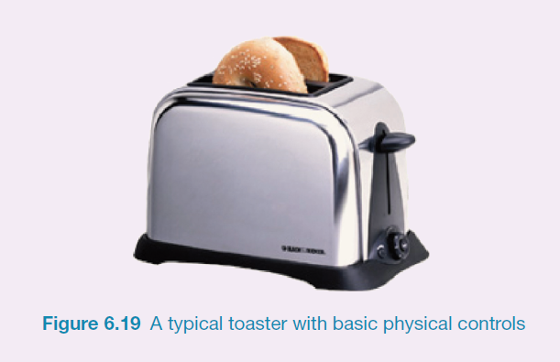
A toaster

Slide 50
Research and design issues
Need to design as transient interfaces with short interactions
Simple interfaces
Consider trade-off between soft and hard controls
e.g. buttons or keys, dials or scrolling
Notes:
50

Slide 51
8. Mobile
Handheld devices intended to be used while on the move
Have become pervasive, increasingly used in all aspects of everyday and working life
Apps running on mobiles have greatly expanded, e.g.
used in restaurants to take orders
car rentals to check in car returns
supermarkets for checking stock
in the streets for multi-user gaming
in education to support life-long learning
Notes:
51

Slide 52
The advent of the iPhone app
A whole new user experience that was designed primarily for people to enjoy
many apps not designed for any need, want or use but purely for idle moments to have some fun
e.g. iBeer developed by magician Steve Sheraton
ingenious use of the accelerometer that is inside the phone

Slide 53
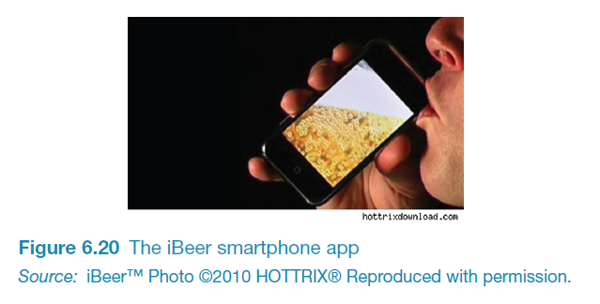
iBeer app

Slide 54
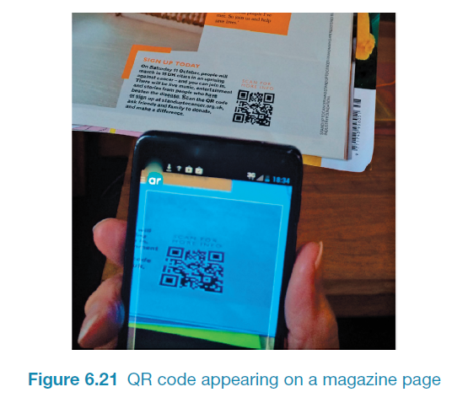
QR codes and cell phones

Slide 55
Mobile challenges
Smaller screens, small number of physical keys and restricted number of controls
Innovative physical designs including:
roller wheels, rocker dials, up/down ‘lips’ on the face of phones, 2-way and 4-way directional keypads, softkeys, silk-screened buttons
Usability and preference varies
depends on the dexterity and commitment of the user
Smartphones overcome mobile physical constraints through using multi-touch displays
Notes:
55

Slide 56
Research and design issues
Mobile interfaces can be tricky and cumbersome to use for those with poor manual dexterity or ‘fat’ fingers
Key concern is hit area
area on the phone display that the user touches to make something happen, such as a key, an icon, a button or an app
space needs to be big enough for fat fingers to accurately press
if too small the user may accidentally press the wrong key
Notes:
56
Mobile interfaces typically have a small screen and limited control space. Designers have to think carefully about what type of dedicated controls (i.e. hard wired) to use, where to place them on the device, and then how to map them onto the software. Applications designed for mobile interfaces need to take into account that navigation will be restricted and text input entry slow, whether using touch, pen or keypad input. The use of vertical and horizontal scrolling provides a rapid way of scanning though images, menus and lists. A number of mobile browsers have also been developed that allow users to view and navigate the internet, magazines or other media, in a more streamlined way compared with how it is typically viewed via PC-based web browsers. For example, Edge Browser was one the first mobile phone browser apps to not have an address bar or navigation buttons. The trade-off, however, is it makes it less obvious how to perform the functions that are no longer visible on the screen.

Slide 57
9. Speech
Where a person talks with a system that has a spoken language application, e.g. timetable, travel planner
Used most for inquiring about very specific information, e.g. flight times or to perform a transaction, e.g. buy a ticket
Also used by people with disabilities
e.g. speech recognition word processors, page scanners, web readers, home control systems
Notes:
57

Slide 58
Have speech interfaces come of age?
Notes:
58

Slide 59
Get me a human operator!
Most popular use of speech interfaces currently is for call routing
Caller-led speech where users state their needs in their own words
e.g. “I’m having problems with my voice mail”
Idea is they are automatically forwarded to the appropriate service
What is your experience of speech systems?
Notes:
59

Slide 60
Format
Directed dialogs are where the system is in control of the conversation
Ask specific questions and require specific responses
More flexible systems allow the user to take the initiative:
e.g. “I’d like to go to Paris next Monday for two weeks.”
More chance of error, since caller might assume that the system is like a human
Guided prompts can help callers back on track
e.g. “Sorry I did not get all that. Did you say you wanted to fly next Monday?”
Notes:
60

Slide 61
Research and design issues
How to design systems that can keep conversation on track
help people navigate efficiently through a menu system
enable them to easily recover from errors
guide those who are vague or ambiguous in their requests for information or services
Type of voice actor (e.g. male, female, neutral, or dialect)
do people prefer to listen to and are more patient with a female or male voice, a northern or southern accent?
Notes:
61

Slide 62
10. Pen
Enable people to write, draw, select, and move objects at an interface using lightpens or styluses
capitalize on the well-honed drawing skills developed from childhood
Digital pens, e.g. Anoto, use a combination of ordinary ink pen with digital camera that digitally records everything written with the pen on special paper

Slide 63
Pros and cons
Allows users to quickly and easily annotate existing documents
Can be difficult to see options on the screen because a user’s hand can occlude part of it when writing
Can have lag and feel clunky

Slide 64
11. Touch
Touch screens, such as walk-up kiosks, detect the presence and location of a person’s touch on the display
Multi-touch support a range of more dynamic finger tip actions, e.g. swiping, flicking, pinching, pushing and tapping
Now used for many kinds of displays, such as Smartphones, iPods, tablets and tabletops
Notes:
64

Slide 65
Research and design issues
More fluid and direct styles of interaction involving freehand and pen-based gestures
Core design concerns include whether size, orientation, and shape of touch displays effect collaboration
Much faster to scroll through wheels, carousels and bars of thumbnail images or lists of options by finger flicking
More cumbersome, error-prone and slower to type using a virtual keyboard on a touch display than using a physical keyboard
Notes:
65

Slide 66
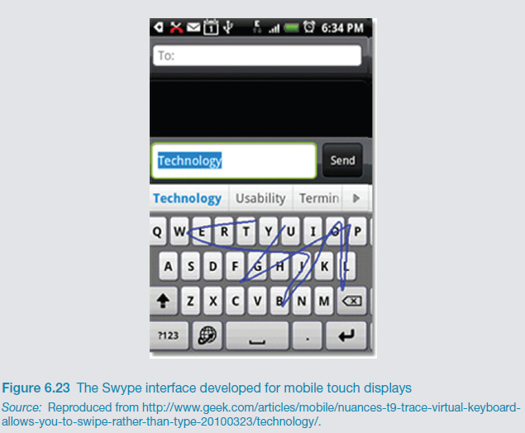
Research and design issues
Will finger-flicking, swiping, stroking and touching a screen result in new ways of consuming, reading, creating and searching digital content?

Slide 67
12. Air-based gestures
Uses camera recognition, sensor and computer vision techniques
can recognize people’s body, arm and hand gestures in a room
systems include Kinect
Movements are mapped onto a variety of gaming motions, such as swinging, bowling, hitting and punching
Players represented on the screen as avatars doing same actions

Slide 68
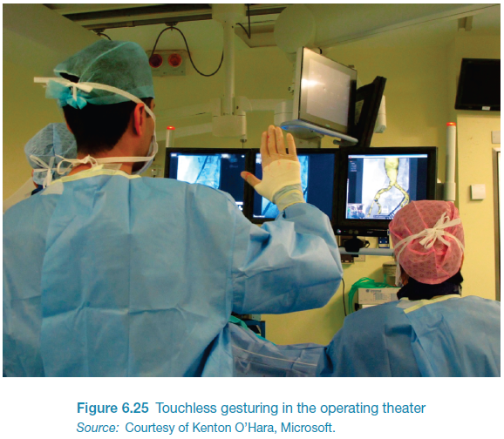
Home entertainment
Universal appeal
young children, grandparents, professional gamers, technophobes

Slide 69
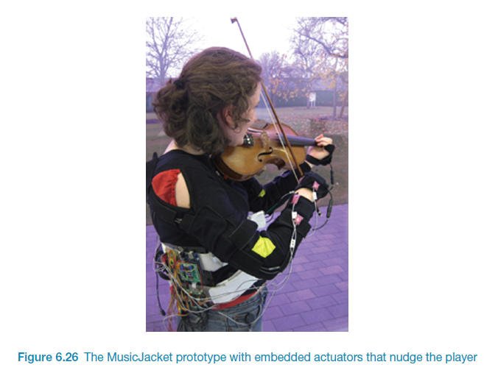
Gestures in the operating theatre
A touchless system that recognizes gestures
surgeons can interact with and manipulate MRI or CT images
e.g. two-handed gestures for zooming and panning

Slide 70
Research and design issues
How does computer recognize and delineate user’s gestures?
Deictic and hand waving
Does holding a control device feel more intuitive than controller free gestures?
For gaming, exercising, dancing
Notes:
A key design concern for using air-based gestural input is to consider how a computer system recognizes and delineates the user’s gestures. In particular, how does it determine the start and end point of a hand or arm movement and how does it know the difference between a deictic gesture (a deliberate pointing movement) and hand waving (an unconscious gesticulation) that is used to emphasize what is being said verbally? Another key design issue is whether holding a control device feels more intuitive for the game or other activity than controller free gestures. Sometimes it clearly is better to be holding something – when for example, hitting a ball with a bat. Other times it may be better hands-free such as when dancing or doing aerobics.
70

Slide 71
13. Haptic
Tactile feedback
applying vibration and forces to a person’s body, using actuators that are embedded in their clothing or a device they are carrying, such as a smartphone
Can enrich user experience or nudge them to correct error
Can also be used to simulate the sense of touch between remote people who want to communicate

Slide 72
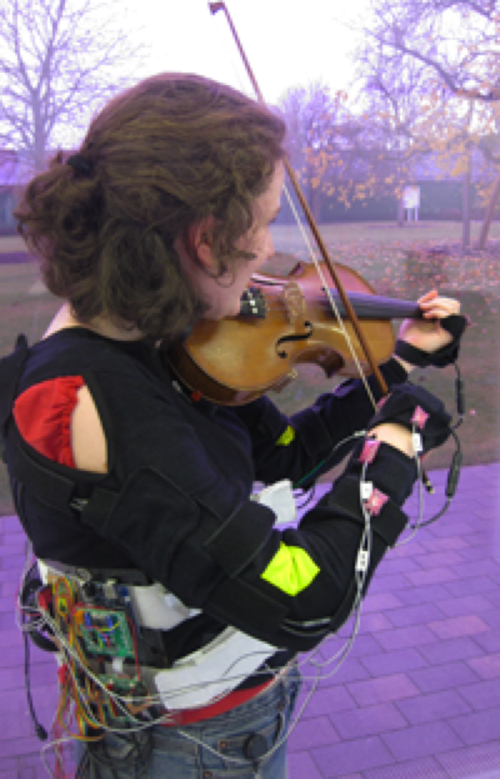
Realtime vibrotactile feedback
Provides nudges when playing incorrectly
Uses motion capture
Nudges are vibrations on arms and hands

Slide 73
Research and design issues
Where best to place actuators on body
Whether to use single or sequence of ‘touches’
When to buzz and how intense
How does the wearer feel it in different contexts?
What kind of new smartphones/smart-watches apps can use vibrotactile creatively?
e.g. slow tapping to feel like water dropping that is meant to indicate it is about to rain and heavy tapping to indicate a thunderstorm is looming
Notes:
Haptics are now commonly used in gaming consoles and controllers to heighten the experience. Haptic feedback is also being developed in clothing and other wearables as a way of simulating being touched, stroked, prodded or buzzed. A promising application area is sensory-motor skills, such as in sports training and learning to play a musical instrument. For example, patterns of vibrations have been played across snowboarders bodies to indicate which moves to take whilst snowboarding. A study reported faster reaction times than when the same instructions were given verbally (Spelmezan et al, 2009). A key design question is where best to place the actuators on the body, whether to use a single or a sequence of touches, when to activate, what intensity and how often to use them to make the feeling of being touched convincing (e.g. Jones and Sarter, 2008). Providing continuous haptic feedback would be simply too annoying. People would also habituate too quickly to the feedback. Intermittent buzzes can be effective at key moments when a person needs to attend to something but not necessarily tell them what to do. For example, a study by Johnson et al (2010) of a commercially available haptic device, intended to improve posture through giving people a vibrotactile buzz whenever they slouched, found that while the buzzing did not show them how to improve their posture it did improve their body awareness.
73

Slide 74
14. Multi-modal
Meant to provide enriched and complex user experiences
multiplying how information is experienced and detected using different modalities, i.e. touch, sight, sound, speech
support more flexible, efficient, and expressive means of human–computer interaction
Most common is speech and vision

Slide 75
Research and design issues
Need to recognize and analyse speech, gesture, and eye gaze
What is gained from combining different input and outputs
Is talking and gesturing, as humans do with other humans, a natural way of interacting with a computer?

Slide 76
15. Shareable
Shareable interfaces are designed for more than one person to use
provide multiple inputs and sometimes allow simultaneous input by co-located groups
large wall displays where people use their own pens or gestures
interactive tabletops where small groups interact with information using their fingertips
e.g. DiamondTouch, Smart Table and Surface
Notes:
76

Slide 77
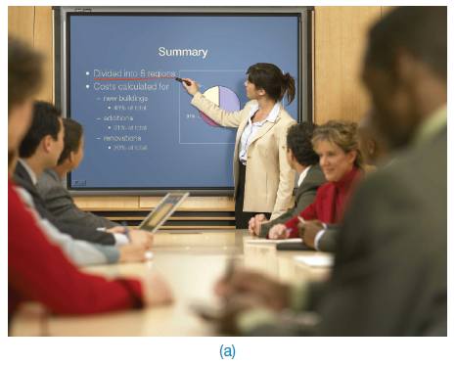

A smartboard
Notes:
77

Slide 78
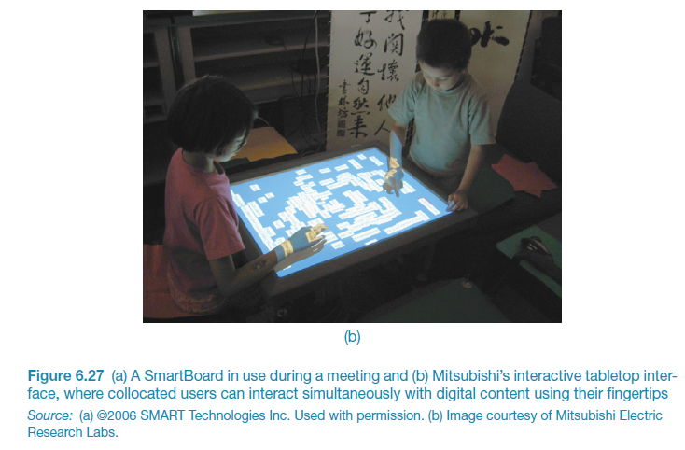
DiamondTouch Tabletop
Notes:
78

Slide 79
Advantages
Provide a large interactional space that can support flexible group working
Can be used by multiple users
Can point to and touch information being displayed
Simultaneously view the interactions and have same shared point of reference as others
Can support more equitable participation compared with groups using single PC
Notes:
79

Slide 80
Research and design issues
More fluid and direct styles of interaction involving freehand and pen-based gestures
Core design concerns include whether size, orientation, and shape of the display have an effect on collaboration
Horizontal surfaces compared with vertical ones support more turn-taking and collaborative working in co-located groups
Providing larger-sized tabletops does not improve group working but encourages more division of labor
Notes:
80

Slide 81
16. Tangible
Type of sensor-based interaction, where physical objects, e.g., bricks, are coupled with digital representations
When a person manipulates the physical object/s it causes a digital effect to occur, e.g. an animation
Digital effects can take place in a number of media and places or can be embedded in the physical object
Notes:
81

Slide 82
Examples
Chromarium cubes
when turned over digital animations of color are mixed on an adjacent wall
faciliates creativity and collaborative exploration
Flow Blocks
depict changing numbers and lights embedded in the blocks
vary depending on how they are connected together
Urp
physical models of buildings moved around on tabletop
used in combination with tokens for wind and shadows -> digital shadows surrounding them to change over time
Notes:
82

Slide 83
Benefits
Can be held in both hands and combined and manipulated in ways not possible using other interfaces
allows for more than one person to explore the interface together
objects can be placed on top of each other, beside each other, and inside each other
encourages different ways of representing and exploring a problem space
People are able to see and understand situations differently
can lead to greater insight, learning, and problem-solving than with other kinds of interfaces
can facilitate creativity and reflection
Notes:
83

Slide 84
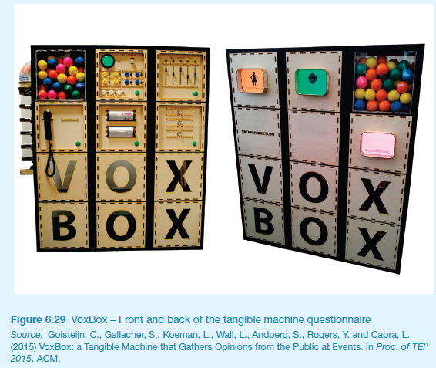
VoxBox
A tangible system that gathers opinions at events through playful and engaging interaction (Goldsteijn et al, 2015)
Notes:
84

Slide 85
Research and design issues
Develop new conceptual frameworks that identify novel and specific features
The kind of coupling to use between the physical action and digital effect
If it is to support learning then an explicit mapping between action and effect is critical
If it is for entertainment then can be better to design it to be more implicit and unexpected
What kind of physical artifact to use
Bricks, cubes, and other component sets are most commonly used because of flexibility and simplicity
Stickies and cardboard tokens can also be used for placing material onto a surface
Notes:
85

Slide 86
17. Augmented and mixed reality
Augmented reality - virtual representations are superimposed on physical devices and objects
Mixed reality - views of the real world are combined with views of a virtual environment
Many applications including medicine, games, flying, and everyday exploring

Slide 87
Examples
In medicine
virtual objects, e.g. X-rays and scans, are overlaid on part of a patient’s body
aid the physician’s understanding of what is being examined or operated
In air traffic control
dynamic information about aircraft overlaid on a video screen showing the real planes, etc. landing, taking off, and taxiing
Helps identify planes difficult to make out

Slide 88
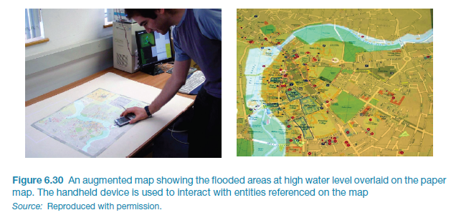
An augmented map

Slide 89
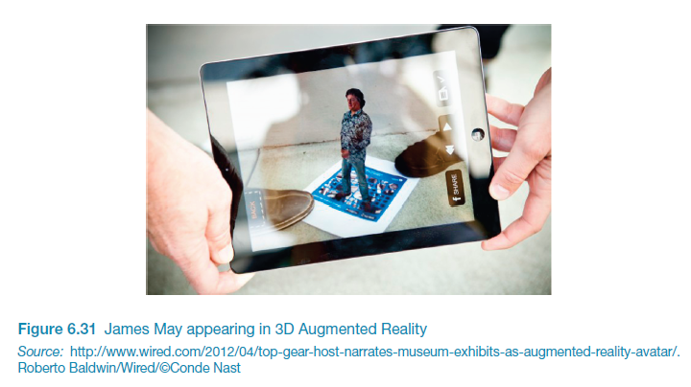
Top Gear James May in AR
Appears as a 3D character to act as personal tour guide at Science Museum

Slide 90
Research and design issues
What kind of digital augmentation?
When and where in physical environment?
Needs to stand out but not distract from ongoing task
Need to be able to align with real world objects
What kind of device?
Smartphone, head up display or other?
Notes:
A key research concern when designing mixed reality environments and augmented reality is what form the digital augmentation should take and when and where it should appear in the physical environment (Rogers et al, 2005). The information needs to stand out but not distract the person from his ongoing activity in the physical world. For example, ambient sounds need to be designed to be distinct from naturally occurring sounds so that they draw a person’s attention without distracting him and then allow him to return to what he was doing. Information that is superimposed on the physical world, e.g. digital information overlaying video footage of a runway to identify vehicles and planes, needs to be simple and easy to align with the real-world objects.
It is important to understand how designing for playful learning experiences is very different from designing for military or medical applications. Ambiguity and uncertainty may be exploited to good effect in mixed reality games but could be disastrous in the latter categories. The type of technology will also determine what guidance will be of relevance. A guideline for the use of an optical see-through display, e.g. shutter glasses or head-mounted display, may not be relevant for a video see-through display. Likewise, a guideline for a mobile augmented reality solution may not be relevant for a fixed display application. Published design guidelines include Cawood and Fiala (2008) and Wetzel et al (2008).
90

Slide 91
18.Wearables
First developments were head- and eyewear-mounted cameras that enabled user to record what was seen and to access digital information
Since, jewellery, head-mounted caps, smart fabrics, glasses, shoes, and jackets have all been used
provide the user with a means of interacting with digital information while on the move
Applications include automatic diaries, tour guides, cycle indicators and fashion clothing
Notes:
91
Imagine being at a party and being able to access the Facebook of a person whom you have just met, while or after talking to her to find out more about her. The possibility of having instant information before one’s very own eyes that is contextually relevant to an ongoing activity and that can be viewed surreptitiously (i.e. without having to physically pull out a smartphone) is very appealing.

Slide 92
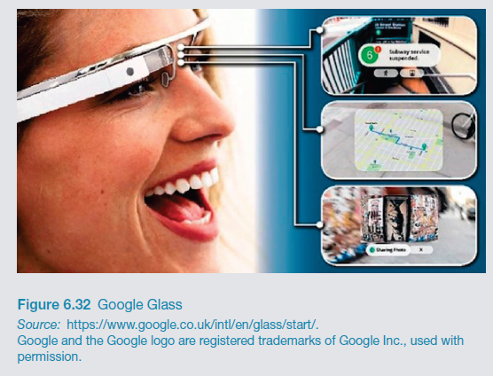
Google Glass: short-lived
What were the pros and cons?
Notes:
Google glass was designed to look like a pair of glasses, but with one lens of the glass being an interactive display with an embedded camera, that can be controlled with speech input. It allows the wearer to take photos and video on the move and look at digital content, such as emails, texts, and maps. The wearer can also search the web using voice commands and the results come back on the screen. A number of applications have been developed besides everyday use, including WatchMeTalk that provides live captions that helps the hearing-impaired in their day-to-day conversations and Preview for Glass that enables a wearer to watch a movie trailer the moment they look at a movie poster.
It stopped being sold at the end of 2014. It was considered slightly unnerving when in the company of someone wearing Google Glass as they look up and to the right to view what is on the glass screen rather than at you and into your eyes. As a result you might see more of the whites of their eyes than the usual interested dilated pupils. Could this be the end of eye contact as we know it? One of the criticisms of early wearers of Google Glass was that it made them appear to be staring into the distance.
Others are worried that those wearing Google Glass are recording everything that is happening in front of them. As a reaction a number of bars and restaurants in San Francisco and other cities have implemented a “no Glass” policy to prevent customers from recording other patrons. There has also been much debate in the press about the latest developments in facial recognition. There are apps developed for Google Glass that take a picture of the person you are talking with and then check their online profile, providing a cloud of personal information about them, presumably mined from Facebook and other social media apps. So, you can find out more about someone on the go while talking to them – for example, what music they like, what films they have just seen, where they have just been on vacation, and so on – all in a digestible précis surrounded by a halo of photos. One could imagine that if this way of meeting up with others actually takes off, we might find ourselves in the situation where we won’t need to talk to each other anymore. Just as text messaging has largely taken over from making phone calls for many people, ‘cloud talk’ could start taking over our initial encounters with people when we meet them at parties, at conferences, on trains etc. We might nod and smile in acknowledgement of each other but we won’t ever have to have those awkward conversations anymore, such as about where you come from or what you do for work. A panacea for the shy? But how will we know what each other is looking at? You might think I am reading your blog or tweets when in your presence but really I might just be watching the latest updates of the football results and pretending to ‘meet you’.

Slide 93
Research and design issues
Comfort
needs to be light, small, not get in the way, fashionable, and preferably hidden in the clothing
Hygiene
is it possible to wash or clean the clothing once worn?
Ease of wear
how easy is it to remove the electronic gadgetry and replace it?
Usability
how does the user control the devices that are embedded in the clothing?
Notes:
93

Slide 94
19. Robots and drones
Four types of robot
remote robots used in hazardous settings
domestic robots helping around the house
pet robots as human companions
sociable robots that work collaboratively with humans, and communicate and socialize with them – as if they were our peers
Notes:
94

Slide 95
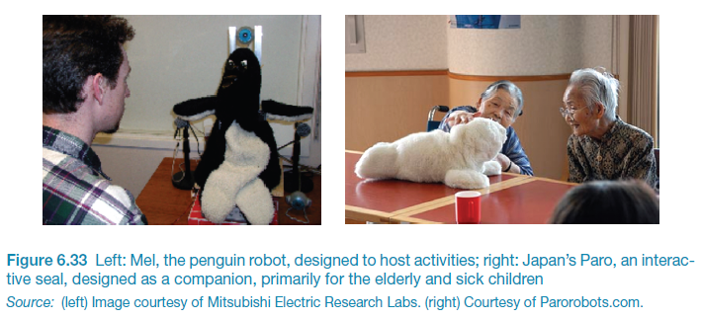
Advantages
Pet robots are assumed to have therapeutic qualities, helping to reduce stress and loneliness
Remote robots can be controlled to investigate bombs and other dangerous materials
Notes:
95

Slide 96
Drones
Unmanned aircraft that are controlled remotely and used in a number of contexts
e.g. entertainment, such as carrying drinks and food to people at festivals and parties;
agricultural applications, such as flying them over vineyards and fields to collect data that is useful to farmers
helping to track poachers in wildlife parks in Africa
Can fly low and and stream photos to a ground station, where images can be stitched together into maps
Can be used to determine the health of a crop or when it is the best time to harvest the crop

Slide 97
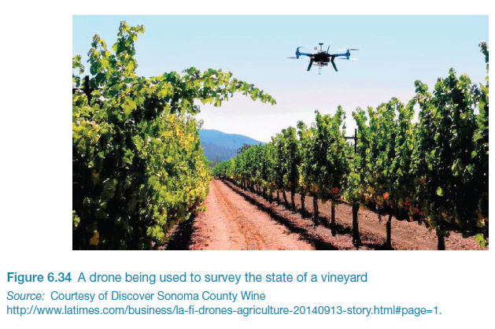
Drone in vineyard

Slide 98
Research and design issues
How do humans react to physical robots designed to exhibit behaviors (e.g. making facial expressions) compared with virtual ones?
Should robots be designed to be human-like or look like and behave like robots that serve a clearly defined purpose?
Should the interaction be designed to enable people to interact with the robot as if it was another human being or more human-computer-like (e.g. pressing buttons to issue commands)?
Is it acceptable to use unmanned drones to take a series of images or videos of fields, towns, and private property without permission or people knowing what is happening?
Notes:
98

Slide 99
20. Brain-computer interfaces
Brain–computer interfaces (BCI) provide a communication pathway between a person’s brain waves and an external device, such as a cursor on a screen
Person is trained to concentrate on the task, e.g. moving the cursor
BCIs work through detecting changes in the neural functioning in the brain
BCIs apps:
Games
enable people who are paralysed to control robots

Slide 100
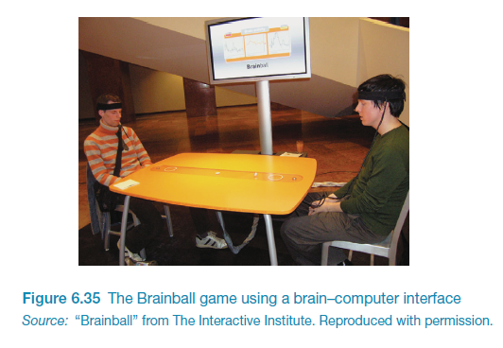
Brainball game
Notes:
Brain-computer interfaces have also been developed to control various games. For example, a game called Brainball is controlled by players’ brain waves in which players compete to control a ball’s movement across a table by becoming more relaxed and focussed.
100

Slide 101
Which interface?
Is multimedia better than tangible interfaces for learning?
Is speech as effective as a command-based interface?
Is a multimodal interface more effective than a monomodal interface?
Will wearable interfaces be better than mobile interfaces for helping people find information in foreign cities?
Are virtual environments the ultimate interface for playing games?
Will shareable interfaces be better at supporting communication and collaboration compared with using networked desktop PCs?
Notes:
101

Slide 102
Which interface?
Will depend on task, users, context, cost, robustness, etc.
Mobile platforms taking over from PCs
Speech interfaces also being used much more for a variety of commercial services
Appliance and vehicle interfaces becoming more important
Shareable and tangible interfaces entering our homes, schools, public places, and workplaces
Notes:
102

Slide 103
Summary
Many innovative interfaces have emerged post the WIMP/GUI era, including speech, wearable, mobile, brain and tangible
Raises many design and research questions to decide which to use
e.g. how best to represent information to the user so they can carry out ongoing activity or task
New interfaces that are context-aware or monitor raise ethical issues concerned with what data is being collected and what it is used for
Notes:
103

